Slide 1
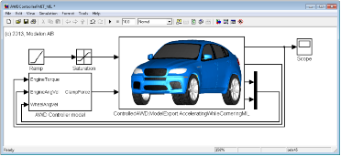
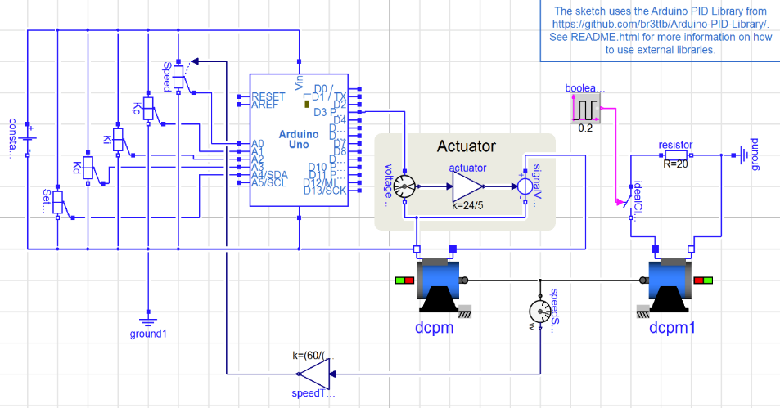
New Course! Fall 2018 ECSE 4961/6961 Modeling & Simulation for Cyber-Physical Systems
Course Description:
This course develops a solid basis for students to model and simulate cyber-physical systems using computer-based object-oriented equation-based modeling languages and tools with the goal of building models with high reusability.
The course covers both theoretical and practical issues related to numerical simulation methods for CPS, including continuous time, discontinuous/discrete and timed clocked systems.
Aspects of code-generation and real-time simulation for embedded systems are introduced.
Note: limited number of seats to 20 students!
Undergrads Note: Co-requirement MATH 4800
Questions? Email - Prof. Vanfretti, luigi.vanfretti@gmail.com
Mode-Based Systems Engineering Languages and Technologies
Numerical Algorithms for Simulation of Continuous, Discrete and Timed Clocked Systems
Model, Simulate , Build and Analyze Cyber-Physical Systems!
Model, Simulate and Build CPS systems based on the Arduino
Measurements
Control Computing
Learn and apply model-based systems engineering and CPS concepts/tools, languages and tools.
Cyber
Controller
Outputs
Sensors
Actuators
Computer
Clock
A/D, Sample
Algorithm
D/A, ZOH
Plant
Physical

Slide 2
New Course! Fall 2018 ECSE 4961/6961 Modeling & Simulation for Cyber-Physical Systems
Course textbooks (required/mandatory):
Theory: Francois E. Cellier and Ernesto Kofman, “Continuous System Simulation,” Springer-Verlag New York, Inc. Secaucus, NJ, USA, 2006. ISBN:0387261028
Practice: P. Fritzson, Principles of Object-Oriented Modeling and Simulation with Modelica 3.3: A Cyber-Physical Approach. Wiley-IEEE Press, 2014. ISBN: 978-1-118-85912-4.
(Free-of-cost) Michael M. Tiller, Modelica by Example. E-book. On-line: http://book.xogeny.com
Dymola, FMI Toolbox and Papyrus-RT User Manuals (Digital version available with the software)
Example Jobs Seeking this Course Competences:
Required Embedded Platform:
Raspberry Pi
Arduino Uno
It is possible to find many options online, the following two are just suggestions:
Official Arduino Starter Kit: https://store.arduino.cc/usa/arduino-starter-kit
Combo including both platforms: https://www.amazon.com/Ultimate-Arduino-Uno-Raspberry-oddWires/dp/B01MXTWE8A
Computing Tools:
Dymola – http://www.dymola.com licenses to be provided by RPI.
OpenModelica – open source software @ http://openmodelica.org
FMI Toolbox for MATLAB/Simulink – licenses to be provided by RPI: http://www.modelon.com/products/modelon-deployment-suite/fmi-toolbox-for-matlabsimulink

Slide 3
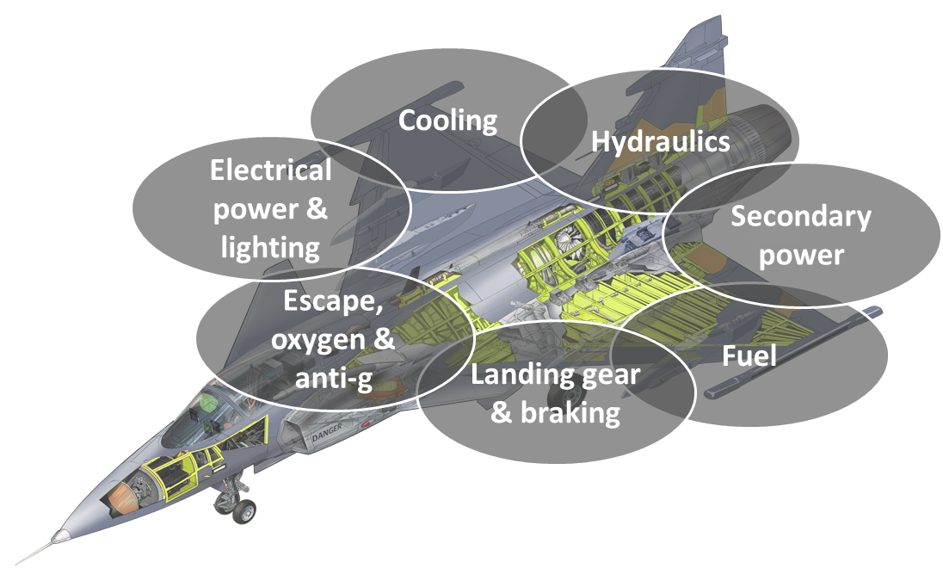
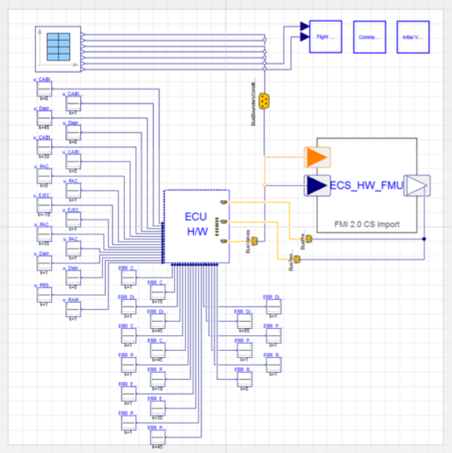
Example Application of this Course Topics Modeling and Simulation of the Aircraft Electronic Control Unit (ECU) in the Grippen Fighter Plane
The ECU code is simulated simultaneously with the aircraft environmental model → No “abstractions” for the controller function, actual controller code!

Slide 4
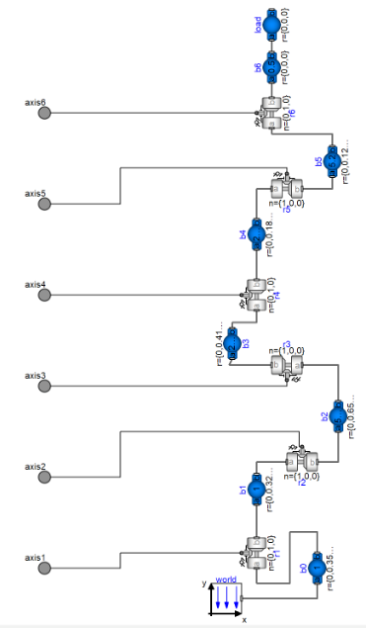
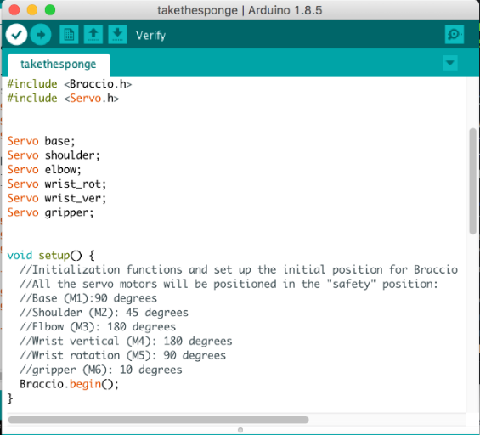
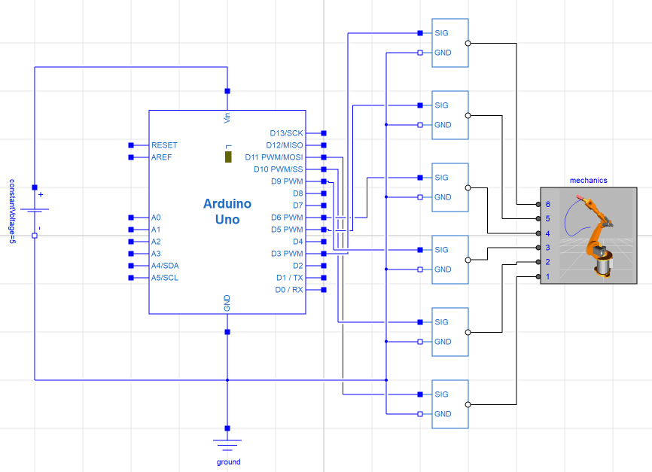
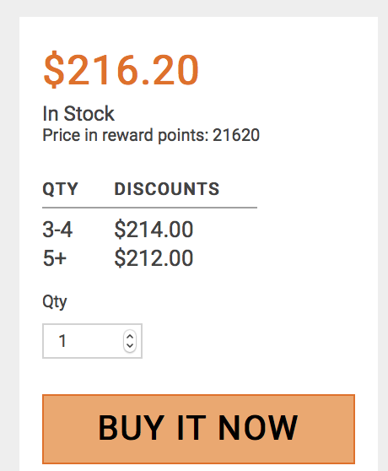
Example Learning Activity – Proposed “6 DOF Robot Arm” Course Project
Virtual Prototyping:
Model, code and simulate!
Build the Prototype!
Deploy control code.
Compare real system and control prototype with the models:
Learn about M&S limitations.
Mechanical Multi-body Dynamics Model
Implement the Controller Code
Model
Simulate
Deploy!

