Slide 1
ELECTRIC CIRCUITS
ECSE-2010
Prof. Shayla Sawyer
Lecture 1

Slide 2
Disclaimer and Etiquette
All Lecture sessions are recorded
When you enter be sure to mute your microphone…you can keep a video on if you like, but it is not necessary
I will mostly have my video off but may turn it on during discussion
I strongly encourage discussion and discourse during the live lecture on WebEx Teams
  Simply say excuse me Prof…and I’ll acknowledge you and answer your question
  You can also write relevant questions in the chat
  Funny/interesting semi-related memes and gifs should go is memes and gifs WebEx Page
  Please use discretion on this page it is a public space and also recorded by the powers that be (all content owned by RPI)
If you do not want to be recorded, you can choose to watch the video and not ask questions verbally (Use the chat!)

Slide 3
Who am I?
Instructor: Prof. Shayla Sawyer (alter ego Mrs. Armand)
Office: My basement
Phone: WebEx Teams
Email: sawyes@rpi.edu, sawyes@gmail.com
Office Hours:
  Wednesday 12-2 pm
  (I will not be available after lecture time)
  Feel free to make an appointment for extra help please send an email to arrange a date/time
  TAs will have additional open hours times TBD

Slide 4
Who am I? ResearchER
Nano/Bio Enhanced Optoelectronic Devices
My research group contributes to bridging the gap between novel hybrid materials and their use in new sensor systems that can shift paradigms of how, where, and when hazards (biological, environmental, chemical, or nuclear) can be detected.

Slide 5
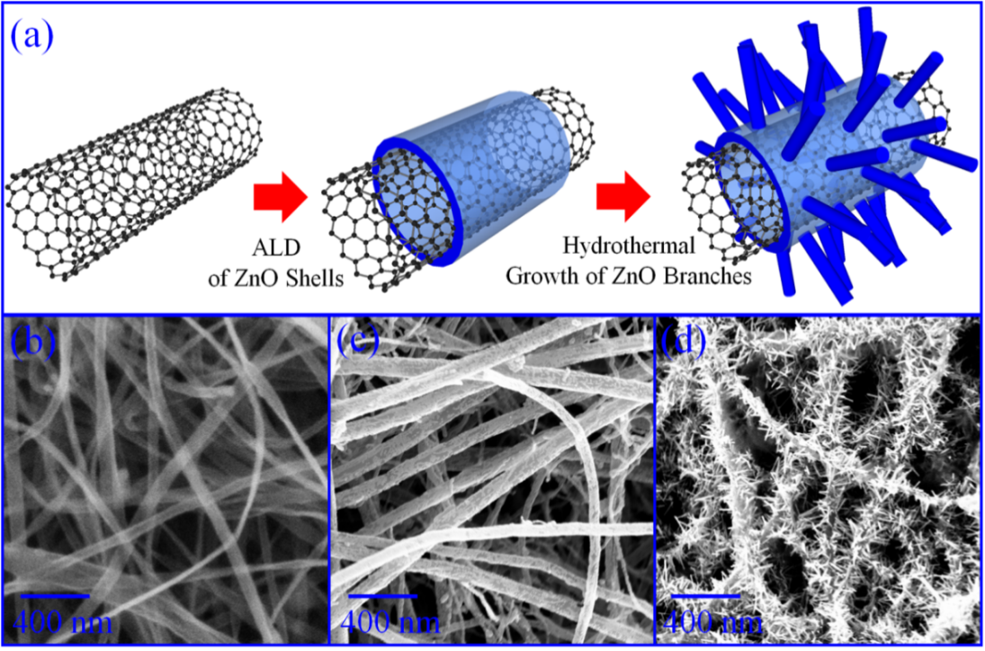
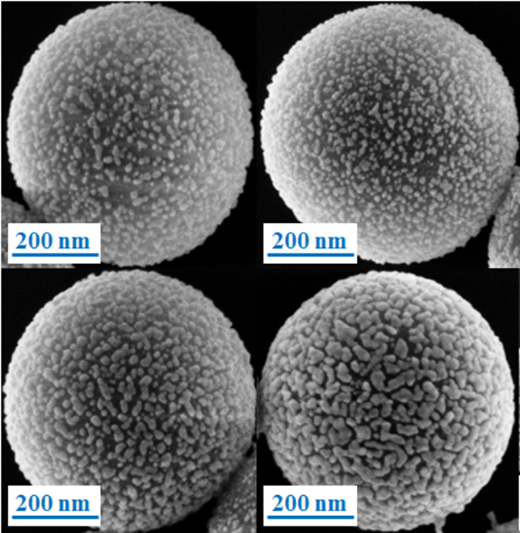
Who am I? Research Group
Materials
D. Shao, H. Sun, J. Gao, G. Xin, T. Yao, N. Koratkar, J. Lian, S. Sawyer, “Thorn-like ZnO-Multiwalled Carbon Nanotube Hybrid Paper for Efficient Ultraviolet Sensing and Photocatalyst Applications”, Nanoscale, in press 2014.
D. Shao, H. Sun, M. Yu, J. Lian, and S. Sawyer, “Enhanced ultraviolet (UV) emission from polyvinyl-alcohol (PVA) nanoparticles using a SiO2-Au core shell structure,” Nano Letters, vol. 12, pp. 5840-5844, 2012.

Slide 6
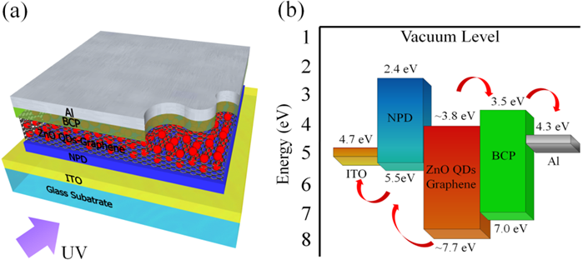
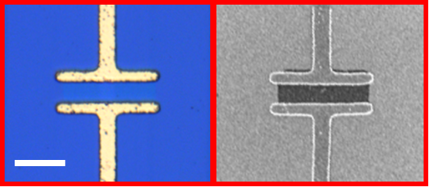
Who am I? Research Group
Devices
D. Shao, X. Sun, M. Xie, M. Yu, S. M. George, J. Lian and S. Sawyer, “ZnO quantum dots-graphene composite for efficient ultraviolet sensing”, Materials Letters 112, 165-168 (2013).
UV ZnO/Graphene Phototransistor, 2014

Slide 7
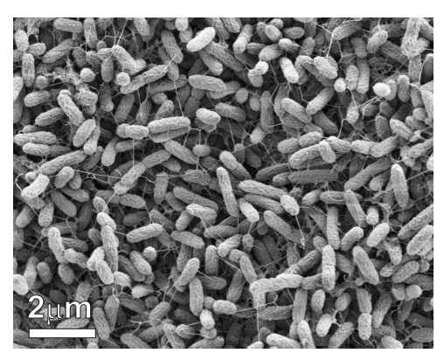
Funded by IBM: Living things are sensors…..can we talk to them?
Understanding and manipulating the extracellular electron transport chain in bacterial species
“Hack” the Bacterial Nanowire
Bacterial Nanofactories
Hybrid Microbial Nanowire Devices
S. Oneidensis MR-1 cultivated under
Electron-acceptor-limited conditions.
Microbial nanowires connect bacteria in a biofilm.
K.M. Leung, Exploring Bacterial Nanowires: From Properties to Functions and Implications, Western University, Thesis, August 2011.

Slide 8
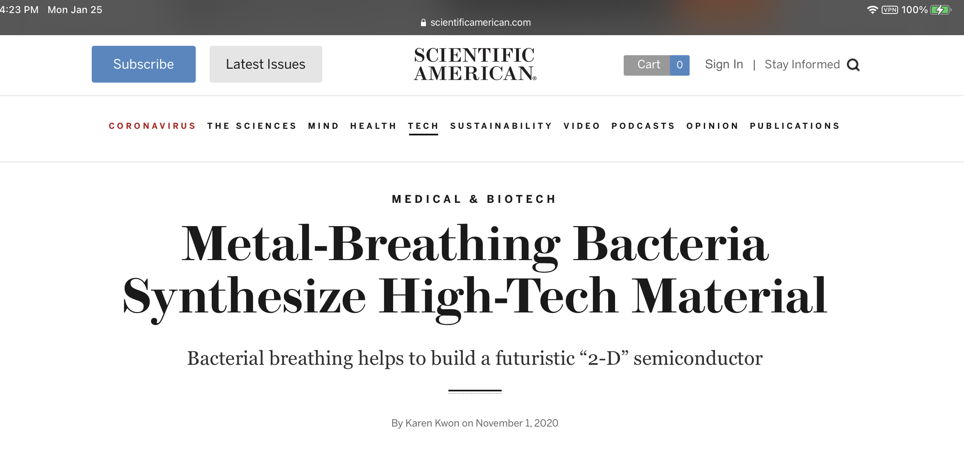



Funded by IBM: Living things are sensors…..can we talk to them?
Understanding and manipulating the extracellular electron transport chain in bacterial species
“Hack” the Bacterial Nanowire
Bacterial Nanofactories
Hybrid Microbial Nanowire Devices
S. Oneidensis MR-1 cultivated under
Electron-acceptor-limited conditions.
Microbial nanowires connect bacteria in a biofilm.
K.M. Leung, Exploring Bacterial Nanowires: From Properties to Functions and Implications, Western University, Thesis, August 2011.

Slide 9
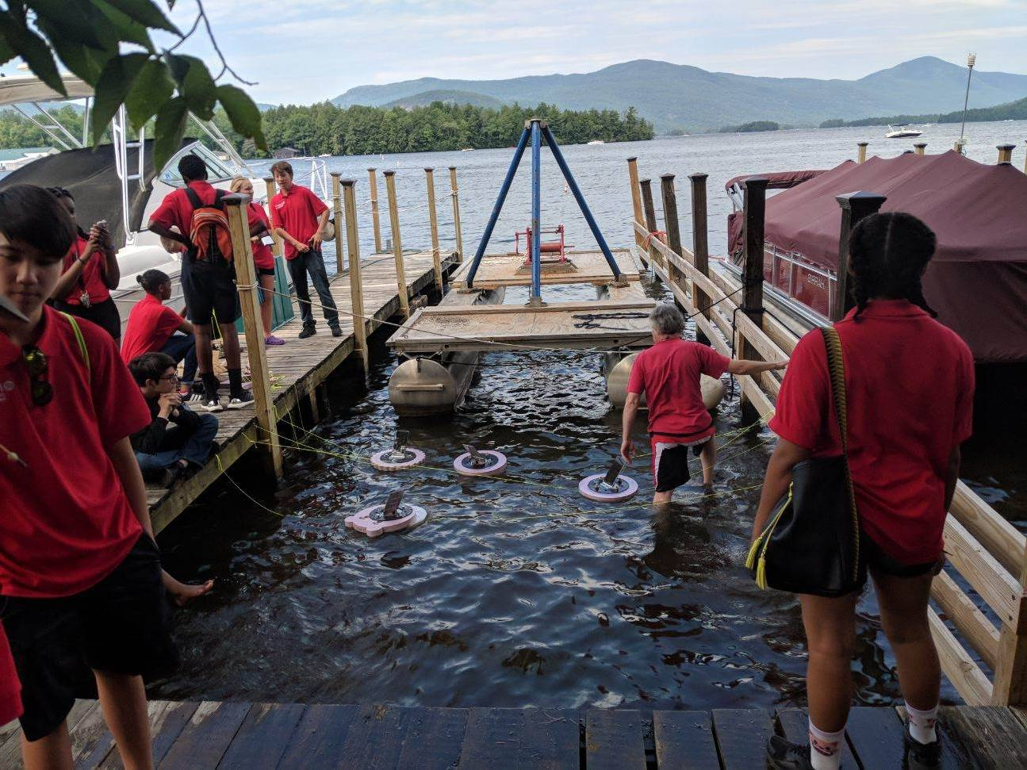
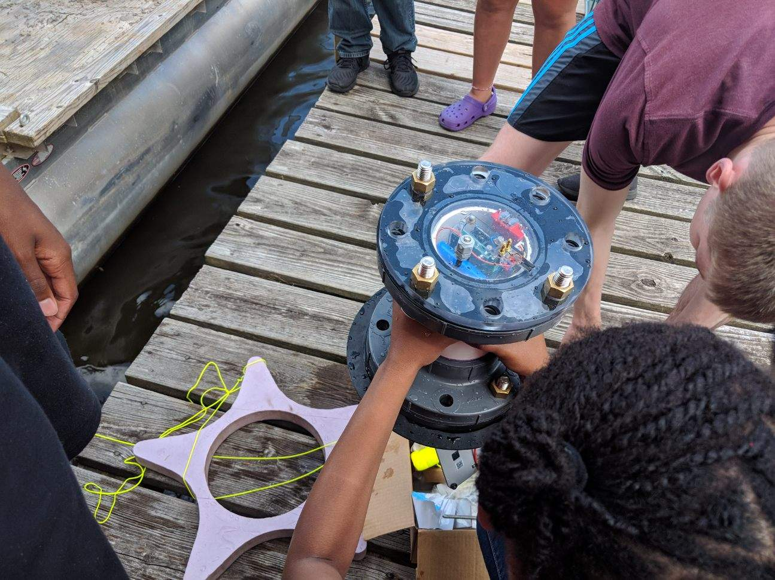
Who am I? Research Group
Systems..now a senior capstone project!

Slide 10
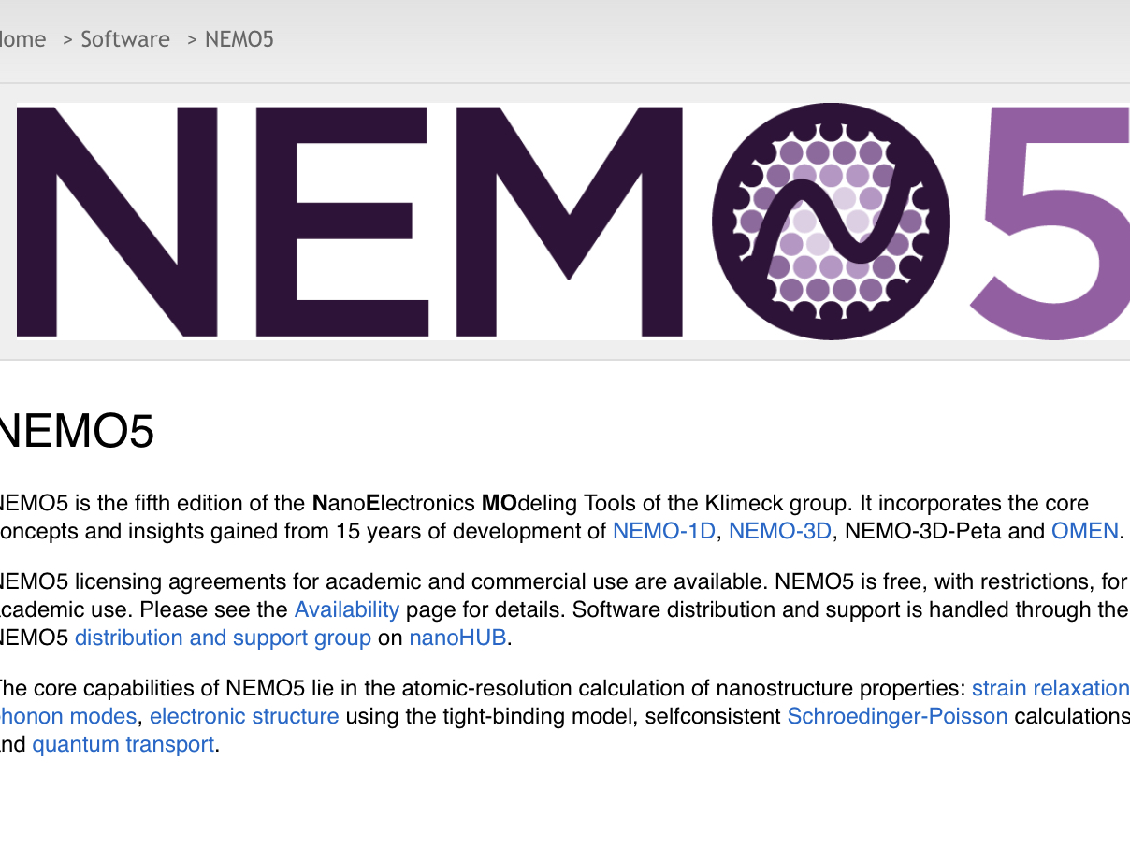



Evolving research in a Covid World
Transitioning and learning new simulation and modeling to expand our prediction capabilities
How do you model and simulate device level performance parameters based on nanostructures with chemical surface reactions?
How do you model and simulate biochemical processes within a device structure for sensing applications?

Slide 11
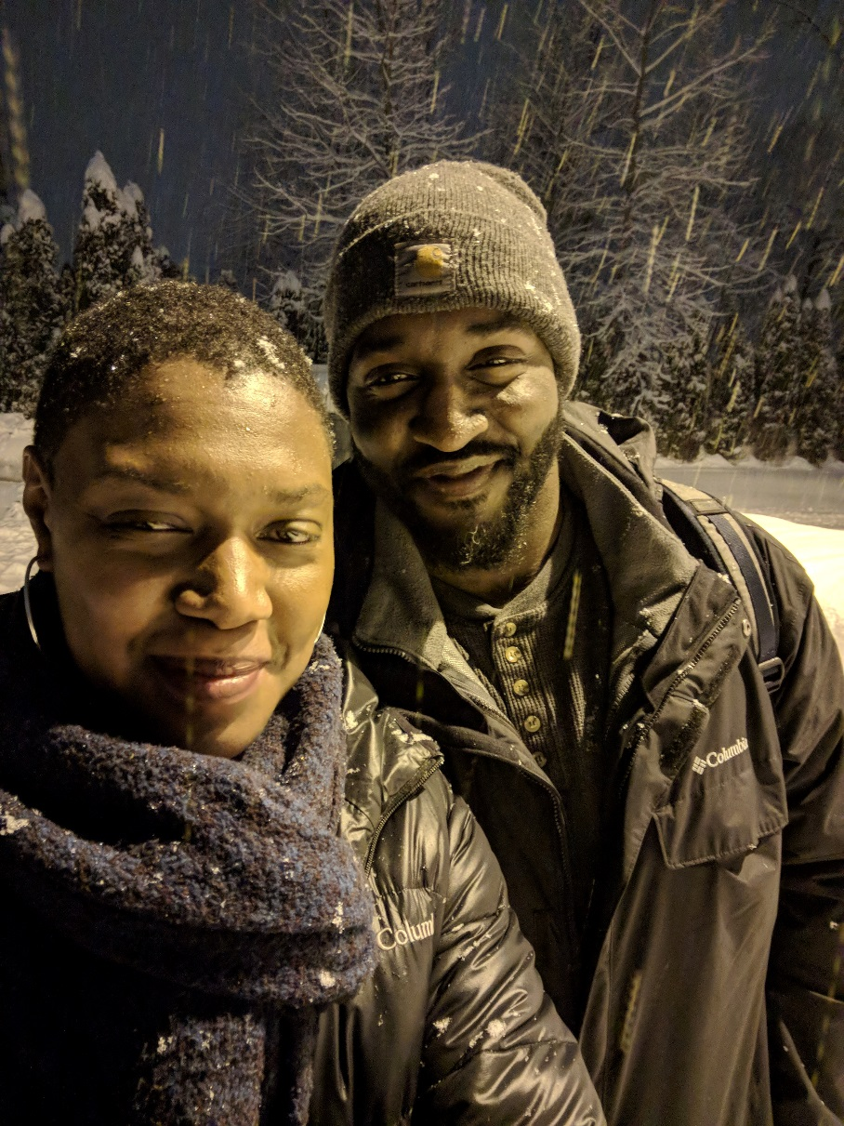

Who am I? WIFe AND MOM of 2 Boys!

Slide 12
How do you contact such a busy Professor?
Yes! I do want to communicate with you…
Don’t question it…I do. So this is how!!!
Please use the learning community tools in the following way:
  PIAZZA (Your 24/7 Communication Portal!!!)
    Have a question about concept or general class concern? (I.e. when will our exam be?, I don’t understand what problem 1 is asking? Is this a typo?) POST to Piazza!!
    Easy to find later (Categorized)
    Everyone can see this question and many folks will have it
    Anyone can answer making it a much faster response time.
  WebEx Team direct contact to Prof. Sawyer
    Have a quick question only I can answer? WebEx me
      Gets my attention if an immediate concern
      Doesn’t need to be found or referenced again
      Actually easier to sign documents this way and return them
  Email me? (Pretty much never…just more formal)
      If you have some kind of formal excuse or document send it here. I will redirect you to Piazza or WebEx otherwise
        Stuff gets lost…basically. I get quite a few a day.

Slide 13

General course info
Monday and Thursday WebEx Lecture Space
4:45 p.m. – 6:35 p.m.
Remote Labs
Sec 01 Wednesday 9:05-11:55 a.m.
Sec 02 Wednesday 2:30-5:20 p.m.
Tuesday test block (tests only!): 8:00-9:50 p.m.
Extra Time students send me your official documents
Distant Time Zone students contact me
I will use a Piazza poll to create different time slots on a test day. Goal is to group together as many of you as possible.

Slide 14


WARNING! Large workload
Successful students spend at least
2 x (in lecture time)=study time
2 x (4 hours) = 8 hours per week studying
This may NOT include labs and write ups
The blessing and the curse: engineers do not depend on pure memorization
Requires plenty of practice to get the nuances of problem solving down, in a way that works for you!
Goal: To be a Spring 2021 CIRCUITS ONLINE LEARNING COMMUNITY!!!

Slide 15
Course Overview
General Information

Slide 16

Enduring Understanding (Learning Objectives) | Important to Know and Do (Core Competencies/Skills) | Worth Being Familiar With (Exposure, Not Mastered)
understanding basic circuit analysis tools and approaches to solving for voltage and current in a resistive network | an ability to analyze circuits using KCL, KVL, superposition, node and mesh analysis, and equivalent circuits | matrix algebra and its usefulness in analyzing complex circuits
understanding behavior of first order circuits and second order circuits | an ability to find the time domain response of circuits using Differential Equations | overall perception of tradeoffs rather than one right answer
understanding of impedance, complex power, and phasors | an ability to find the time domain response (and s-domain response in the process) of circuits using Laplace transforms | basic applications of fundamentals in real- world power systems
understanding the usefulness of analysis in the s-domain | an ability to convert convey circuit properties graphically in complex space | why and when to use math tools: different math, different perspective, different efficiency of solving for same circuit
understanding of AC State Responses | an ability to write transfer function and draw a bode plot | limitations of a passive filters in design. the existence of higher order filters
understanding the relationship between mathematical analysis, experiment, data, and simulation | an ability to self-regulate progress and approach troubleshooting | non-idealities are significant data sheets are important approaches to solving an open-ended question or problem

Slide 17
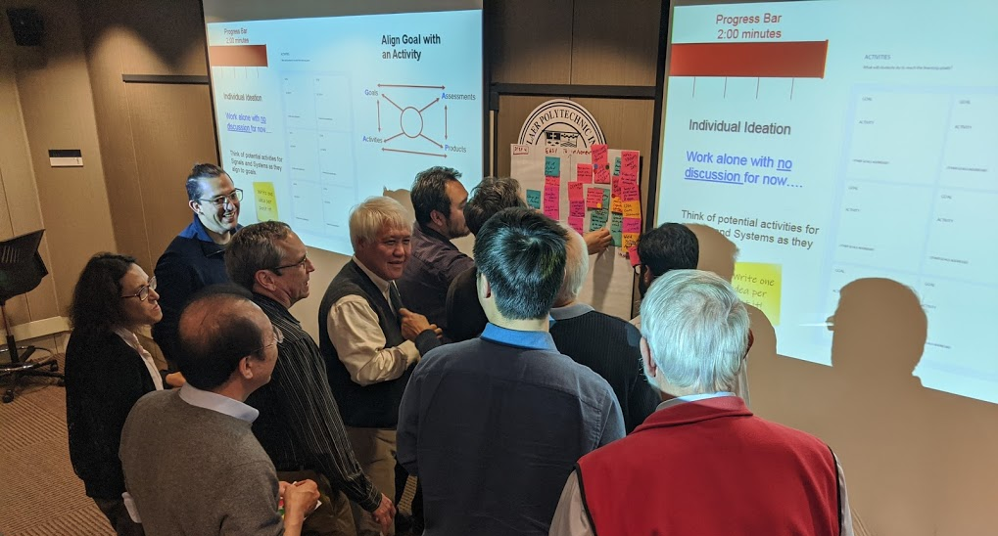
Working toward Goals and Activities for Signals and Systems…..

Slide 18
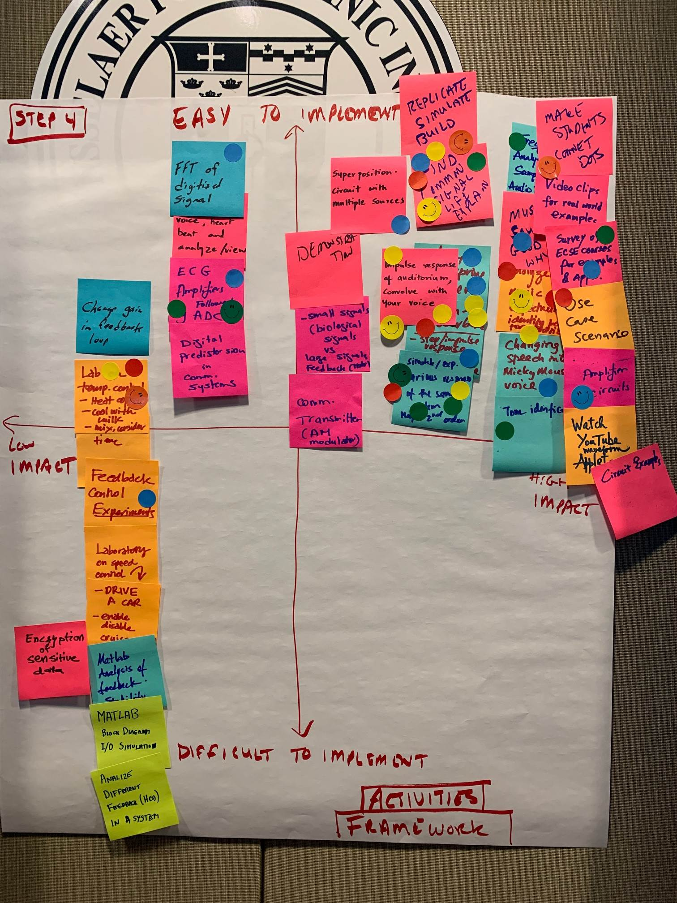
GAPA Tool: Signals and Systems

Slide 19
ABET Student Oucomes

Slide 20
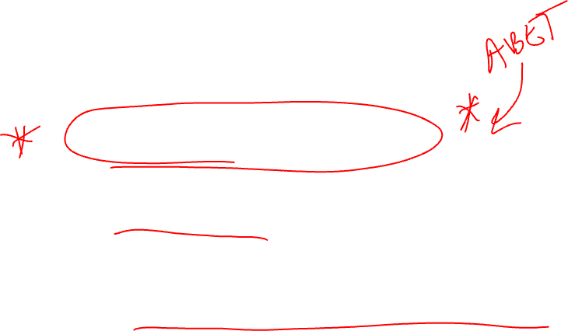
ELECTRIC CIRCUITS
Problem Solving Techniques:
  Circuits and Other Systems
  Modeling, Analysis, Simulation, and Experimentation of Circuits
Vocabulary:
  Language of EE’s/CSE’s/EPOW’s/IT’s
Fundamentals:
  Concepts EE’s/CSE’s Need to Know
  Gateway course: Foundation for Further Courses

Slide 21

TEXTBOOK (Recommended)
The Analysis and Design of Linear Circuits – Laplace Early Roland E. Thomas and Albert J. Rosa
  Seventh Edition – Published by Wiley
PREREQUISITES:
  MATH-2400 Introduction to Differential Equations
  PHYS-1200 Physics II (Changed recently!)

Slide 22

What is a Blended classroom environment?
Students are required to learn introductory information at home through course videos and/or reading of textbook BEFORE lecture times
Short summary lecture given (<20 minutes on average)
Class is driven by discussion and class problems worked in groups of 2-4 people
Occasional interruption of instructor to focus on prevailing issue in class
We’ll get in small groups for discussion time!

Slide 23

Student opinions?
Fall 2015: 50% Blended with Instructor Led problems 50% Totally Flipped, student-led problems
I liked the collaboration in class on team assignments……Even though I didn't really like the flipped course structure at first, it really helped me gain more of an understanding as well, especially because we could collaborate in class.
The way the material was presented and continued to build upon itself was nice….I feel like I've learned the most I have yet in a class at RPI.
The change in the course was something I did not know I needed but more practice at every turn with ready guidance was paramount to my improving grade moving from exam 1 and 2 onto 3.

Slide 24

Student Opinions?
It’s interesting that the EVEN the negative responses still prove the same point….
The flipped classroom was a failure due to the mediocre quality of the videos. This was probably because the videos were designed to be supplements for the lectures and without the lectures they were ineffective. I often found myself using other sources to learn the content. Not enough practice with answers. The class problems are pointless for studying unless you took adequate notes during lectures. Labs were useful in proving that not everything was ideal.
Instructor should not have changed the style of the course…. I liked it better and understood the problems more when the instructor went over the problems. Its hard to do a problem on our own when we have a slim idea of what’s going on in the first place.

Slide 25

Student Opinions?
The course videos provided adequate knowledge, but not enough to master the material
The course is structured well. I feel that my main obstacle was my time management, which is unrelated to the way the course is run. I definitely should have taken advantage of office hours more frequently.

Slide 26

Recent changes for course communication/Efficiency
Tools for Better Communication and Efficiency
Student Need Driven
Efficiency Driven
COVID Driven
Blended: Course Videos
Alpha-Omega Labs
Piazza (Virtual TA)
Gradescope
WebEx Teams
Exam Reworks
**Introduced Fall 2019 semester**
Individual Check-Ins!!

Slide 27
What is gradescope?
Asynchronous submission system for every assignment, exam, homework and lab
  You don’t have to come and find me
  Timer is set on all assignments so you know EXACTLY when they are due
Grading system with FULL transparency
  Rubric for grading shown to all students (fairness, elimination of unintended bias)
  If a change is made to the rubric for one, it modifies all tests at the same time
  Re-grading feature built in so questions can be answered directly
  All assignments sent back by email link (Paperless transactions!)
Collection of data for future analysis of teaching effectiveness
  Statistical analysis per question is available

Slide 28
Piazza youR 24/7 Asynchronous, Virtual TA
Post questions anytime, anywhere
You are free to discuss and answer any other student
TAs will be watching to comment
I have an interested retired professor who is also watching and may help you
I am also watching and will make comments
Anonymous setting available

Slide 29
Course Website
No LMS for this class..yet!!! All resources needed are here
https://ecse.rpi.edu/~ssawyer/videos/

Slide 30

Course Website
Syllabus Page – Central Focus Point
Direct Access to:
  Course Schedule
  Lecture videos (<10 minutes per video)
  Live WebEx videos (will try to cut down to 10 minute each)
  LevelUP Problems
  Circuits X Topic Page
  Class Slides
  Reading, Class Preparation
  Homework/Assignments Due Dates
  Class Problems and their solutions

Slide 31

LeCTURE Videos
  Introduction to theory and concepts
  A few basic example problems often given
  Quizzes dispersed throughout (participation points)
  Survey of what you’d like me to focus on during lecture time asked
  Find mistakes? Piazza fix my typos space!!!…good finds will get you a few extra points

Slide 32
Learning how to learn:
How to prepare for class
LIFE PRO TIP:
Stay ahead of the professor by one lecture…
Try at least one Class Problem……
BEFORE EACH LECTURE:
Go to lecture videos on website
Take notes from videos and/or from textbook
Answer all quiz questions (embedded in video)
Bring notes from video to lecture
Are the quizzes graded? No…participation points!

Slide 33
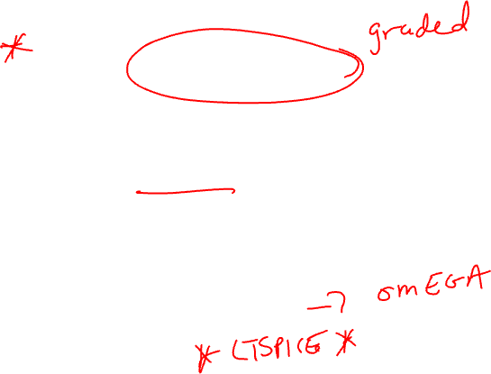
OTHER RESOURCES
Class Problems and Team Assignments:
  Will be used in EVERY class
  CPs Available on Class Website
  Team Assignments “handed out” during class (are graded)
  Have ready for class each day
Laptops:
  Download Student Version of LTSpice
  PSpice is also fine to use

Slide 34

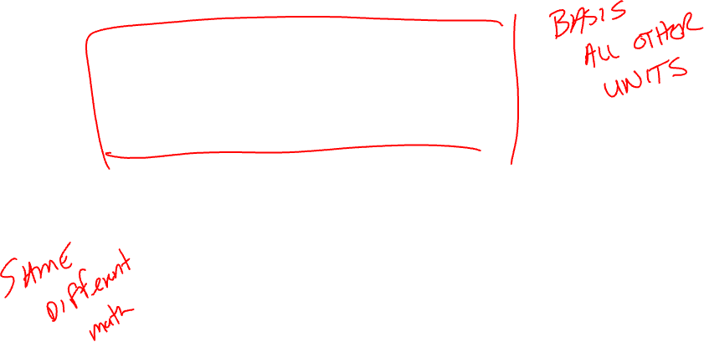
COURSE STRUCTURE
Unit I: Chapters 1, 2, 3, 4
  Basic Circuit Analysis Techniques
  Transistors and Op Amps
  DC Steady State
Unit II: Chapters 5, 6, 7, 8, 9 (extended!)
  Signal Waveforms
  Circuits with Inductors and Capacitors
  Response of 1st and 2nd Order Circuits
  Laplace Transforms
Changing math tools
Unit 1 Concepts

Slide 35

COURSE STRUCTURE
Unit III: Chapters 10, 11, 12, 14
  s-Domain Circuit Analysis
  AC Steady State Intro
  Frequency Response Intro
  Phasors and Power Circuits
  Mutual Inductance and Transformers
Unit IV: Chapters 15, 16, 17
  Frequency Response (cont.)
  Bode Plots
  Filter Design
Changing math tools
Unit 1 Concepts

Slide 36
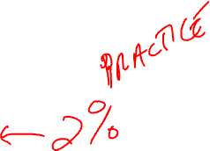
Class Format
Lectures: Come Prepared
  Very short summary of lecture points
  Many student led problems
  Interactive work (***design ideation**/short simulations/experiments)
Team Assignments: Work Together, Time Limited Graded
Laboratory Experiments: Wednesdays, Lab reports required with deadlines on course website, Graded
Homework: Due Each Week, Graded for completeness….meant to be practice!!!

Slide 37
Partners/Teams
During lecture time, problems will be given
  Work in groups of 2 (can confer with group of 2 across from you)
  Team assignments are groups of 4 people
Laboratories: Choose one partner (two at most for a total of 3 students)
  One report for both partners
Team Assignments on WebEx Teams
  Work with your lab group (two groups per team assignment for a maximum of 6 students per assignment)
  Excused team assignment space are for those who are overseas and contact me about completing these outside of scheduled class time
  Do NOT be a dictator and DO NOT be silent either!
  Important concept in your future careers: Communicate to learn!

Slide 38

Partners/Teams
Homework – turned in individually
  May work in groups
  All points for completeness
All Exams Done Individually
  Conceptual questions often from class discussions included
  Academic Integrity signature required at the end of class today!!!

Slide 39
Alpha-Omega Lab Continuum
Evolution of Hands-on Learning through Design

Slide 40
New fall 2019
In-Class Design Ideation Exercises
Alpha-Omega Lab Design Continuum Labs
New Documentation for Omega Labs (Emphasize: Iteration, Analysis, and Improvement)
New Documentation for Alpha Labs
Metacognition Journals (Optional)

Slide 41
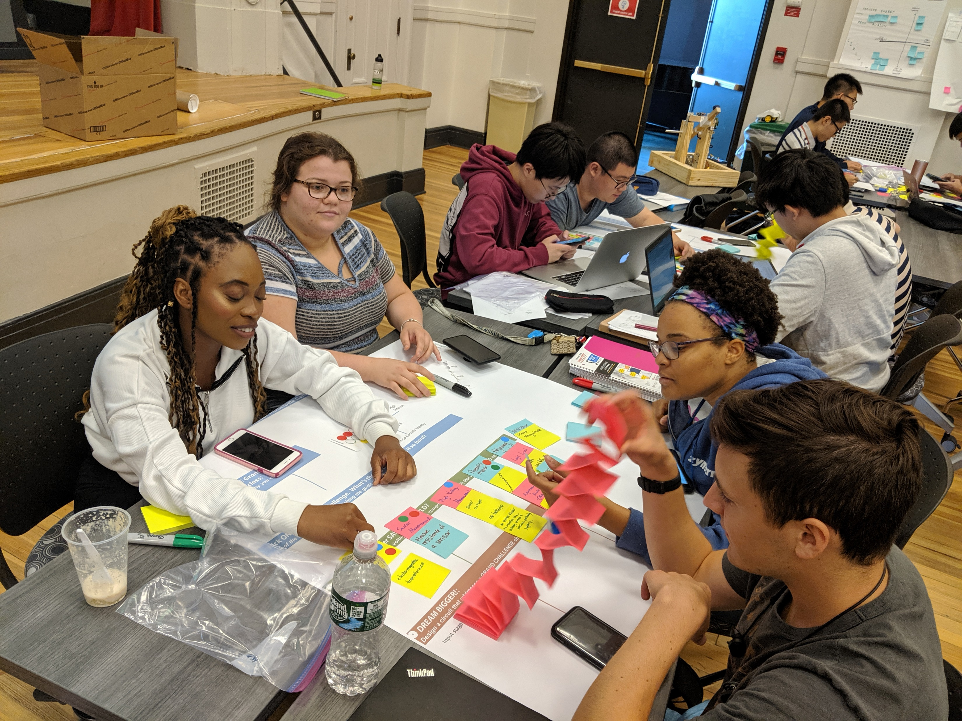
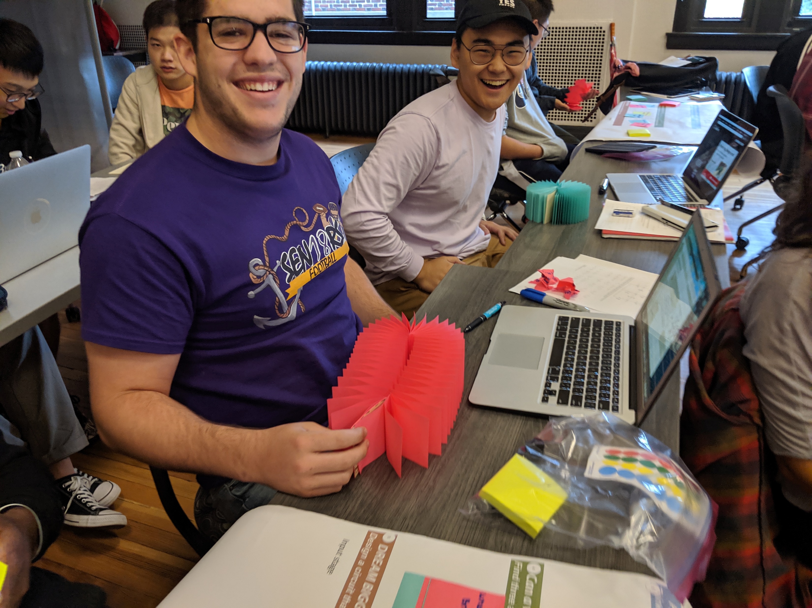
Alpha-Omega Lab Continuum
With focus on student-chosen class theme “TBD”
Students choose either:
  Alpha Labs: a bottom up, procedural lab with design applications in a smaller scope
  or
  Omega Labs: a top down, full design-based approach to engineer their own unique solutions
Students can also switch between Alpha and Omega at times throughout the semester allowing them to practice design as much or as little as they desire. (Design is Non-Binary!)
If all milestones are completed with well-written documentation only Omega Lab these students have the option to not take the final.

Slide 42
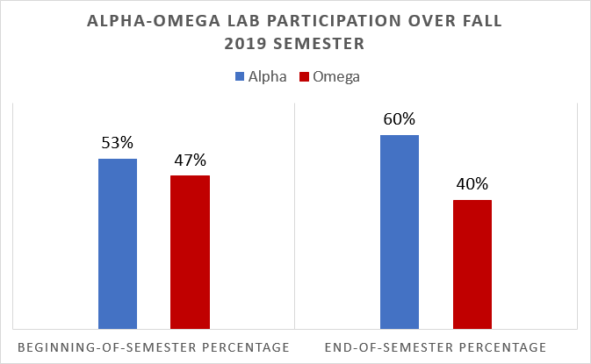
Student Choice in Alpha-Omega Lab Continuum
Beginning of the semester:
45 students out of 95 (53%) started Omega Labs
By the end of the semester:
38 students out of 95 (40%) students completed Omega Labs
- 21 out of 38 students met all challenges and had the option to not take the final

Slide 43

Fall 2019 Omega DESIGNS: Dream Clean https://ecse.rpi.edu/~ssawyer/videos/AdditionalResources/OmegaHighlights_final_vFinal/OmegaHighlights_final_vFinal.html
CIRCUIT DESIGNS RELATED to CLEAN OR DREAM: ENERGY, WATER, or the Interconnections of the Human Brain
REM Sleep Detector using IR sensors
Temperature Automated Fan
Clean Water: Turbidity Sensor/Filter Activator
Smart Light
Sun Follower
Light Sensor: Fluorescence Detection Circuit
Solar Cell Power Switch
Sunlight Replicator
FM Demodulator
EMG Controlled RC Car (Muscle Flex Controlled Car)
Analog Components for a Digital Brain (Computer)
Light Activated Musical Mood Changer
Wind Turbine Prototype Developer (Testing Platform)

Slide 44
Omega Labs Logistics
Three Milestones throughout the semester: Milestone 1, Milestone 2, Milestone 3
Three documents comprise one report for each Milestone (submitted iteratively and improved)
  Project Plan – planning of entire project, approved by TA before starting, signed at end
  Project Manual -An engineer reading the project manual should be able to use it to rebuild and redesign the circuit.
  Proof of Concepts-a summary of your analysis on each of Unit concepts every student MUST cover as they apply to your project (if concept of your project doesn’t apply, pick Alpha Lab example…)
At deadline of each Milestone, Rubrics for each are in this document
Assignment | Percent of Total Grade
Project Manual | 33%
Proof of Concepts* | 33%
Presentation | 28%
Project Plan | 5%

Slide 45
Concept List (Example)
Concept List
Unit 1
Ohm’s Law
Polarity
One of: KVL, KCL, Nodal Analysis, or Mesh Analysis
In Discussion section, compare and contrast each of these methods of analysis. Discuss when you might use one over the other.
Circuit Reduction of Parallel and Series Resistors
Voltage Divider
Equivalent Sources
Superposition
Thevenin or Norton Circuit
Operational Amplifier as a Comparator
Operational Amplifier as an Amplifier

Slide 46
Building Blocks – GENERAL INSTRUCTIONS
Each Milestone must include:
  An Input stage, 2 new Primary stage blocks for the corresponding Milestone, and an Output stage.
The Input and Output stages can remain the same throughout the semester.
TA or Professor must approve building blocks beyond given list.

Slide 47
Building Blocks – Input anD OUTPUt STage
Input Stage
Choose at least 1 input
Sensor
IR LED
Antennae
Photodetector
Microphone
Temperature Sensor
Light Sensor
Gas Sensor
Output Stage
Choose at least 1 output
Solenoids
LED
Display
Motor
Buzzer
Antennae

Slide 48
Building Blocks – Primary STAGE
Primary Stage
Choose at least 2 primary stages
Milestone 1
Digital to Analog Converter (R-2R Ladder)
Inverting Amplifier
Non-Inverting Amplifier
Summer
Difference
Comparator
Wheatstone Bridge
Milestone 2
Analog-to-Digital Converter (Rectifier and First-Order Filter)
Monostable Multivibrator (Timed Pulse Generator)
Astable Multivibrator (Square Wave Generator)
Differentiator
Integrator
Analog Multiplier
First-Order Passive Filter
Second-Order Passive Filter
Phase Shifter
Milestone 3
Transformer
Analog Multiplier
First-Order Filter
First-Order Passive Filter
Second-Order Passive Filter
First-Order Active Filter
Second-Order Active Filter

Slide 49

Comparison: Alpha, OMEGA
  OMEGA Labs allow you to design a circuit, ANY circuit, using building blocks of the course based on our COURSE THEME….GRAND CHALLENGE….
  OMEGA Labs have 3 Milestone days which includes a Demonstration
  OMEGA Labs have 3 components of a documentation due around every Milestone. (They are essentially like one report). These are iteratively improved over the entire semester.
    Omega Labs and Alpha Lab students using the M1K can improve write-ups to the end of the semester. There will be an optimization link in Gradescope!
  If you meet the expectations of an Omega Lab (cannot 5s or 1s from the rubric in the documentation grade), you have THE OPTION to skip the FINAL!!!!
  ALPHA LABS are procedural, which means you follow instructions and compare analytical calculations, to simulation, and experiments.
  ALPHA LABS have 6 different reports to turn in. You will have to write your Alpha Lab version of Proof of Concepts.
  ALPHA LABS have small design applications at the end of every lab.

Slide 50


New this semester: Individual Check-Ins
You have 6 check-ins throughout the semester worth 40% of your lab grade!
  You need to create a 1-3 minute video or audio (with accompanying document) about your INDIVIDUAL contribution to your lab
  You will post this in your lab groups space for your lab members to see
  They are pre-scheduled in your Gradescope list of assignments
  They have an online assignment that guides the content of your video
  You should show your work…if it’s a simulation, show it, if it’s a circuit, show it, if it’s a calculation show it…..
  Why?
    To encourage conversation early about your individual progress on labs
    Connect you to a student assistant as a mentor (formalize the learning community!)
    Find teamwork problems very early and help the team
    YOU should get points for being ACCOUNTABLE

Slide 51
Alpha Lab Grading: Criteria
10 pts each
1. Proof the students did the work (via screen shots: not necessarily for all measurements but most)
2. Answers to any and all questions in the lab
3. Organization and logical flow for ease of grading
4. When required, analytical-simulation-measurement comparisons with discussion of any differences

Slide 52

HYBRID Lab
There will be a sign up sheet for Sec 1 and Sec 2 to come to labs
Only a maximum of 30 people can come at a time
Undergraduate Student assistants and Graduate Teaching Assistant will be there
Still use WebEx Teams to communicate as much as possible
The Graduate Teaching Assistant will help you get parts if you need them
This is entirely optional for any student
MUST follow RPI Protocols including social distancing and cleaning up space after using

Slide 53
Homework Grading:
One problem will be randomly chosen (6 pts)
Completeness of homework (4 pts)
Total: 10 pts
Solutions posted online, night of homework due date
Check your entire homework using solution!

Slide 54
Grading Breakdown
Team assignments | (15%)
Homework | (2%)
Laboratory | (15%)
Lab reports | (9%)
Individual check-ins | (6%)
Exam I | (16%)
Exam II | (16%)
Exam III | (16%)
Final exam | (20%)
Total | (100%)

Slide 55
Spring Hybrid COVID Circuits FINAL GRADES
Grades you all have As right now
Grading spreadsheet in syllabus can guide how to keep it
Essentially a grade calculator to keep track of your average scores and what that means as you go through the course
Can send to me at the end of the class to confirm!

Slide 56

Homework 0
Install LTSpice
  Download from the course webpage
  Use default installation unless you absolutely know better
  Best to do this right after class today
Read the ENTIRE syllabus
Check Omega Lab and Alpha Lab descriptions and decide….
If you have a lab partner or partners in mind, go ahead and make a space
We’ll find partners during Lab on Wednesday

Slide 57
Integrity and Digital Tool Signatures
I’ve placed two documents in the chat to review and sign
Going over them now….
Digital Tool Waiver
Academic Integrity Signature
Both must be place on Gradescope today

Slide 58
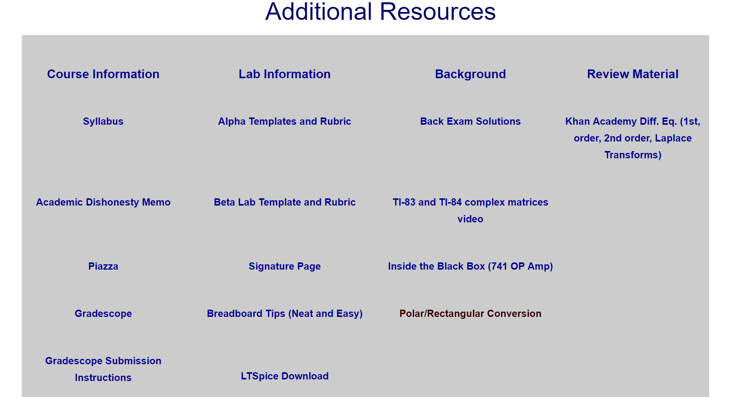

Testing Gradescope submission
Download Any Scanner APP on smartphone
With Laptop sign into Gradescope (for new students Entry Code: D5K5RN)
How to upload: link on website
One person take a picture of your poster and add group mates
Individually read and sign Gradescope and Academic Integrity acknowledgement sheet and upload it to Gradescope

Slide 59
Class Problem Worksheets
Handouts given with questions and example problems on them
Feel free to take your notes on them and/or use them as a guide
Often “mimic” at least one homework problem
One problem partners will try to figure out
Not graded

Slide 60
Lecture 1.1 Agenda
Symbols and Units
Circuit Variables
Passive Sign Convention
Voltage Reference Point – Ground

Slide 61
Taking up a GRAND CHALLENGE/UN Sustainability Goals
(Finding a course theme!!! How about “Living in a COVID World”..)
Find your Group on We
(General Space has links you can click in the chat)
Start working with your whiteboard and sticky notes.

Slide 62
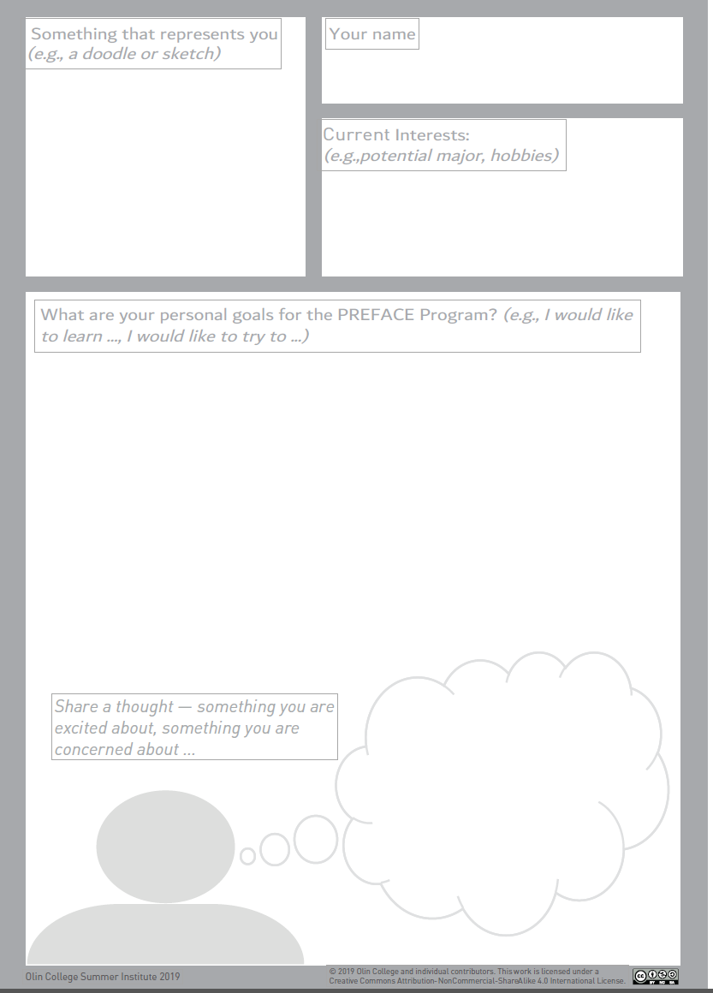
Progress Bar
5:00 minutes
Individual Activity (5 minutes)
PERSONAL PROFILES
Fill out your personal card.
Capture your goals, hopes and wishes over the PREFACE program.
Save for your team poster!

Slide 63
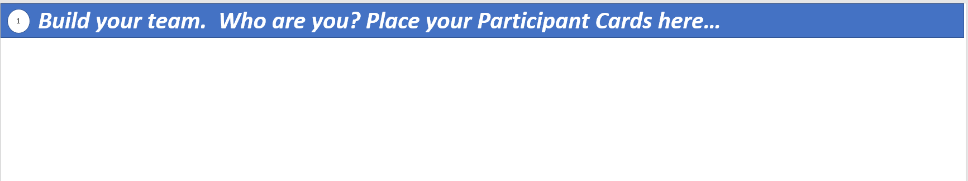
Progress Bar
5:00 minutes
Share your Card Activity (5 minutes)
PERSONAL PROFILES
Exchange your personal card until everyone reads it.
Write category 1: Build your team with marker on poster.
Place cards on poster.

Slide 64
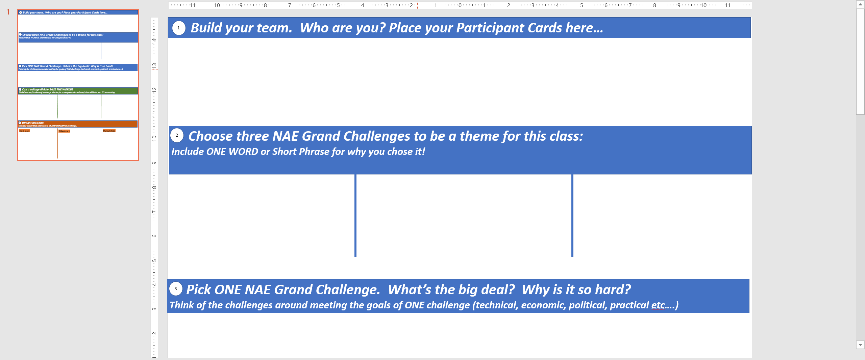

Progress Bar
5:00 minutes
2. Choose three NAE OR UN Sustainable Development Goals as a theme for this class
Individual Ideation
Work alone with no discussion for now….
Write one idea per post it!
Write down any NAE OR UN Sustainable Development that interests you and WHY!!!! (One word or short phrase)

Slide 65
Progress Bar
10:00 minutes
2. Choose three NAE OR UN Sustainable Development Goals as a theme for this class
Group Ideation
Share now with groups of 4-5!
Process:
Read one and post one post-it
Add similar
Repeat
Add new ideas on post-it
See if any of your group mates came up with the same goals or challenges! Follow process…one at a time!!!

Slide 66
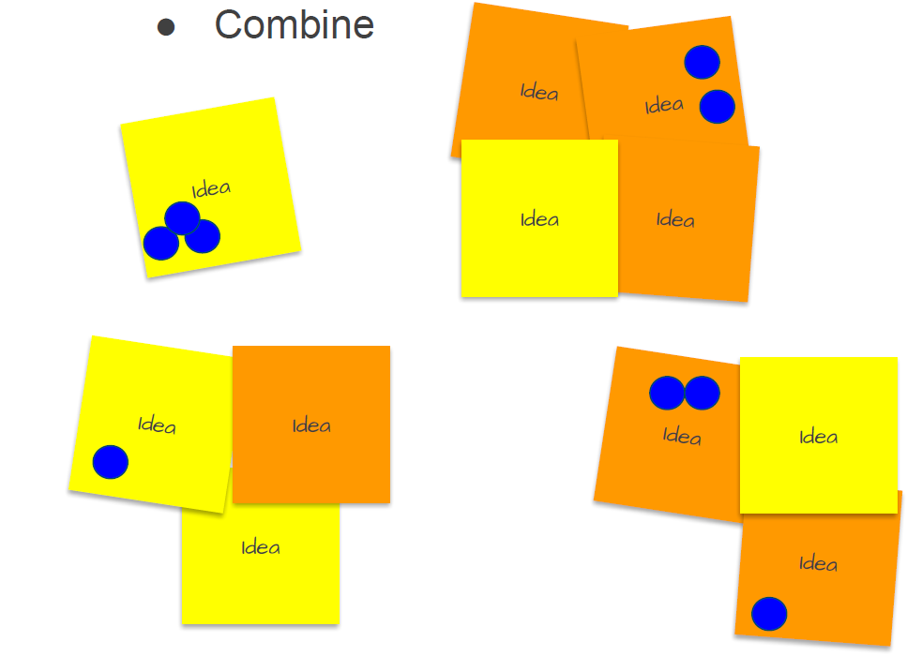
Progress Bar
10:00 minutes
Categorization:
1. Discuss
2. Place on Framework of Circuits “worthy” and interesting
3. Place top three in order of preference in the boxes. on large poster.
Circuits “worthy”
Write framework on your poster underneath participant cards.
Low
Interest
High
Interest
Not so Circuits “Worthy”
Notes:
More important to less important. Three different color dots for each. Border between Worth and Important left fuzzy.

Slide 67
Progress Bar
2:00 minutes
3. Pick one NAE/UN Challenge/Goal. What’s the big deal? Why is it so hard?
Individual Ideation
Work alone with no discussion for now….
Write one idea per post it!
Write down challenges for the challenge. Think big or small. Think about practical uses in the class and society.

Slide 68
Progress Bar
10:00 minutes
3. Pick one NAE/UN Challenge/Goal. What’s the big deal? Why is it so hard?
Group Ideation
Share now with groups of 4-5!
Process:
Read one and post one post-it
Add similar
Repeat
Add new ideas on post-it
See if any of your group mates came up with the same goals or challenges! Follow process…one at a time!!!

Slide 69
Testing Gradescope submission
Download Any Scanner APP on smartphone
With Laptop sign into Gradescope (for new students Entry Code: D5K5RN)
How to upload: link on website
One person take a picture of your poster and add group mates
Individually read and sign Gradescope and Academic Integrity acknowledgement sheet and upload it to Gradescope

Slide 70
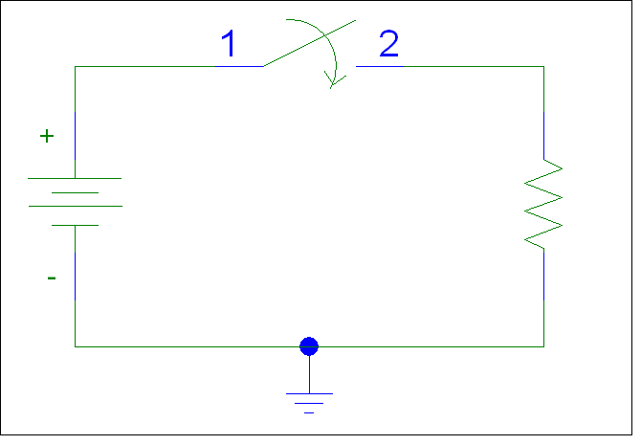
MODEL FOR FLASHLIGHT
Using PSpice
Circuit Variables
Current (i)
Voltage (v)
Power (p)
Passive sign convention
Ground

Slide 71
Lecture 1.2 AGENDA
Circuits & Devices
Linear Resistor – Ohm’s Law
Open/Short Circuits – Ideal Switches
Ideal Voltage and Current Sources

Slide 72
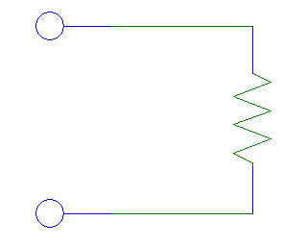
OHM’S LAW

Slide 73
LINEAR RESISTOR

Slide 74
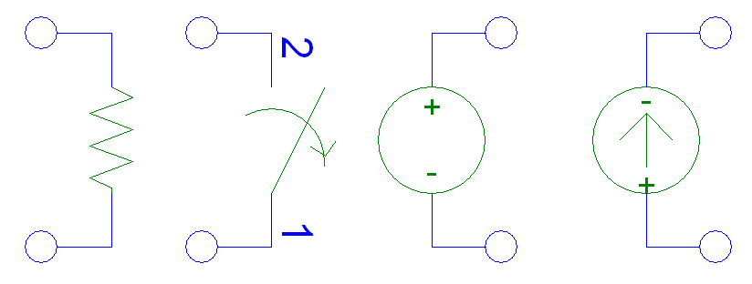
INITIAL CIRCUIT ELEMENTS

Slide 75
Lecture 1.3 AGENDA
Definitions
Reference Marks
Kirkoff’s Laws
Practice Problems

Slide 76
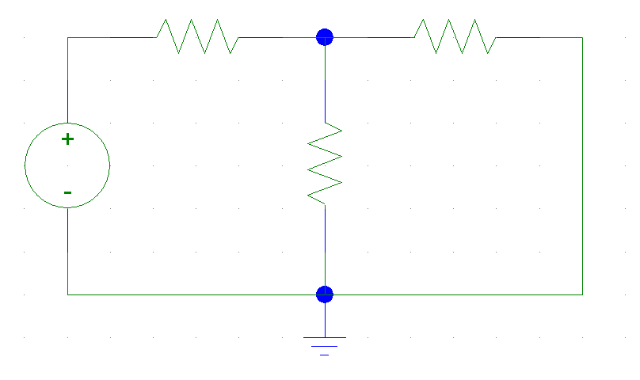

DEFINITIONS

Slide 77
KIRCHHOFF’S LAWS
Kirchhoff's Current Law:
The algebraic sum of the currents entering a node is zero at every instant

Slide 78
KIRCHHOFF’S LAWS
Kirchhoff’s Voltage Law:
The algebraic sum of all the voltages around a loop is zero at every instant

