Slide 1
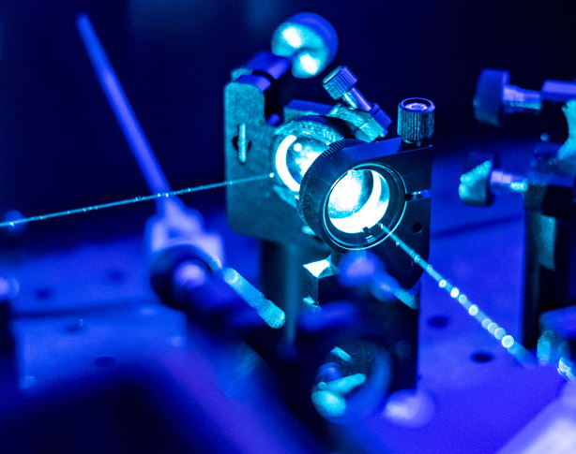
Optoelectronics
Technologies
John Spina
Notes:
Be sure to actually make funny in the future

Slide 2
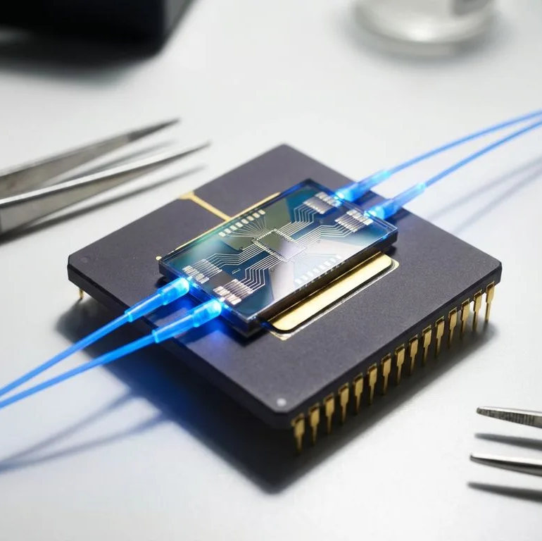
Agenda
Fundamentals of Light
Different Optical Technologies and How They Work
Why to Use Optoelectronic devices
Applications of Optoelectronic devices

Slide 3
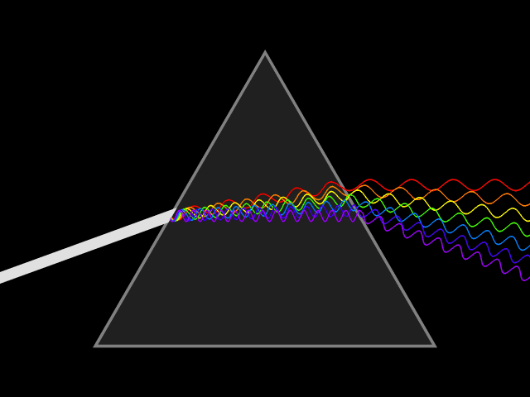
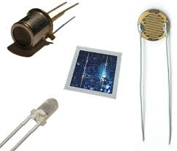
What are Optoelectronics
Optics is the study of light and how it interacts with different materials
Photonics refer to the study of how to use photons
Optoelectronics refers to electronic based and related devices that use photonic principles

Slide 4
Fundamentals of Light

Slide 5
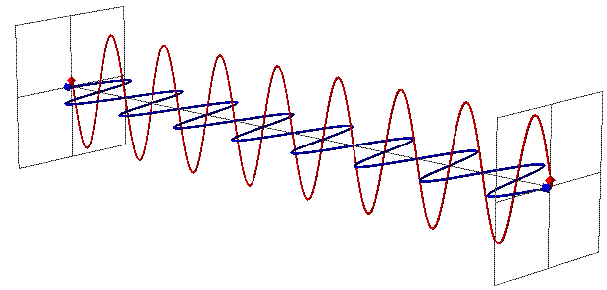
What is Light?
Wave but also particle
Photon model is better to use when dealing with energy
Wave model is better to use when dealing with travelling light
  Contains an E-Field and a perpendicular B-Field
Photon
  A particle representation of light that contains an energy with a correlated wavelength

Slide 6
Important Terms to know
Intensity
  Defined as Power over an area
Polarization
  The Electromagnetic field is aligned in a specific direction (we’ll assume most of the light is polarized)
Refractive Index
  Property of a material that determines how quickly and easily light should move inside the material
  Harder for light to escape from high index to low index

Slide 7
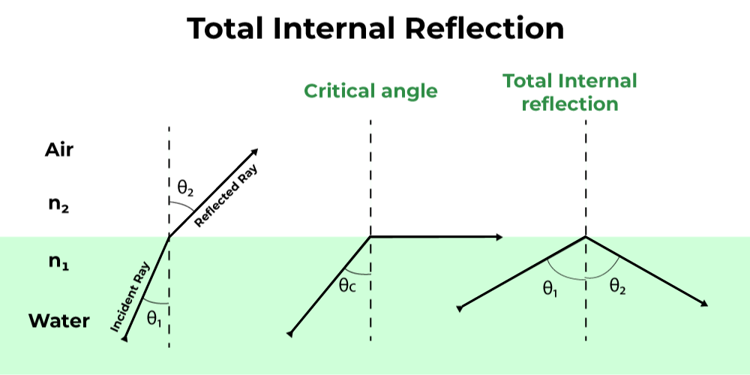

Total Internal Reflection
When two materials are at a junction with different refractive indexes, some light will go into the new medium and some will reflection
At a critical angle, all the light will reflect, and none will be transmitted
Useful in many optical technologies to capture light
$$θ_{C}=\arcsin\left(\frac{n_{2}}{n_{1}}\right)$$
Where $n_{1}>n_{2}$

Slide 8
The Optoelectronics Technologies

Slide 9
Different Types of Devices
Waveguides
Photodiodes
Modulators
LEDs & lasers

Slide 10
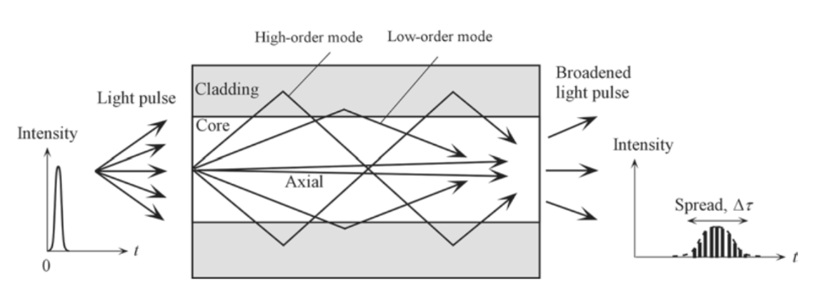
Waveguides
Guides light into going a specific direction
  Likes the “wires” of the photonics world
Consist of an inner core material surrounded by outside cladding to keep light inside the fiber
Often supports multiple “modes”, or angles that a frequency can be set at and still travel forward

Slide 11
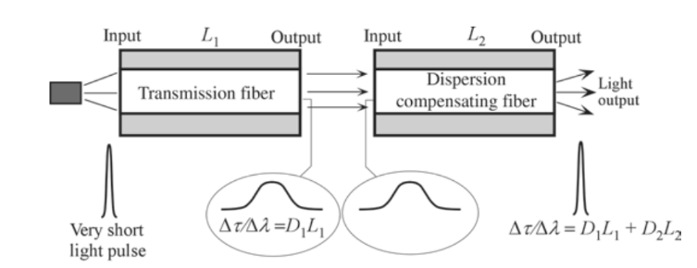
Waveguide Dispersion
Signals and become distorted over time due to refractive index
Solution is to use different material to reverse this distortion
  Typically Silica (SiO)
Notes:
At the end, ask “what is the simplest way to produce light?”

Slide 12
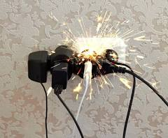

Slide 13
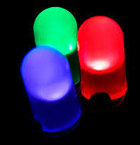
LEDs
Simplest design light emission with electronics (Next to destroying something)
Low intensity
Non coherent light
Current efficient

Slide 14
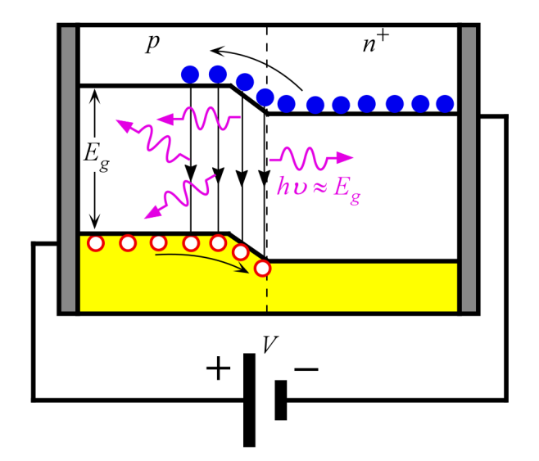
LEDs
Applied voltage allows electrons to recombine with holes at the junction and p side
This recombination emits a photon
Frequency is based of materials band-bap energy
Notes:
How they work

Slide 15
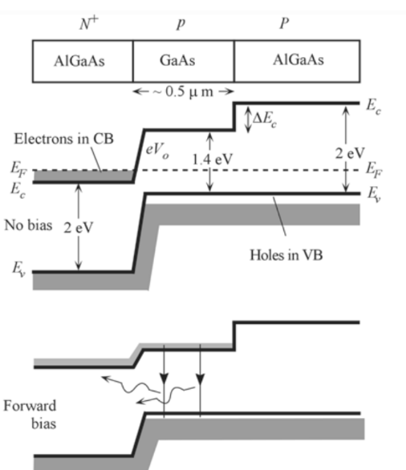
Heterostructure LED
Two (or more) semiconductor materials of different band-gaps are put together
Increases chance of recombination
Acts as a waveguide, guiding the photons out of the device
Photon energy is determined by narrower bandgap

Slide 16
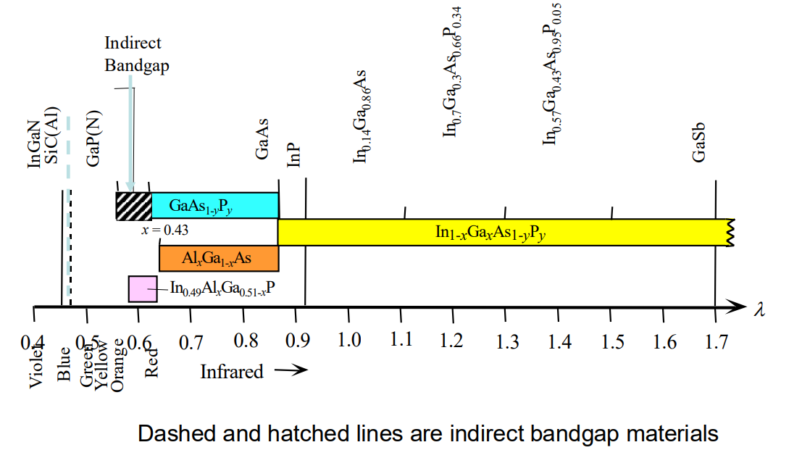
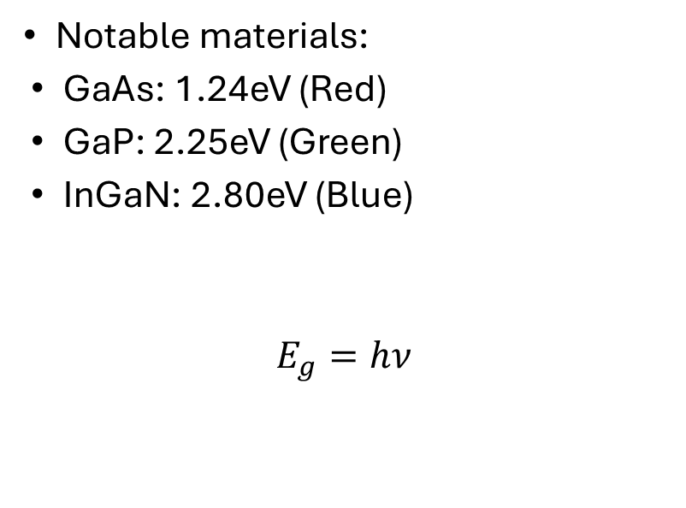
Semiconductor Color Correlation
Notable materials:
GaAs: 1.24eV (Red)
GaP: 2.25eV (Green)
InGaN: 2.80eV (Blue)
$$E_{g}=hν$$

Slide 17
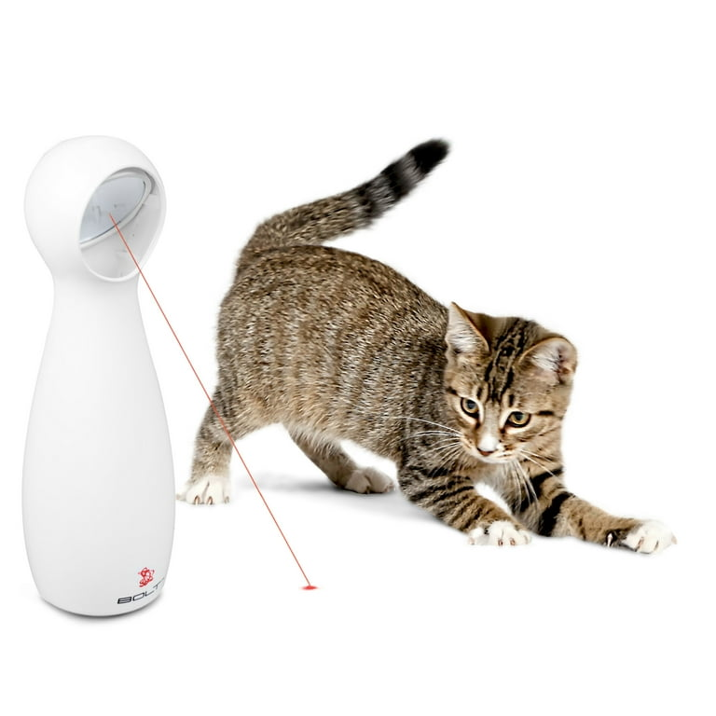
LASERs
Light Amplification by Stimulated Emission of Radiation
Complex design
High intensity
Coherent beam due to optical cavity

Slide 18
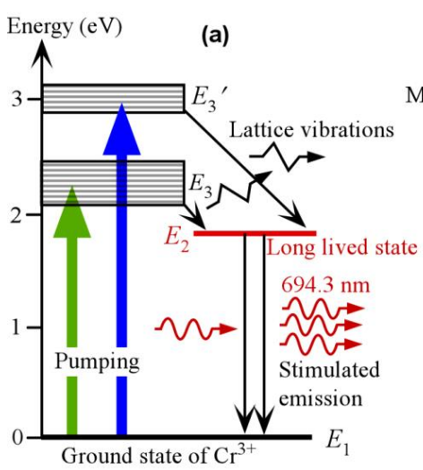
Lasers
electrons gets pumped to a high energy level and falls to a slightly lower level
3 Levels are necessary to avoid reabsorption and allow again
Incoming photons stimulates the electrons at that level to emit more photons
Notes:
Not true for all lasers, fix this

Slide 19
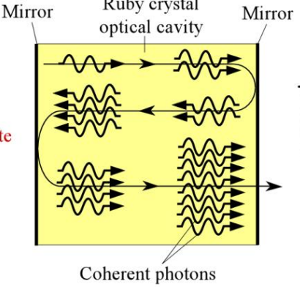
Lasers
The light is generated in an optical cavity
Photons build up in cavity, generating even more photons
Out of phase and frequency are reabsorbed, making coherent light
The Reflectance of the mirrors are nearly 100%
Notes:
Not true for all lasers, fix this

Slide 20
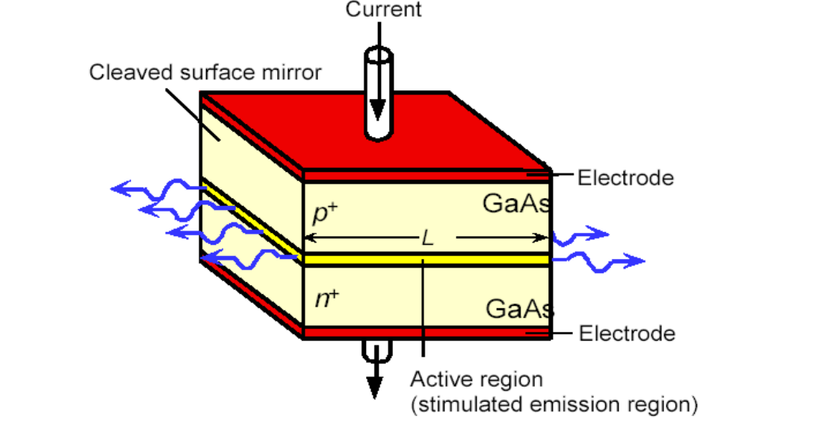
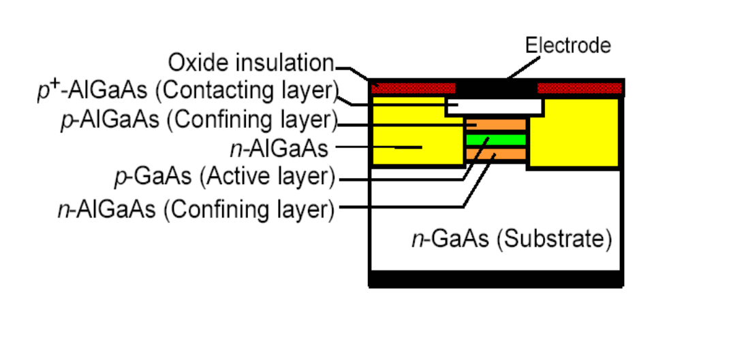
Laser Diodes
In laser diodes pumping is achieved via injection of carriers due to induced current
Semiconductors have a high reflective index and thus good reflectors
For similar reasons to LEDs, heterogenous structures provide more benefits

Slide 21
LEDs vs Laser Diodes
LEDs
Laser Diodes
Simple design
Low output intensity
Non-coherent light
Scattered beam
Low input current
Wider frequency spectrum
Complex Design
High output intensity
Coherent light
Directed beam
High input current
Narrower frequency spectrum

Slide 22
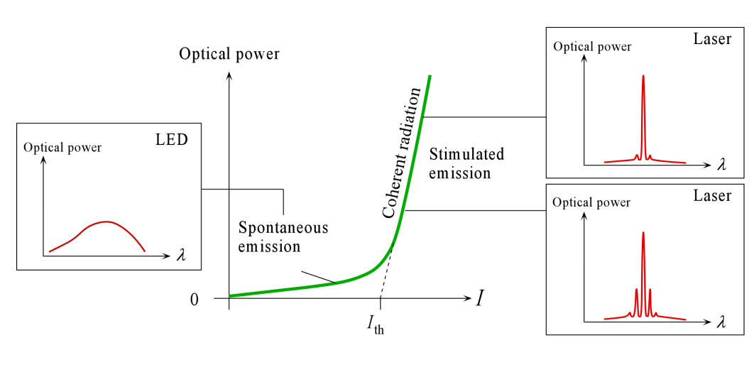
LEDs vs Lasers

Slide 23
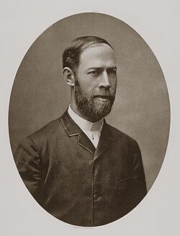
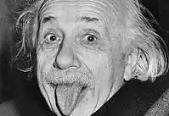
Photodiodes
Take in light and converts it into current
Photodiodes can act as (bad) LEDs
This is possible due to the photoelectric effect
  Photon hits a material and ionizes electron

Slide 24
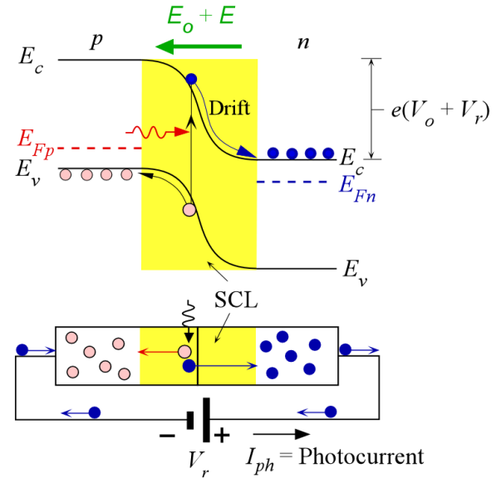
Photodiodes
Photodiode is placed in reverse bias, creating a large energy difference between p and n sides
Photons ionize material, creating free electron and hole
  Due to large energy difference, the carriers drift to respective sides, creating current

Slide 25
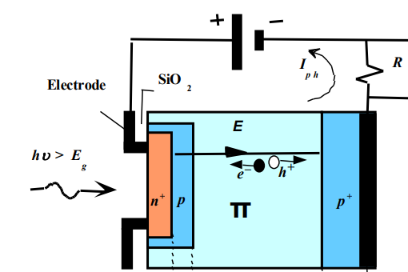
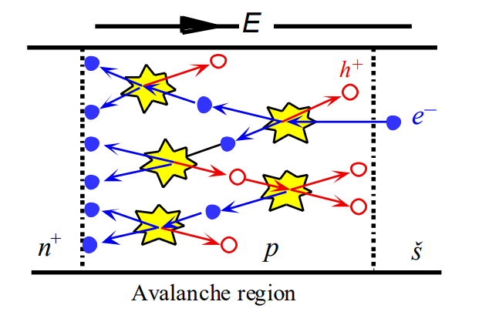
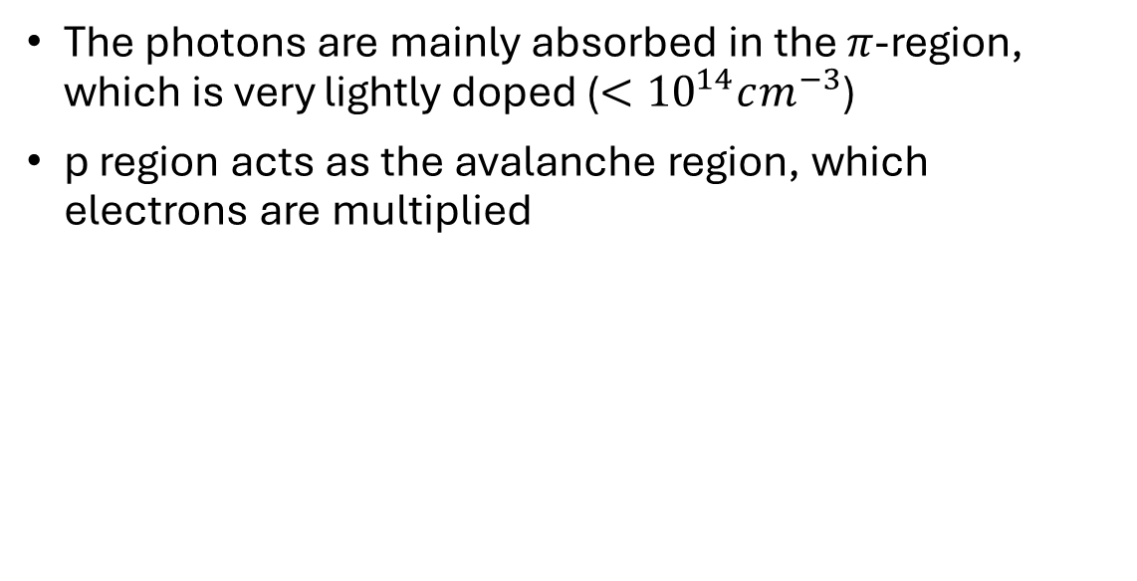
Avalanche Photodiode
The photons are mainly absorbed in the $π$-region, which is very lightly doped ($<{10}^{14}cm^{−3}$)
p region acts as the avalanche region, which electrons are multiplied

Slide 26
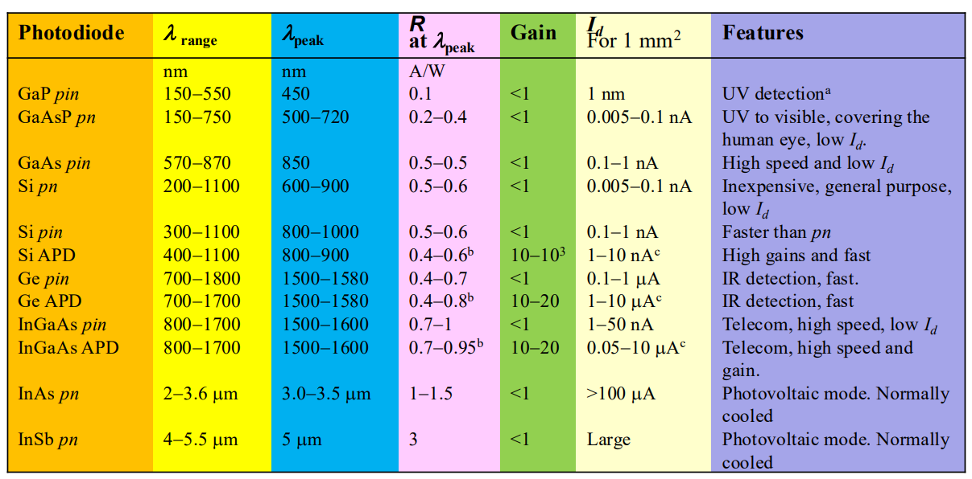
Photodiode materials

Slide 27
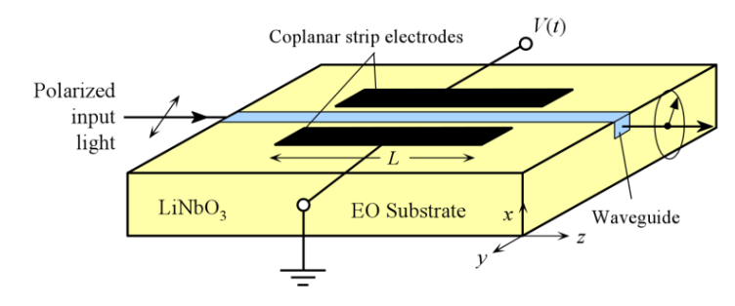
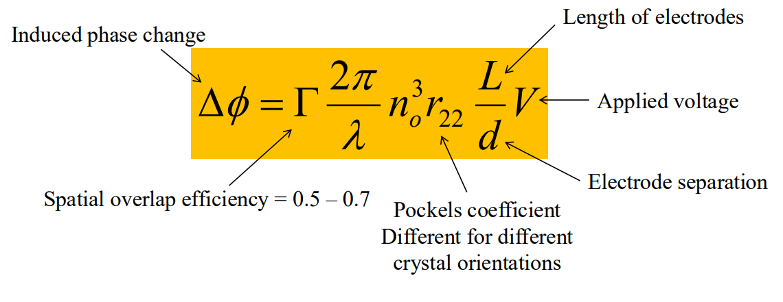
Optical Phase Modulator
Electro-Optic Effect
  Different materials change their refractive index in the presence of an electric field
A voltage signal can be used to encode a message onto a beam
  Like phase modulated radio!

Slide 28
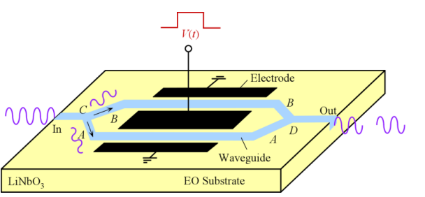
Mach-Zehnder Modulator
Takes advantage of out of phase photons to cancel out
Clear use in transmitting binary data

Slide 29


Why to Use Optoelectronics

Slide 30
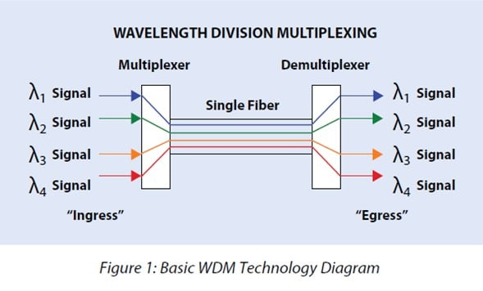
Benefits of Optoelectronics
Allows for multiplexing of multiple channels by using different colors
  Don’t have to deal with different interfering signals or characteristic impedance
  Allows for transfer of much more data via a single fiber strand

Slide 31
Benefits of Optoelectronics
No electromagnetic interference
  Photons do no create any extra E&M interference
  This allows designs to be smaller
  Relevant in small traces
Low power loses
  Allows cables to be much smaller compared to electrical counterpart at long distance

Slide 32
Applications of Optoelectronic Devices

Slide 33
How are Optoelectronic Devices Being Used?
Fiber-Optic Communication
Integrated Photonics
LiDAR

Slide 34
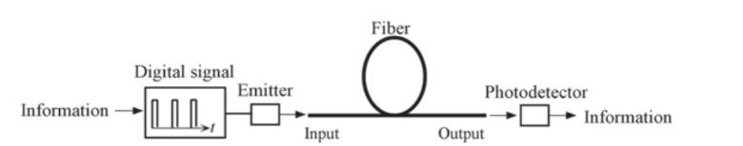
Fiber-Optic Communication
Information is encoded by a laser onto a fiber-optic waveguide over a long distance and detected via a photodiode
Loses over distance are much lower compared to copper
  Fiber-optic: 0.0002 – 0.003 dB/m
  Copper: 0.2 – 40 dB/m
Fiber-optic is more expensive up front

Slide 35
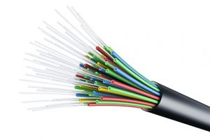
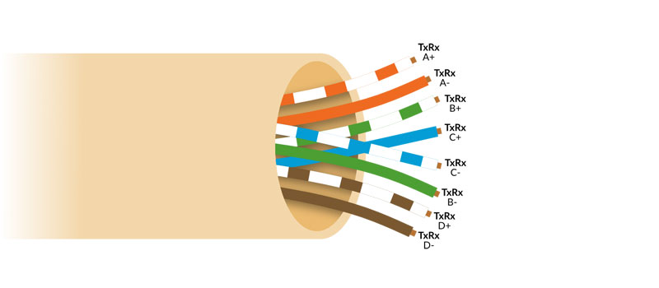
Fiber-Optic Communication
Optic fibers are much smaller compared to copper cables
  Fiber-Optic: 250 microns thick
  Copper: 8 mm thick
Smaller size allows fiber cables to contain more strands compared to ethernet

Slide 36
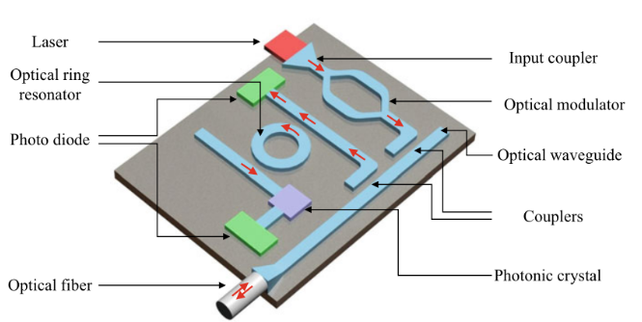
Integrated Photonics
Waveguides and modulated can be used within chips to perform calculations
Optical modulator can be used to “program” functions using light
  By altering phase and amplitude

Slide 37
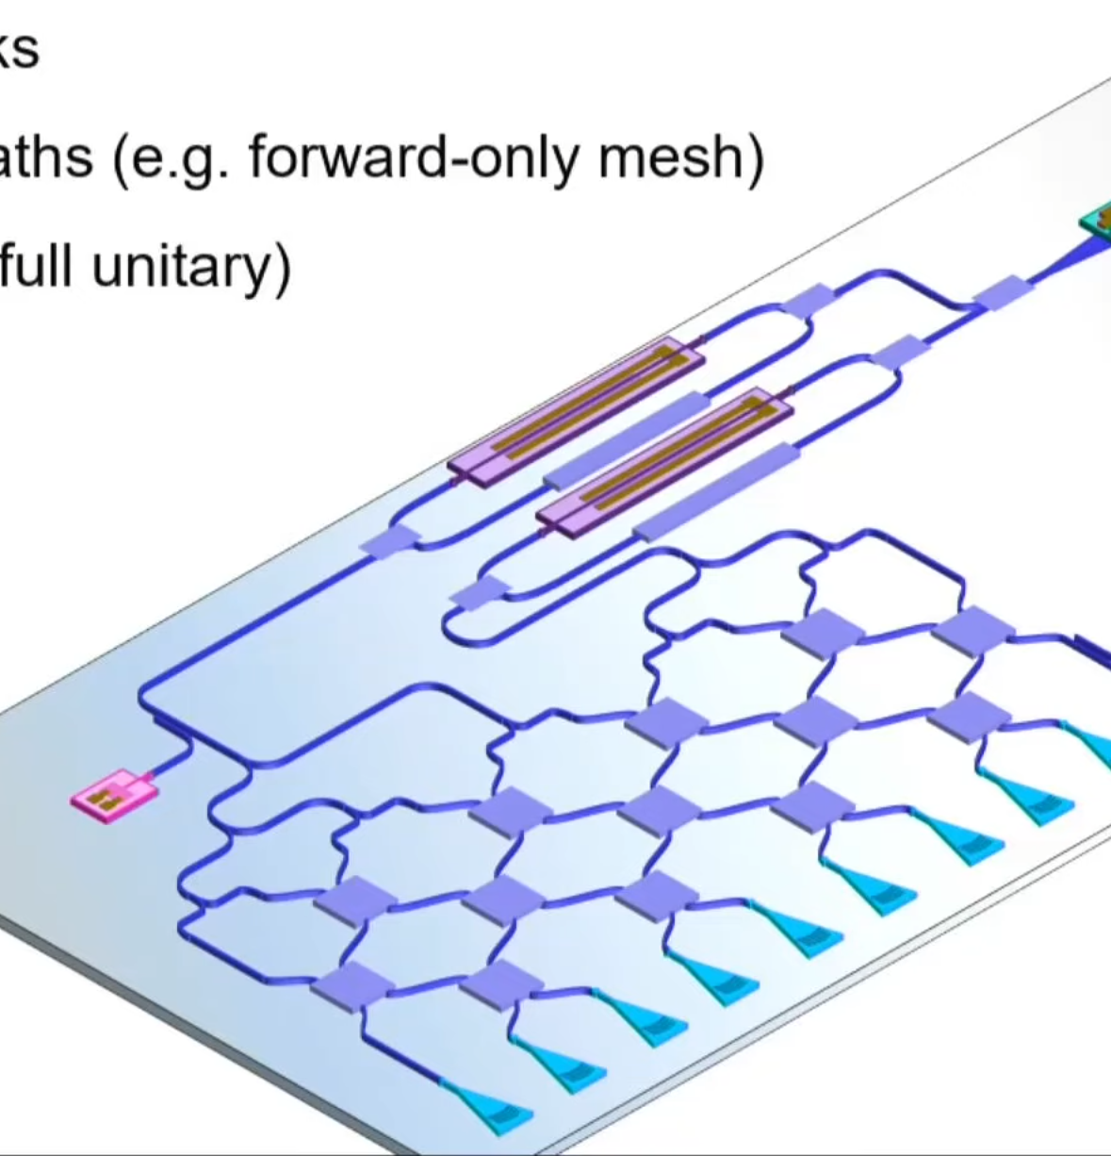
Programmable Photonics Chips
The mesh of Mach-Zehnder Interferometers manipulate can be programmed to perform a specific operation
Perfect for performing matrix operations at light speed
  Interference patterns represent elements in matrix multiplication
  Parallel computing
  Used in neuromorphic computing

Slide 38
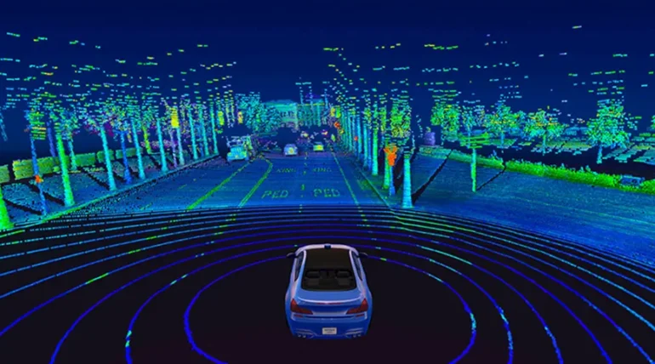
LiDAR
Very similar to Radar, but uses light instead of radio waves
Light is shot out from lasers thousand times a second, and photodiodes are used to detect when they bounce back
Math is used to find the distance from the source and target based off return time

Slide 39
Conclusion
Many optoelectronics take advantage of photon emission and absorption in bandgaps to generate and read light
Optoelectronics provide more efficient and low power solutions to popular issues, although with added complexity and up-front costs

Slide 40


Thank you for Listening

