Slide 1
Microelectromechanical Systems (MEMS)
David King

Slide 2
Agenda
History and Evolution of MEMS Devices
Basic Operating Theory
Fabrication Process
Trends and Future Prospects

Slide 3
History

Slide 4
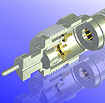
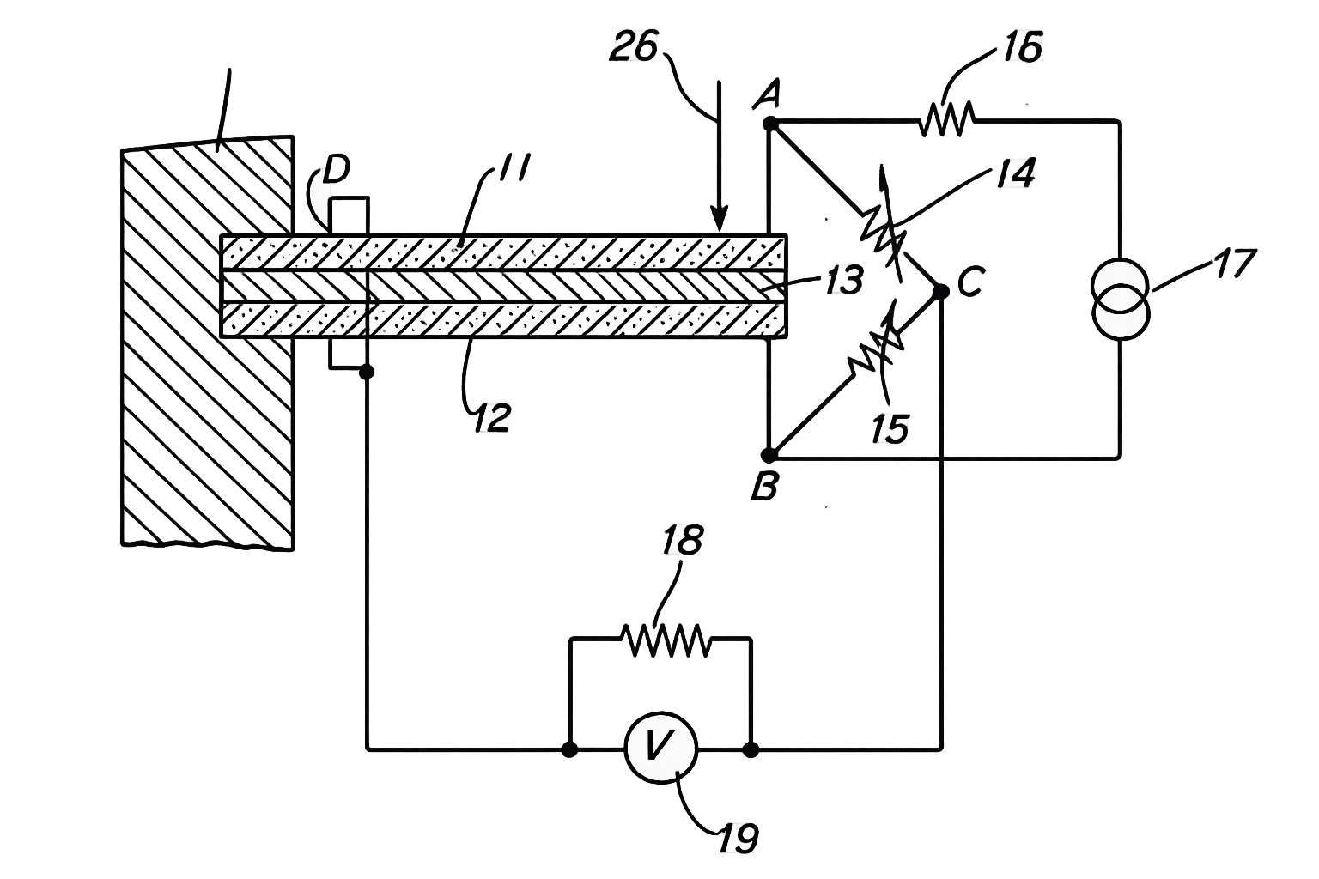
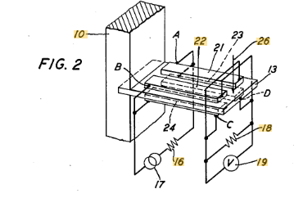
1950s: Piezoresistive Sensors Emerge
1954: Bell Labs develops first silicon/germanium piezoresistive strain gauge, enabling semiconductor sensing,
1958: Kulite becomes first licensee of Bell labs’ patent, releasing first commercially offered silicon strain gauges.
  First application was in jet engine testing and wind tunnel testing for high frequency pressure testing
Notes:
US2939317A — “Variable resistance semiconductive devices”
Filed: Oct 31, 1955
Published: Jun 7, 1960
Inventor: Warren P. Mason
Original assignee: Bell Telephone Laboratories Inc.
US2963911A — “Piezoresistive accelerometer”
Filed / Prior art date: Feb 18, 1959
Published: Dec 13, 1960
Inventors: Jeofry S. Courtney-Pratt and Warren P. Mason
Original assignee: Bell Telephone Laboratories Inc.
US3034345A — “Gauges using piezoresistive elements” (temperature-compensated bridge-based gauge circuits)
Filed: May 19, 1959
Published: May 15, 1962
Inventor: Warren P. Mason
Original assignee: Bell Telephone Laboratories Inc.

Slide 5
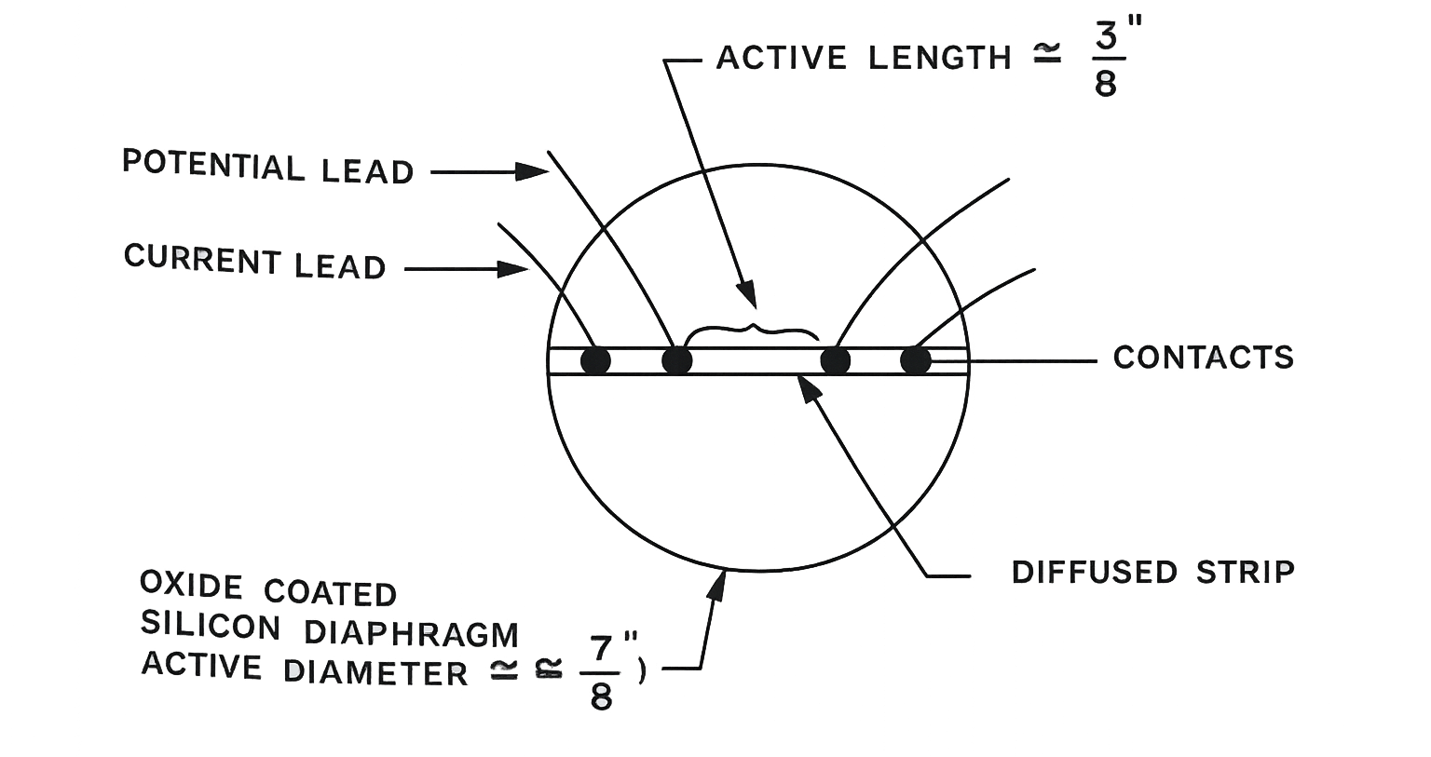
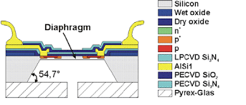
1962: First Homogeneous Silicon Pressure Sensor
First monolithic (homogeneous) silicon pressure sensor
Piezoresistive strain gauges formed by impurity diffusion directly into single-crystal silicon
No bonded gauges → sensing element and mechanical diaphragm are the same material

Slide 6
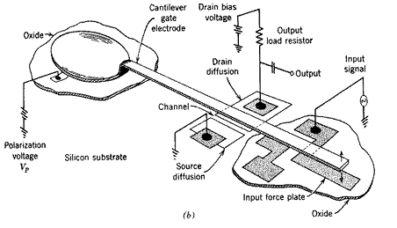
1964: The Resonant Gate Transistor
A MOS transistor with a mechanically resonant gate.
Considered first MEMS device by most standards, as it was the first to be surface micromachined.
Marks the transition from passive silicon sensors to active microelectromechanical systems.

Slide 7
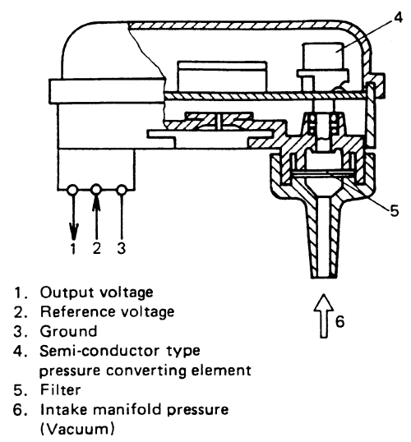
1970s: Automotive Breakthrough
Silicon micromachined/piezoresistive pressure sensing matured from low-volume instrumentation into high-volume automotive
A wave of dedicated sensor companies, IC Transducers / Foxboro ICT, Transensory Devices, IC Sensors, NovaSensor (and peers) built product lines and manufacturing aimed specifically at automotive OEM requirements
Most successful automotive application: Engine-control pressure sensing, especially MAP (manifold absolute pressure), became the first major high-volume “killer app,”

Slide 8
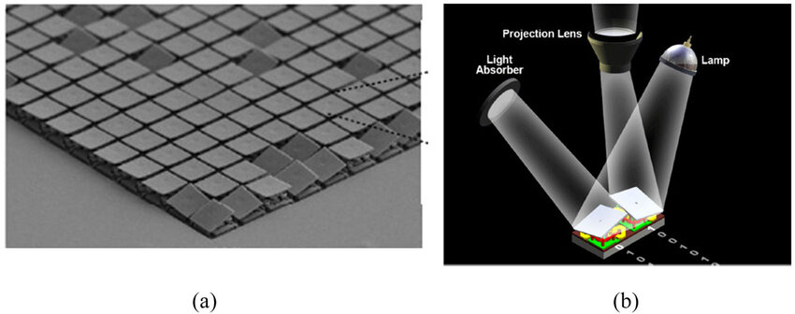
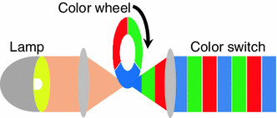
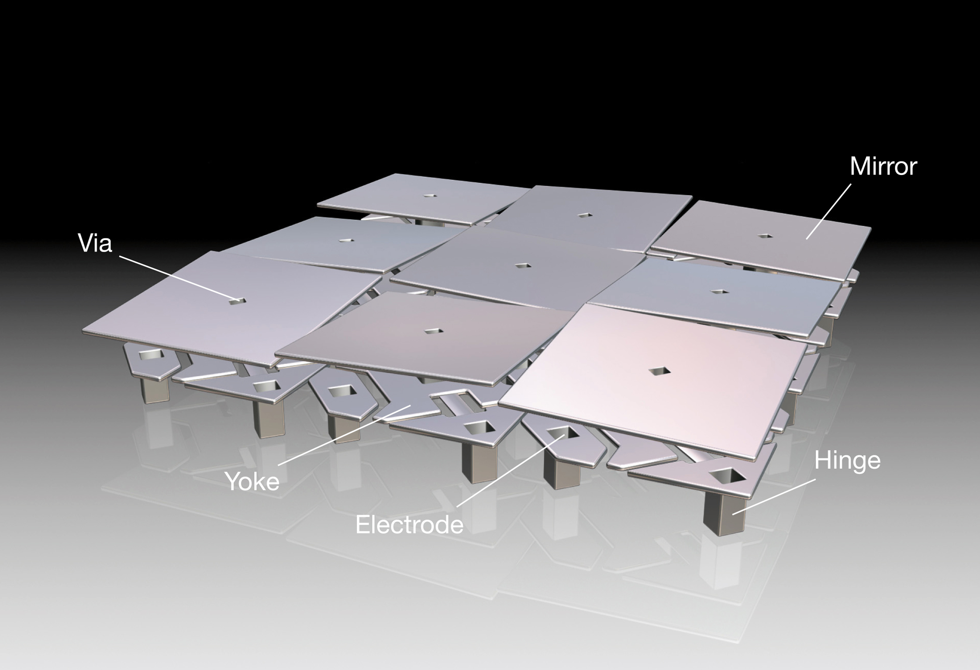
1980s: DLP Technology Created
Surface micromachining matures as a standard approach: building released structures from deposited thin films (polysilicon, oxides/nitrides).
1987: TI creates the first Digital Micromirror Device (DMD) prototype (MOEMS/MEMS optics).

Slide 9
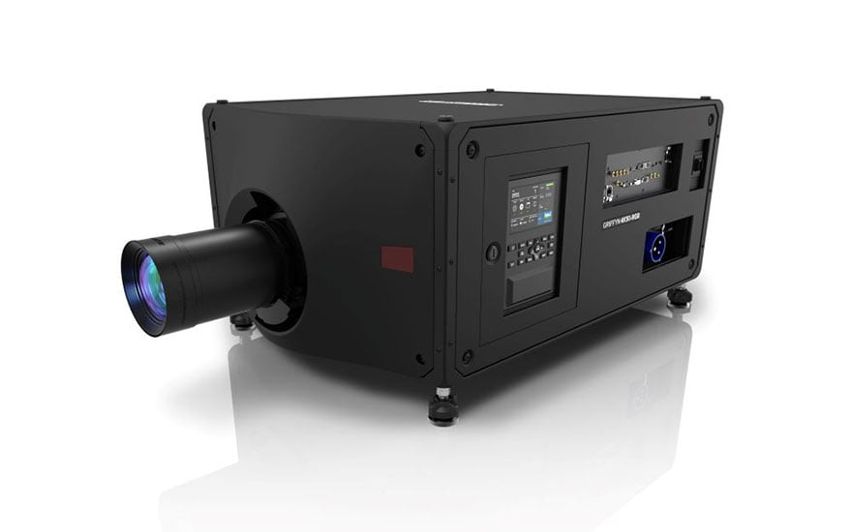
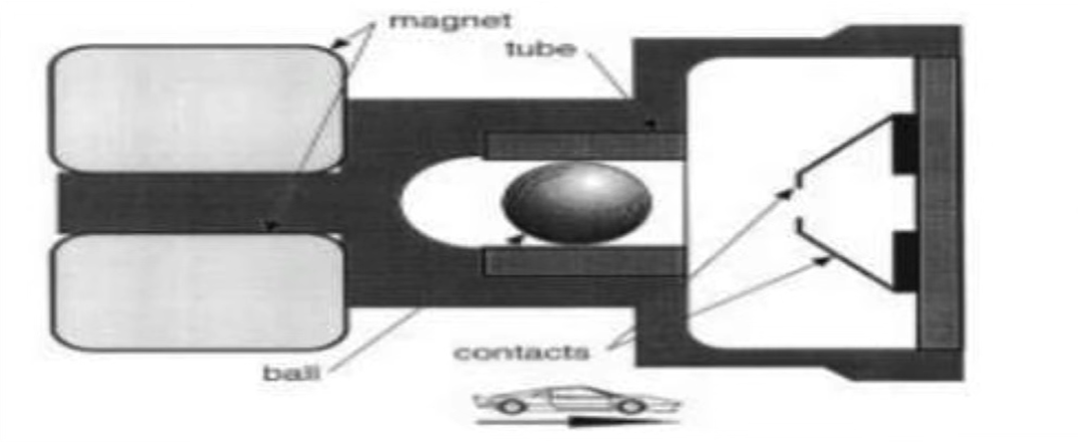
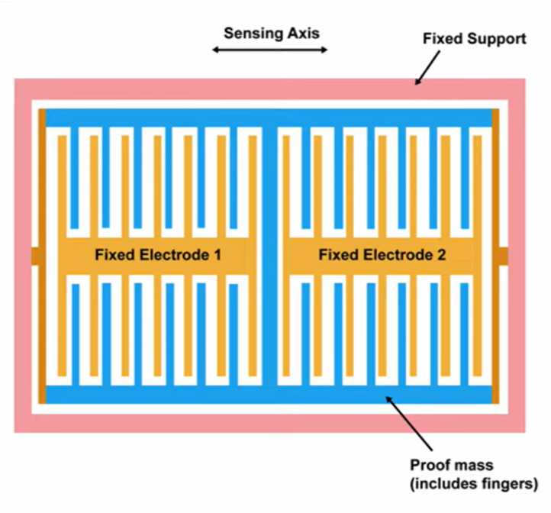
1990s
1991–1992 (commercial): TI delivers a DMD line array for the first commercial DMD product; shipments to customers start in 1992.
1991 (commercial): Analog Devices ADXL50 released; widely cited as the first successfully commercialized MEMS accelerometer product.
1993 (process milestone): DRIE introduced (Bosch process), a major enabler for high-aspect-ratio silicon MEMS structures.

Slide 10
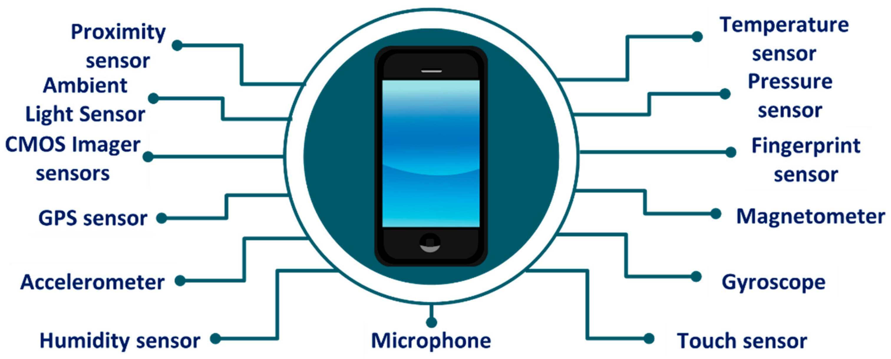
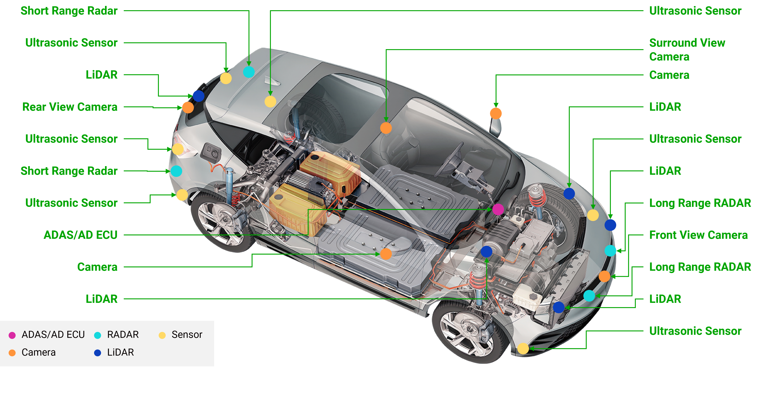
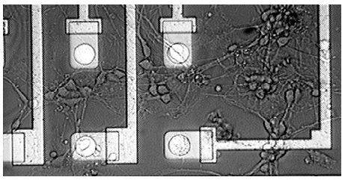
2000s
High-volume consumer MEMS continues to scale, led by IMUs, microphones, and pressure sensors
Wafer-level packaging (WLP) enables low cost, small form factor, and high throughput
Multi-sensor MEMS modules increasingly replace single-sensor components

Slide 11
Basic Theory and Operation

Slide 12
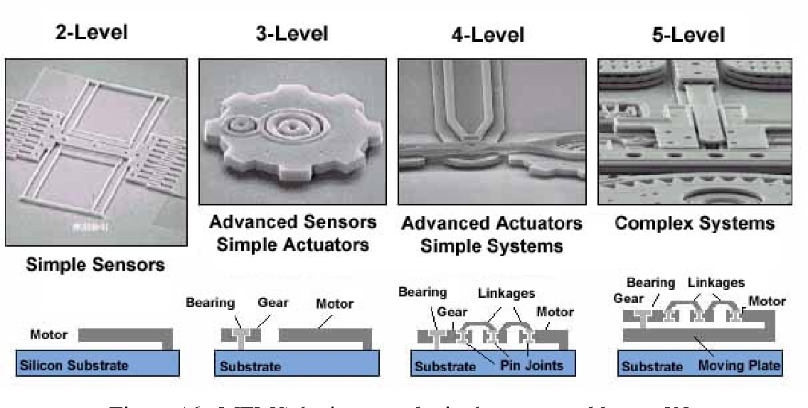
Basic Operating Principle of MEMS
MEMS interface the physical world with electronics
Physical stimulus → mechanical response → electrical signal
Operation governed by scaling laws at the microscale
Same physics as macrosystems, different dominant forces

Slide 13
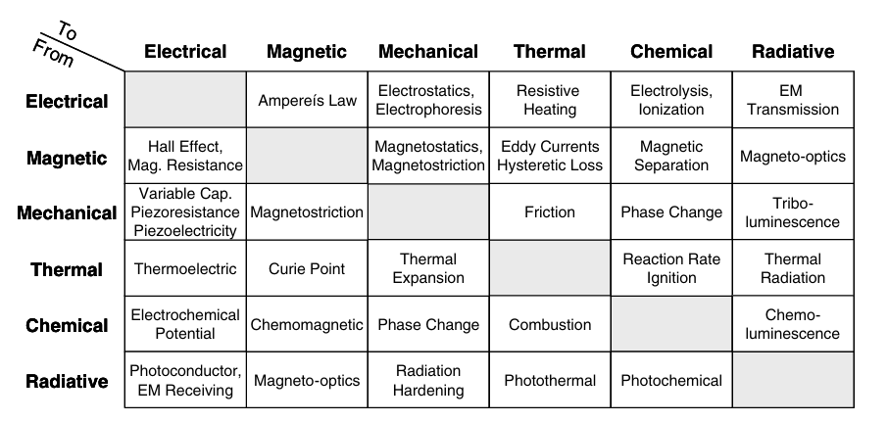
Energy Domains in MEMS
Electrical
Mechanical
Thermal
Magnetic
Chemical
Radiative (optical)
MEMS operate by coupling energy domains

Slide 14
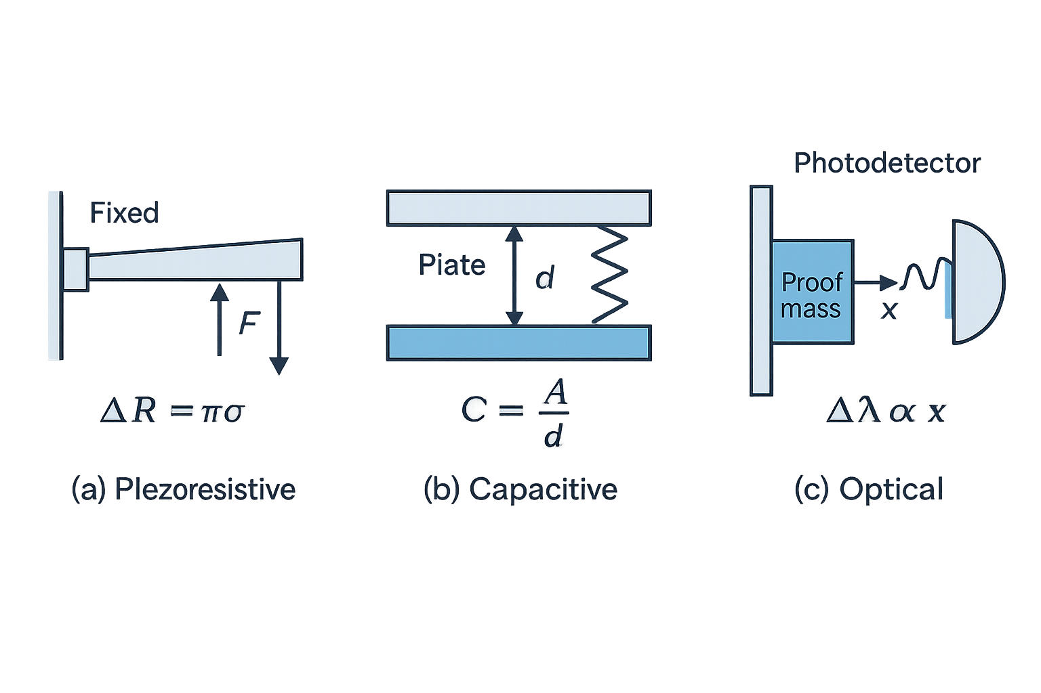
Transduction
Transduction: conversion between energy forms
Sensors: physical → electrical
Actuators: electrical → physical
Often multiple transduction steps in series

Slide 15
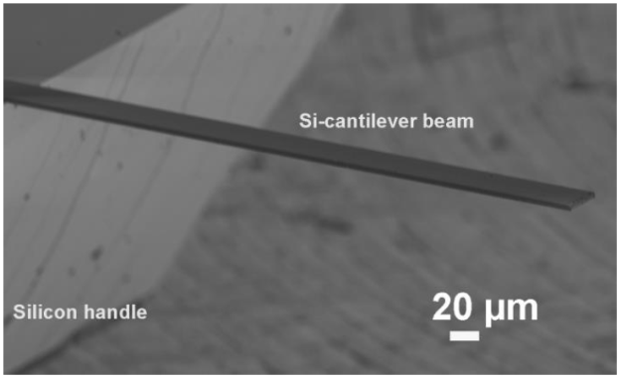
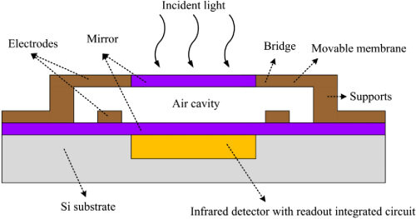
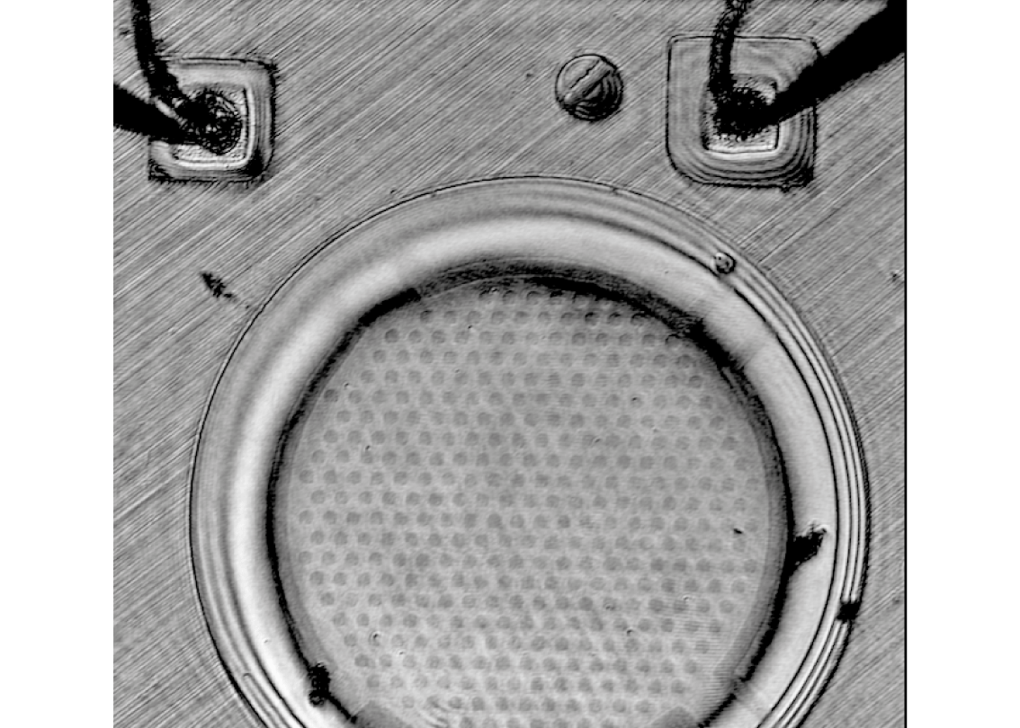
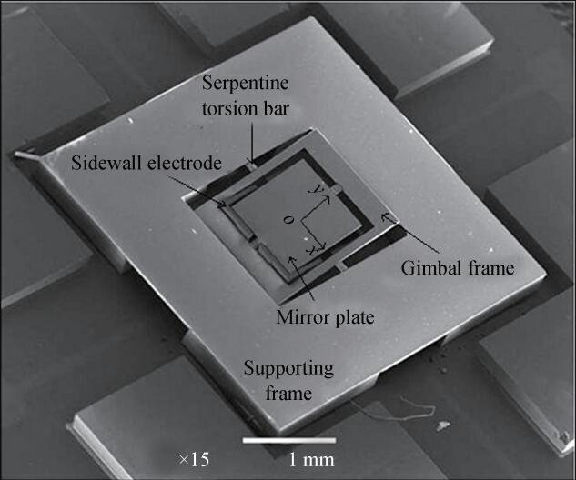
Mechanical Elements in MEMS
Cantilevers
Bridges
Plates
Membranes
Torsion bars
Proof masses
Mechanical motion typically:
  Microns or less
  Elastic (not plastic)

Slide 16




Scaling Effects (Why MEMS Behave Differently)
Mass scales with volume (∝ L³)
Stiffness scales with length (∝ L)
Inertial forces drop rapidly with size
Surface forces dominate over body forces

Slide 17
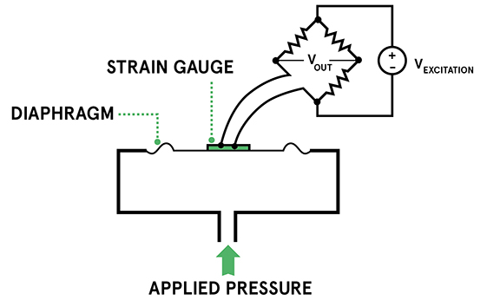
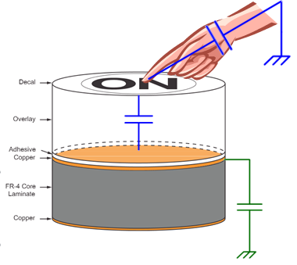
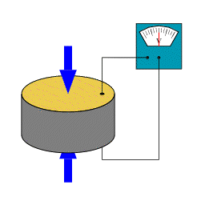
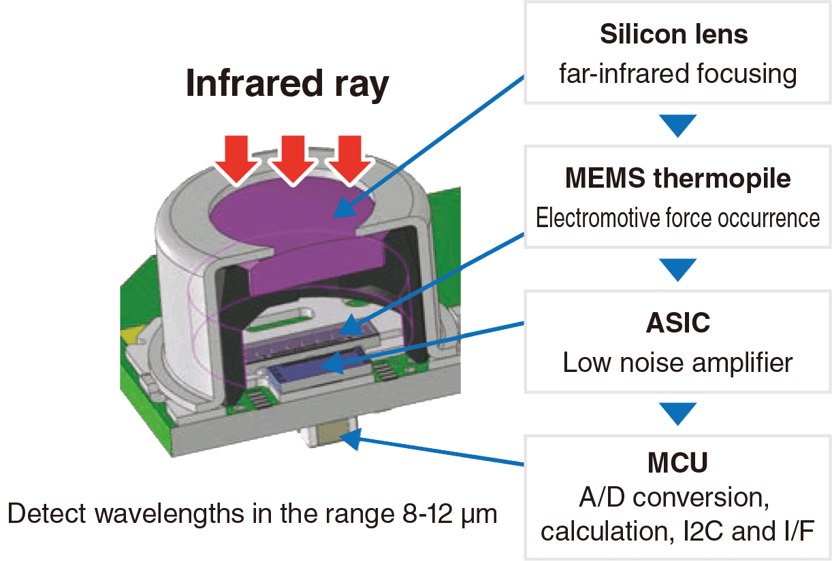
Common Sensing Mechanisms
Piezoresistive: stress → resistance change
Capacitive: displacement → capacitance change
Piezoelectric: stress → charge generation
Thermal: temperature → resistance/voltage change

Slide 18
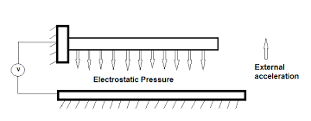
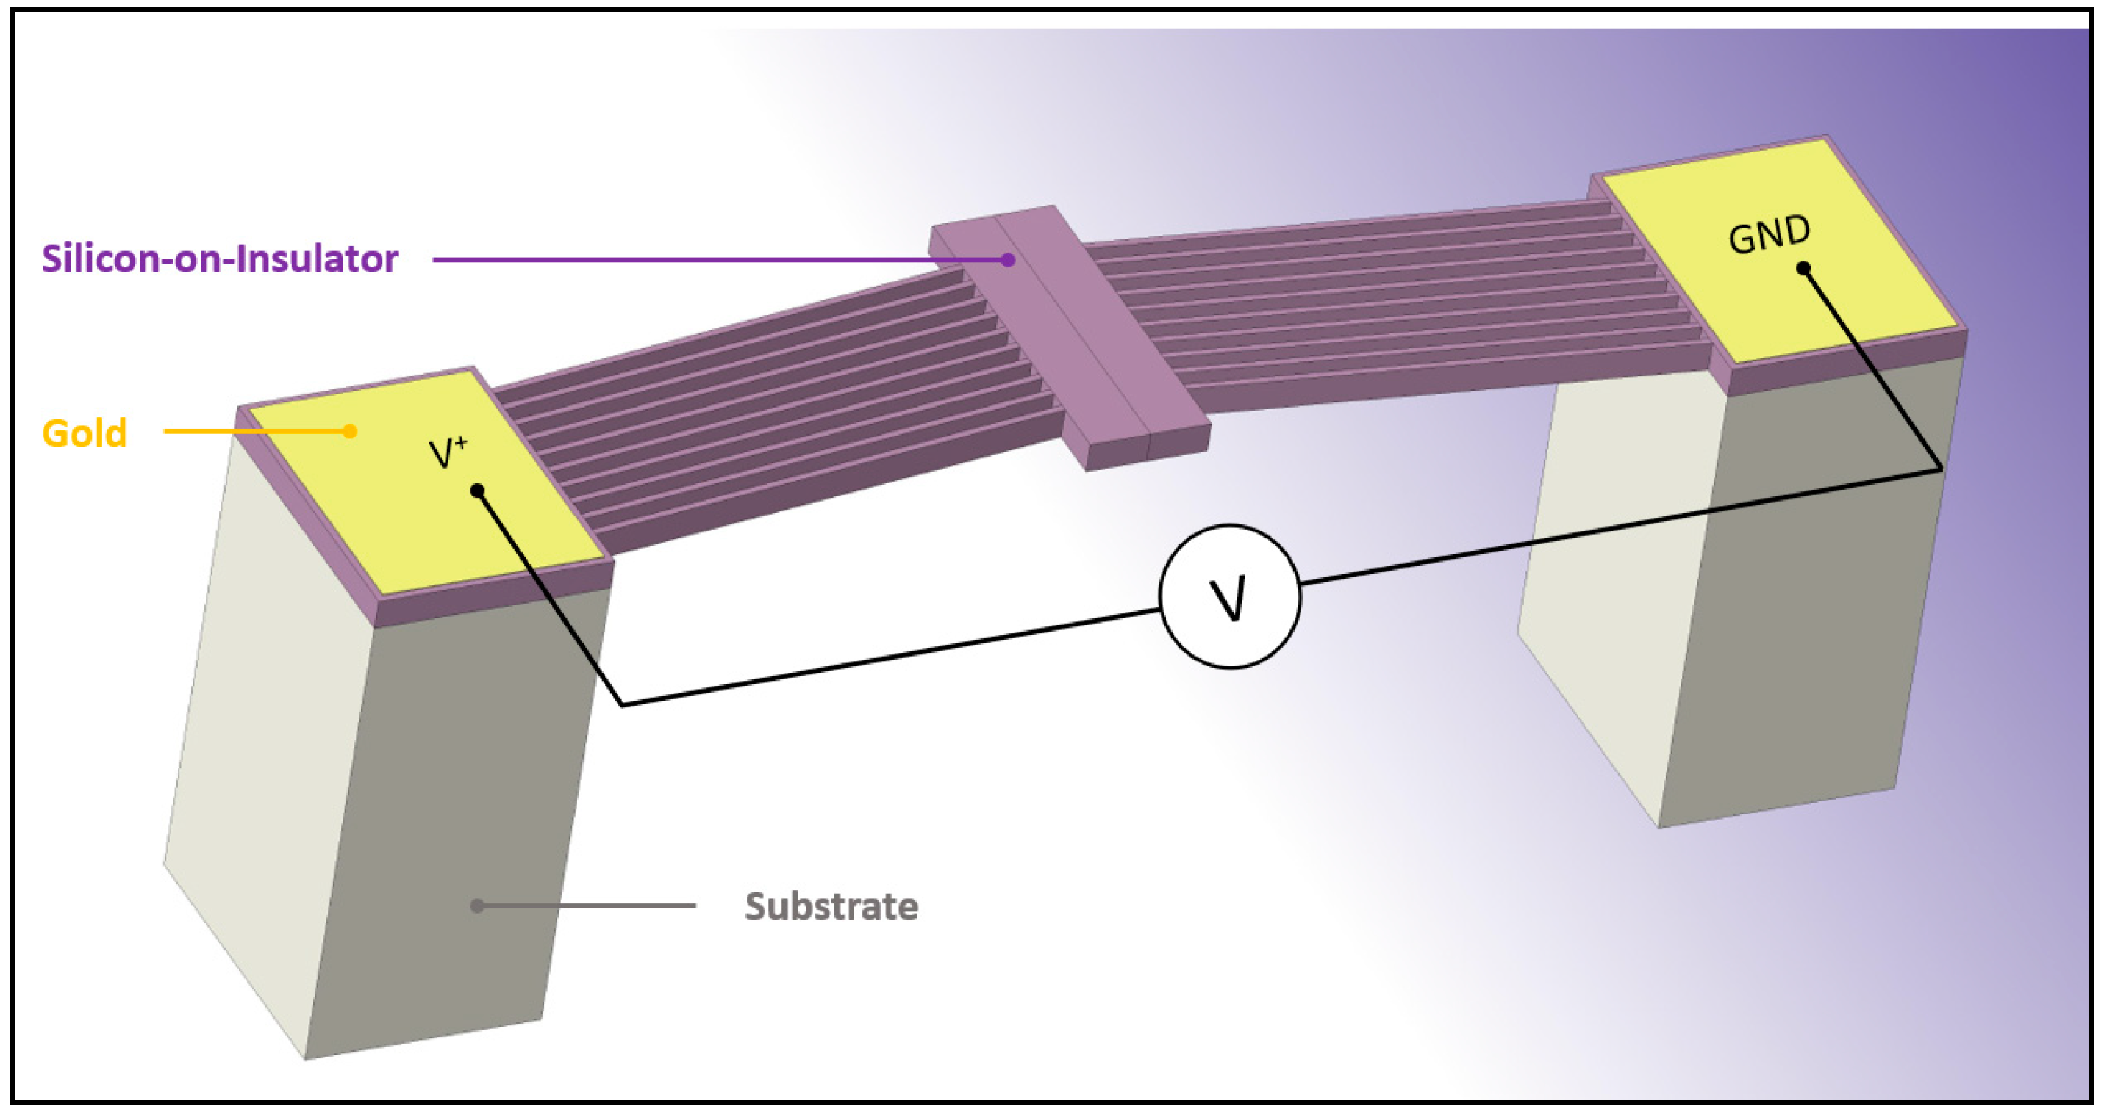
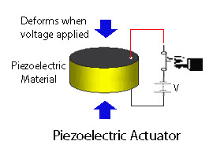
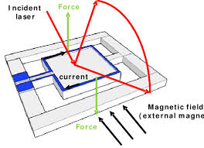
Common Actuating Mechanisms
Electrostatic
Electrothermal
Piezoelectric
Magnetic
Choice driven by:
  Force
  Displacement
  Power
  Environment

Slide 19
Fabrication Process

Slide 20
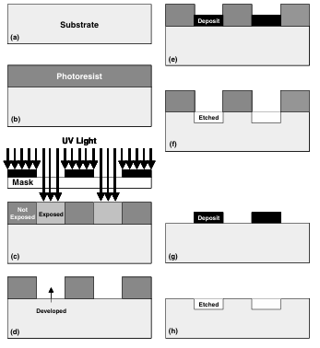
Traditional IC Fabrication (FEOL)
MEMS inherit:
  Photolithography
  Thin-film deposition
  Etching processes
MEMS extend IC processes to:
  Create movable structures
  Enable 3D geometries
  Fabrication often diverges from strict CMOS rules

Slide 21
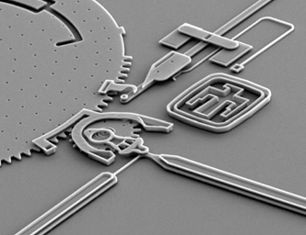
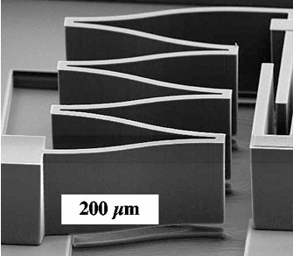
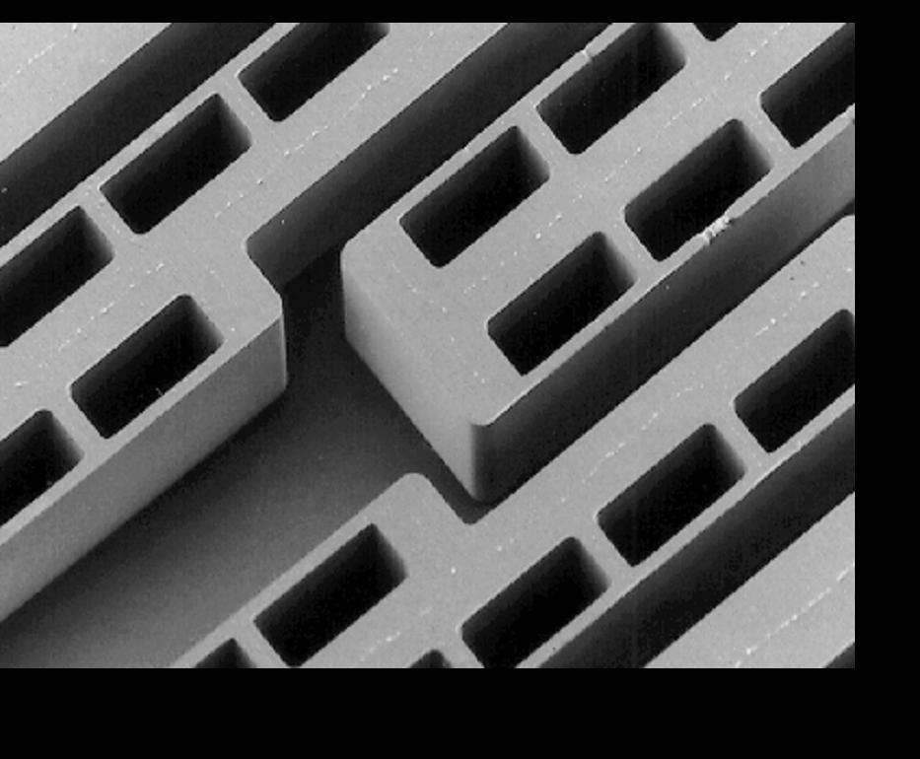
MEMS Specific Fabrication Process’
Surface Micromachining
Bulk Micromachining
LIGA
Low Aspect Ratio
High Aspect Ratio

Slide 22
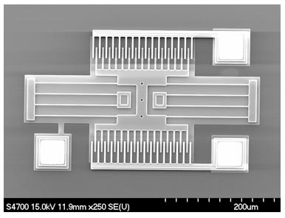
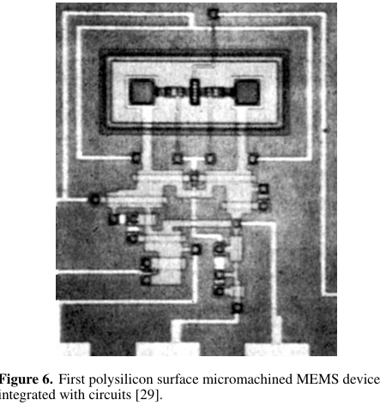
Surface Micromachining
Structures formed from deposited films
Typical thickness: 0.1–5 µm
Excellent planarity and alignment
Limited out-of-plane thickness
Well suited for monolithic integration

Slide 23
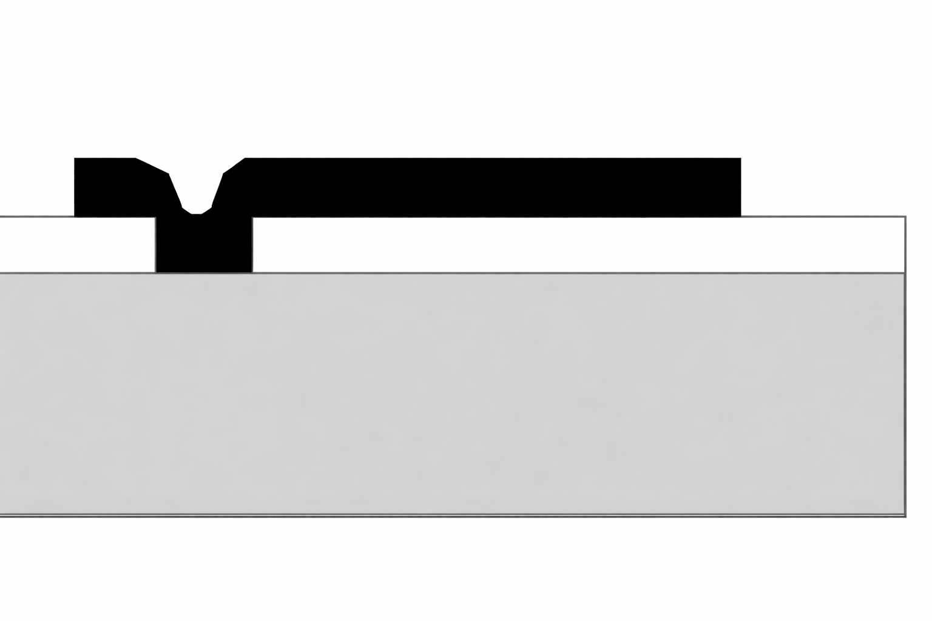
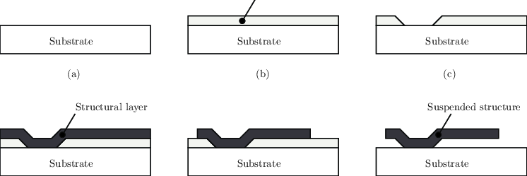
Surface Micromachining Process
The image depicts a microcantilever.
Anchor
Structural Layer
Sacrificial Layer
Substrate

Slide 24
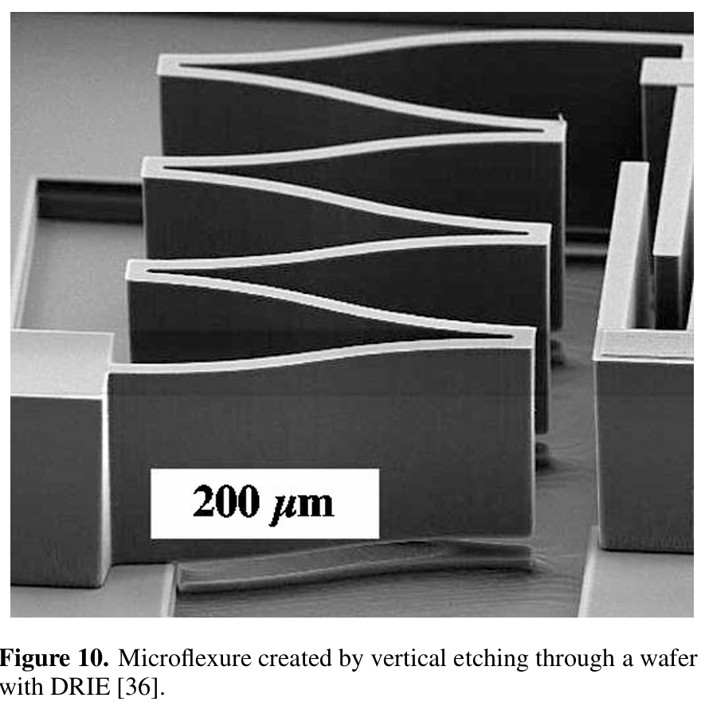
Bulk Micromachining
Structures formed from single-crystal silicon
Typical thickness: 10–500+ µm
High stiffness and mechanical strength
Natural 3D geometries
Substrate is a functional element

Slide 25
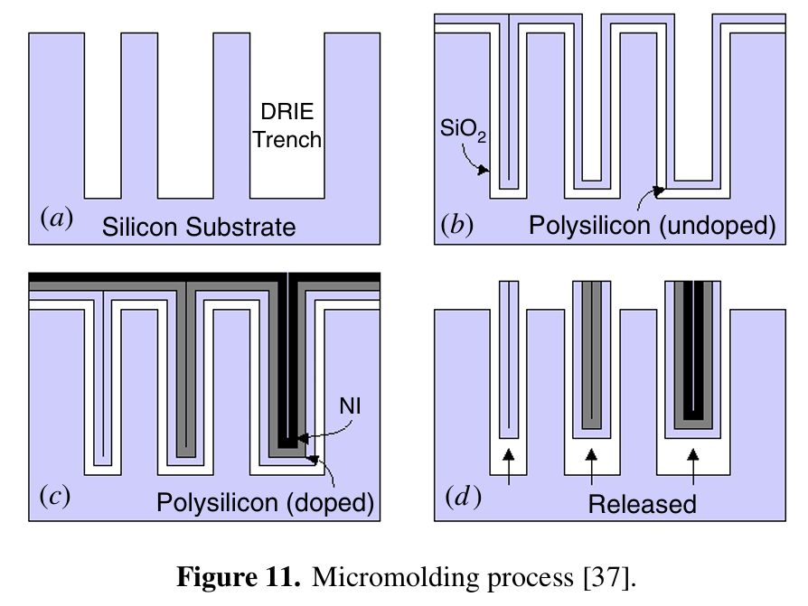
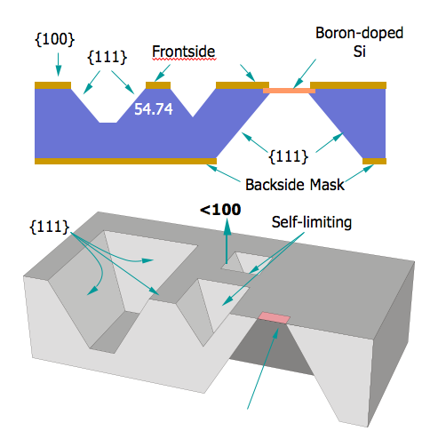
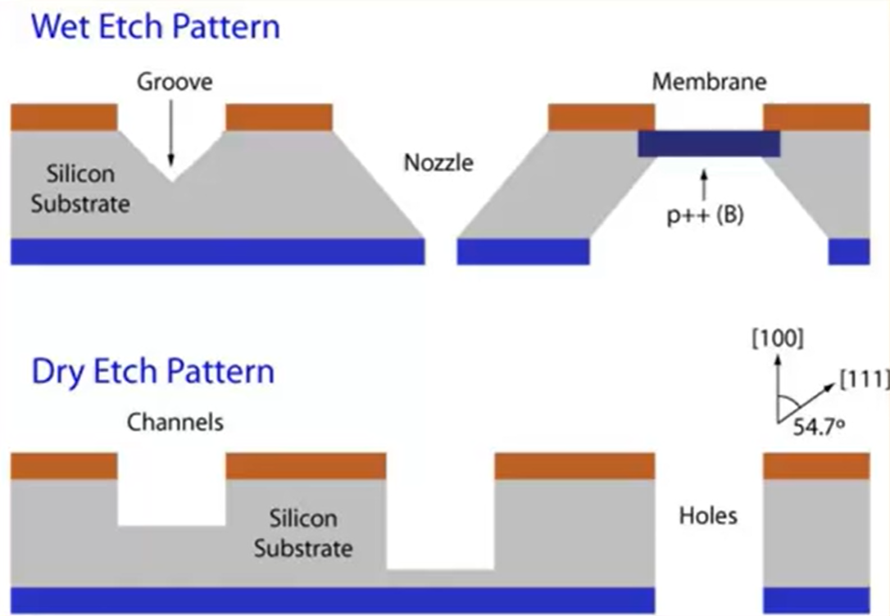
Bulk Micromachining Process
Pattern mask on silicon substrate
Remove substrate material via:
  Anisotropic wet etching
  DRIE (deep reactive ion etching)
Remaining silicon becomes structure

Slide 26
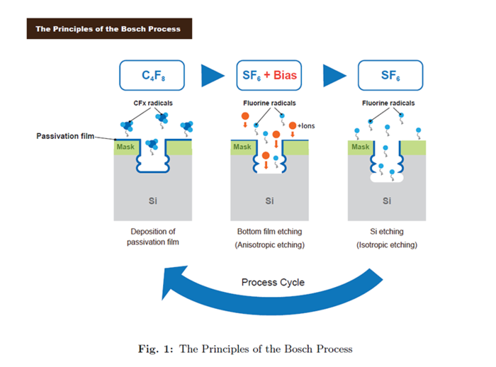
Deep Reactive-Ion Etch (Bosch Process)
Alternating etch/passivation cycles
Enables vertical sidewalls
Aspect ratios: 20:1 to >50:1
Crystallography-independent
Major enabler of modern bulk MEMS

Slide 27
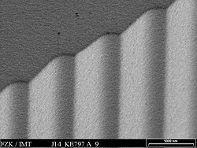
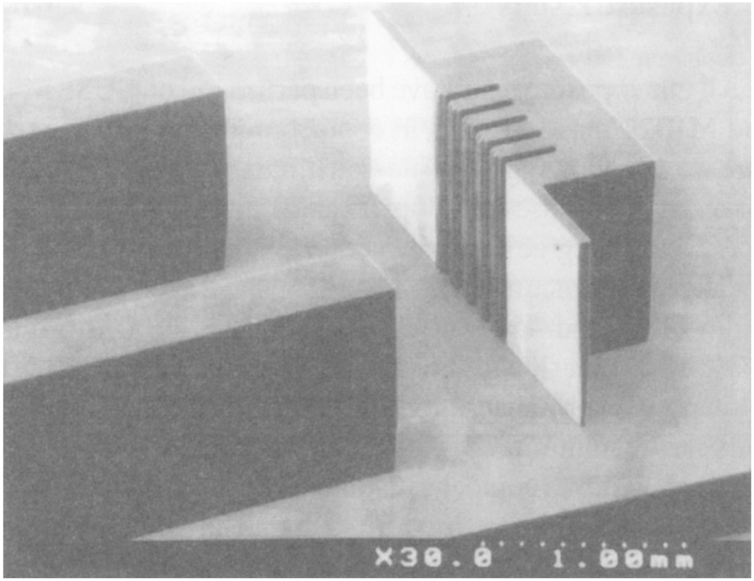
Lithographie Galvanoformung and Abformung (LIGA)
Thick resist patterned via:
  X-ray lithography (LIGA)
  UV lithography (SU-8)
Structures formed by electroplating or molding
Enables extreme aspect ratios
Limited CMOS compatibility

Slide 28
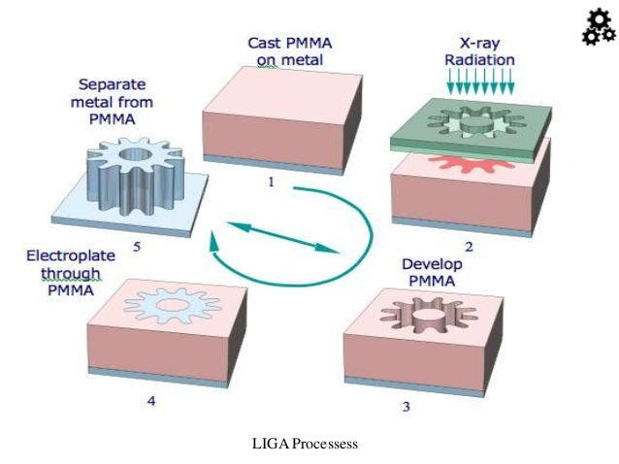
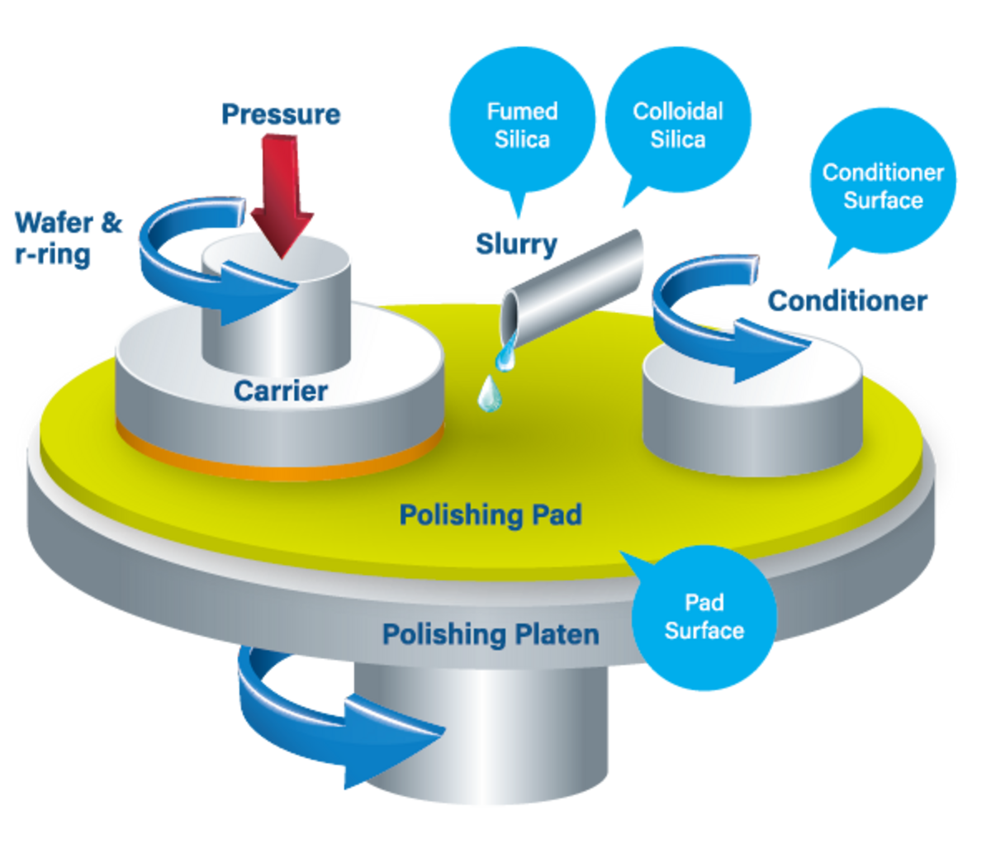
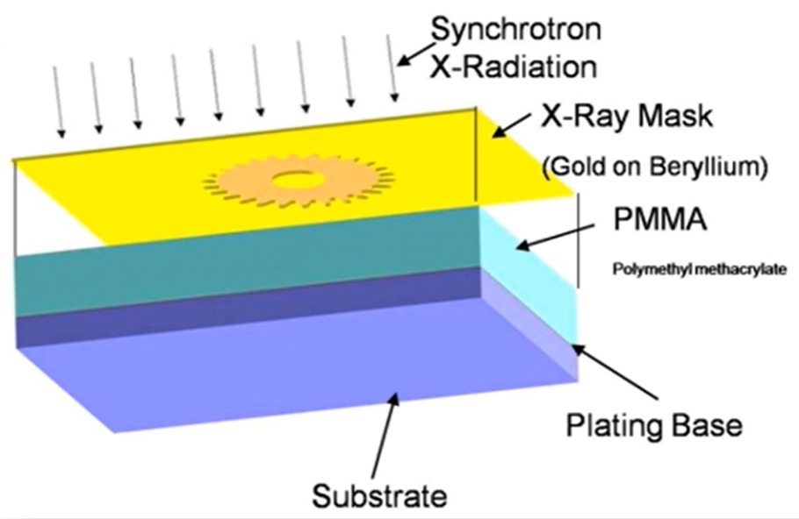
LIGA Process
Cast PMMA on metal substrate
X-ray exposure through mask
Develop PMMA to form deep mold
Electroplate metal into mold
Remove PMMA → freestanding metal structures

Slide 29
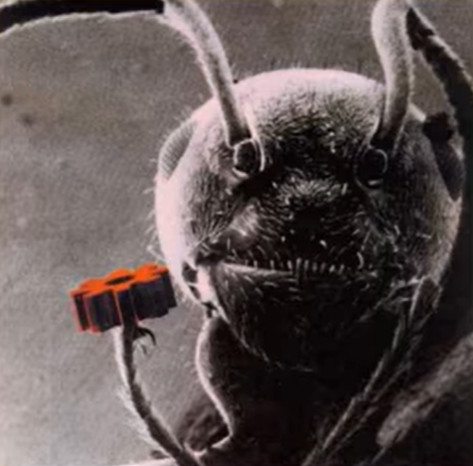
LIGA Gear with Ant

Slide 30
Trends and Future Prospects

Slide 31


Heterogeneous Integration
Integration of dissimilar technologies MEMS, CMOS logic, RF, photonics, power, and memory into a single package or module
Benefits:
  Smaller footprint, lower power, higher performance
  Improved signal integrity and reduced parasitics
  Faster time-to-market vs. full monolithic integration

Slide 32

AI Focused Architecture
Raw MEMS data volume exceeds what off-chip processing can handle efficiently
Latency, power, and bandwidth dominate system constraints
Intelligence moves closer to the sensor
Architectural shift:
  Traditional: MEMS → ADC → MCU → cloud
  Emerging: MEMS → on-sensor preprocessing → inference → event output

Slide 33


A few words from distinguished research man from industry

Slide 34

This is a massive problem

Slide 35

But what does the data say?

Slide 36


Further supporting evidence

Slide 37

Back to David!

Slide 38
That is all!
Thank you!

