Slide 1

Lithography & Patterning
Evan Chen

Slide 2
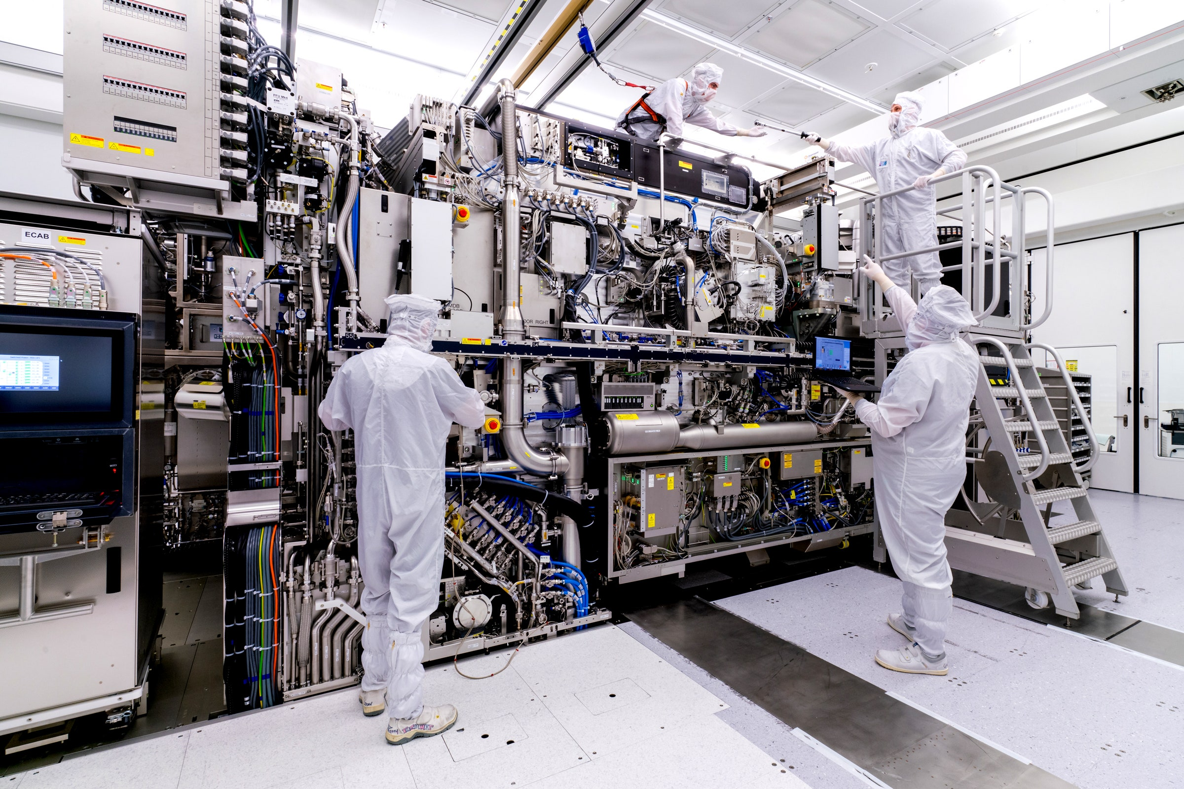
Overview
Review of Fabrication Techniques
Lithography Over the years
Lithography Types & Settings
Physics Behind Lithography
Future State of Lithography

Slide 3
What is Lithography? Why is Lithography? (How is Lithography?)
Let’s say you wanted to build a full adder out of transistors

Slide 4
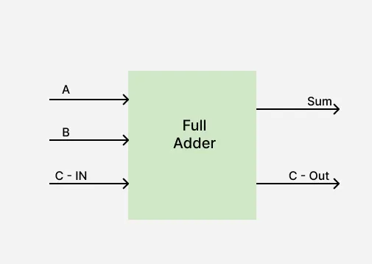
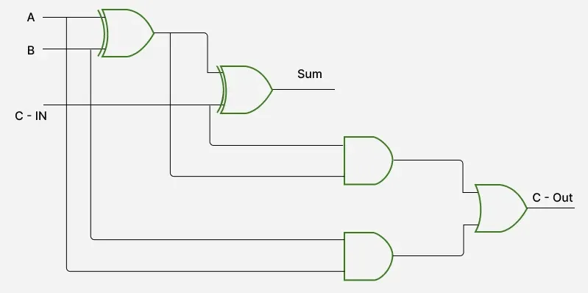
What is Lithography? Why is Lithography? (How is Lithography?)

Slide 5
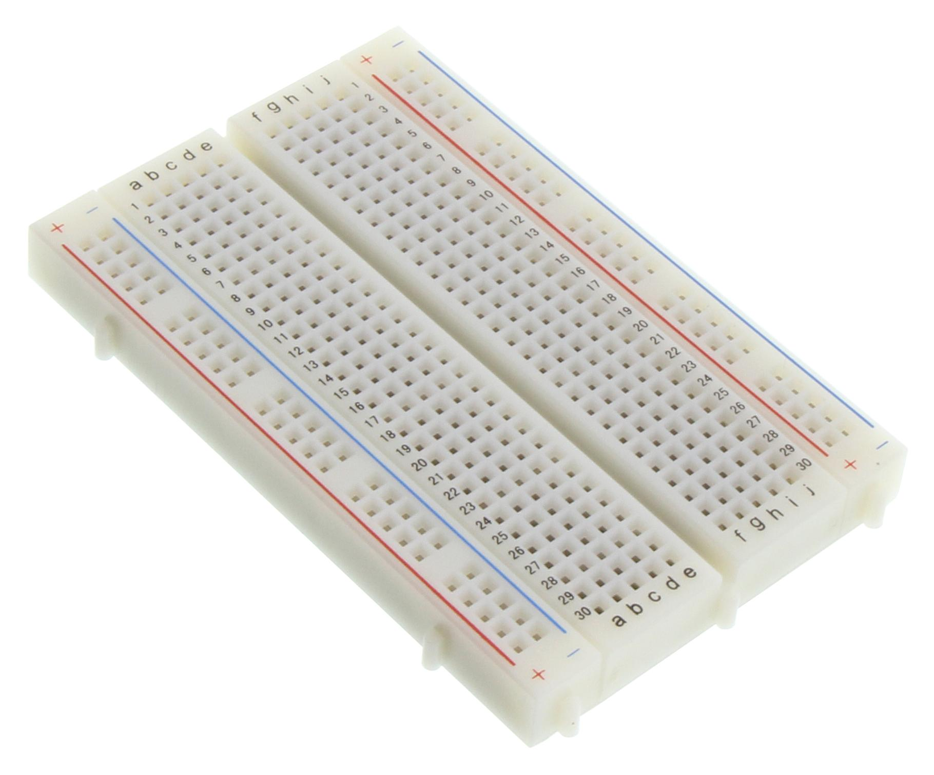
What is Lithography? Why is Lithography? (How is Lithography?)

Slide 6
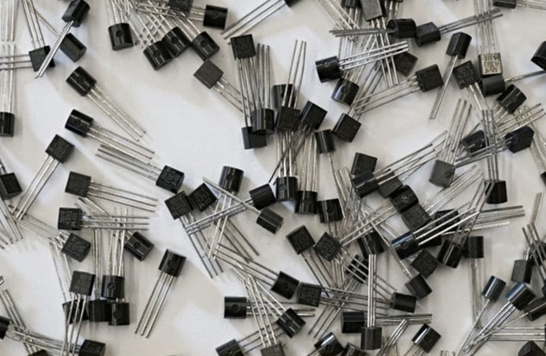
What is Lithography? Why is Lithography? (How is Lithography?)

Slide 7

What is Lithography? Why is Lithography? (How is Lithography?)

Slide 8
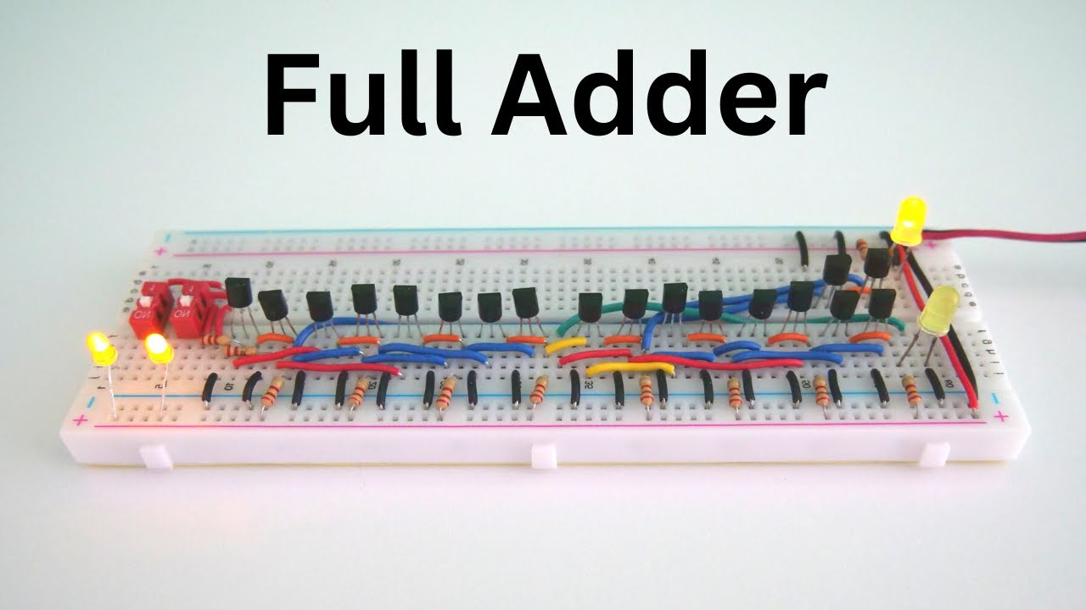
What is Lithography? Why is Lithography? (How is Lithography?)

Slide 9
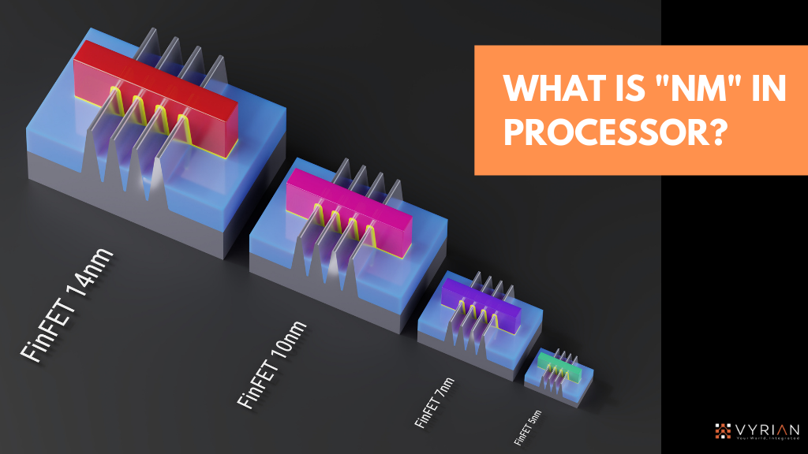
What is Lithography? Why is Lithography? (How is Lithography?)

Slide 10
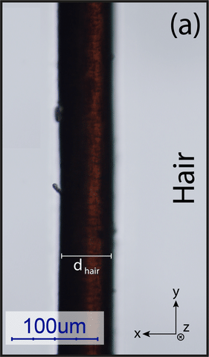
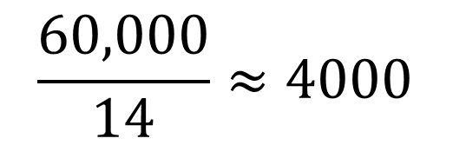
What is Lithography? Why is Lithography? (How is Lithography?)
$$\frac{60,000}{14}≈4000$$
60µm = 60,000nm
14nm

Slide 11
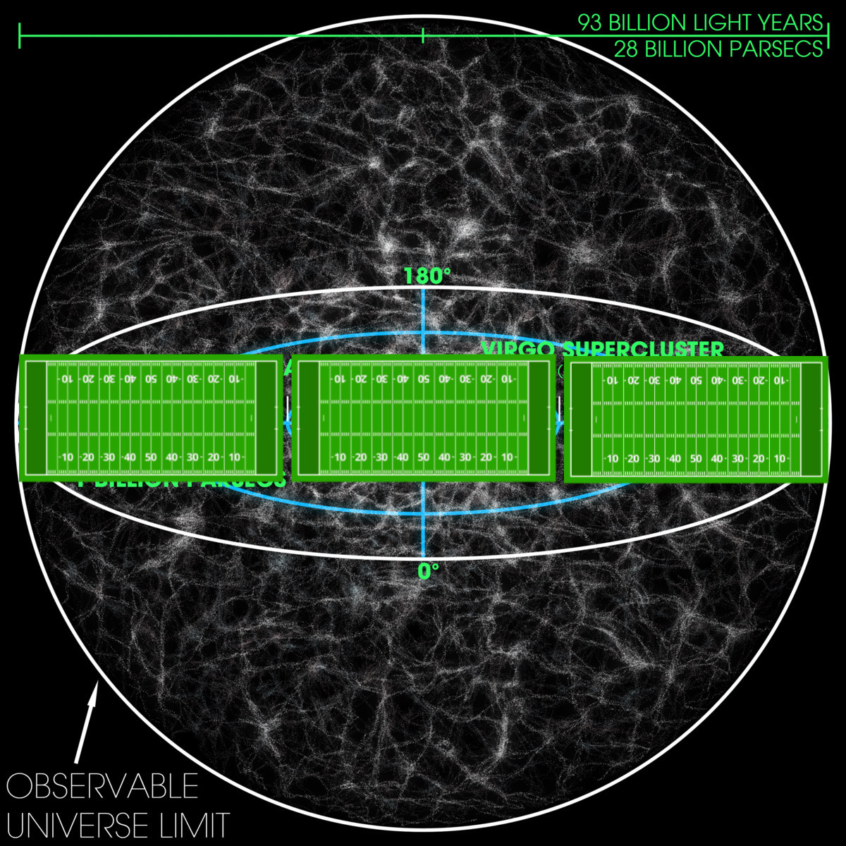
What is Lithography? Why is Lithography? (How is Lithography?)

Slide 12

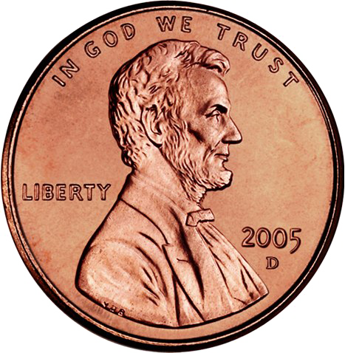
What is Lithography? Why is Lithography? (How is Lithography?)
14nm FinFET
Human hair diameter (60µm)

Slide 13
What is Lithography? Why is Lithography? (How is Lithography?)
Probably not going to be able to wire 14nm transistors using hands, tools, machines, etc…

Slide 14
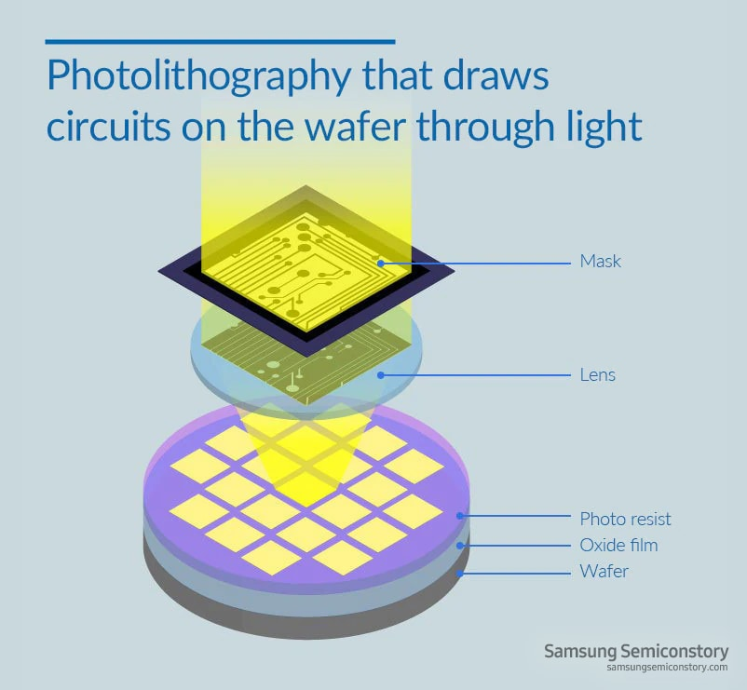
What is Lithography? Why is Lithography? (How is Lithography?)
The solution?
LITHOGRAPHY!
Basically, we’ll design our transistors and circuits using light
What is Lithography?
Method of transferring circuit design to silicon wafer
  Patterns are too small to be transferred physically
  Light has wavelength in scale ~nm
  Followed by less precise “blanket techniques”

Slide 15
Fabrication Techniques
Lithography (Framing)
Implantation (Modification)
Deposition (Additive)
  Oxidation
  Plating
Etching (Subtractive)
  Wet, Dry

Slide 16
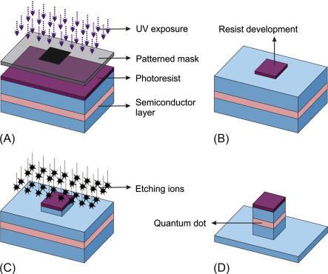
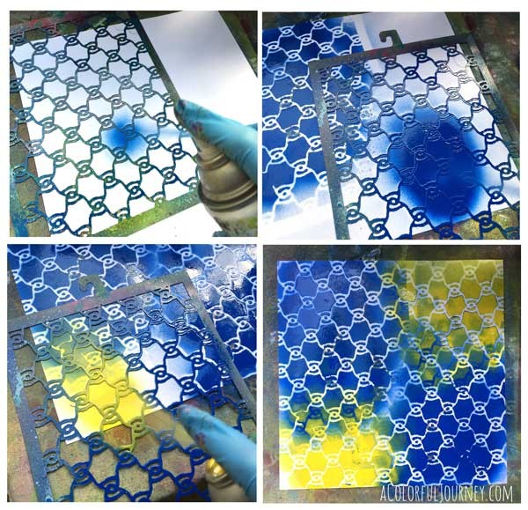
Fabrication Techniques - Lithography
Technique used to define where you want a pattern to be
Involves wavelengths of light reacting with a chemical (photoresist)
Material can be added/removed between the photoresist

Slide 17
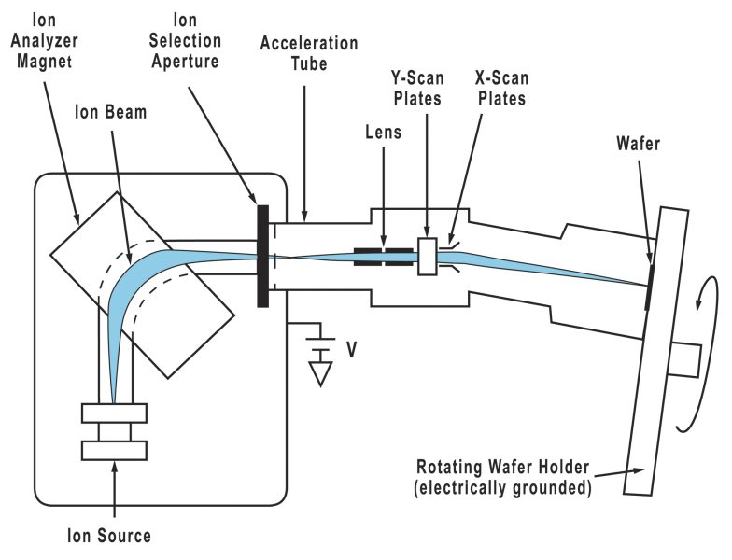
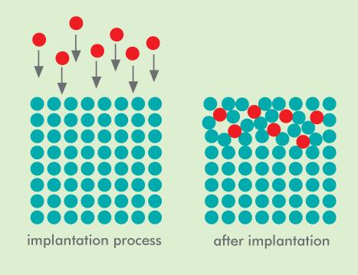
Fabrication Techniques - Implantation
Used to modify properties of the wafer underneath
In Silicon, dopants may result in excess electrons or holes (N, P-type)
Slight changes in concentration results in large change in electrical conductivity (~100x)
Always causes damage to substrate- must be repaired with an anneal step

Slide 18
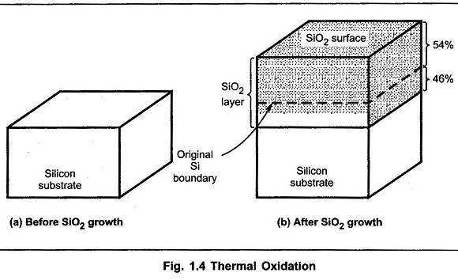
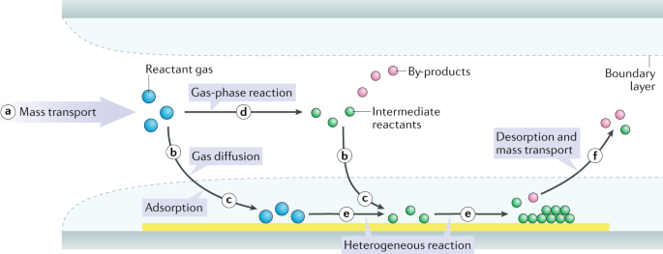
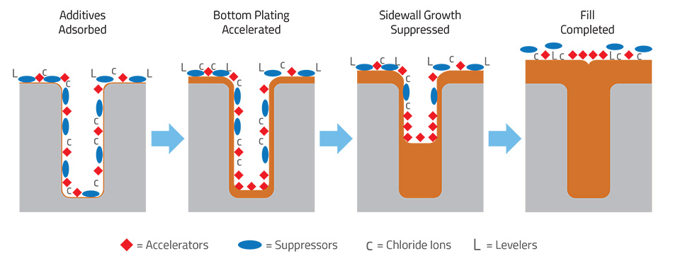
Fabrication Techniques - Deposition
Additive technique for wafer fabrication
3 (main) types
  Oxidation
  Deposition
    Many sub-categories:
      CVD, LPCVD, PVD, PECVD…
  Electroplating

Slide 19
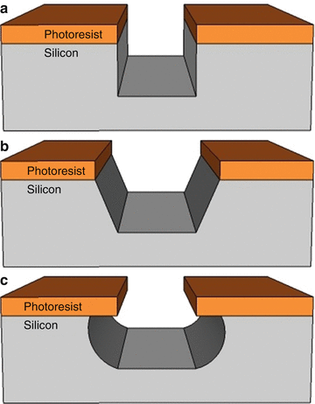
Fabrication Techniques - Etching
Two important characteristics
Selectivity: How quickly one material is etched relative to another
Anisotropy Ratio: How quickly material is consumed in a certain direction versus another
Two main types
Wet Etching (Typically with acids/other wet chemistry)
Dry Etching (Typ. Reactive Ion Etching)

Slide 20
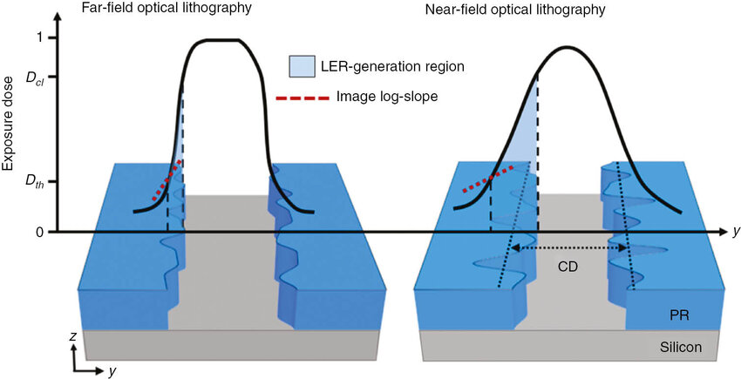
Lithography Over the Years
What is the goal when optimizing the lithography process?
  Better resolution!

Slide 21
Lithography Over the Years
What is the goal when optimizing the lithography process?
  Better resolution!

Slide 22
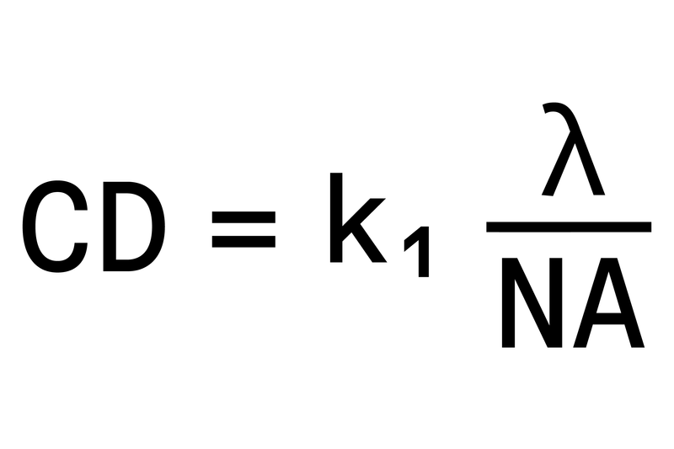
Lithography Over the Years- Characteristic Equation
CD: Critical Dimension (Minimum feature size)
K1: Process Coefficient
  Typ. 1, Can go to ~0.5 or lower
Lambda: Wavelength of incoming light
NA: Numerical Aperture
  Typ. 0.5-0.7, can go above 1
We’ll come back to this…

Slide 23
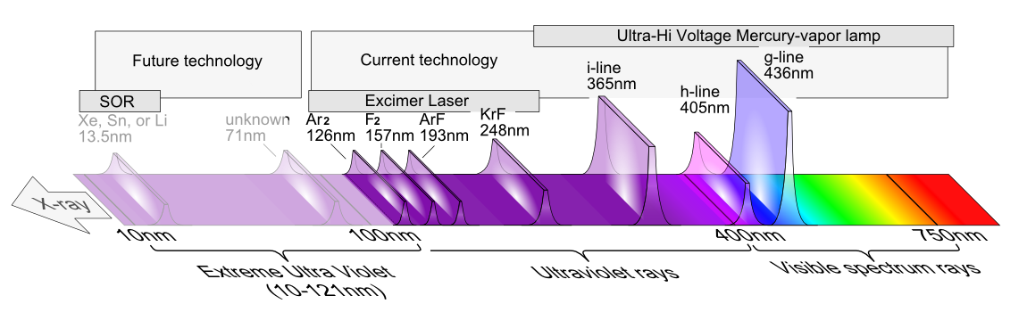
Lithography Over the Years- Wavelengths
Mercury Lamp (UV)
  G-line (436nm), H-line (405nm), I-line (365nm)
Excimer Laser (DUV)
  KrF (248 nm)
  ArF (193nm)
EUV (13.5nm)

Slide 24
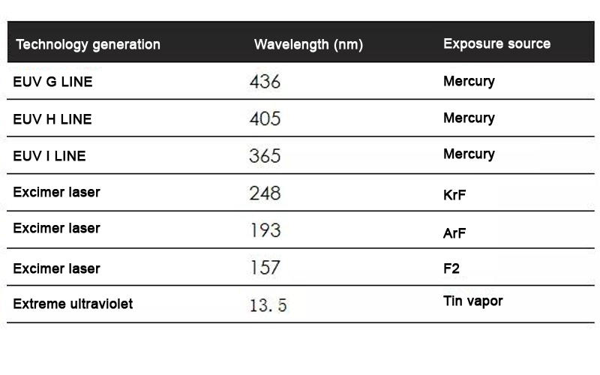
Lithography Over the Years- Wavelengths
????
https://www.youtube.com/watch?v=ZPa_RKFTBPc

Slide 25
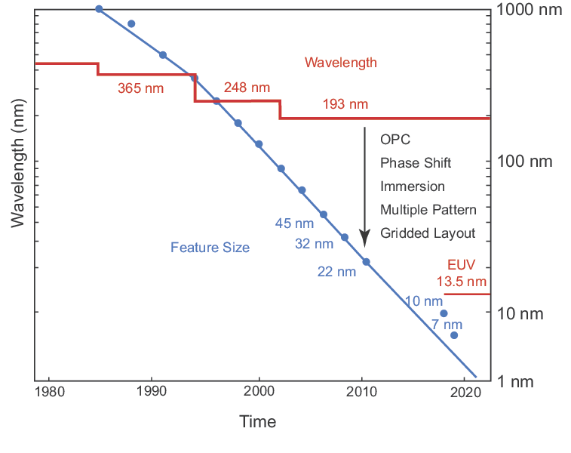
Lithography Over the Years- Why 193???
Before 1990:
  “Like drawing thick lines with a sharp pencil”
After 1990
  “Mask Designer’s Nightmare”

Slide 26
Lithography Over the Years- What happened to 157?
  Technical Challenges:
  Poor Photoresist
  Needed new reticle design
  Expensive processing
  Upcoming Solutions (for 1990s)
  Immersion technology!?
  EUV supposed to come out in 2001

Slide 27
Lithography Over the Years- What happened to 157?
  Technical Challenges:
  Poor Photoresist
  Needed new reticle design
  Expensive processing
  Upcoming Solutions (for 1990s)
  Immersion technology!?
  EUV supposed to come out in 2001
    (GTA6 of Semiconductor Industry)

Slide 28

Brute Force for Moore’s Law (k1)
Resolution Enhancement Techniques
Optical Proximity Correction
Phase Shift Masks
Double Patterning Techniques
(image unrelated)

Slide 29
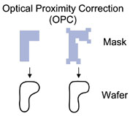
Brute Force for Moore’s Law (k1) - OPC
Optical Proximity Correction (OPC)
Constructive/Destructive Interference
  Introduce serifs/additional patterns so OUTPUT looks correct (mask doesn’t)
  VERY interesting field for optics engineering & computer science

Slide 30
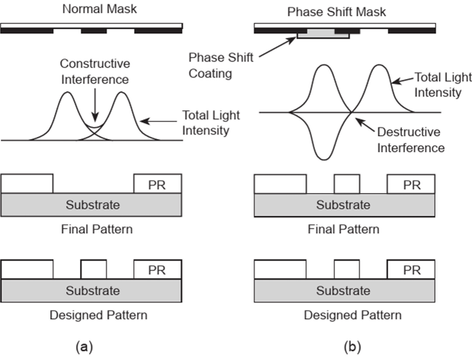
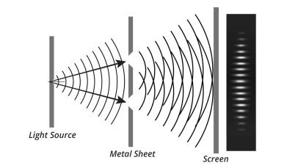
Brute Force for Moore’s Law (k1) - Phase Shift Masks
Phase Shift Masks
Control interference for better feature fidelity

Slide 31
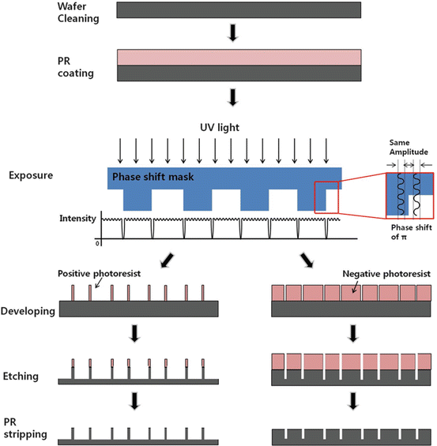
Brute Force for Moore’s Law (k1) - Phase Shift Masks
  Phase Shift Masks
  Mask Design No longer Binary
  Designed constructive/destructive interference for high-resolution output

Slide 32
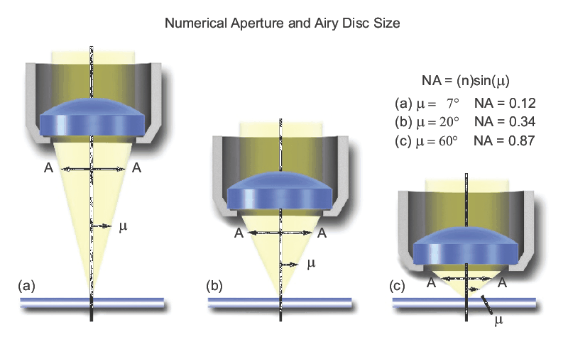
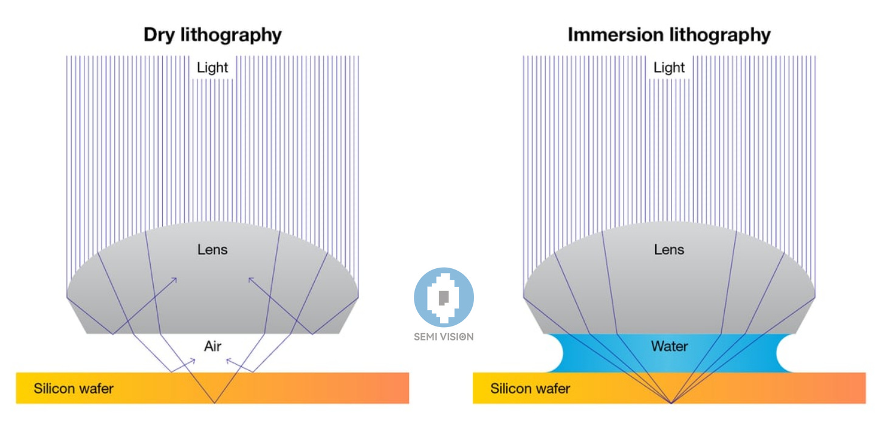
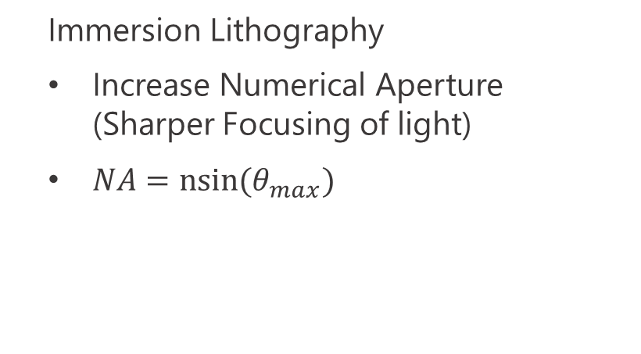
Brute Force for Moore’s Law (NA) - Immersion Lithography
  Immersion Lithography
  Increase Numerical Aperture (Sharper Focusing of light)
  $NA=nsin⁡(θ_{max})$

Slide 33
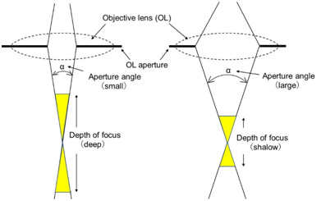

Brief Aside - The issue with NA
  Depth of Focus (DoF)
  More precision in distance from lens
  In EUV, photoresist needs to be ~10s of nm thick
  DoF inversely proportional to NA

Slide 34
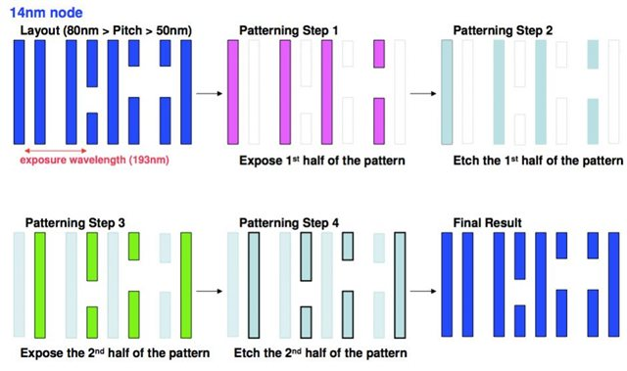

Brute Force for Moore’s Law (k1) - Double Patterning
  Solve interference problem by just making more masks
    2x, 4x patterning
  POV: Mask designers selling more masks to do the same work

Slide 35
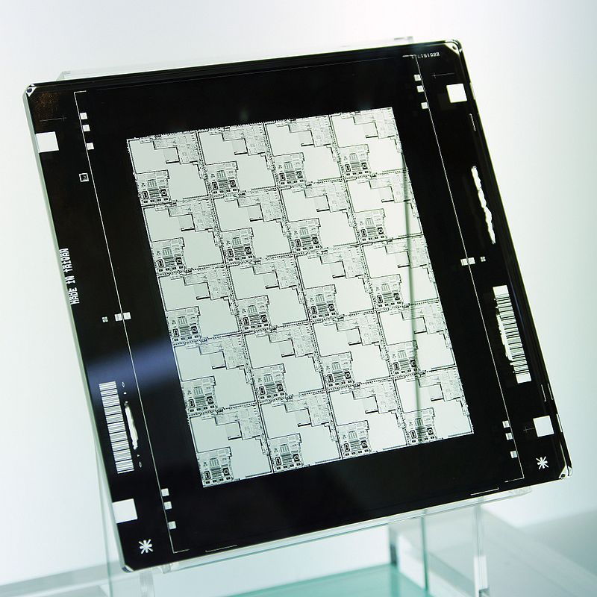
Mask Design
Exposure Area:
Limited by Reduction Lenses
~26x33 mm max
DUV/Older systems:
Quartz (Fused Silica)
Chromium
Can cost ~10-100k
https://youtu.be/9RZreu5z_Gc?si=rI32Z36lvvmAOuUl

Slide 36
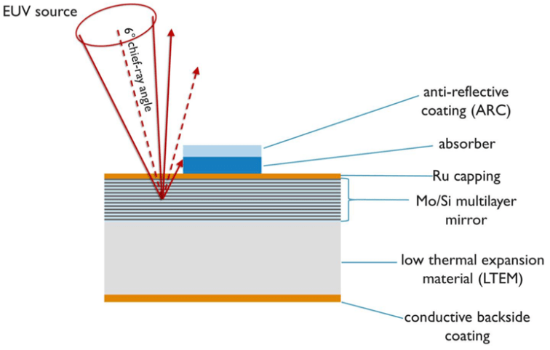
Mask Design (EUV)
Extremely Expensive
“Mirror mask”
~70% of energy is absorbed
  11 mirrors -> 0.7^11 = 2% energy transfer
50+ layers of Molybdenum + Silicon
Can cost ~500k each

Slide 37
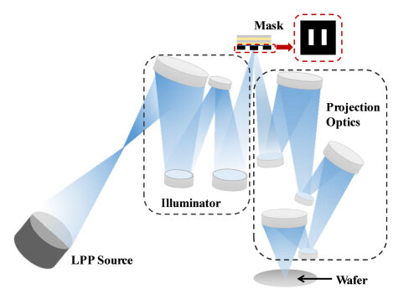
Mask Design (EUV)

Slide 38
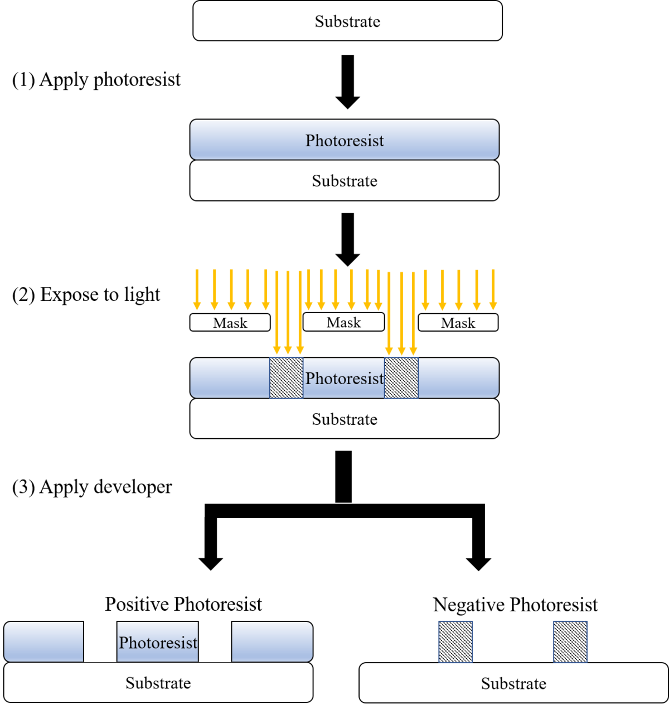
Photoresist
  Large, Organic polymers
  When exposed to light, cross-linking occurs between polymers
  Good photoresist requires the following
    Specific wavelength sensitivity
    High uniformity
    Very strong chemical resistance (When exposed)
    Easy development (Removal of “blank” areas)
    Limiting factor for new wavelengths!

Slide 39
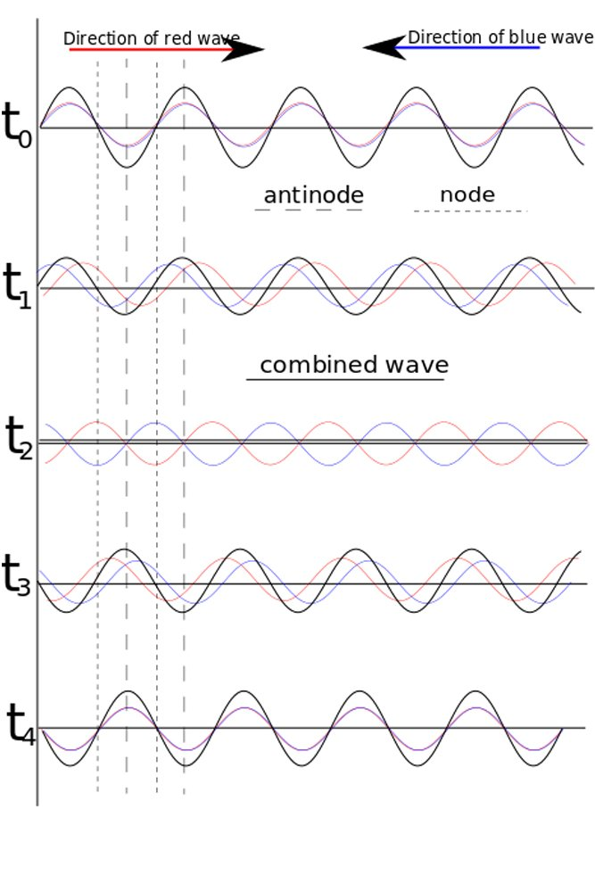
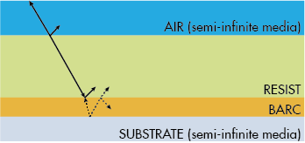
Weird Photoresist (EUV)
Etch rate additives
Actual resist is too thin to work long enough…
BARC/Underlayers
Reduce “Standing waves”
Improve adhesion/resolution

Slide 40
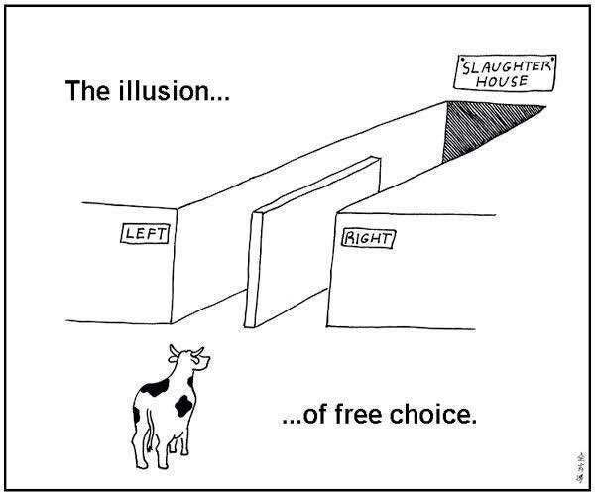
Lithography Types- “Choose your own adventure”
Contact
Non-Contact
Projection
E-Beam*

Slide 41
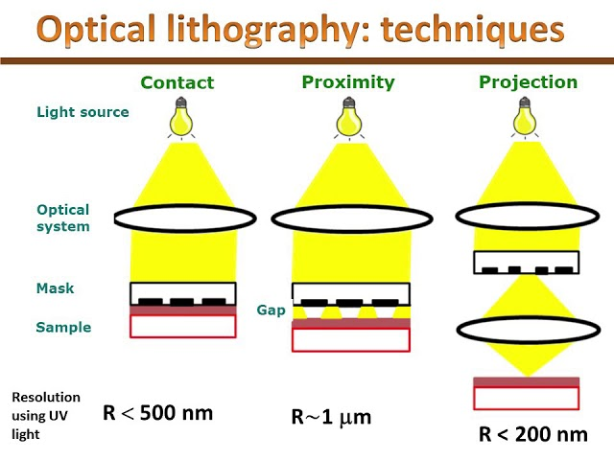
Lithography Types- “Choose your own adventure”

Slide 42
Lithography Types- Performance Comparison
Each are useful!
  Which would you use for…
    Academic (Very low volume)
    Industry (High Volume)
    Research
Parameter | Contact | Non-Contact | Projection | E-beam
Cost | Low | Low | High | High
Speed | Med | High | High | Low
Defectivity | Very High | Low | Low | Low
Resolution | Med | Low | High | Very High
Complexity | Low | Med | High | Med

Slide 43
Lithography Procedure
Spincoat
Soft-Bake
Expose
Post-exposure Bake (Optional)
Develop
Hard-Bake

Slide 44
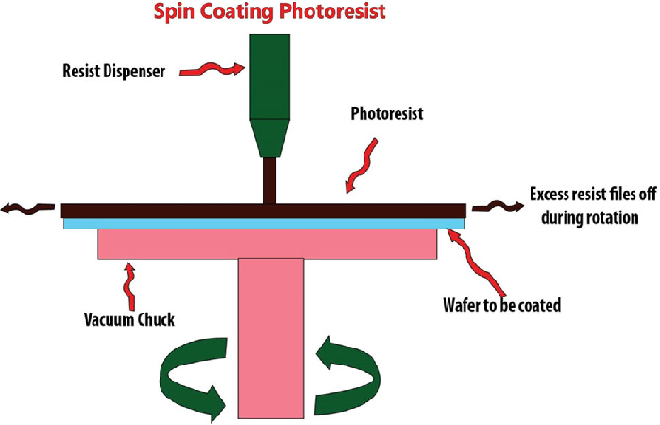
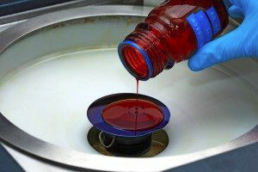
Lithography Procedure- Spincoat

Slide 45
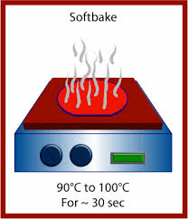
Lithography Procedure- Softbake
Solidify photoresist
Removes solvent
Can be done with hotplate in research applications
Integrated in lithography machine for industry applications

Slide 46
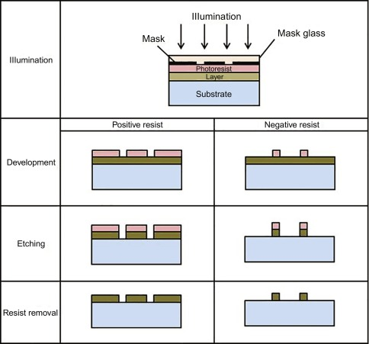
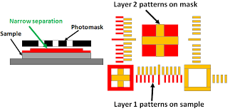
Lithography Procedure- Exposure
Align with previous layers of mask
Use lightsource (EUV, DUV, etc) to bond photoresist

Slide 47
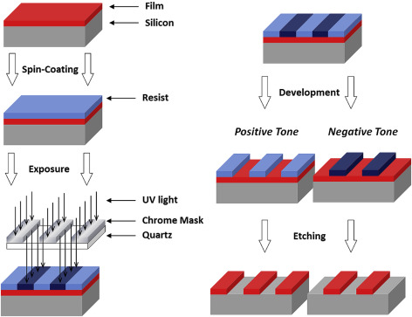
Lithography Procedure- Develop
Dissolves un-bonded photoresist

Slide 48
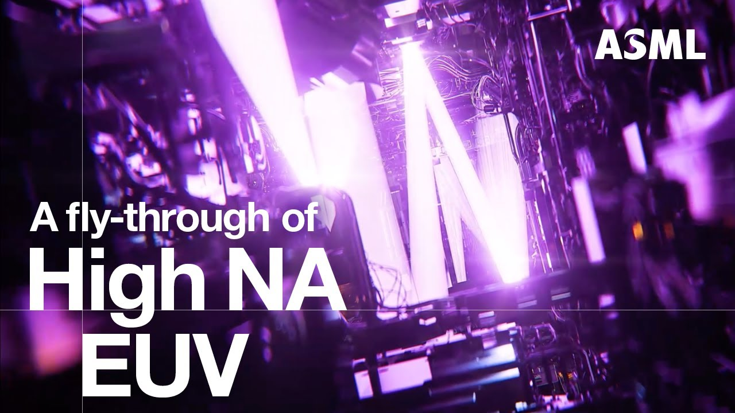
Lithography Procedure- Modern Systems
https://youtu.be/h_zgURwr6nA?si=Jx0LdQDefZiJwbs1

Slide 49
Future State of Lithography
High-NA EUV Resolution Enhancement Techniques
Higher Power Source (Free Electron Laser)
Larger exposure field? (Reticle)
Mechanical Improvements for
High-Throughput/Precision
Cutting Cost???

Slide 50
The End
Thanks for listening!

