Slide 1

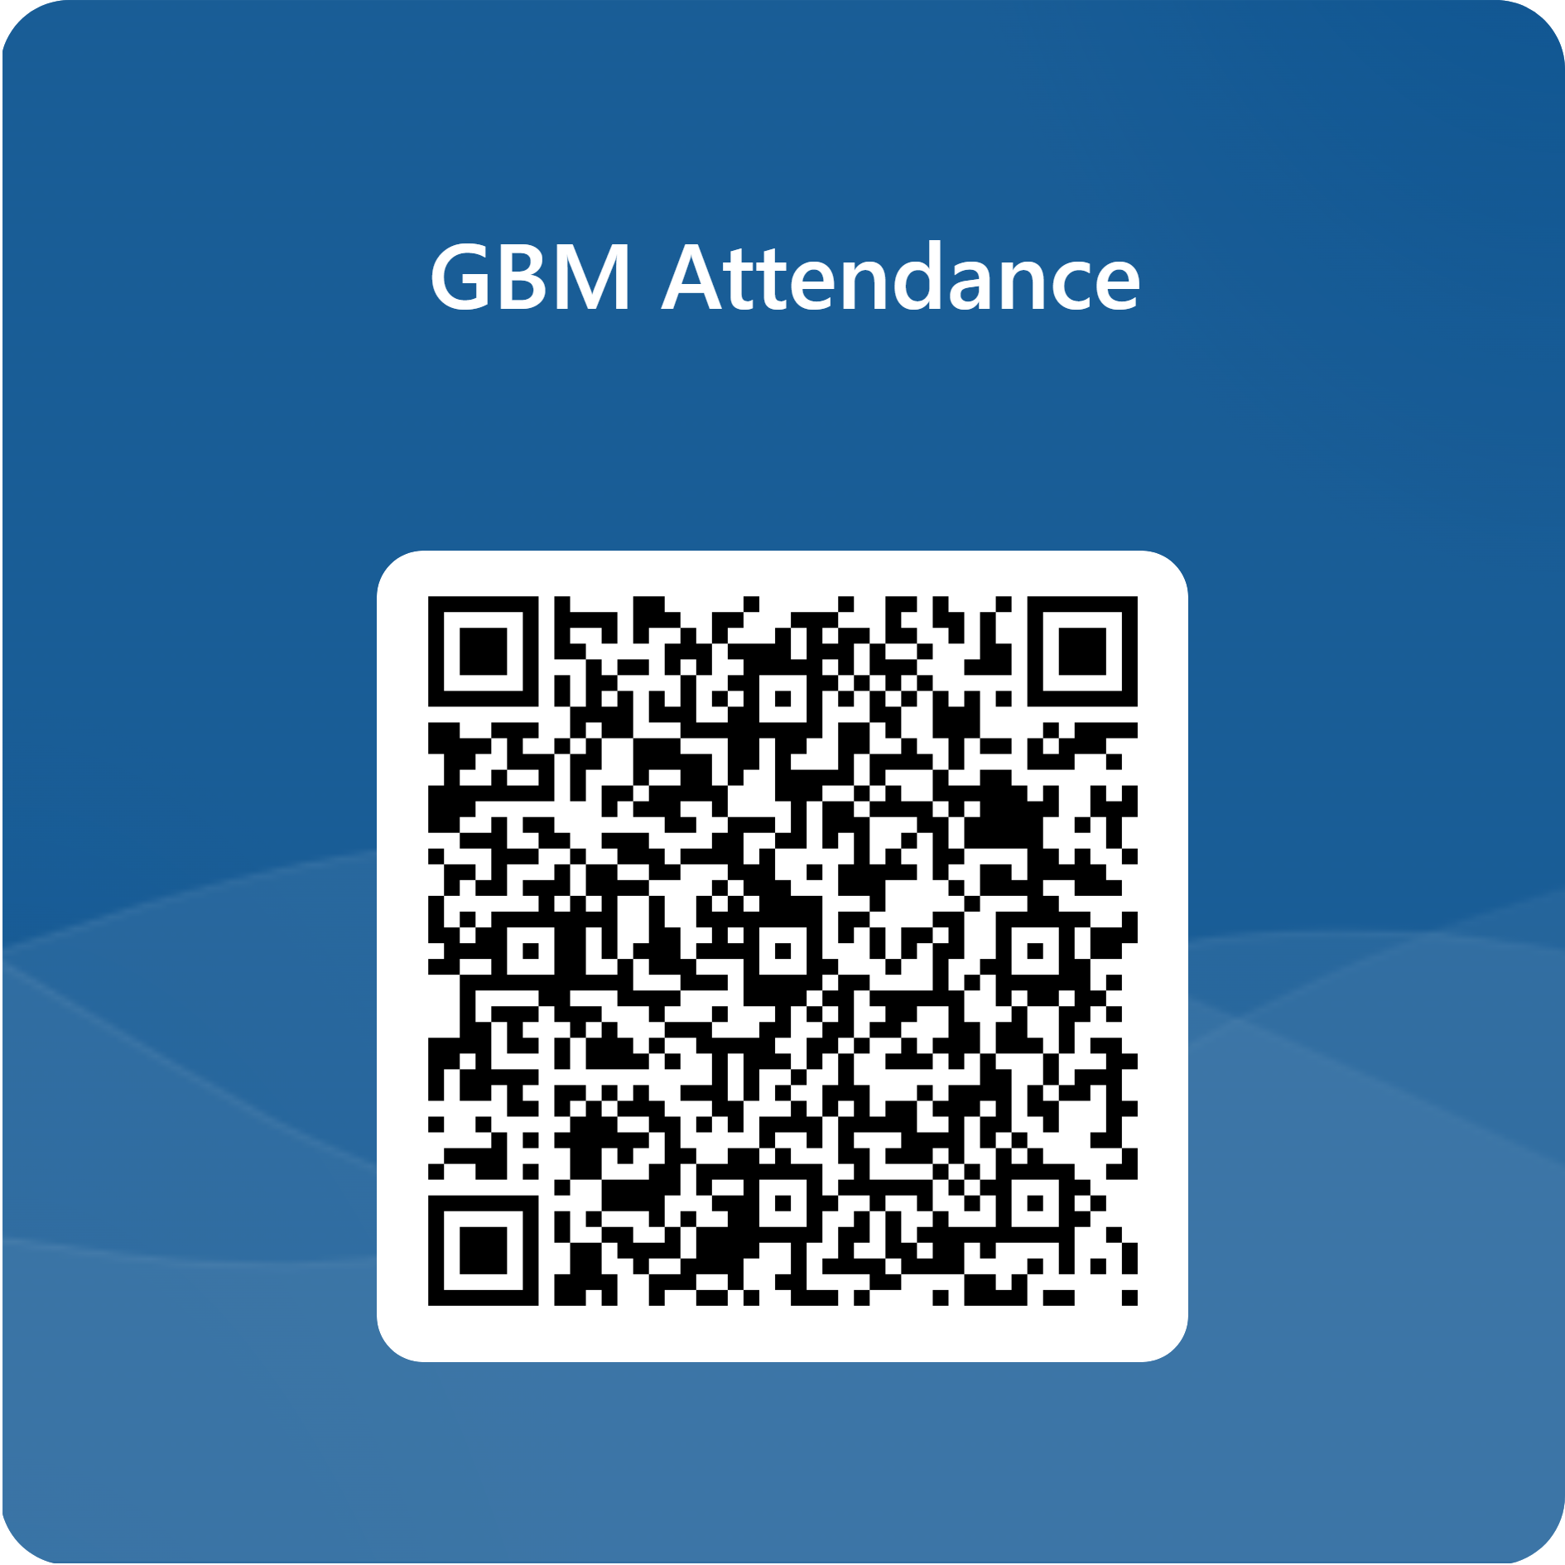
EPS/EDS Info Session
Heterogeneous Integration Overview

Slide 2
Meet our EPS/EDS executive board
David King
Chair
Class of ‘27
Major: ECSE Dual
Clubs/Affiliations:
  IEEE
Evan Chen
Vice Chair
Class of ‘27
Major: ECSE Dual
Clubs/Affiliations:
  Mercer XLabs
  RPI Esports
[Vacant]
Secretary
Jonas Kendra
Treasurer
Class of '24 (M.E.)
Mechanical Eng.
Clubs/Affiliations:
  Engineering Ambassadors
  Rensselaer Motorsport
  RPI Esports
WE NEED OFFICERS. WE WANT YOU!

Slide 3
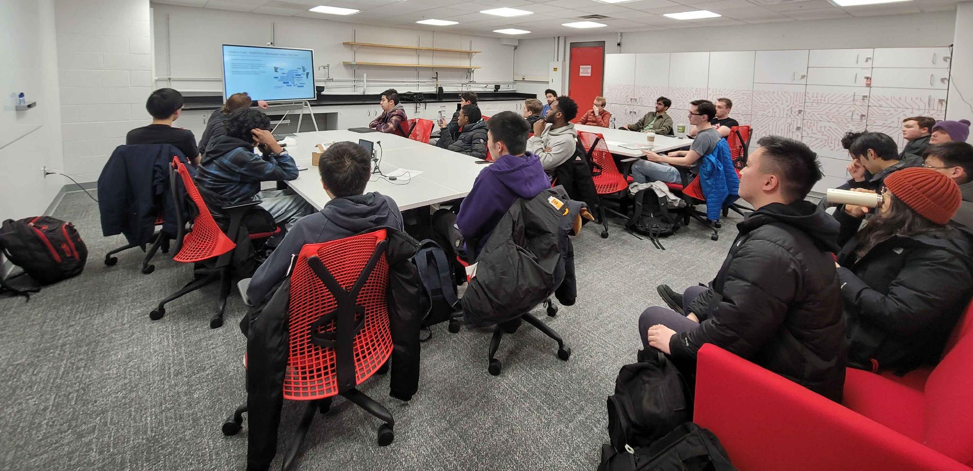
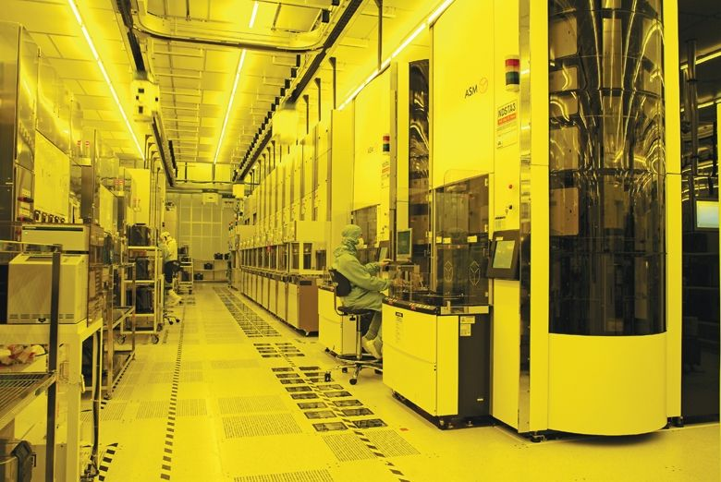
What is IEEE EPS/EDS @ RPI?
IEEE – Institute of Electronics and Electrical Engineers
IEEE Technical Societies:
  EPS – Electronic Packaging Society
  EDS – Electron Devices Society
We are a community for people interested in semiconductor technology.
Chip Design
Semiconductor Manufacturing
Advanced Packaging

Slide 4
Why does EPS/EDS exist here and now?
A weirdly specific question

Slide 5
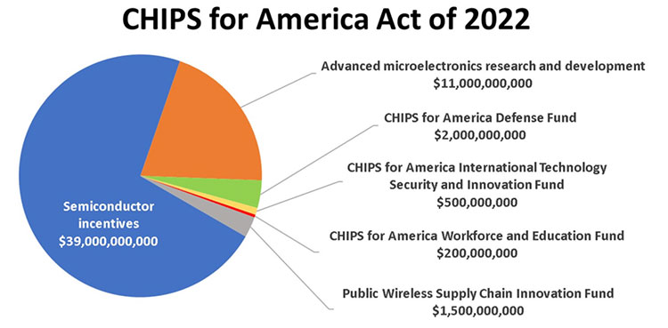
Government Support
Intended to bring manufacturing back to the US to secure supply chains and stay competitive with China.
Funding distributed over ~one decade
Investment in education, infrastructure, and manufacturing
Over 100,000 new jobs are being created between construction, manufacturing, and research.

Slide 6
Government Support Cont.
Facility / Company | Location | What it Produces / Role | Status / Key Dates
TSMC Arizona — First Fab | Near Phoenix, Arizona | Advanced logic chips (4-nm process) | Started high-volume production Q4 2024.
TSMC Arizona — Second Fab | Arizona | N3 logic (3-nm process) | Building the fab structure completed in 2025; expected operations later (target 2028 for some)
TSMC Arizona — Third Fab | Arizona | Aiming for even more advanced (2-nm / A16 process) logic / leading-edge chips | Broke ground in April 2025; scheduled for operations by end of decade.
GlobalWafers – Sherman, Texas | Sherman, Texas | 300mm silicon wafer fabrication (silicon substrate / wafer supply) | Opened May 2025; first of three planned fabs in Sherman.
Amkor – Arizona Packaging Plant | Peoria, Arizona | Advanced packaging and testing (back-end chip processes) | Approved in August 2025; projected begin production in early 2028.

Slide 7
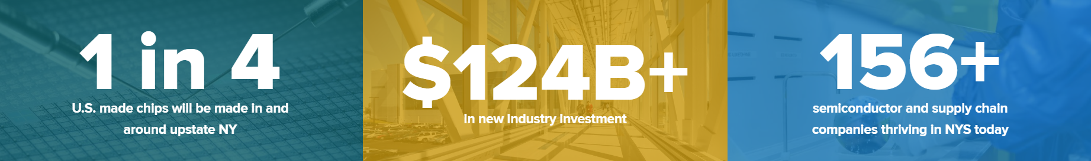
State Incentives
New York State: A Global Semiconductor Hub
New York State is home to the fastest growing semiconductor ecosystem in the nation.
"We are building a semiconductor highway along the I-90 corridor from Albany to Buffalo bringing with it good paying jobs and transforming our economy.
By 2030, 1 in 4 U.S.-made chips will be produced in [and around] Upstate New York, making [the Empire State] the country’s leading hub for semiconductor manufacturing." - Governor Kathy Hochul

Slide 8
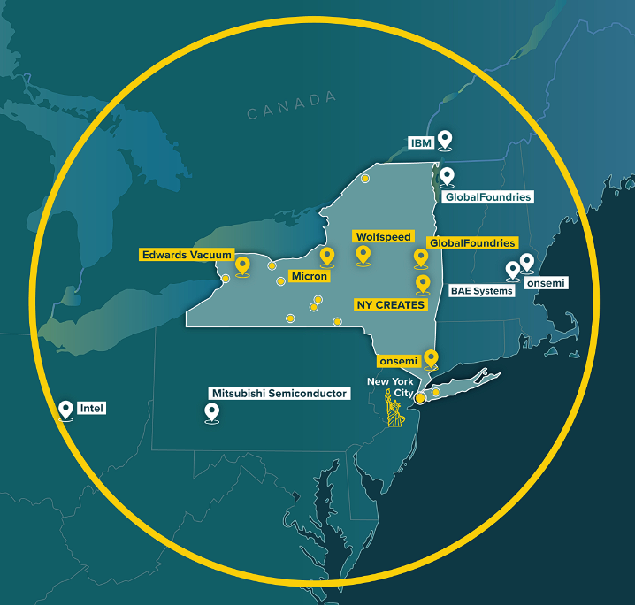
Location
In New York State there are seven big semiconductor companies:
IBM
Micron Technologies
Applied Materials
Tokyo Electron
ASML
GlobalFoundries
Samsung Semiconductor
The red is less then 20 min away

Slide 9
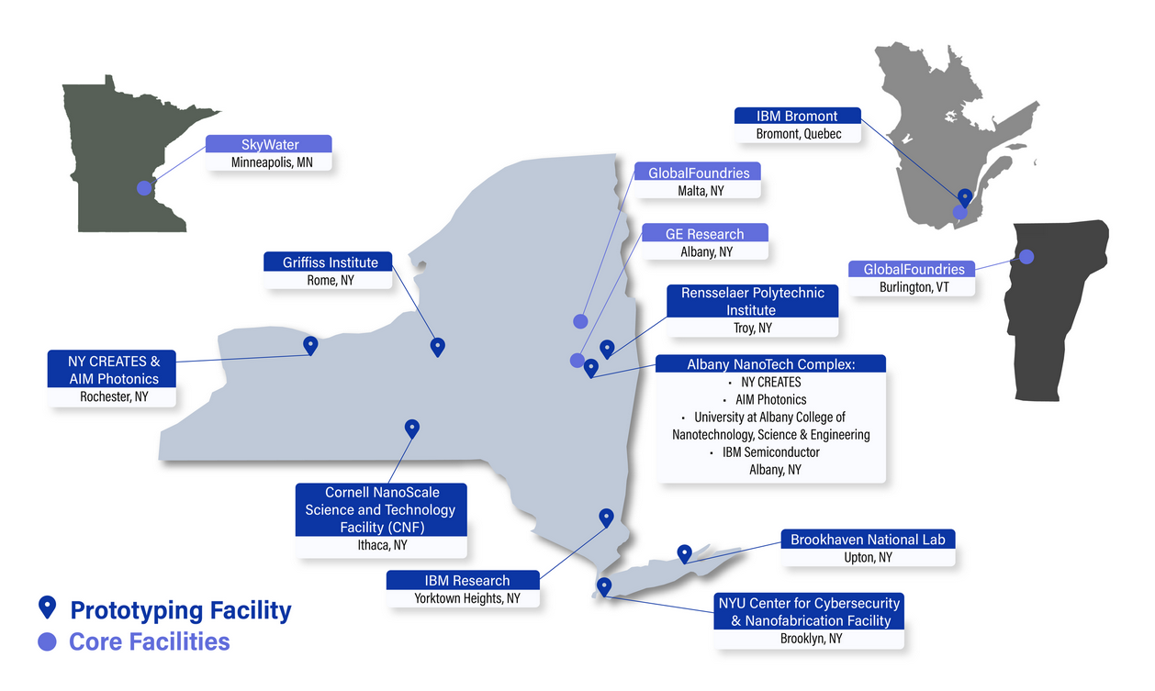
Location Cont. - NORDTECH: Northeastern Region Tech HUB
Funded through the Chips and Science Act
A part of the U.S. Microelectronics Commons, an initiative from the DOD to decrease dependence on foreign microelectronics supply chains
Microelectronics supply chains are critical to the functioning of the entire U.S. economy.

Slide 10
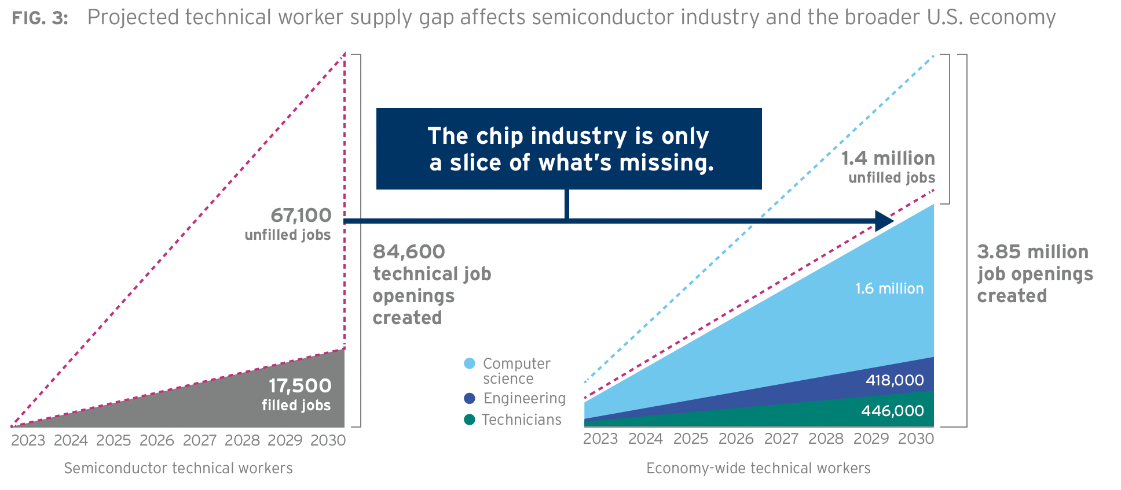
Talent Shortage
Significant Shortage: The U.S. semiconductor industry faces a severe shortage of hardware designers.
An estimated shortfall of 59,000 to 146,000 workers by 2029
Rising needs for chips in AI, cloud computing, automotive, IoT, etc.
Governmental policies and incentives to localize or secure chip manufacturing,
Investment in cutting-edge semiconductor technologies.
Note: The semiconductor industry does not have a shortage of applicants, they have a shortage of people with specialized skills.

Slide 11
Why does EPS/EDS exist here and now?
It is the perfect time and place to start a career in the
semiconductor industry!

Slide 12
Programs
Providing value to the student body

Slide 13


Driving Accessibility
OPPORTUNITY
KNOWLEDGE

Slide 14
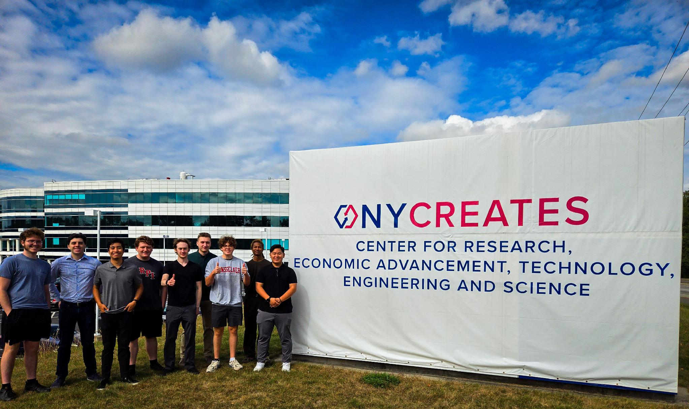
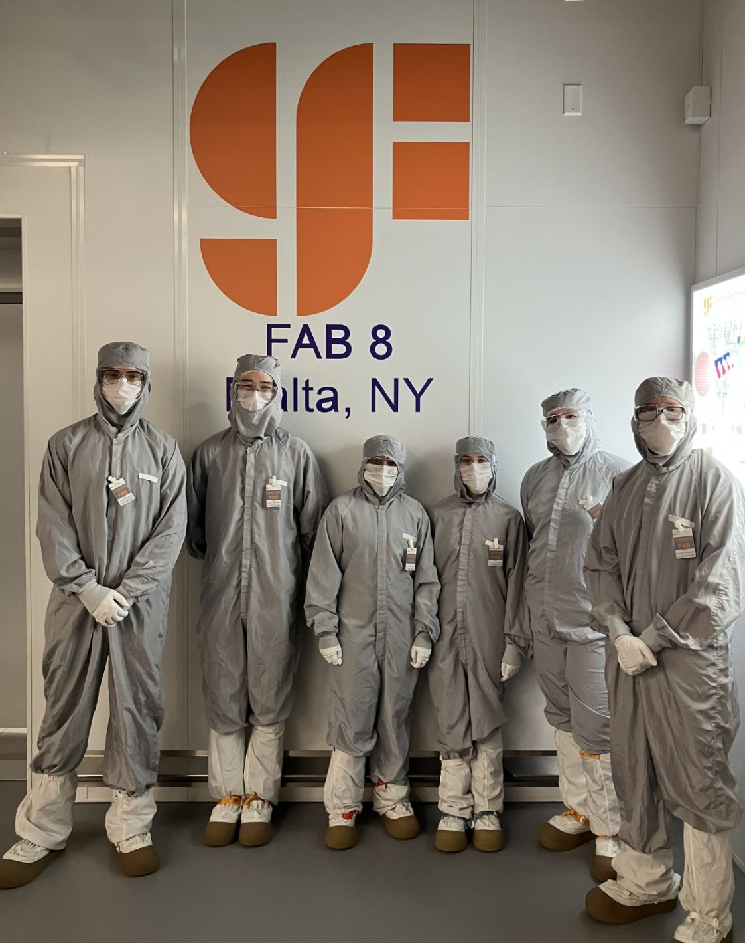
Opportunity – Industry Tours
Albany Nanotech Complex
  Collaboration with the Center for Materials, Devices, and Integrated Systems (CMDIS)
  A state-of-the-art campus that brings together industry leaders, academia, and international partners to develop next-generation chips and chip fabrication processes.
  Major Companies: IBM, Applied Materials, Tokyo Electron, Wolfspeed
GlobalFoundries Fab 8
  Collaboration with American Institute of Chemical Engineers @ RPI (AIChE)
  A world-class semiconductor fabrication facility specializing in high-performance chips for a variety of applications, including consumer electronics, telecommunications, and automotive systems.

Slide 15
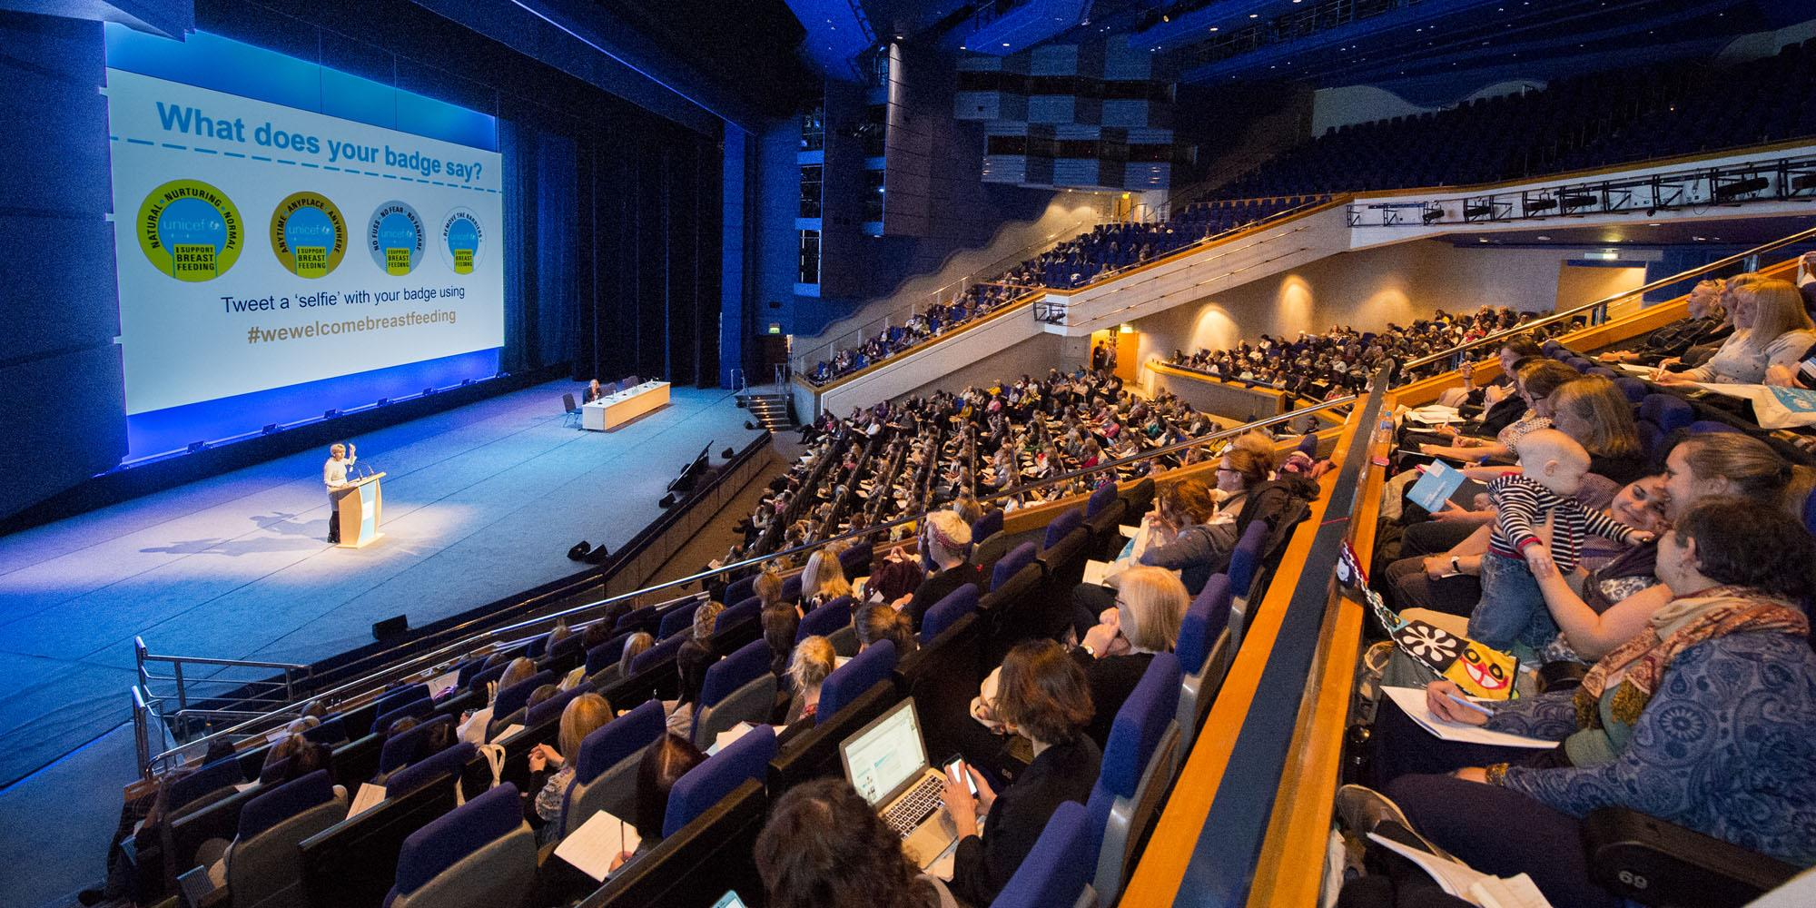
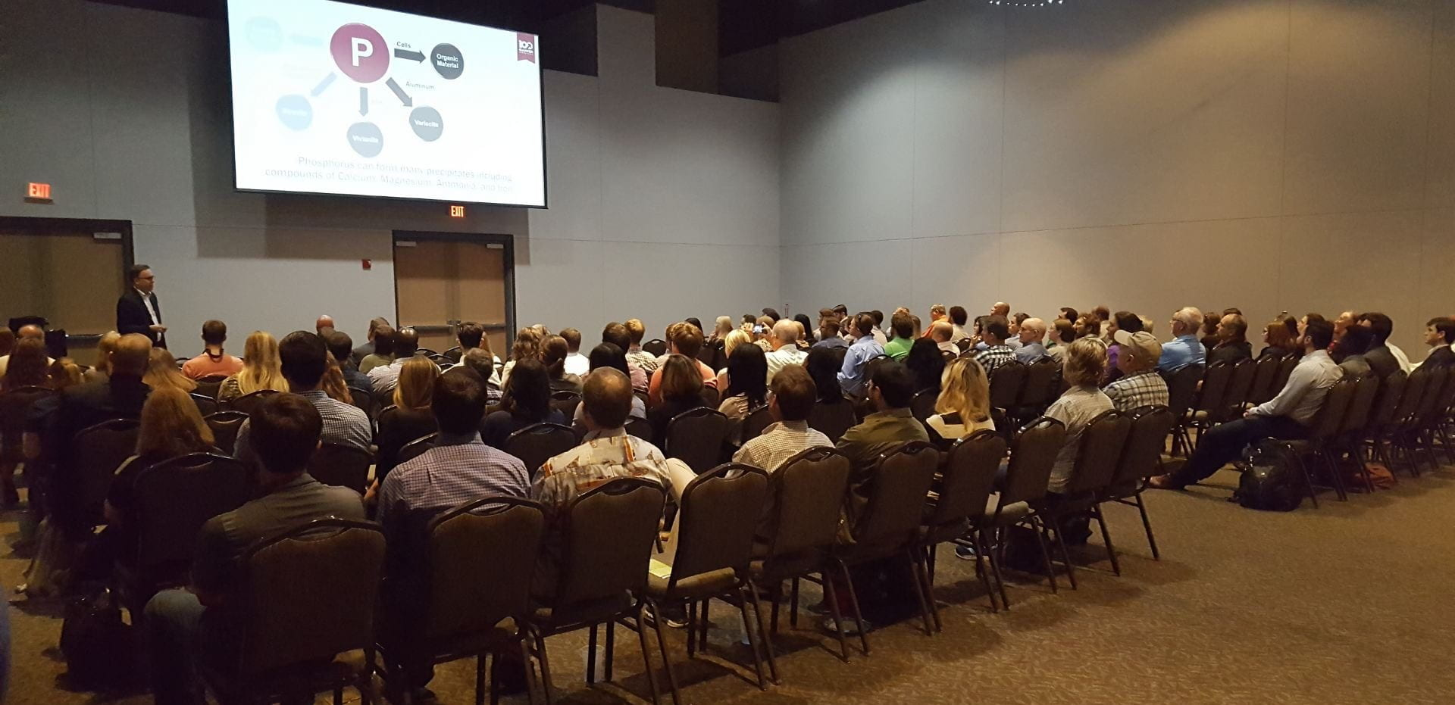
Opportunity – Off-Campus Conferences
2025 37th Annual SEMI Advanced Semiconductor Manufacturing Conference (May 5th – May 8th)
  Albany, NY
37th Annual Electronic Packaging Symposium
  Binghamton, NY
Smaller seminars at the ANC also happen and we will provide transport to those.
  RPI Semiconductor CoLab Catalyst Seminars

Slide 16
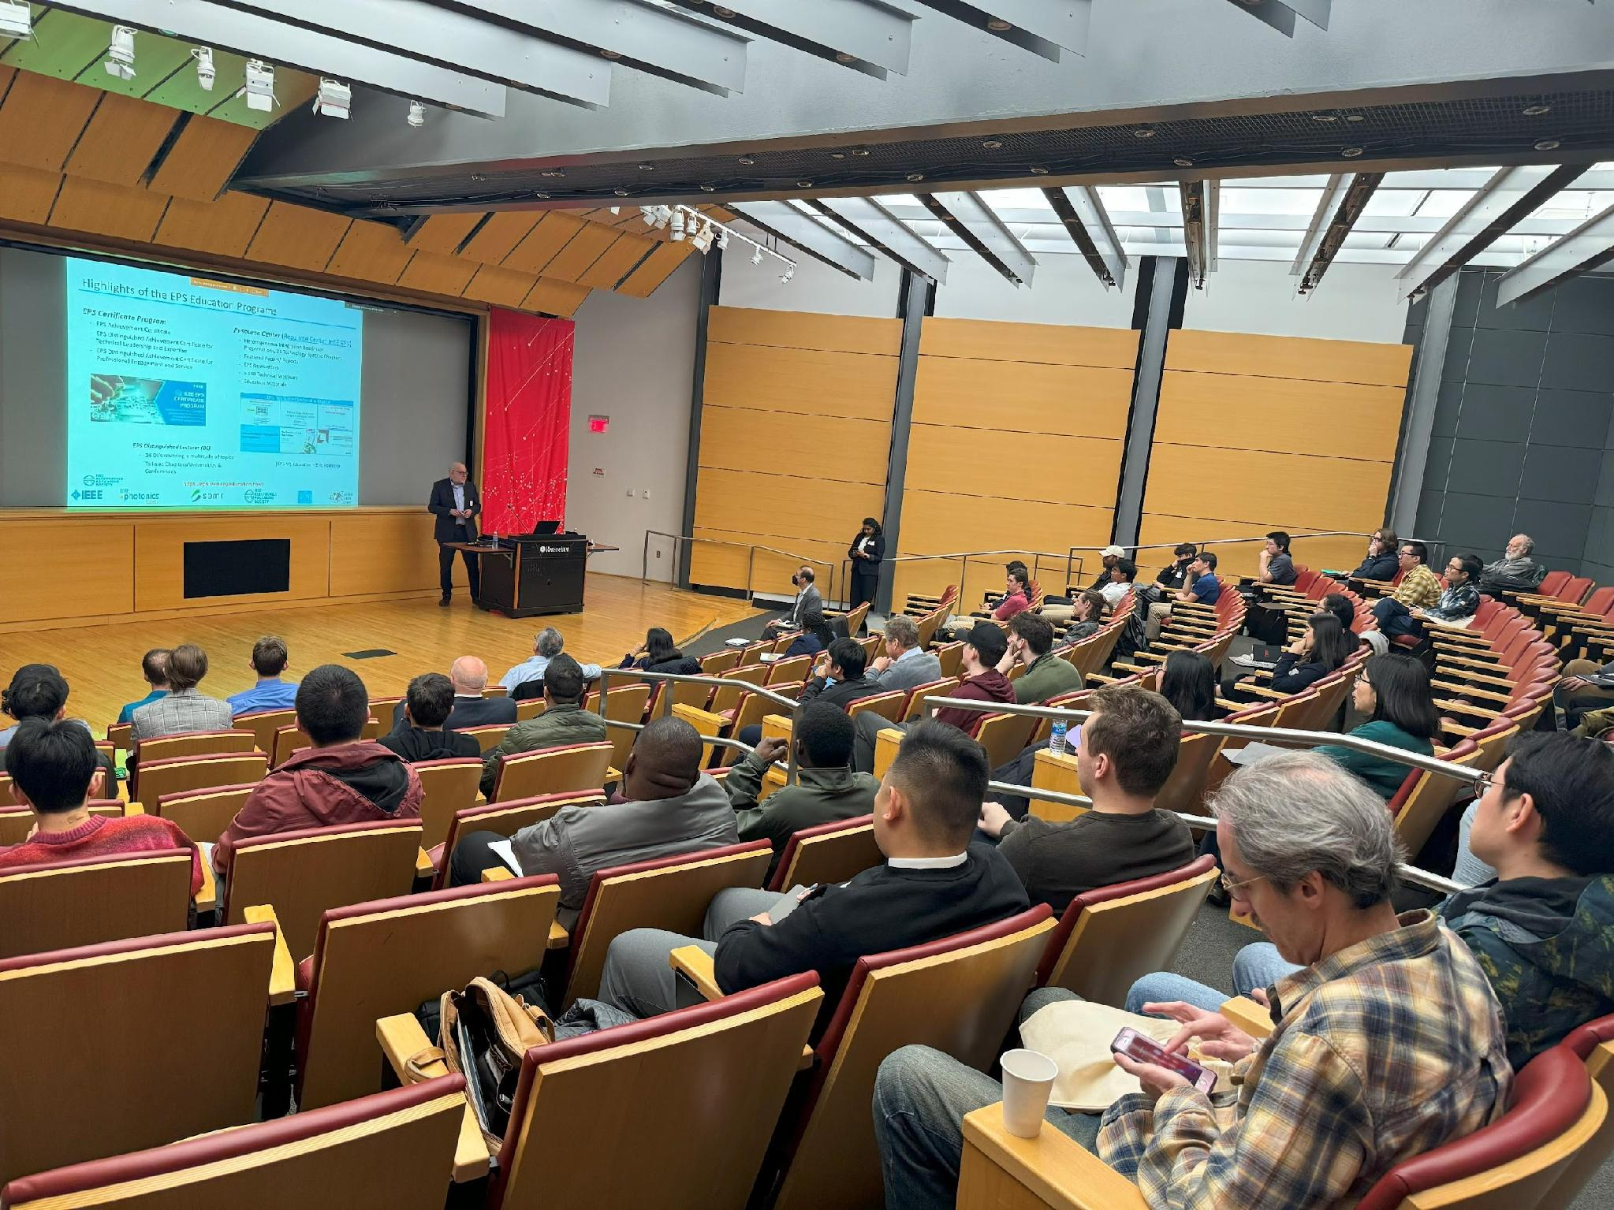
Opportunity – On-Campus Colloquiums
An academic conference featuring invited speakers from industry and academia hosted by YOUR EPS/EDS CHAPTER!
Currently working with the IEEE regional section to bring you a pool of companies to network with
Environment to collaborate and learn about the latest tech advancements

Slide 17
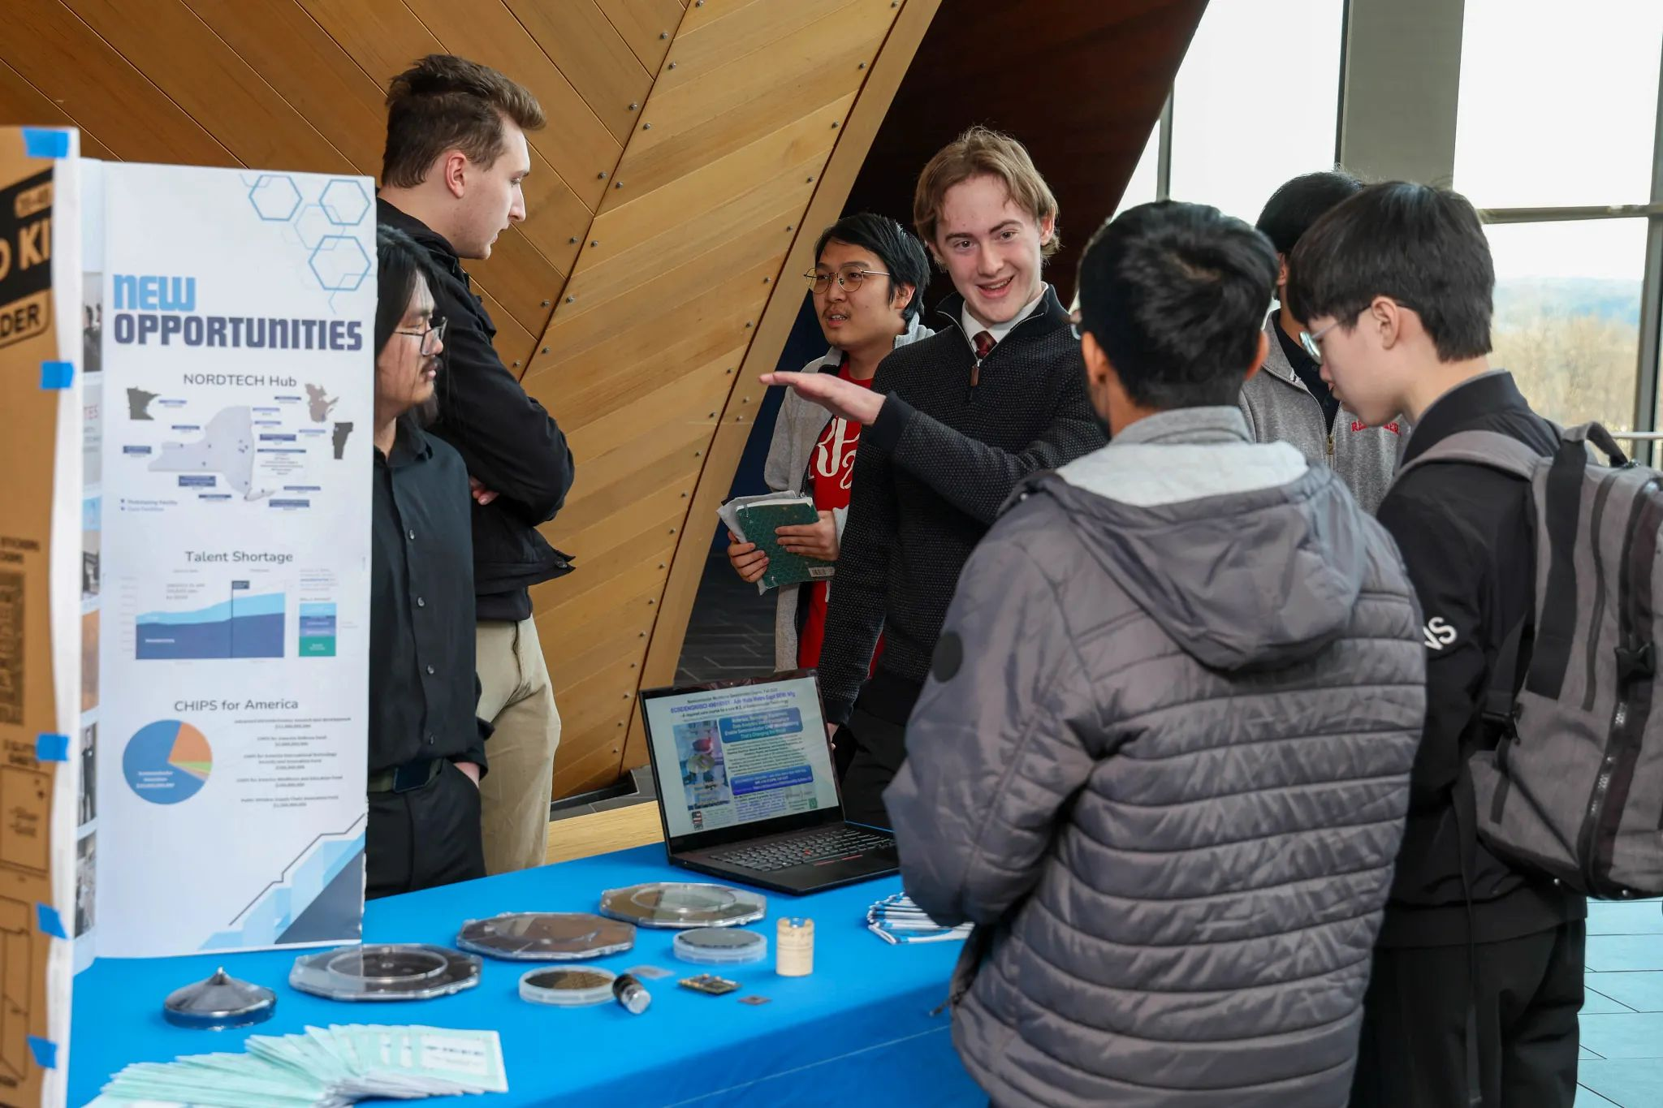

Semiconductor Summit
Semiconductor Careers Summit occurring at the end of the spring semester in EMPAC
Great opportunity for high-level semiconductor industry awareness, workforce development, and career guidance
Last year featured 10 companies:
  Apple, Applied Materials, ASML, EMD Electronics, Entegris, GlobalFoundries, IBM, Marvell, Rapidus, Tokyo Electron

Slide 18
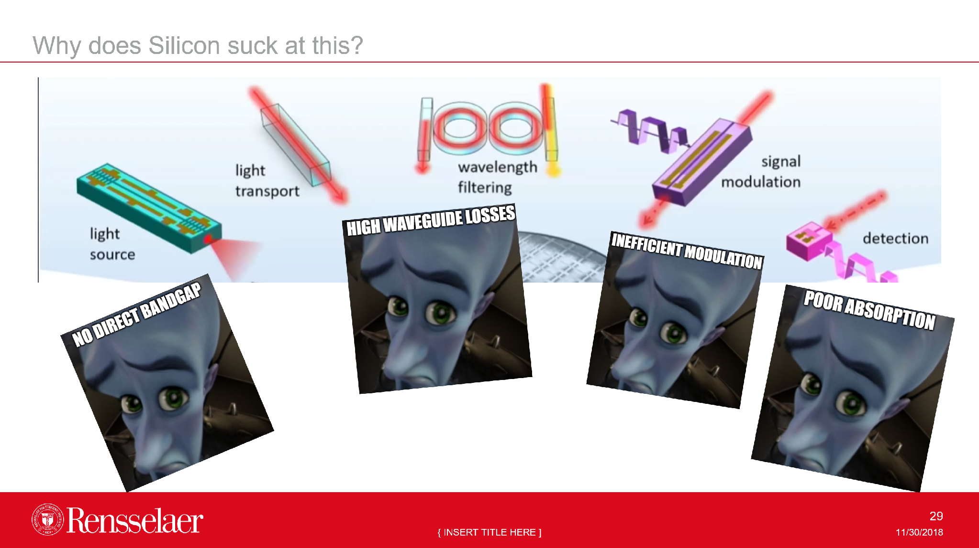
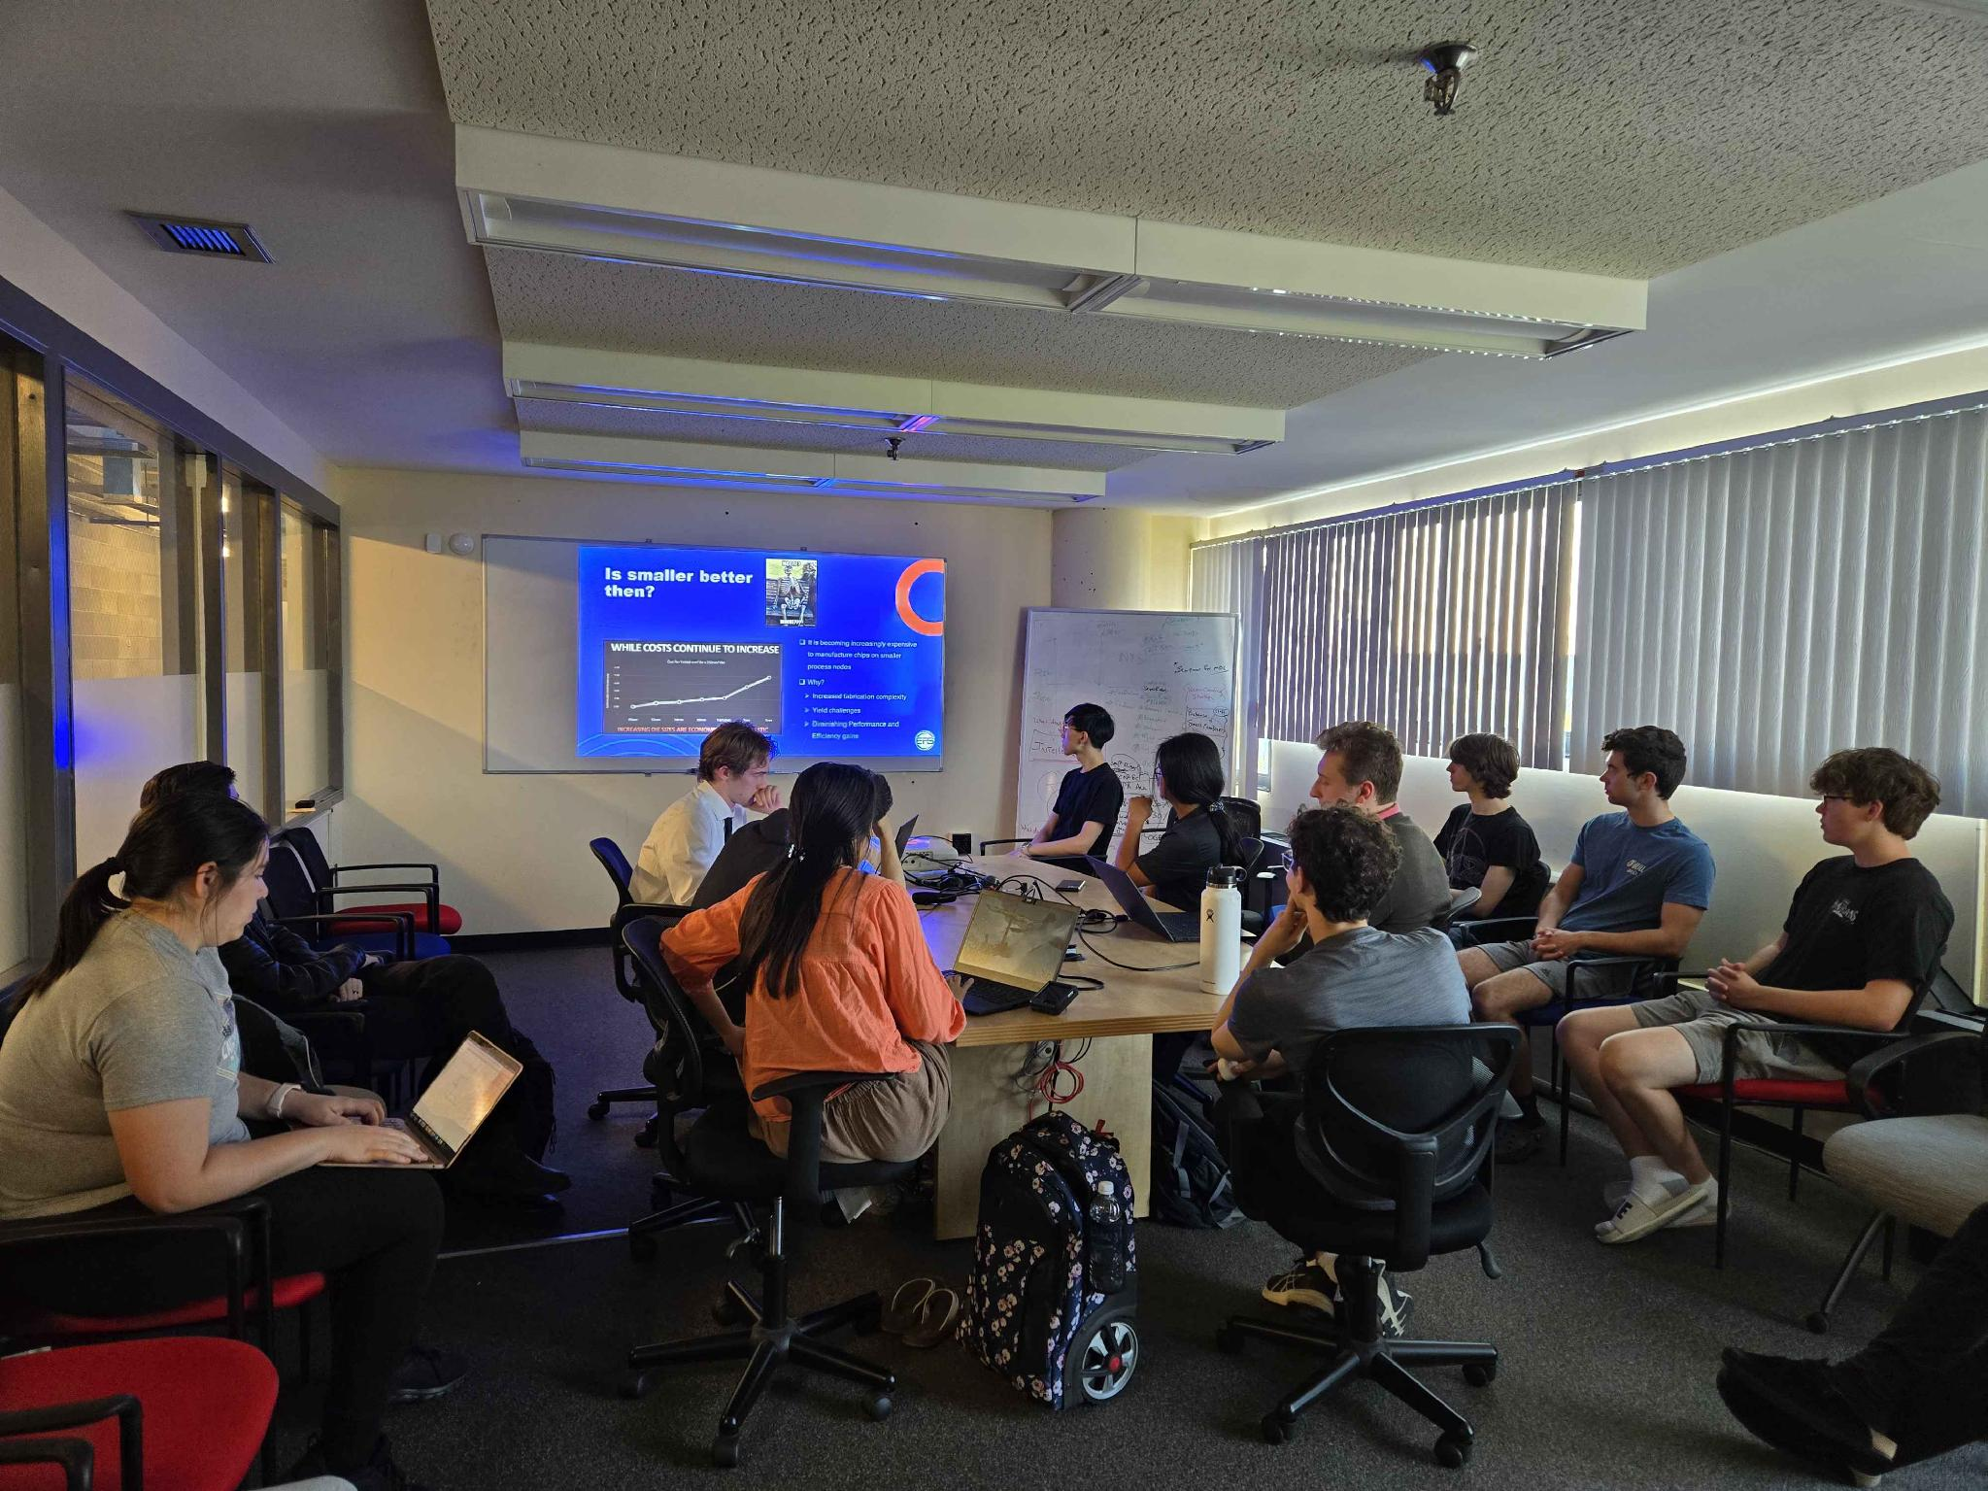
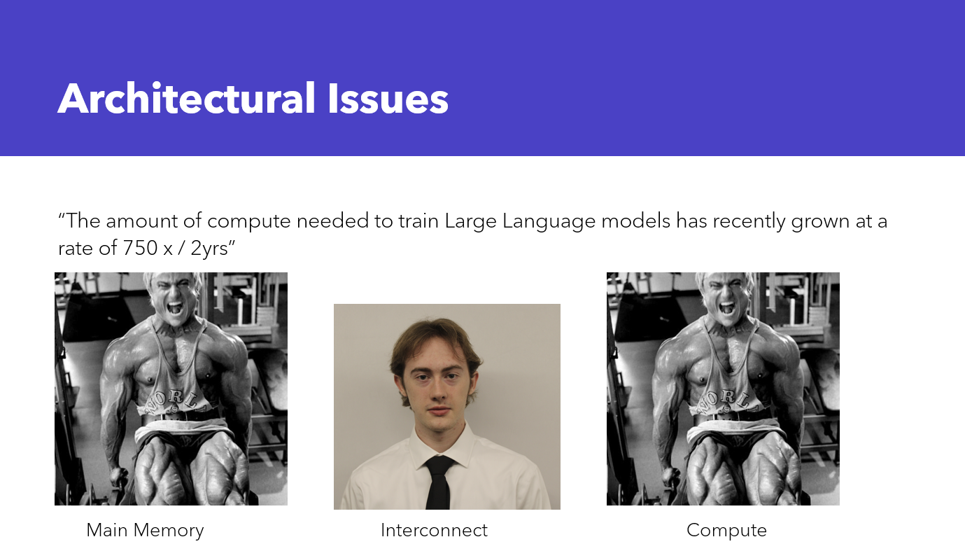
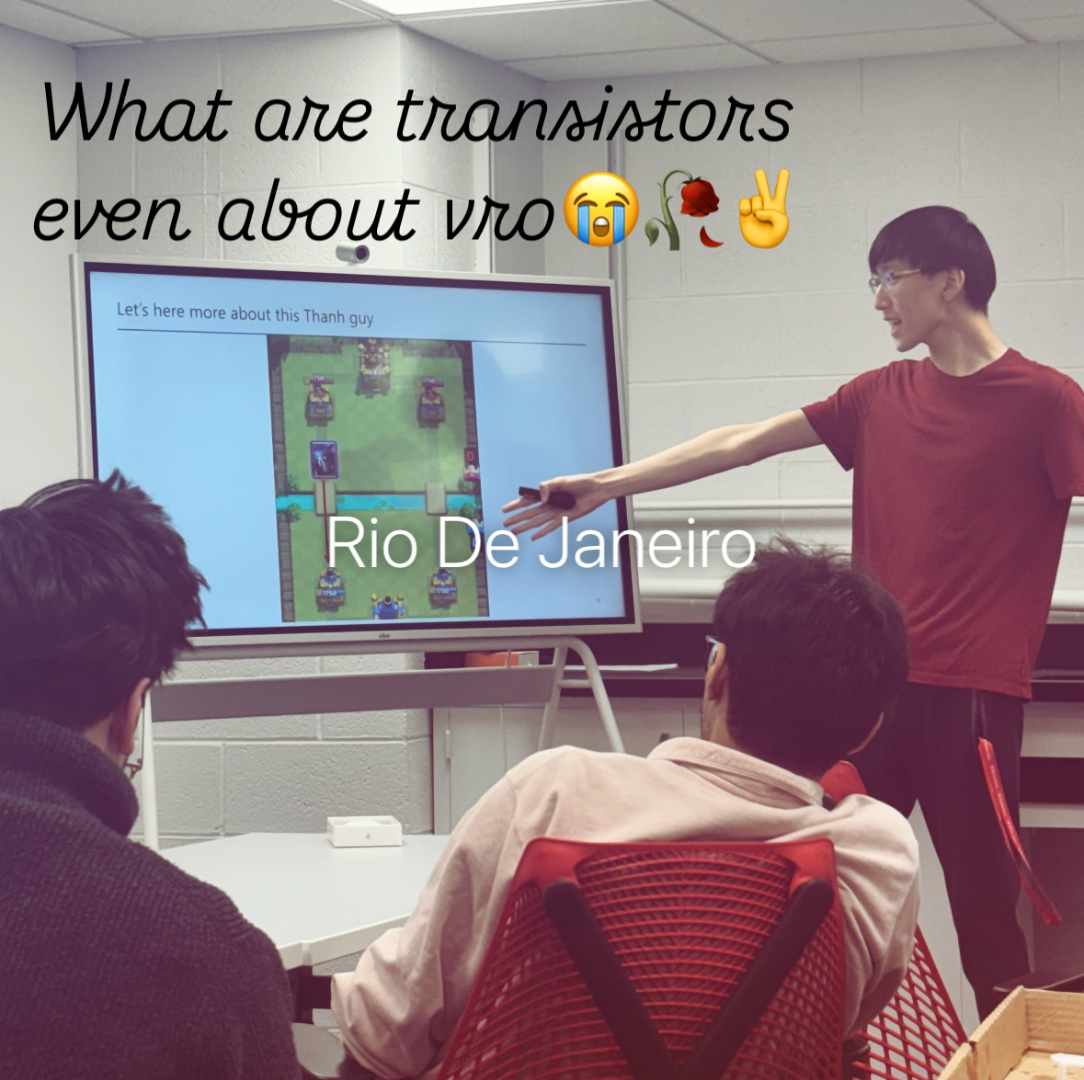
Knowledge – Seminar Series
Officer-led presentation and discussion on topical issues in the semiconductor field
Learn content that will prepare you for interviews & enable meaningful conversation with industry engineers
Excellent way to learn and engage with the field
Sometimes, there is pizza!

Slide 19
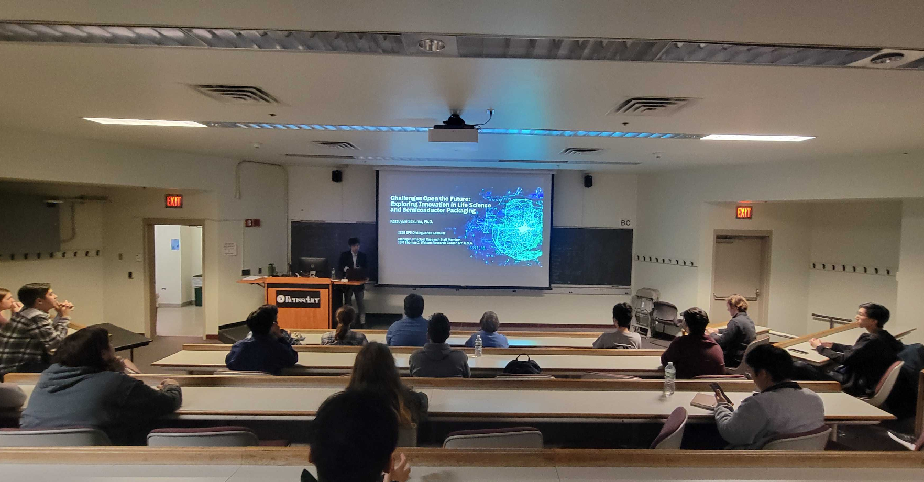
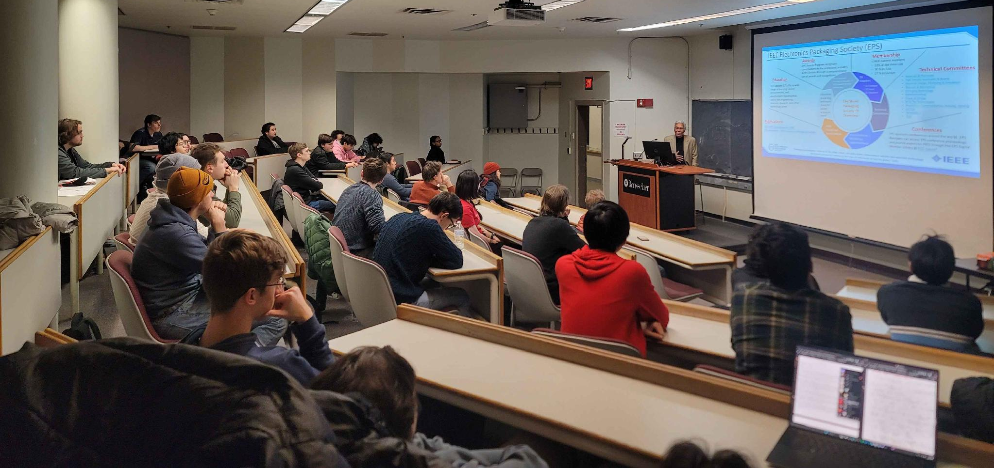
Knowledge – Distinguished Lecturer Seminars
EPS/EDS Distinguished Lecturers from industry and academia
Opportunities to learn about cutting edge research and connect directly with engineers and researchers from industry
There will be pizza!

Slide 20
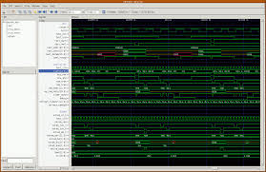
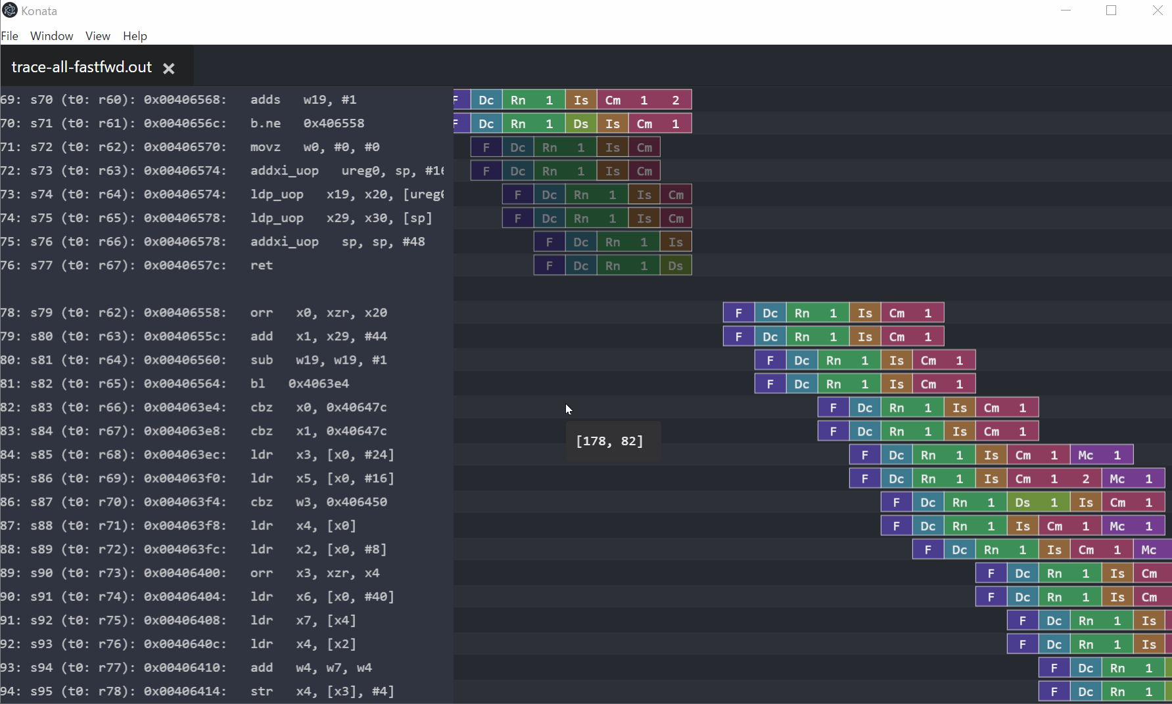
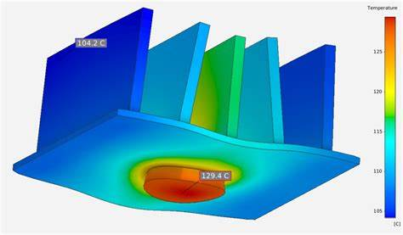
Knowledge – Mentorship
Project-Based Learning: Emphasizing hands-on experience, the program allows students to engage directly with real-world design challenges.
Tool-Focused: Focused on teaching well-known open-source or widely-used industry tools, the program provides students with a solid understanding of their functionality and practical applications.

Slide 21
Packaging Foundations
Let’s get technical

Slide 22


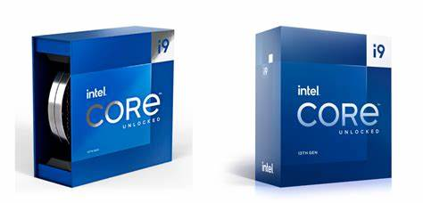
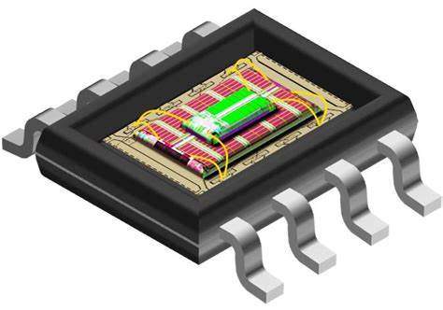
What is this “packaging” you speak of?

Slide 23
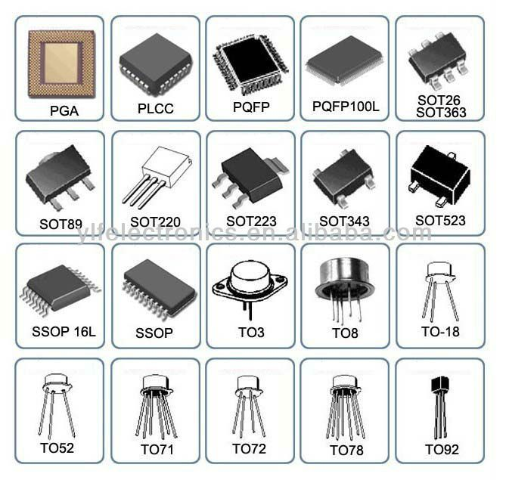
What is this “packaging” you speak of?
Physical Enclosure of Chips: IC packaging refers to the protective housing that encloses integrated circuits.
Ensures Protection:
  Mechanical: Kinetic shocks, pressure, or vibrations can fracture a wafer.
  Chemical: Exposure to moisture or other chemicals can lead to corrosion of metal parts
  Thermal: Protects against thermal changes in the environment and ensures good heat dissipation

Slide 24
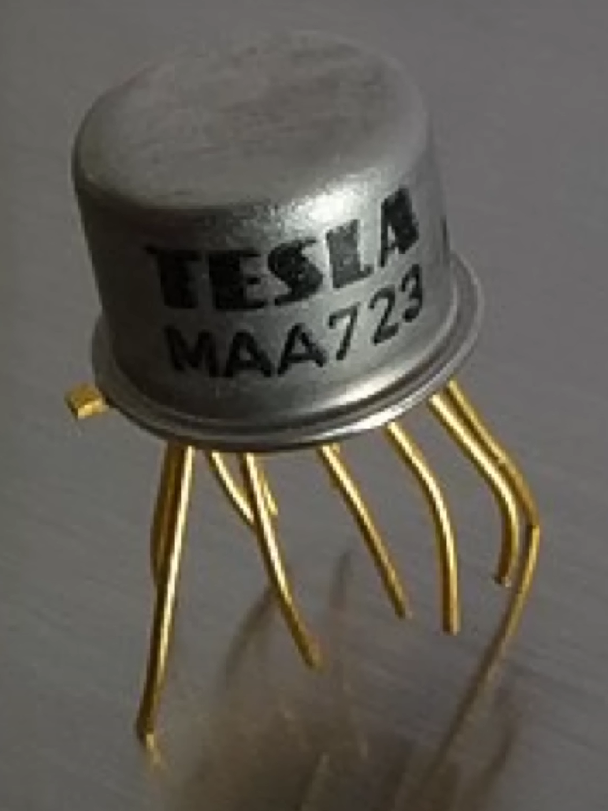
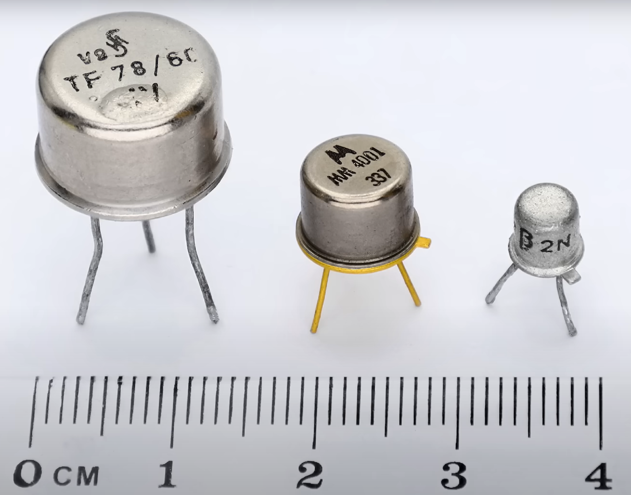
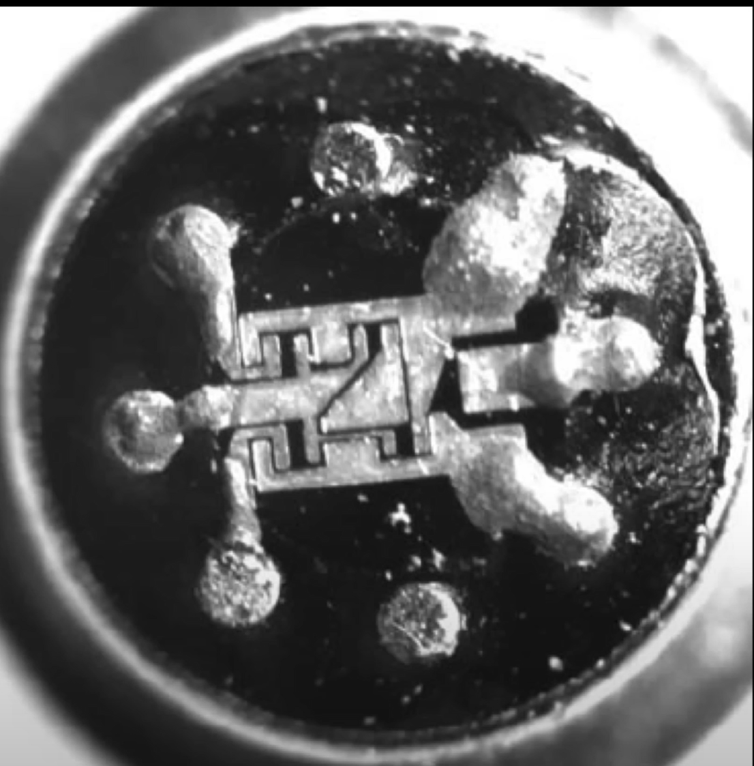
How did we begin? (1970)
In the beginning, only the military and aerospace companies used semiconductor devices.
  Cost wasn’t an issue
  Total Reliability
Die is hermetically sealed inside a can with the leads coming from the bottom.
  Referred to as a transistor outline (TO) package
  It is also referred to as a squid package
Problem: Only supports a max of 8-10 leads.

Slide 25
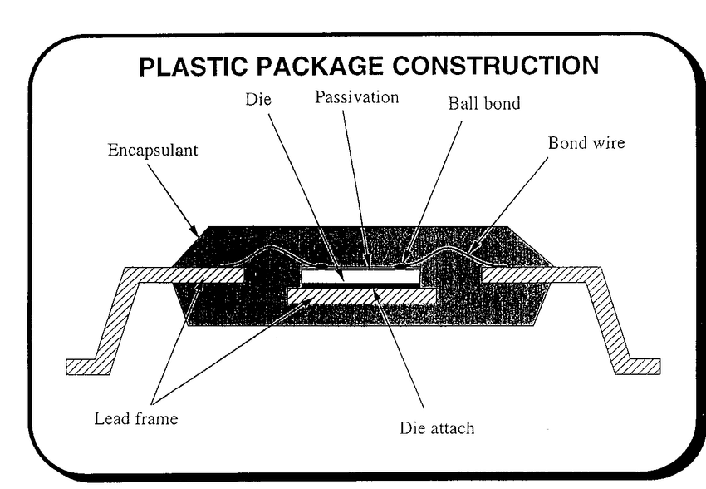
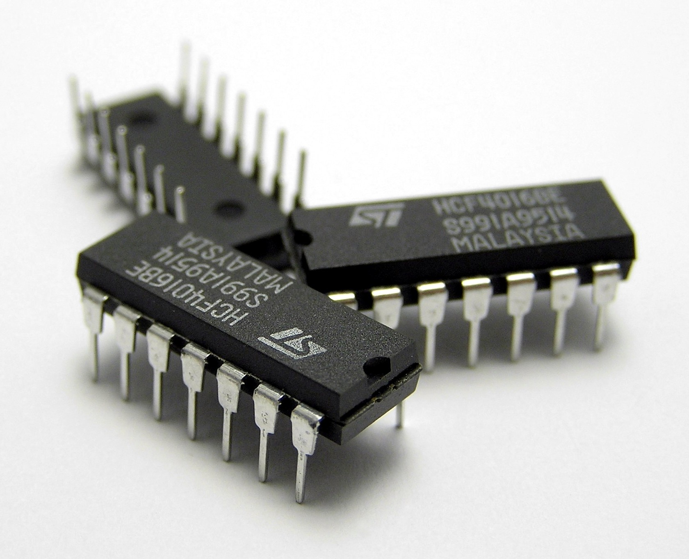
How did we evolve? (1970-1990)
Dual inline package became the new state of the art
Plastic encapsulation became the new package manufacturing process
  Primarily driven by, of course, Fairchild Semiconductor
Had poor thermal and chemical characteristics but plastic is cheap and easy to do
  Allowed us to easily outsource to Asia early on

Slide 26
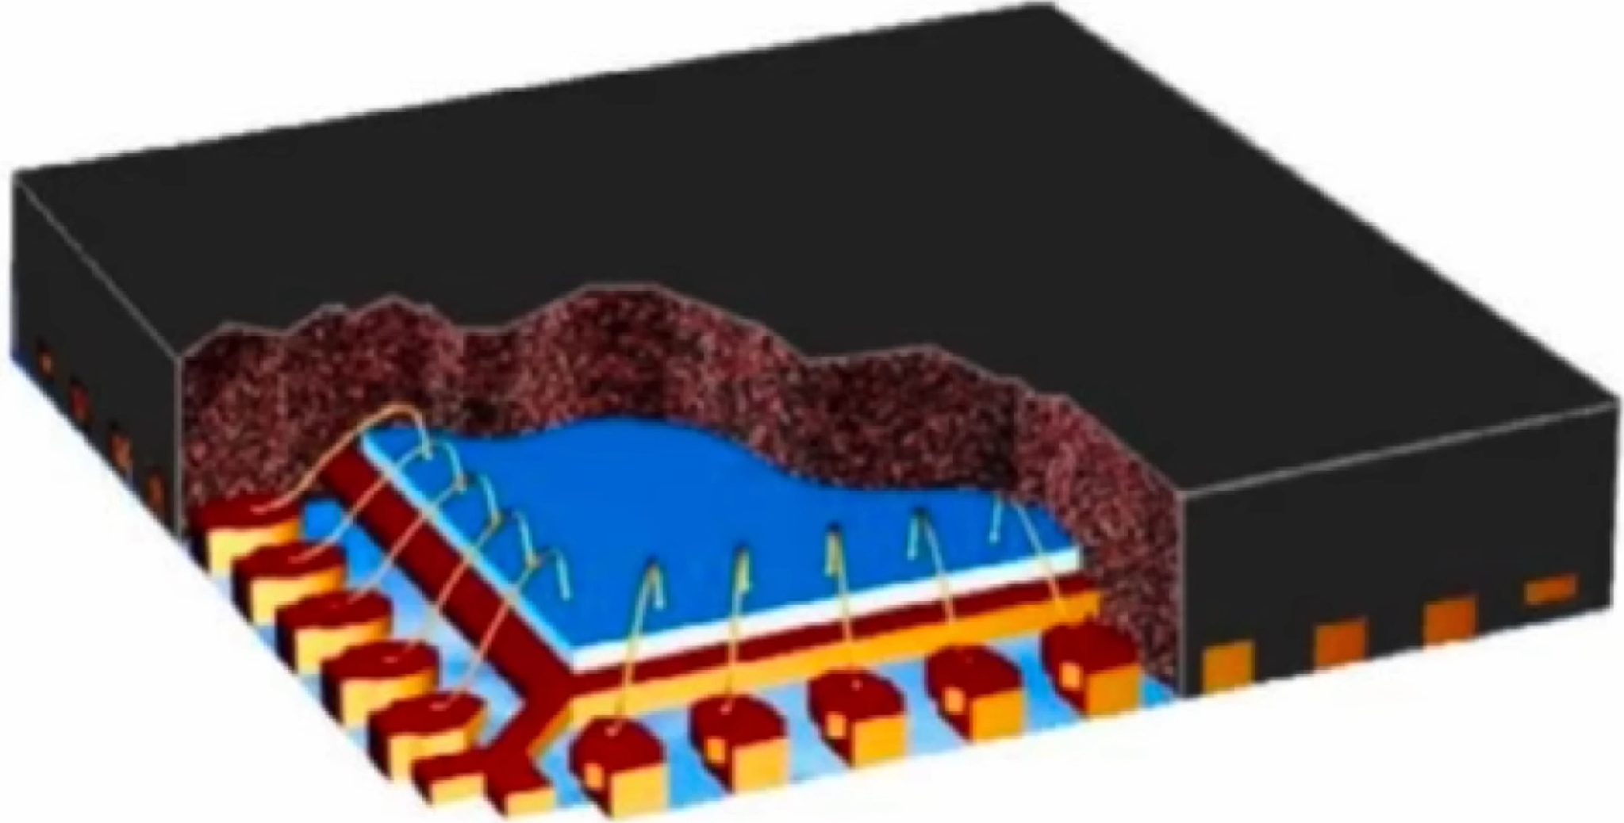
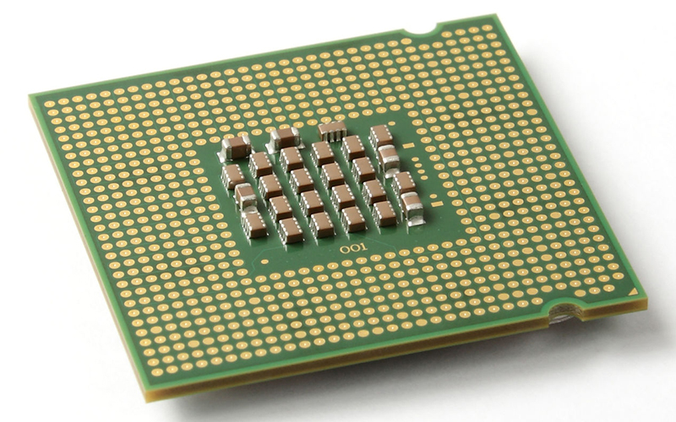
The start of VLSI (1990-2000)
Our chips are now starting to require more IO than ever.
  DIPs are no longer feasible for larger or more complicated chips, as the packaging would become unbelievably large.
Introduction of the quad flat package (QFP) that uses surface mounting technology (SMT) as opposed to through-hole mounting.
Socketed packaging options also became available such as the LGA

Slide 27
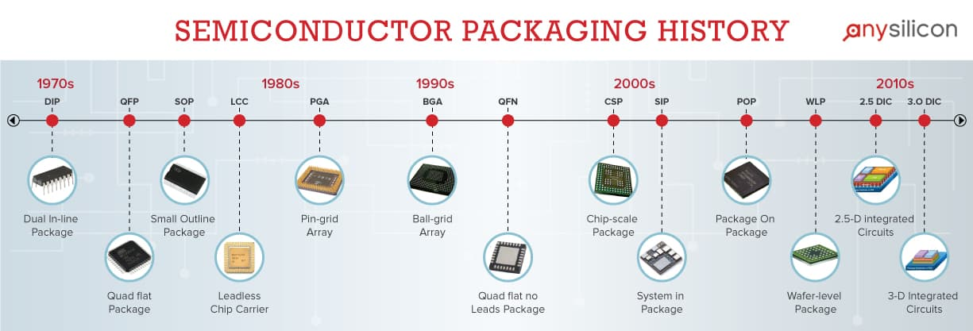
Packaging History
NOT VERY EXCITING
VERY EXCITING

Slide 28


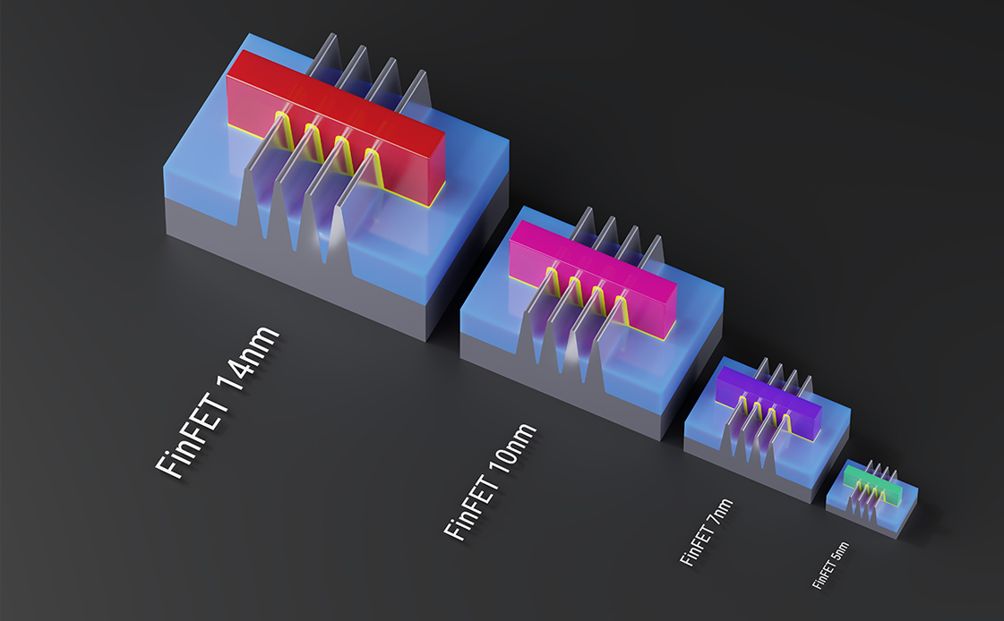

Integrated Circuit Innovations
Moore’s Law
Continuous growth in transistor count
1.4x Annual Performance Improvement for 40+ Years ≈ 10,000x
Dennard Scaling
Power per transistor shrinks as speed and density increase
Energy expended per computation is reducing
Clock Rate Evolution
3 MHz to 4 GHz (improved through both technology and architecture)

Slide 29
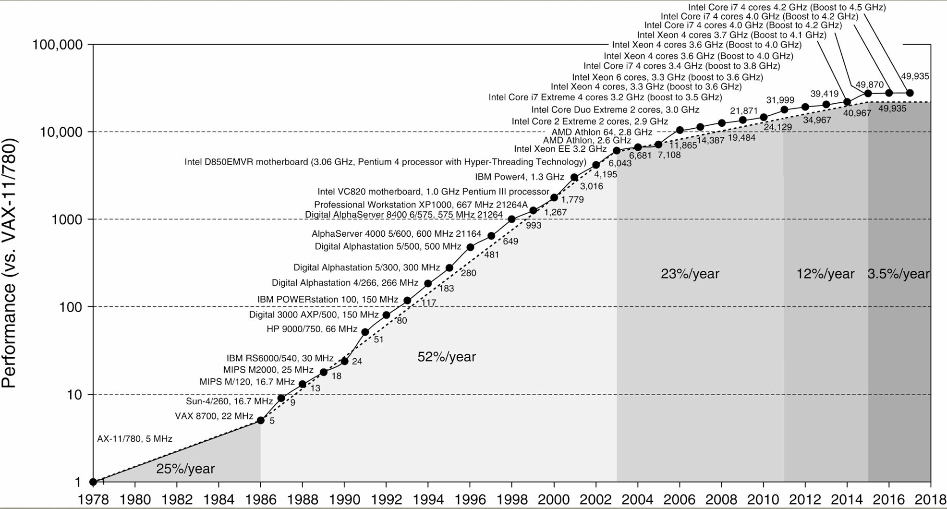
Uni-Processor Performance (Single Core)
Plateauing of DRAM Density, and Computing Performance. Source: J Hennessy, ERI Conf July 2018

Slide 30
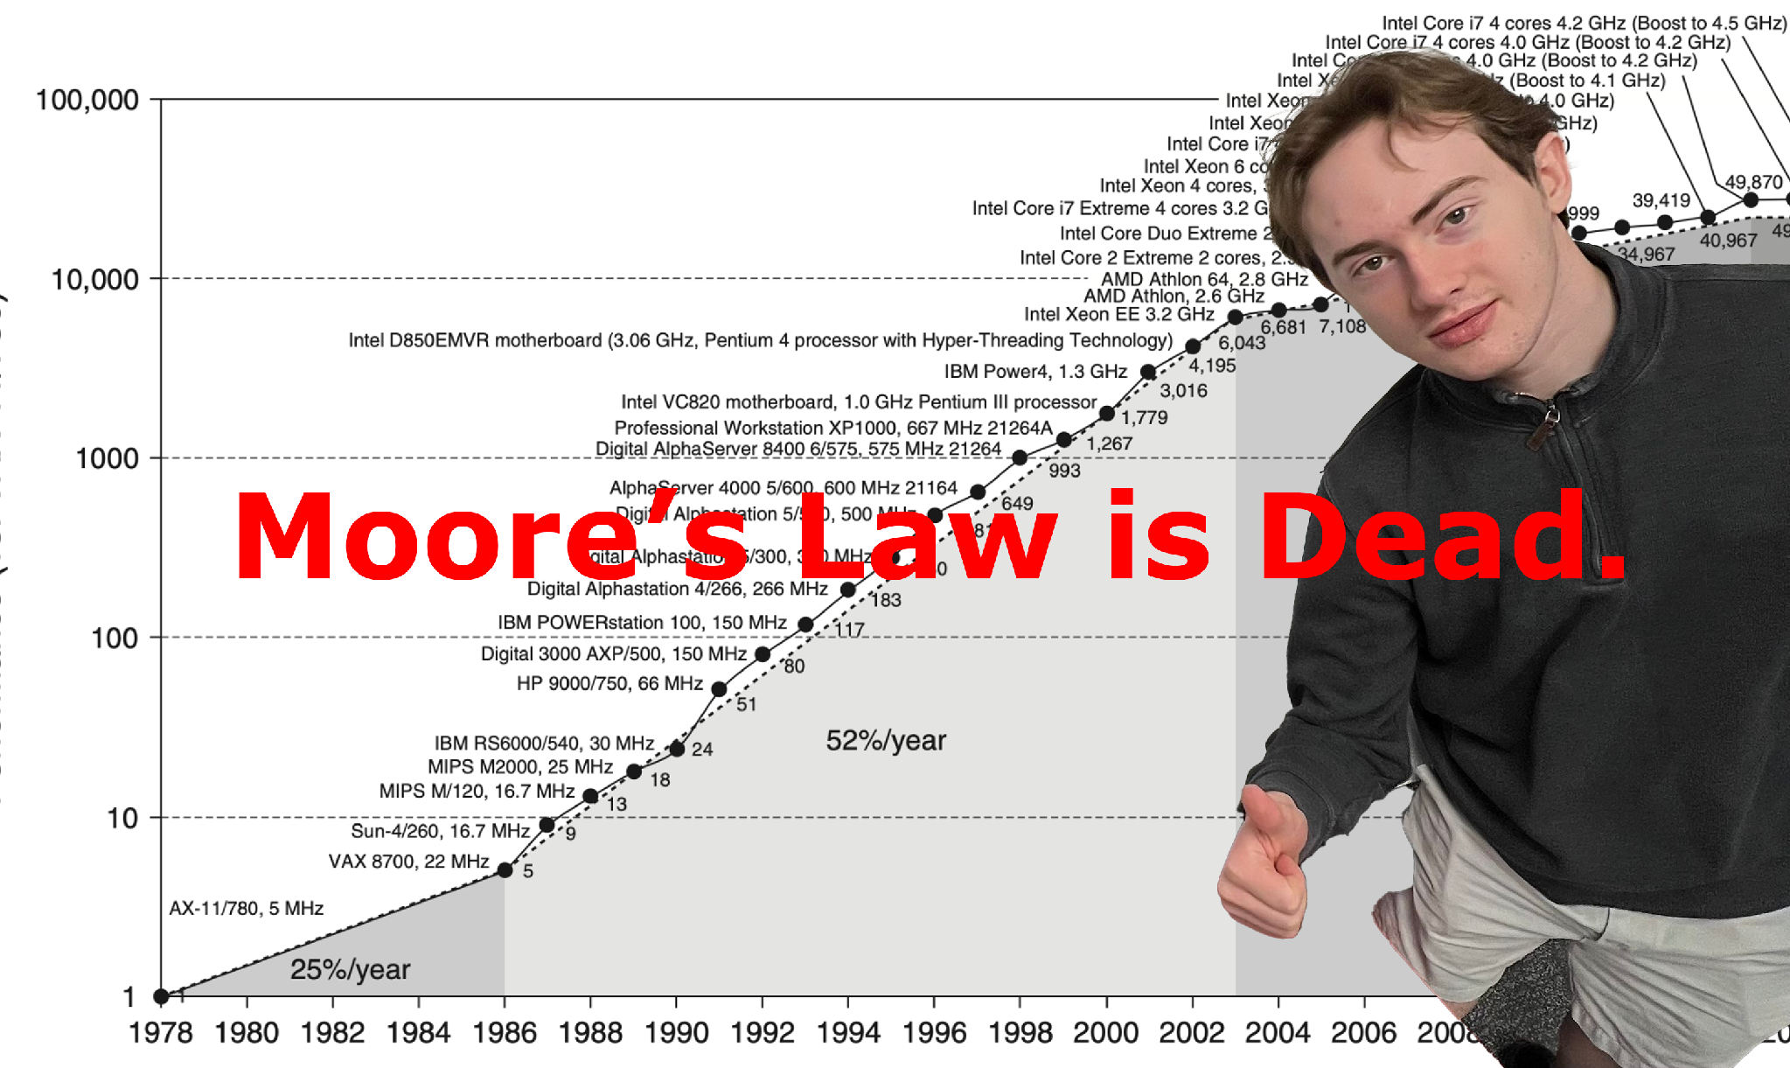
Uni-Processor Performance (Single Core)

Slide 31
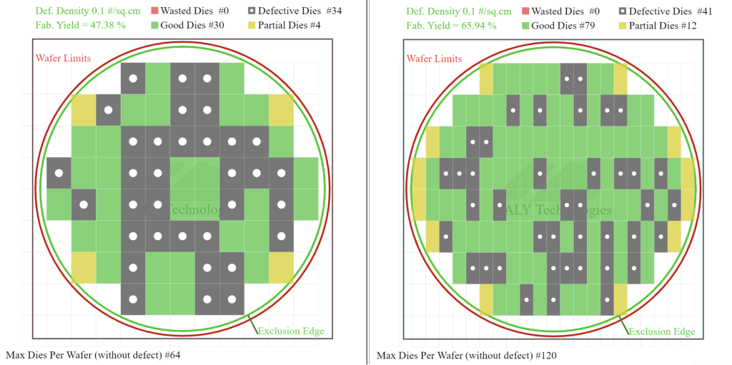
Let’s make the chips bigger!

Slide 32
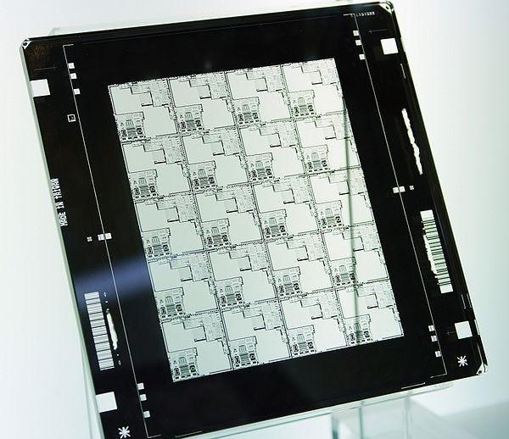
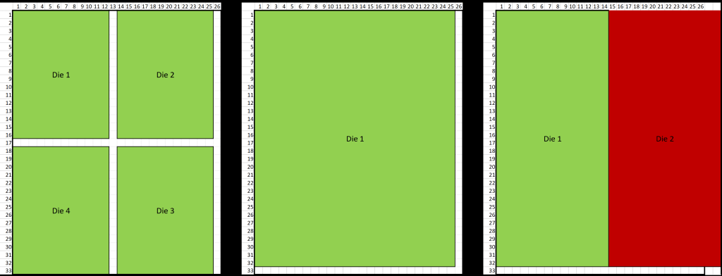
A more recent challenge
A standard reticle is 104mm by 132mm
Most designs do not perfectly line up with the 104 mm by 132 mm dimensions.
  This results in a portion of the photomask not being exposed.
  This is what reticle utilization is about.

Slide 33
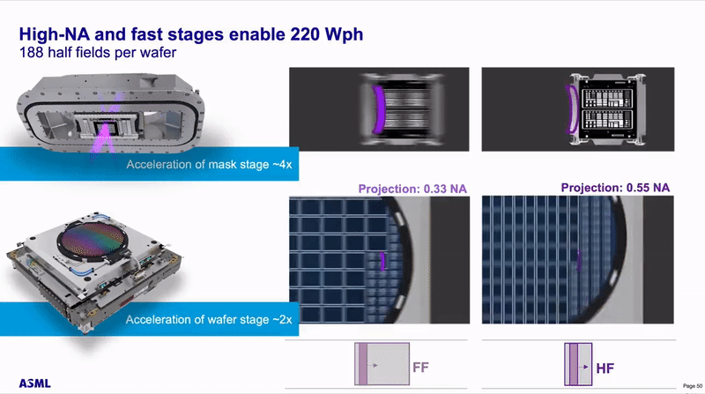
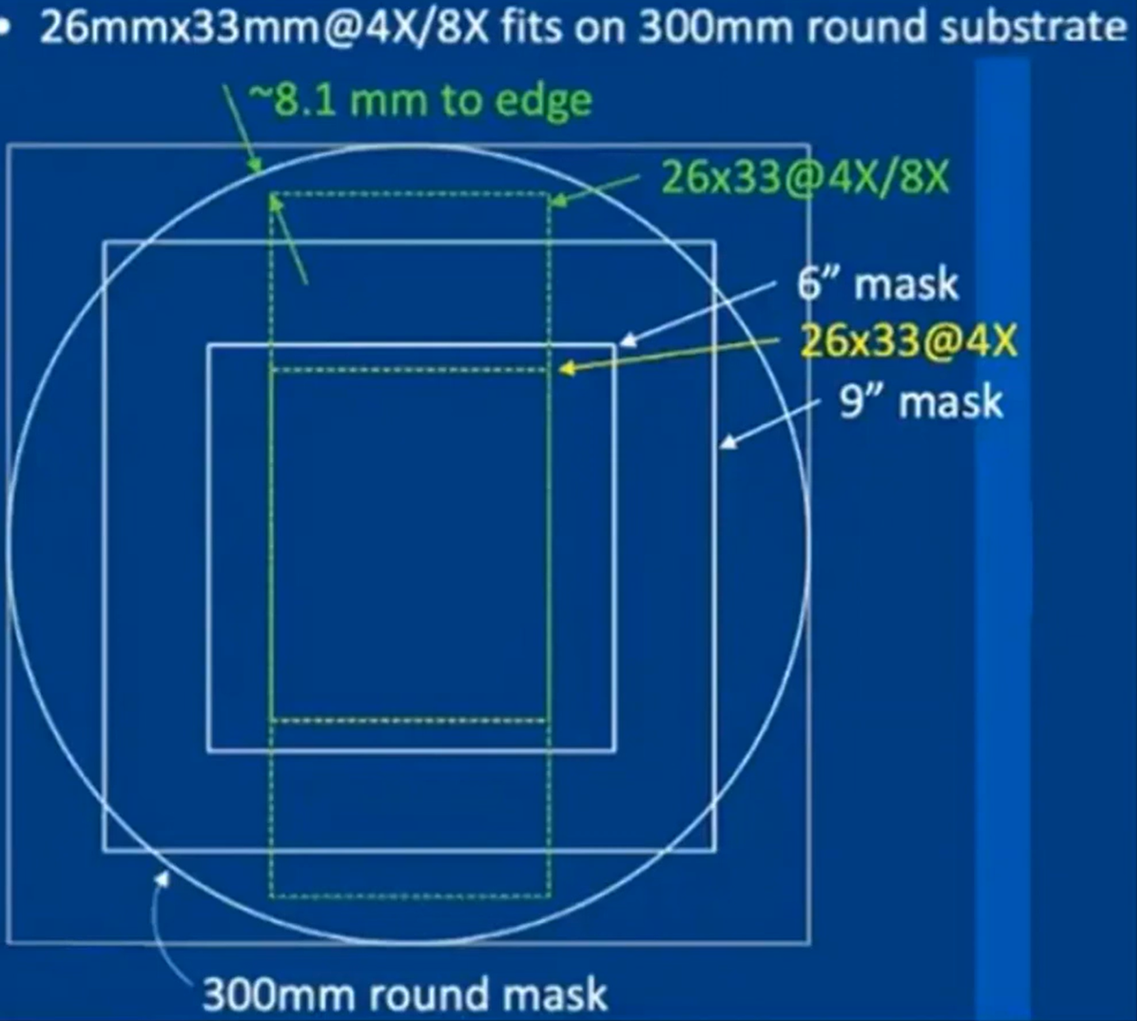
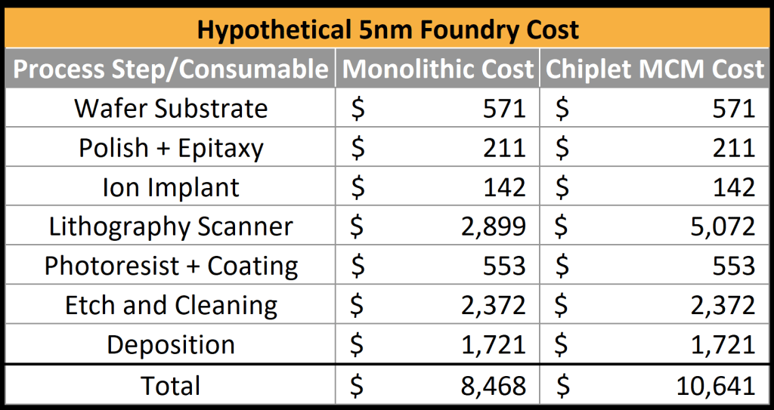
A more recent challenge
Why exactly is this problem?
  Loss of reticle utilization
  Misalignment chances increase
This may not seem like a big deal, but lithography tool cost increases with time.

Slide 34
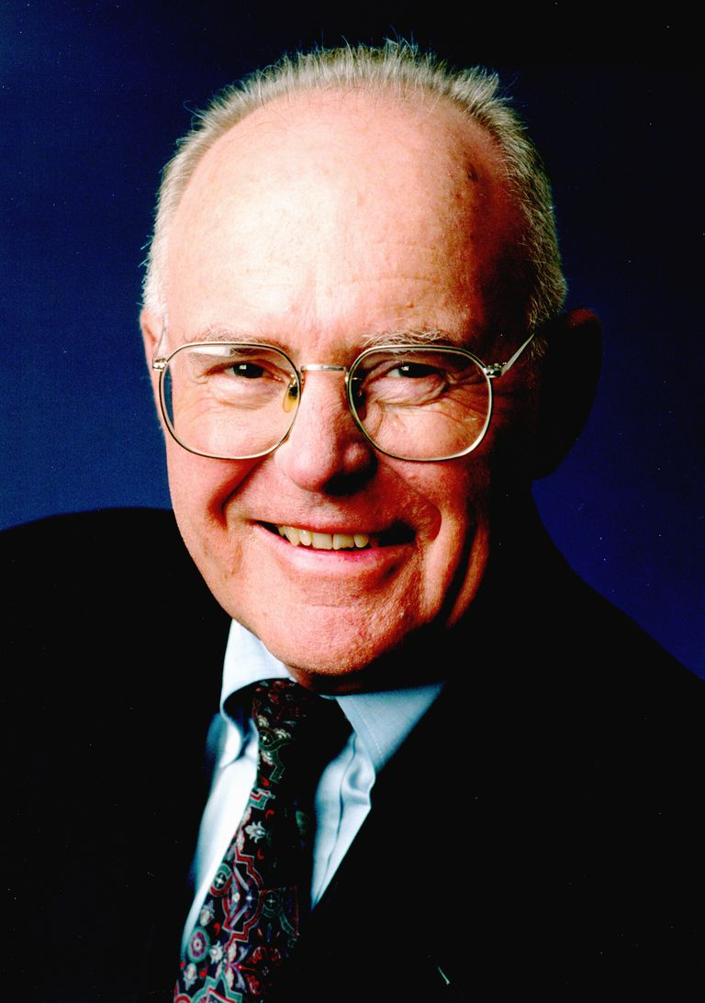
A Quote from Gordon Moore
“It may prove to be more economical to build large systems out of smaller functions, which are separately packaged and interconnected.“
        Gordon Moore, 1965
        (Founder of Moore’s Law)

Slide 35
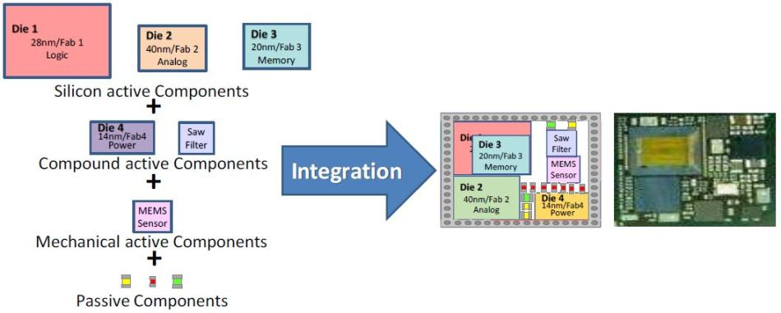
What is Heterogeneous Integration?
Involves combining different types of components, such as logic, memory, sensors, and more, into a single package.
Provides a way to continue advancing performance when scaling traditional chips becomes too costly or inefficient.
Enables integration of components built on different process nodes or with different materials.

Slide 36
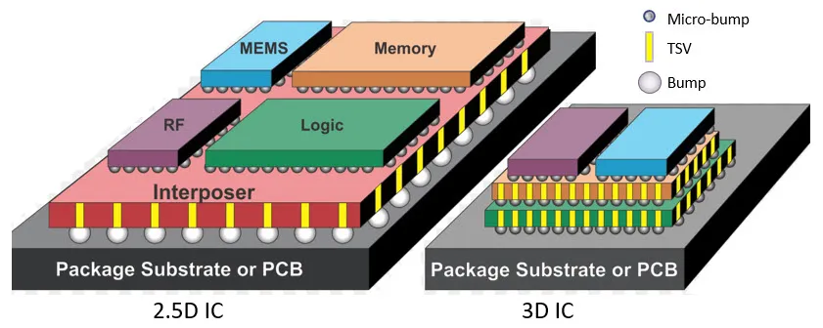
What is Heterogeneous Integration?
2.5D Heterogeneous Integration:
  Uses an interposer (usually silicon) to connect multiple dies side by side.
  Less complex than 3D in heat dissipation and design, but still allows for integrating different process technologies.
  Commonly used in high-performance computing and graphics processors.
3D Heterogeneous Integration:
  Involves stacking multiple dies vertically
  More compact and allows for shorter signal paths, resulting in faster communication between components.
  More challenging in terms of thermal management due to stacked layers, requiring advanced cooling solutions.
  Used in memory stacking (e.g., High Bandwidth Memory or HBM) and advanced logic integration.

Slide 37
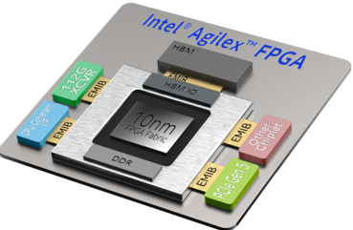
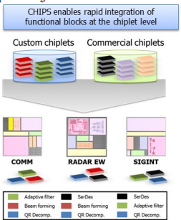
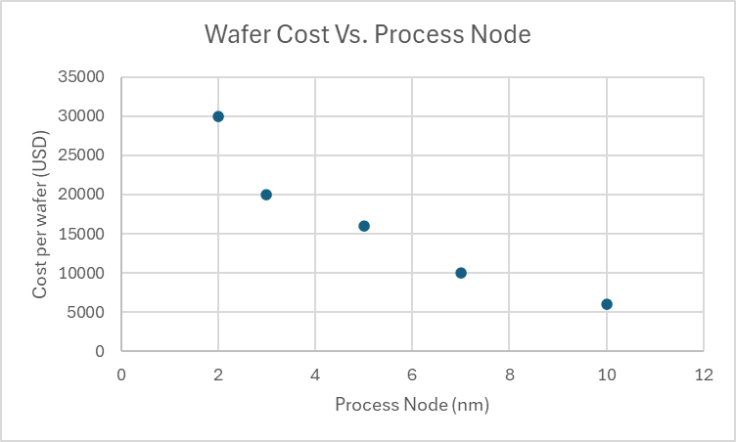
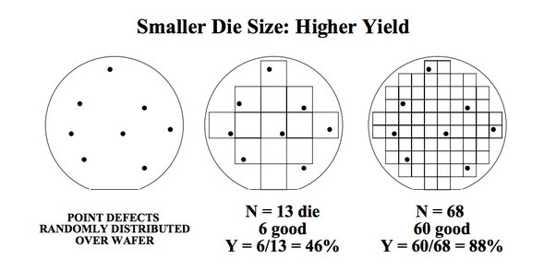
Advantages of Heterogeneous Integration
Innovative packaging solutions can improve:
  Time to market for new technology
  Yield/cost-effectiveness

Slide 38

Packaging Industry Impact
Impacts many industries in the economy:
High-Performance Computing and Data Centers
Medical, Health, and Wearables
Autonomous Automotive
Mobile
Aerospace and Defense
IoT
Co-packaged Optics

Slide 39
Any questions?

Slide 40



Get Involved!
Join our Discord!

Slide 41
Thank you!

