Slide 1
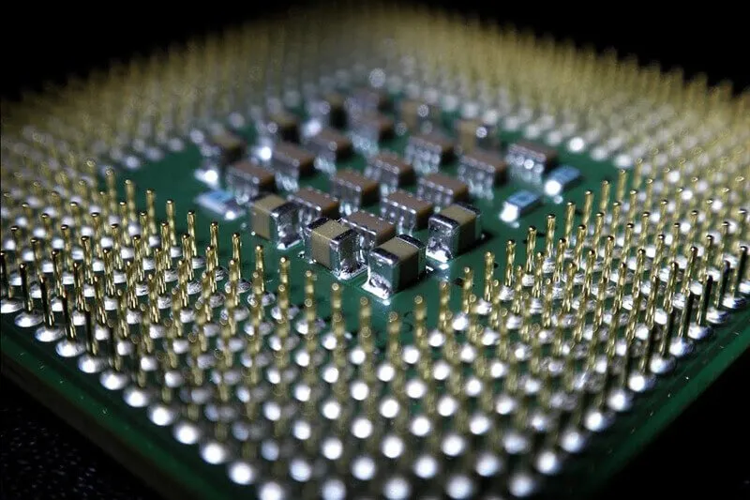
Chip Building
From Wafer to Package
J Kendra Jan. 29

Slide 2
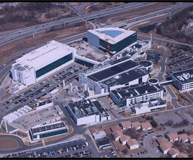

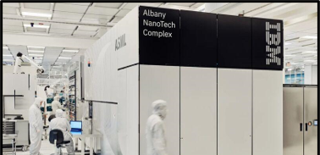
General Updates
Albany Nanotech Complex Tour
  Most advanced semiconductor research and development facility in the US
  1.65 million square feet of cool stuff

Slide 3
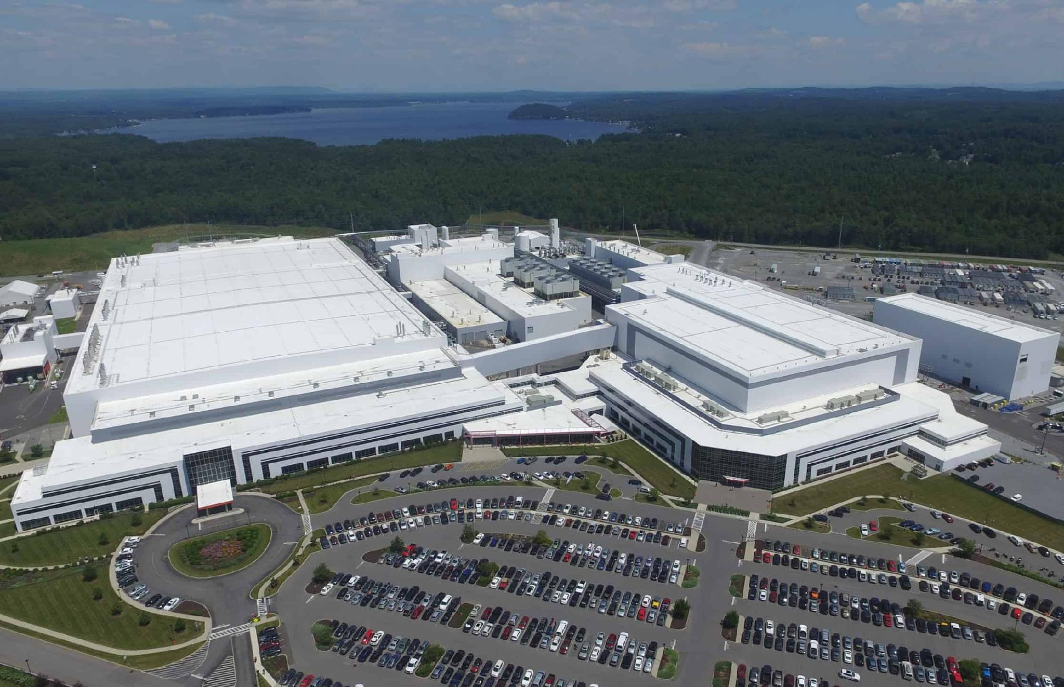
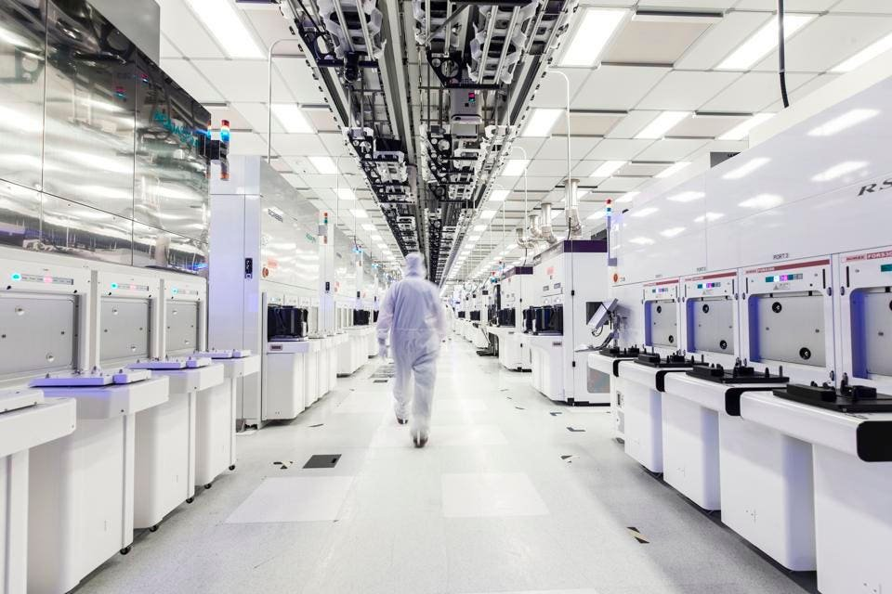

General Updates
GlobalFoundries Fab 8 Tour
  GlobalFoundries Headquarters
  30 minutes from Troy
  Get to go into the fab and see equipment close up
  Talk w/ and ask questions to real GF engineers!
Interest Form

Slide 4

What is a transistor?
https://youtu.be/Bfvyj88Hs_o?si=pmCoD15TxR33lPaB&t=68

Slide 5
How many processing steps does it take to make…
-A transistor?
-A full die (E.g. CPU)

Slide 6
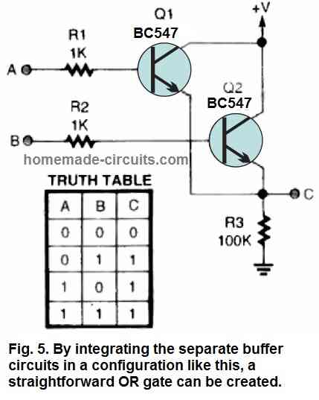
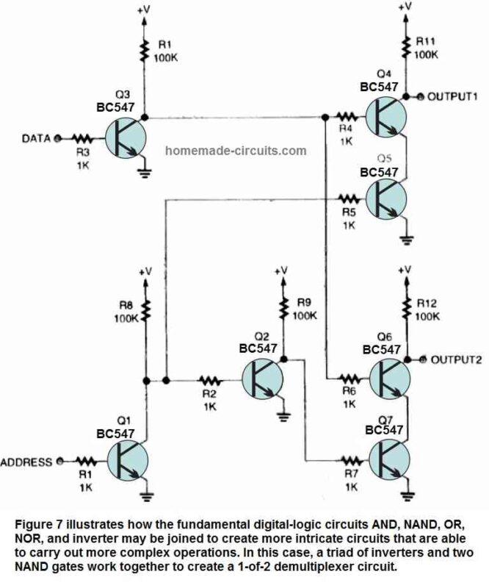
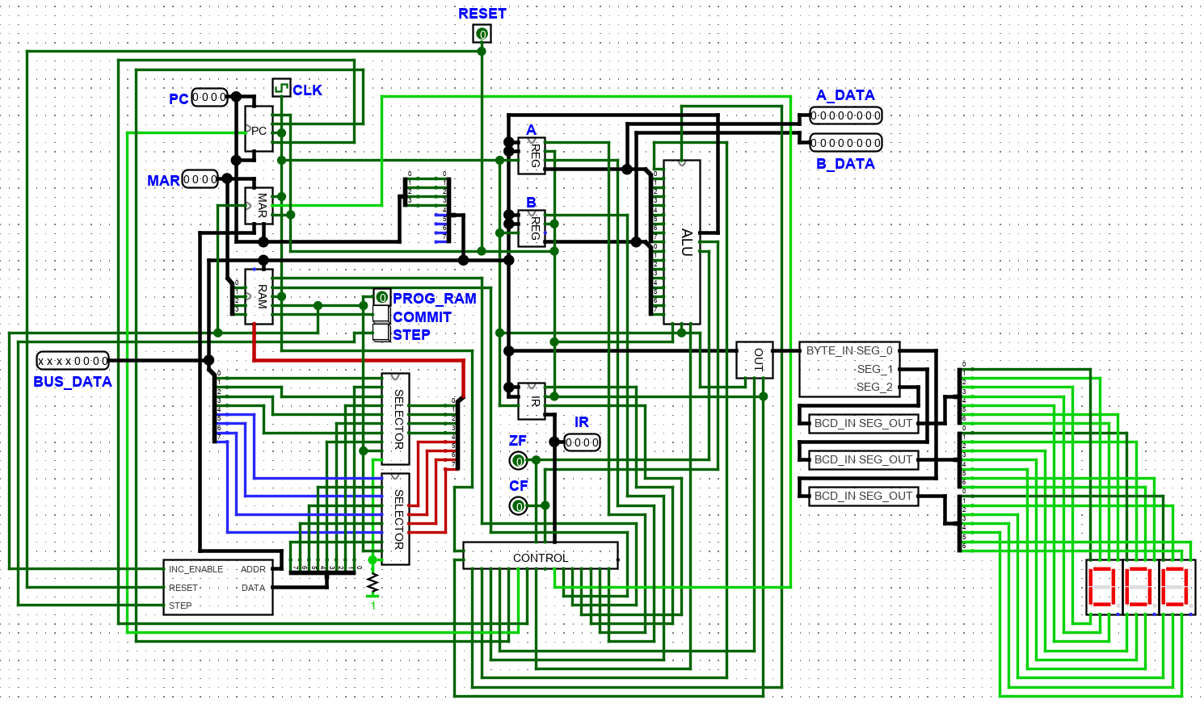
The Transistor: How does this compute anything?
Basic Flow:
Transistors -> Logic Gates
Logic Gates -> Discrete Math
Discrete Math -> Computing

Slide 7
MOSFET Fabrication Tools/Processes
Oxide Growth
Lithography
Etching
Implantation/Doping
Deposition

Slide 8
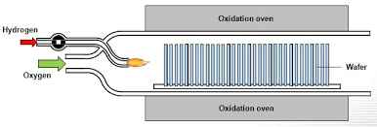
Oxide Growth
Purpose: Create the gate insulator
Process:
Oxide growth is the process of growing a thin layer of silicon dioxide (SiO₂) on the surface of a silicon wafer.
This layer is typically created by exposing the silicon to oxygen or steam at high temperatures in a furnace.
Silicon dioxide acts as an insulator between the gate and the semiconductor, preventing current leakage and controlling the electrical behavior of the transistor.
Types of Oxide Growth:
Thermal Oxidation: Direct oxidation in a furnace by reacting silicon with dry or wet oxygen.
Chemical Vapor Deposition (CVD): A method where oxide is deposited onto the wafer surface using a chemical reaction.
Notes:
Importance: The quality and thickness of the oxide layer are crucial for the performance and scaling of transistors in integrated circuits.

Slide 9
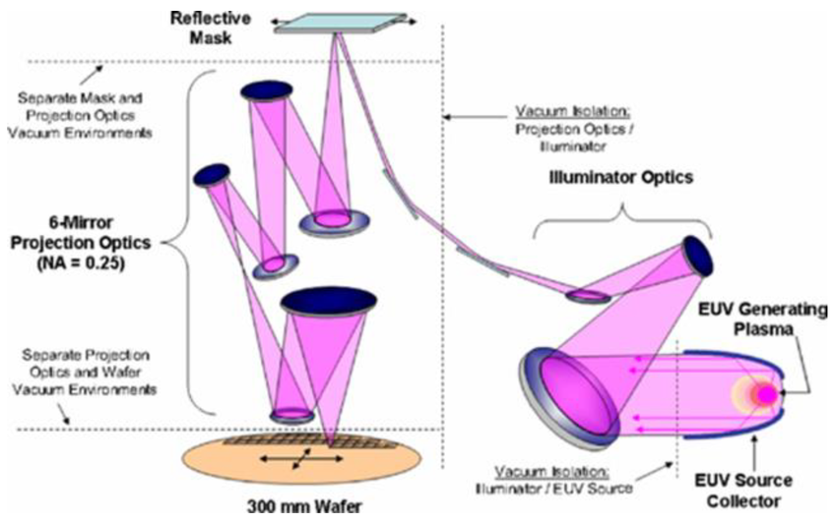
Lithography
Purpose: Define patterns on the wafer for circuit elements.
Process:
Lithography is a method used to transfer patterns from a mask to a wafer.
It involves applying a photoresist layer on the wafer, which is sensitive to light.
The wafer is then exposed to ultraviolet (UV) light through a photomask, which defines the pattern of the circuit.
Types of Lithography:
Photolithography: Uses UV light to transfer the mask pattern.
E-Beam Lithography: Uses a focused beam of electrons to write custom patterns, often used in research or prototype production.
Extreme Ultraviolet (EUV) Lithography: A cutting-edge technology for producing smaller features in advanced semiconductor manufacturing.
Notes:
Importance:
Lithography is a critical step in fabricating integrated circuits (ICs), determining the resolution and scale of features.
Advanced lithography enables continued scaling of transistors, in line with Moore's Law, for faster and more efficient devices.

Slide 10
Lithography - Photoresists
Photoresist: A chemical that becomes stronger or weaker when exposed to light.
Positive
Long Polymer Chains
Light Breaks Molecular Bonds
Becomes Weaker When Exposed
Negative
Small Molecules
Light Forms Molecular Bonds
Becomes Stronger When Exposed

Slide 11
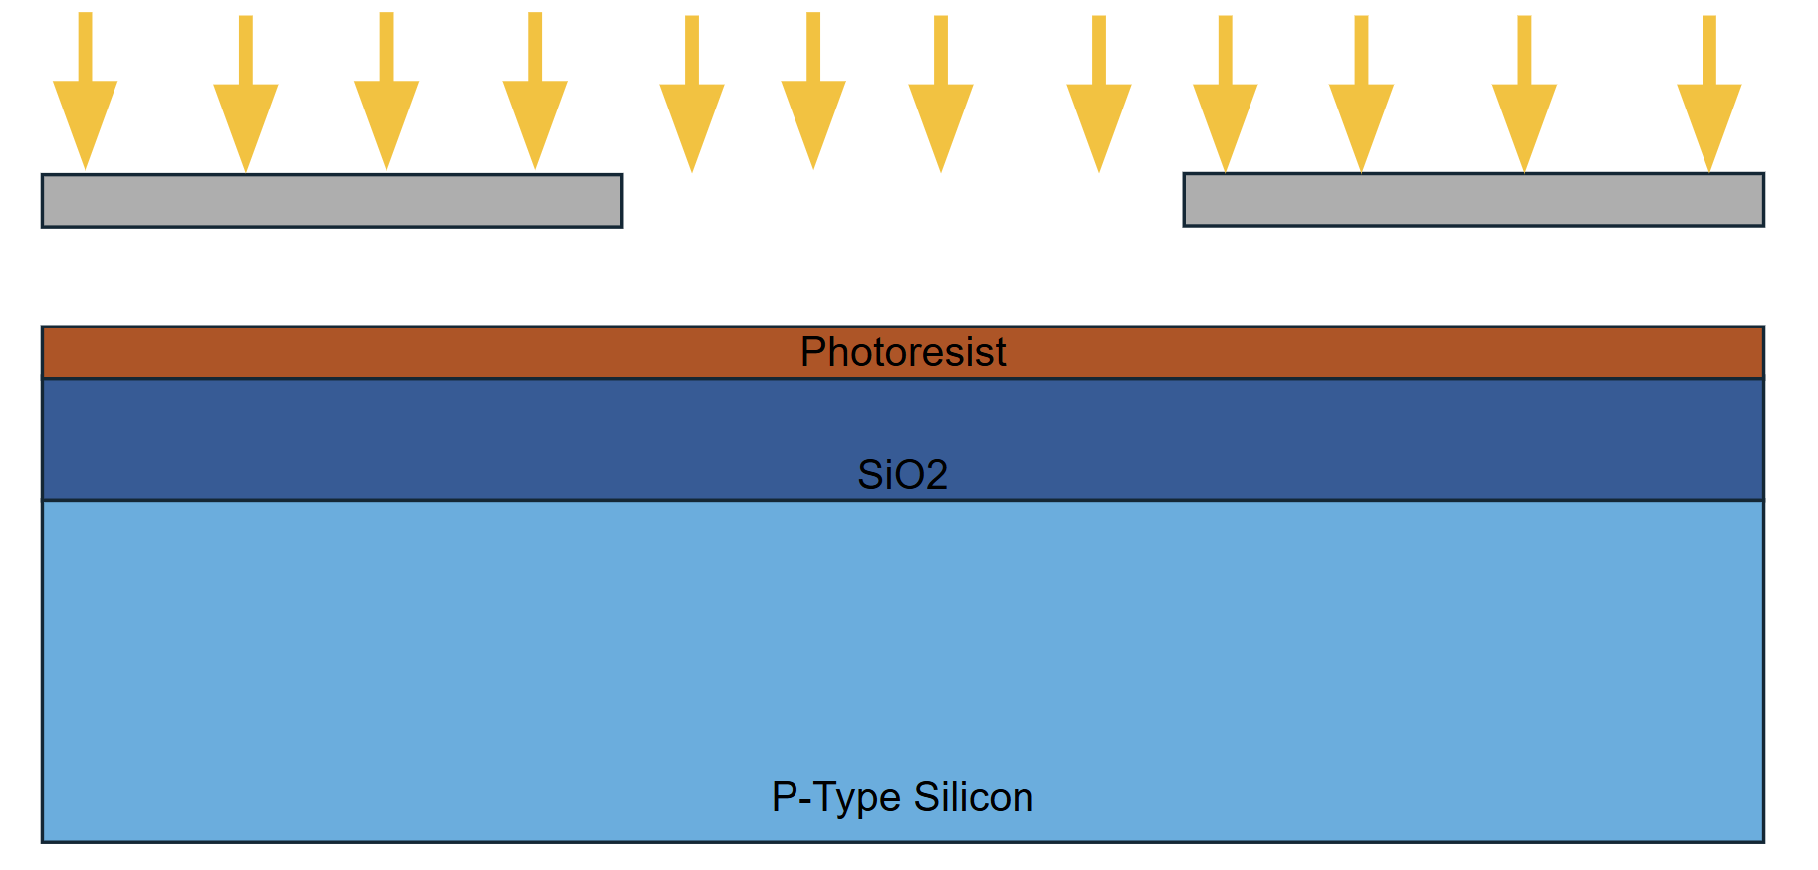
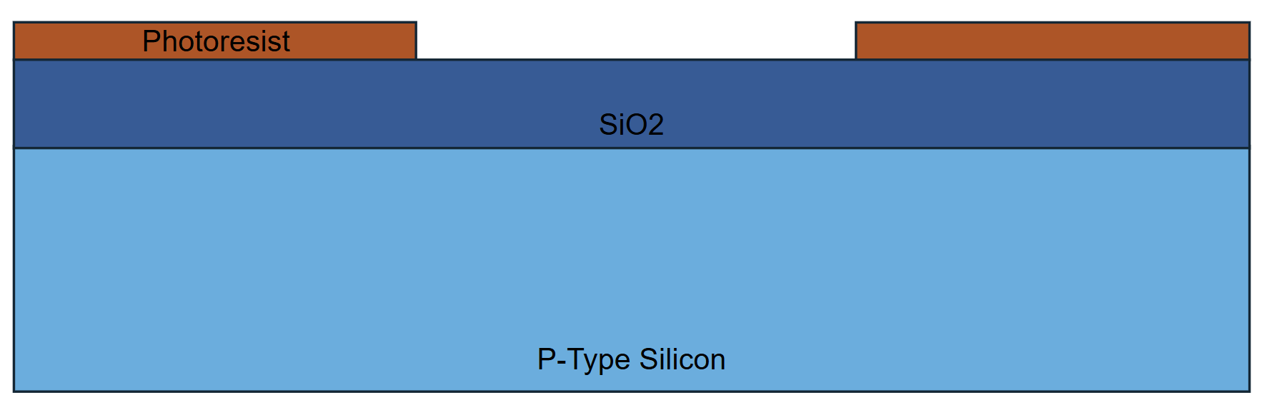

Positive
Negative

Slide 12
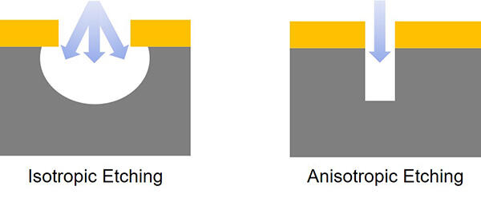
Etching
Purpose: Remove material to define specific structures on the wafer.
Process:
Etching is used to remove layers of material from the wafer to create the desired patterns defined by lithography.
It can be used to selectively remove exposed areas of the wafer or thin films after the photoresist has been patterned.
The etching process needs to be precise to ensure that only specific areas are removed while maintaining the integrity of other regions.
Types of Etching:
Wet Etching:
  Uses liquid chemicals (acids or bases) to dissolve materials.
  Offers good selectivity but may lack precision for small-scale features.
Dry Etching:
  Uses gases or plasmas (ionized gases) to etch materials.
  More precise and widely used in advanced semiconductor manufacturing.
  Examples include Reactive Ion Etching (RIE), which combines chemical and physical processes for better control.

Slide 13
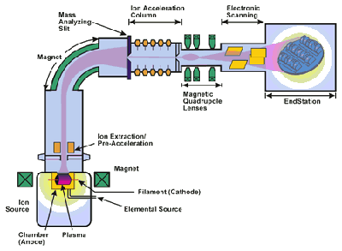
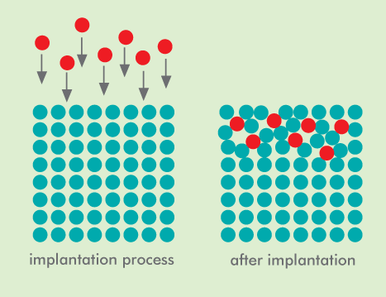
Implantation/Doping
Purpose: Modify the electrical properties of the semiconductor by introducing impurities (dopants).
Process:
Doping introduces atoms of elements such as boron (for p-type) or phosphorus (for n-type) into the silicon wafer to alter its conductivity.
This is done by ion implantation, where ions are accelerated and embedded into the silicon surface at high velocities.
After implantation, the wafer is usually heated (annealed) to repair the crystal structure and activate the dopants, allowing them to take their places in the lattice.
Types of Dopants:
N-type Doping: Adds electrons to the material by introducing elements like phosphorus or arsenic, which have more electrons than silicon.
P-type Doping: Creates holes (positive charge carriers) by adding elements like boron, which have fewer electrons than silicon.
Notes:
Importance:
Doping controls the electrical characteristics of the semiconductor, enabling the creation of p-n junctions in transistors and diodes.

Slide 14

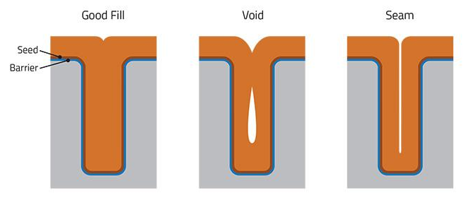
Material Deposition
Purpose: Place down new material to enable creation of complex structures
Process:
Metal deposition involves placing a thin layer of metal onto the surface of the wafer to create conductive connections.
Metals like aluminum, copper, or tungsten are commonly used because of their high conductivity.
After deposition, the metal is patterned using lithography and etching to form the desired circuit interconnects.
Types of Metal Deposition:
Physical Vapor Deposition (PVD):
  Metals are vaporized in a vacuum and deposited as a thin film on the wafer.
  Common methods include Sputtering and Evaporation.
Chemical Vapor Deposition (CVD):
  A chemical reaction is used to deposit metal onto the wafer, often resulting in more uniform layers.
Electroplating:
  A layer of metal, commonly copper, is deposited on the wafer through an electrochemical process.

Slide 15
Make sense?
Let’s make a transistor

Slide 16
Final Goal
Insulating Layer
Ti
Polysilicon
SiO2
SiO2
N-doped Si
P-Type Silicon

Slide 17
0) Silicon Wafer arrives in fab
P-Type Silicon

Slide 18
Field Oxide Formation

Slide 19
Goal:
SiO2
SiO2
P-Type Silicon

Slide 20
1) Thermal Oxide Growth
SiO2
P-Type Silicon

Slide 21
2) Spin-coat Photoresist
Photoresist
SiO2
P-Type Silicon

Slide 22
3) Photoresist exposed to light through mask, developed
Photoresist
SiO2
P-Type Silicon

Slide 23
4) Uncured photoresist washed away
Photoresist
SiO2
SiO2
P-Type Silicon

Slide 24
5) SiO2 is etched to substrate below
Photoresist
SiO2
P-Type Silicon

Slide 25
6) Photoresist is removed via acid solution
SiO2
P-Type Silicon

Slide 26
7) Thin layer of SiO2 is deposited (Thermal Oxide Growth)
SiO2
SiO2
P-Type Silicon

Slide 27
Gate Creation

Slide 28
Goal:
Polysilicon
SiO2
SiO2
P-Type Silicon

Slide 29
8) Polysilicon is grown on wafer (LPCVD)
Polysilicon
SiO2
SiO2
P-Type Silicon

Slide 30
9) Photoresist is spun on surface
Photoresist
Polysilicon
SiO2
SiO2
P-Type Silicon

Slide 31
10) Exposed to light, developed
Photoresist
Polysilicon
SiO2
SiO2
P-Type Silicon

Slide 32
11) Photoresist is developed, uncured resist washed off
Polysilicon
Photoresist
SiO2
SiO2
P-Type Silicon

Slide 33
12) Polysilicon is etched, leaving SiO2 below
Photoresist
Polysilicon
SiO2
SiO2
P-Type Silicon

Slide 34
13) Acid wash removes Photoresist
Polysilicon
SiO2
SiO2
P-Type Silicon

Slide 35
Source/Drain Doping

Slide 36
Goal:
Polysilicon
SiO2
SiO2
N-doped Si
P-Type Silicon

Slide 37
14) More photoresist spun on
Photoresist
Polysilicon
SiO2
SiO2
P-Type Silicon

Slide 38
15) Photoresist developed, cleaned
Photoresist
Polysilicon
SiO2
SiO2
P-Type Silicon

Slide 39
16) SiO2 layer is etched, revealing bare silicon below
Photoresist
Polysilicon
SiO2
SiO2
P-Type Silicon

Slide 40
17) Photoresist is acid washed
Polysilicon
SiO2
SiO2
P-Type Silicon

Slide 41
18) Phosphorous is used to dope substrate
Phosphorous Atoms
Polysilicon
SiO2
SiO2
N-doped Si
P-Type Silicon

Slide 42
Metal Insulation Layer Creation

Slide 43
Goal:
Insulating Layer
Polysilicon
SiO2
SiO2
N-doped Si
P-Type Silicon

Slide 44
19) Insulating Oxide is deposited on surface
Insulating Layer
Polysilicon
SiO2
SiO2
N-doped Si
P-Type Silicon

Slide 45
20) Photoresist spun on again
Photoresist
Insulating Layer
Polysilicon
SiO2
SiO2
N-doped Si
P-Type Silicon

Slide 46
21) Exposed Again
Photoresist
Insulating Layer
Polysilicon
SiO2
SiO2
N-doped Si
P-Type Silicon

Slide 47
22) Developed, washed
Photoresist
Insulating Layer
Polysilicon
SiO2
SiO2
N-doped Si
P-Type Silicon

Slide 48
23) Etched
Photoresist
Insulating Layer
Polysilicon
SiO2
SiO2
N-doped Si
P-Type Silicon

Slide 49
24) Photoresist Acidwashed
Insulating Layer
Polysilicon
SiO2
SiO2
N-doped Si
P-Type Silicon

Slide 50
Metallization

Slide 51
Goal:
Insulating Layer
Ti
Polysilicon
SiO2
SiO2
N-doped Si
P-Type Silicon

Slide 52
25) Metal (Ti) Deposited on surface
Insulating Layer
Polysilicon
SiO2
SiO2
N-doped Si
P-Type Silicon

Slide 53
26) Resist spun on
Insulating Layer
Polysilicon
SiO2
SiO2
N-doped Si
P-Type Silicon

Slide 54
27) Resist exposed
Insulating Layer
Polysilicon
SiO2
SiO2
N-doped Si
P-Type Silicon

Slide 55
28) Resist developed, washed
Insulating Layer
Polysilicon
SiO2
SiO2
N-doped Si
P-Type Silicon

Slide 56
29) Ti etched away
Insulating Layer
Polysilicon
SiO2
SiO2
N-doped Si
P-Type Silicon

Slide 57
30) Photoresist washed off, revealing “finished” MOSFET
Insulating Layer
Ti
Polysilicon
SiO2
SiO2
N-doped Si
P-Type Silicon

Slide 58
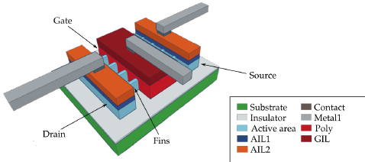
How do we control the gate?

Slide 59
The end!

Slide 60
Unless…

Slide 61
Dual Damascene-The real metallization

Slide 62
31) Grow Electrical Insulator (SiO2)
SiO2
Insulating Layer
Ti
Polysilicon
SiO2
SiO2
N-doped Si
P-Type Silicon

Slide 63
32) Spin on Photoresist
Photoresist
SiO2
Insulating Layer
Ti
Polysilicon
SiO2
SiO2
N-doped Si
P-Type Silicon

Slide 64
33) Pattern Vias
Photoresist
SiO2
Insulating Layer
Ti
Polysilicon
SiO2
SiO2
N-doped Si
P-Type Silicon

Slide 65
34) Develop Photoresist
Photoresist
SiO2
Insulating Layer
Ti
Polysilicon
SiO2
SiO2
N-doped Si
P-Type Silicon

Slide 66
35) Anisotropic Etch of Vias
Photoresist
SiO2
Insulating Layer
Ti
Polysilicon
SiO2
SiO2
N-doped Si
P-Type Silicon

Slide 67
36) Remove Photoresist
SiO2
Insulating Layer
Ti
Polysilicon
SiO2
SiO2
N-doped Si
P-Type Silicon

Slide 68
37) Put even more photoresist
Photoresist
SiO2
Insulating Layer
Ti
Polysilicon
SiO2
SiO2
N-doped Si
P-Type Silicon

Slide 69
38) Pattern next metal layer
Photoresist
SiO2
Insulating Layer
Ti
Polysilicon
SiO2
SiO2
N-doped Si
P-Type Silicon

Slide 70
39) Pattern next metal layer
Photoresist
SiO2
Insulating Layer
Ti
Polysilicon
SiO2
SiO2
N-doped Si
P-Type Silicon

Slide 71
40) Etch metal layer/Via (again)
Photoresist
SiO2
SiO2
Insulating Layer
Ti
Polysilicon
SiO2
SiO2
N-doped Si
P-Type Silicon

Slide 72
41) Remove Photoresist
SiO2
SiO2
Insulating Layer
Ti
Polysilicon
SiO2
SiO2
N-doped Si
P-Type Silicon

Slide 73
42) Electroplate with Copper
SiO2
SiO2
Insulating Layer
Ti
Polysilicon
SiO2
SiO2
N-doped Si
P-Type Silicon

Slide 74
43) CMP to remove excess copper
M1
SiO2
V1
SiO2
Insulating Layer
Ti
Polysilicon
SiO2
SiO2
N-doped Si
P-Type Silicon

Slide 75
(Repeat)¹⁵

Slide 76
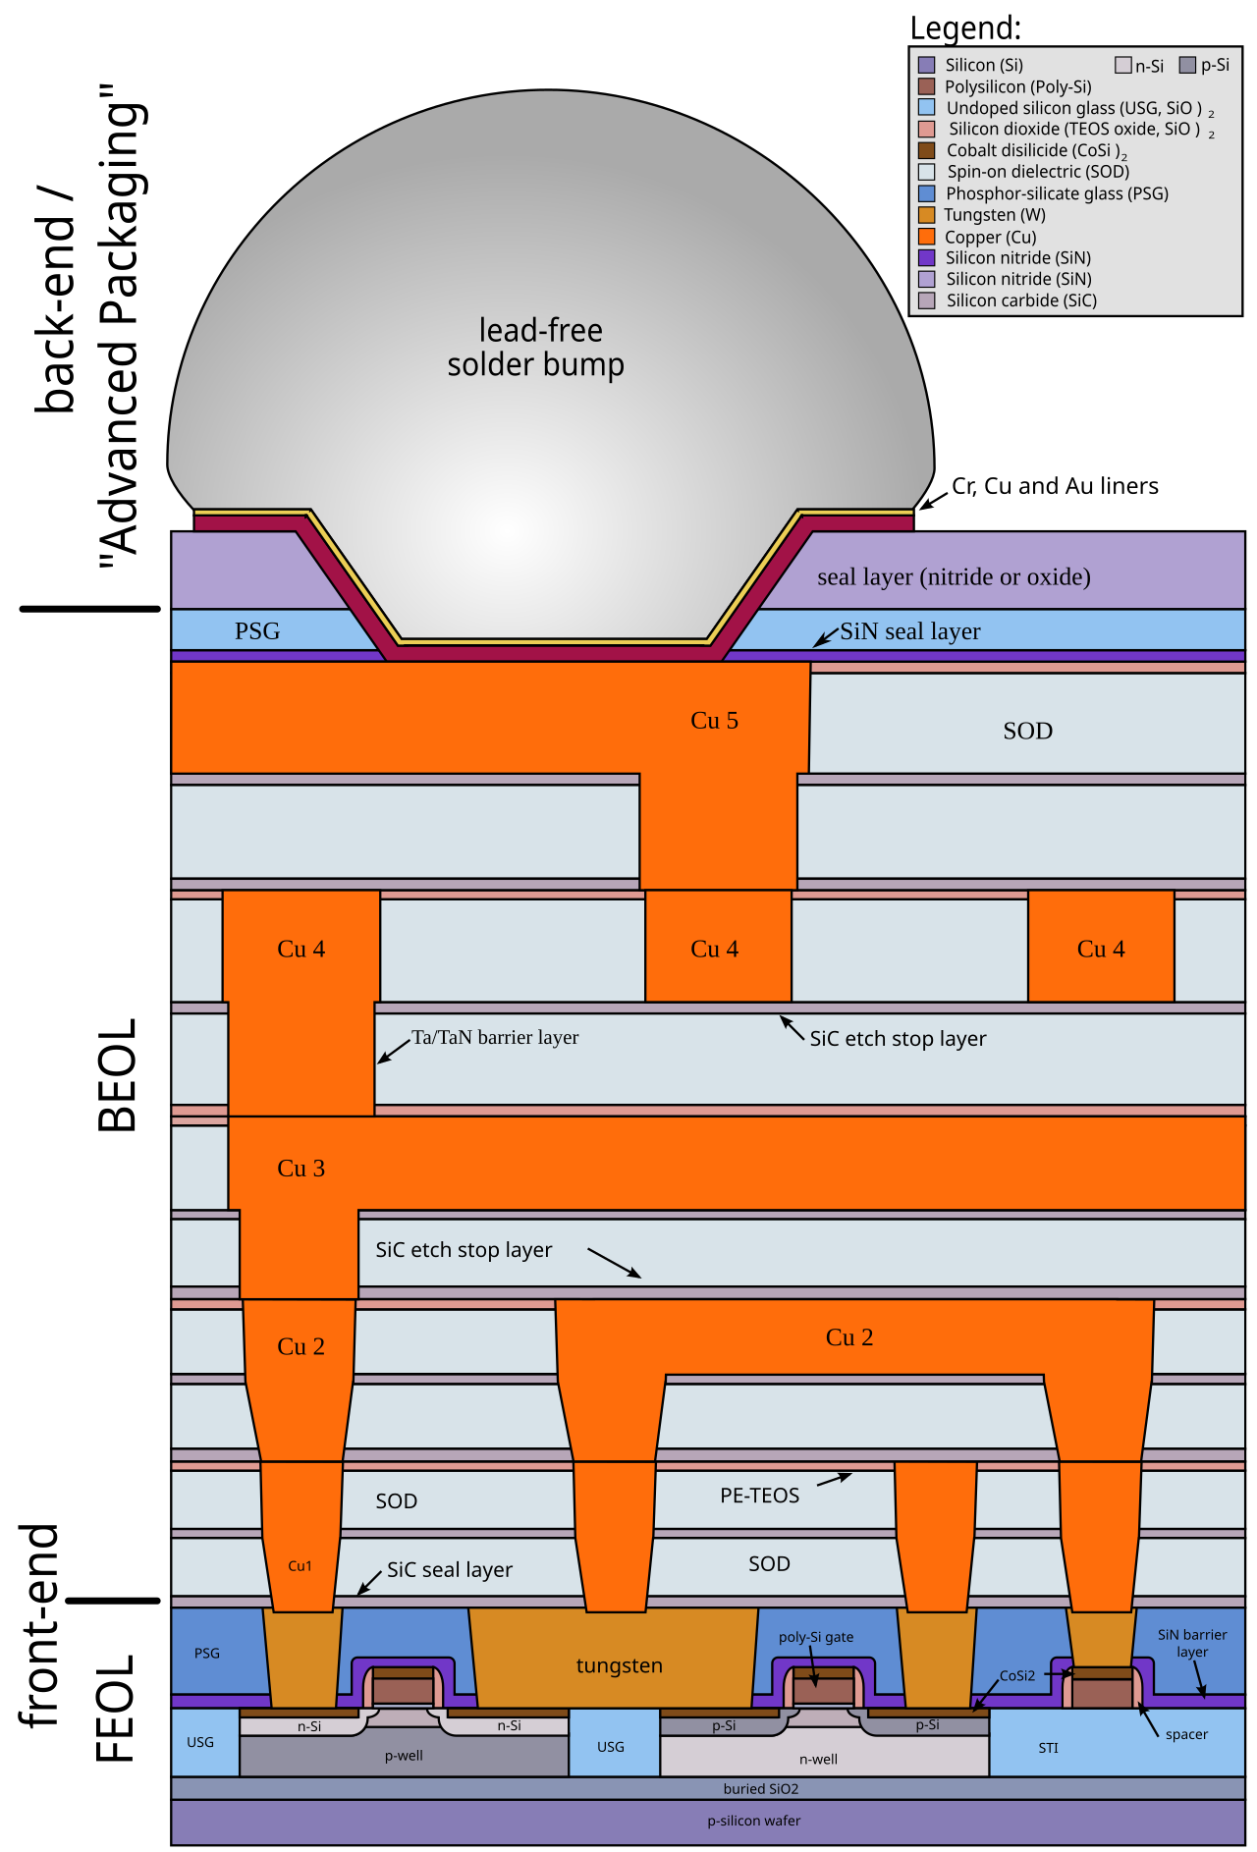

Slide 77
Questions?

Slide 78
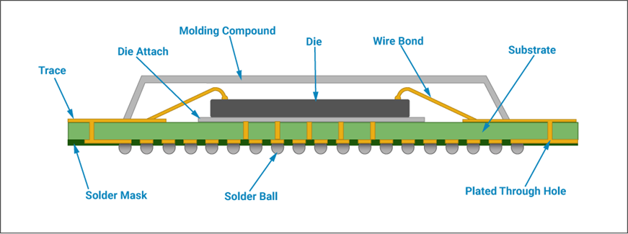
Final Packaging

Slide 79
Which Techniques?
Wirebond (Simple)
Solder (Hard)
  Wave solder
  Solder Balls
Wafer bonding (Insane)
  W2W
  C2W/C2C

Slide 80
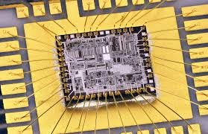
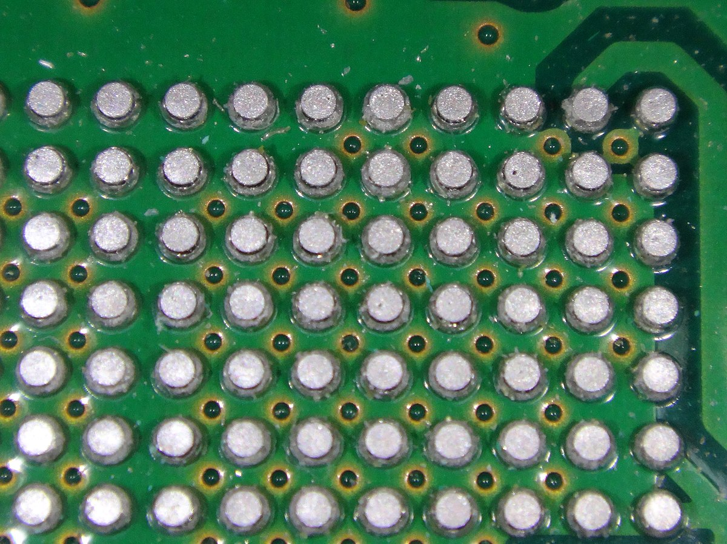
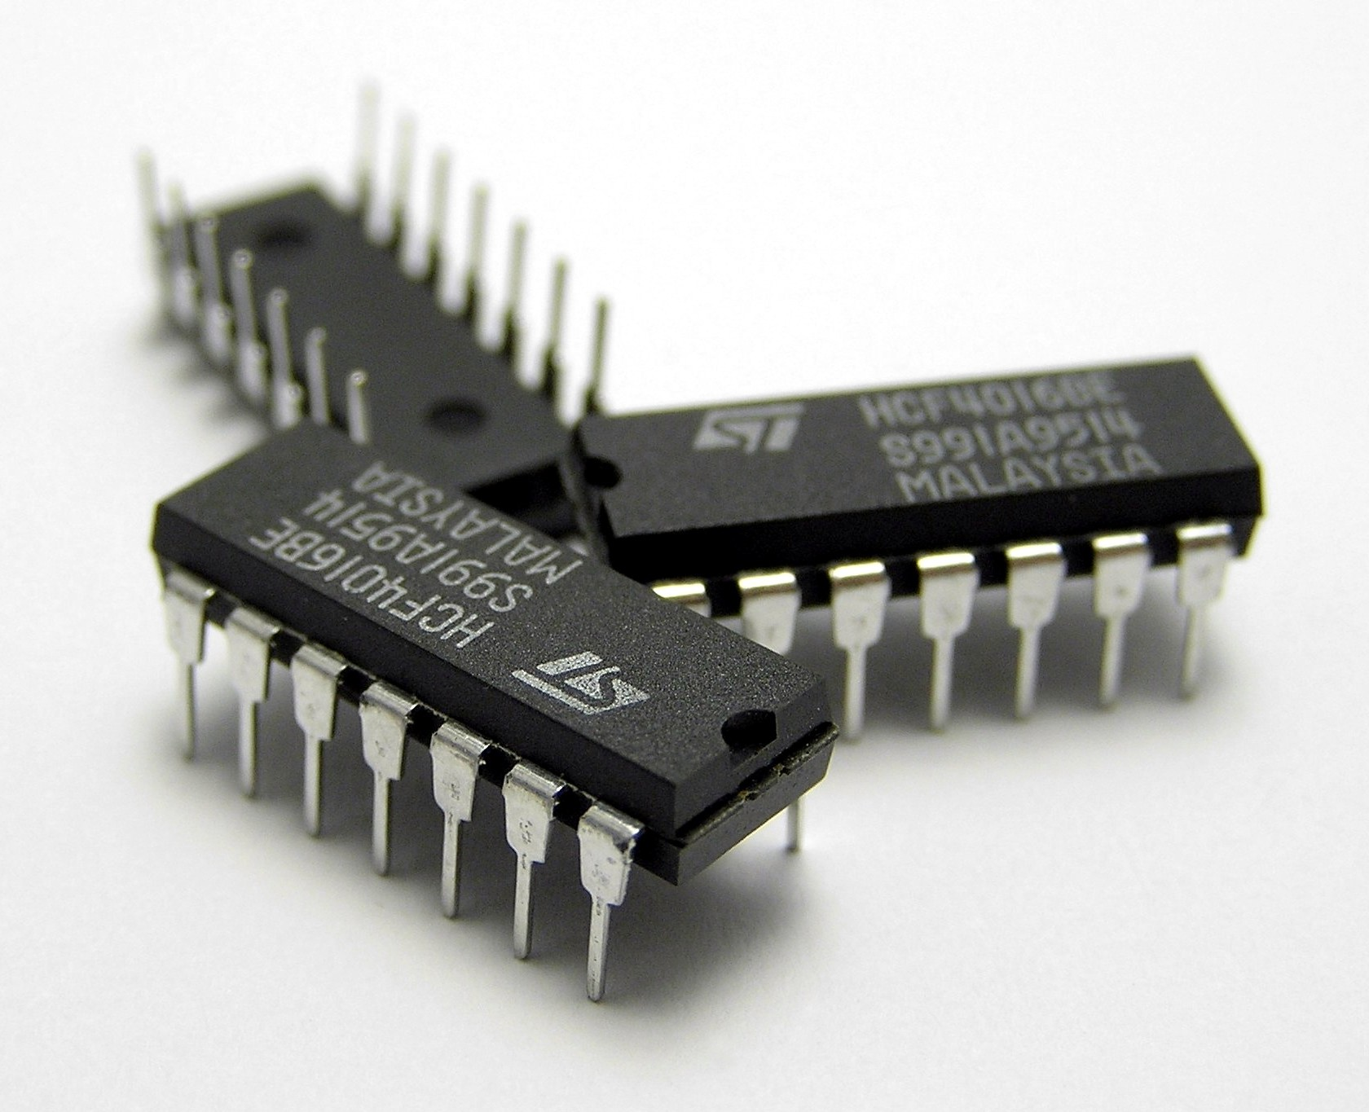
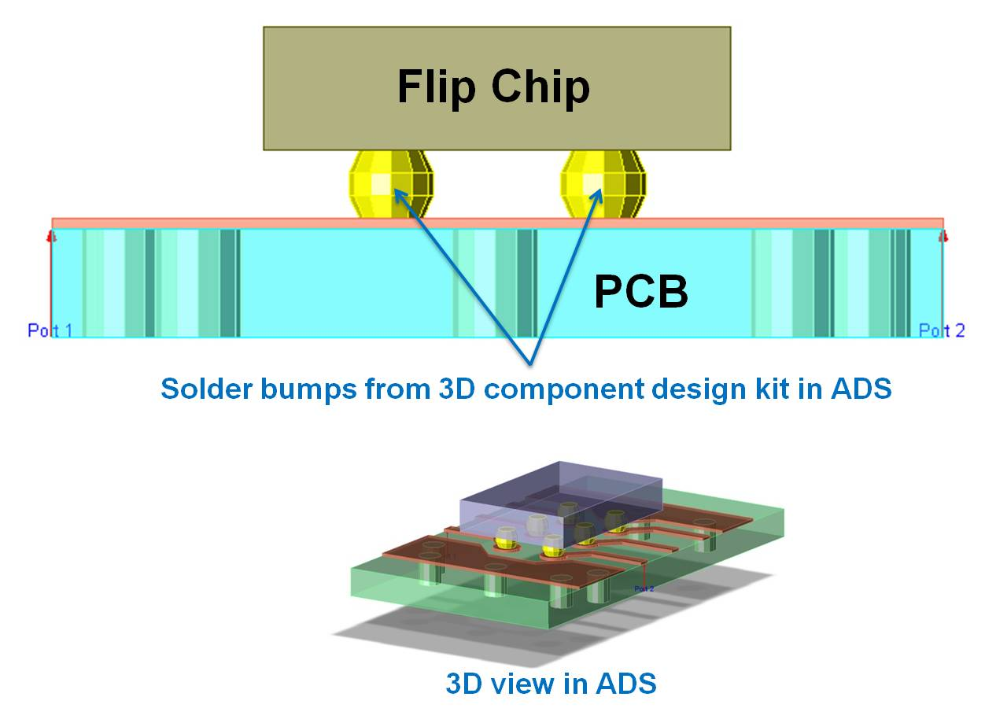
Overview
Wirebond Solder

Slide 81
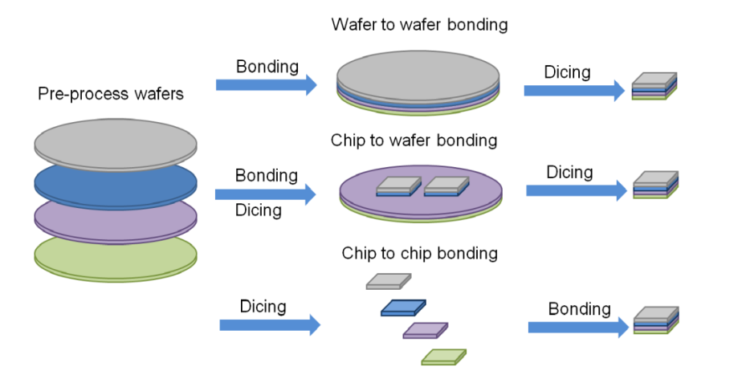
Overview
Wafer Bond

Slide 82
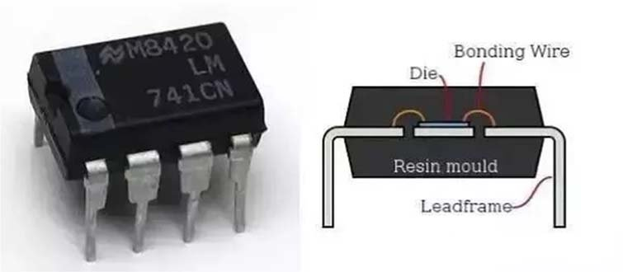
Wire bonding
Pros:
Cheap
Common
Cons:
Low density (~1-5mm)
(Often) Poor Thermal Performance

Slide 83
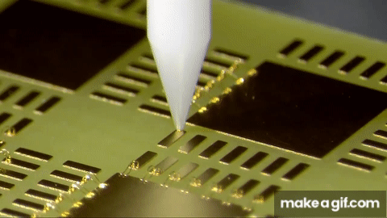
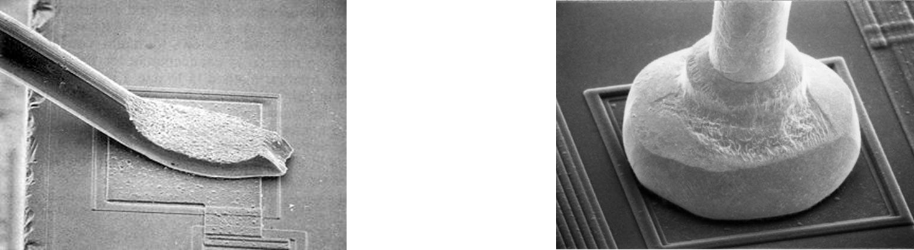
Wire bonding
Materials:
-Gold
-Copper *
Cost:
<$1/Chip
Used in >80% of chips! Wedge Bond ($$) Ball Bond ($)

Slide 84
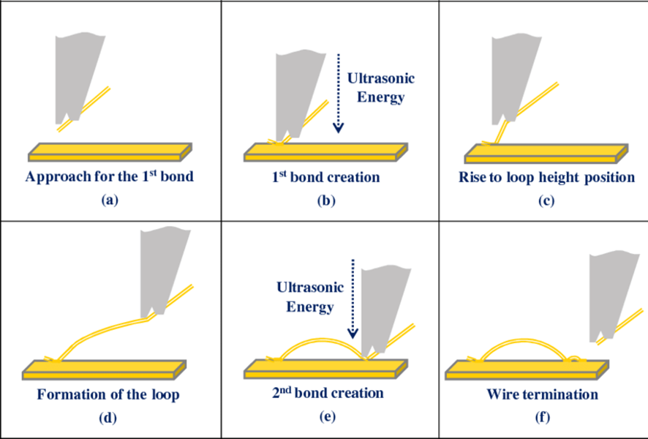
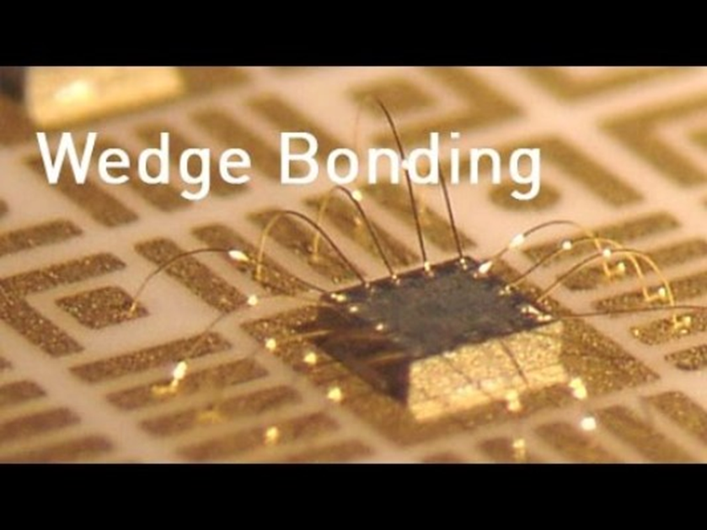
Wedge bonding

Slide 85
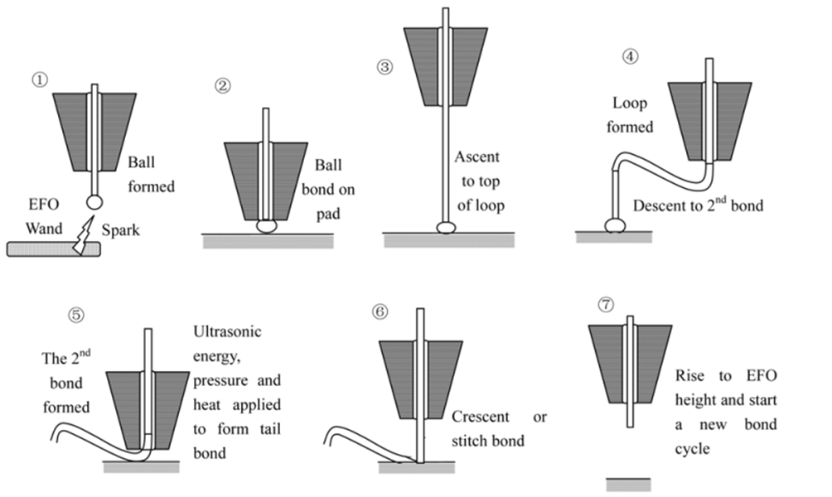
Ball bonding

Slide 86
Wire bonding
Wire Bonding Method | Operating Temperature | Wire Materials | Pad Materials | Note
Thermo-compression | 300-500°C | Au | Al, Au | High pressure, no ultrasonic energy
Ultrasonic | 25°C | Au, Al | Al, Au | Low pressure in ultrasonic energy
Thermo-sonic | 100-240°C | Au, Cu | Al, Au | Low pressure in ultrasonic energy

Slide 87
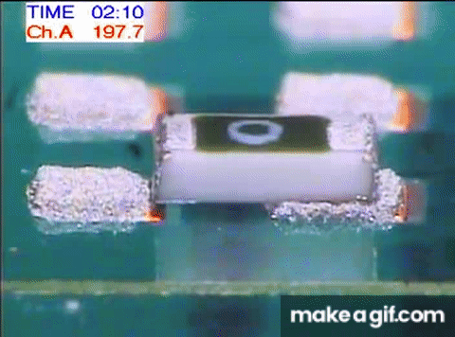
Solder Techniques
Solder Reflow
-Surface Packaging
-Cheap
-Reliable

Slide 88
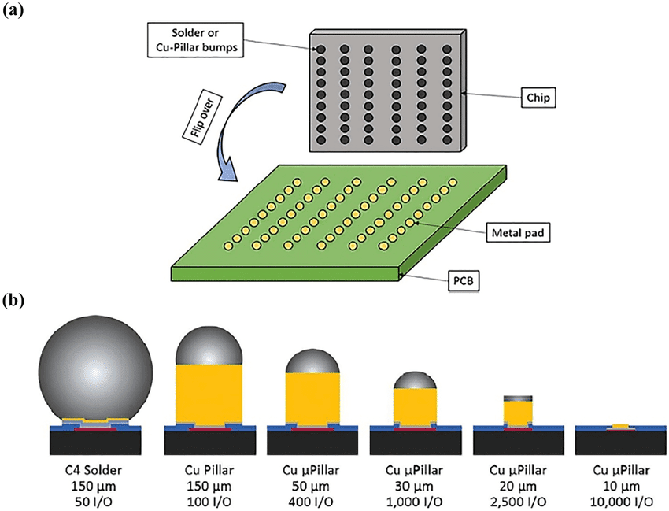
Solder Techniques
Solder Balls/Microbumps
“Flip Chip”
Alignment Requirement?
Improved Thermal Pathways

Slide 89
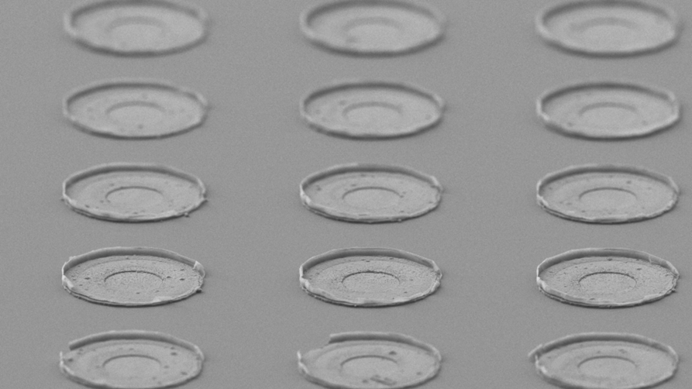
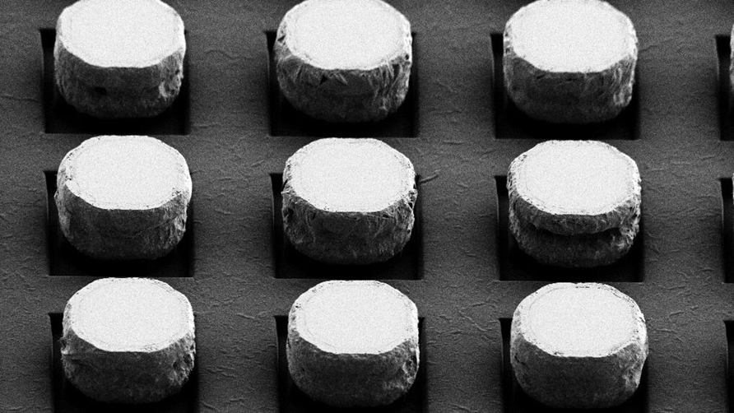
Solder Techniques

Slide 90
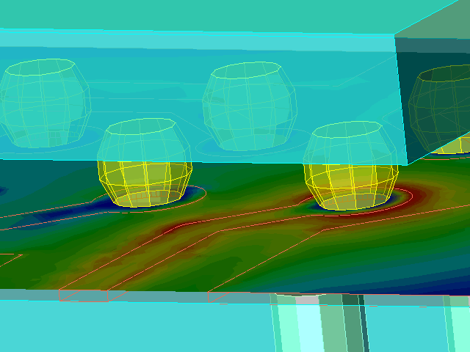
Solder Techniques
Solder Balls/Microbumps

Slide 91
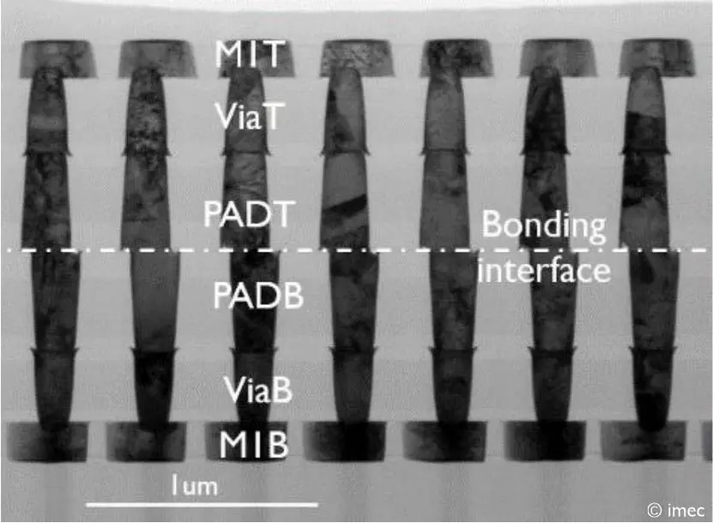
Hybrid Bonding
High Price
Tight interconnects (400nm?)

Slide 92
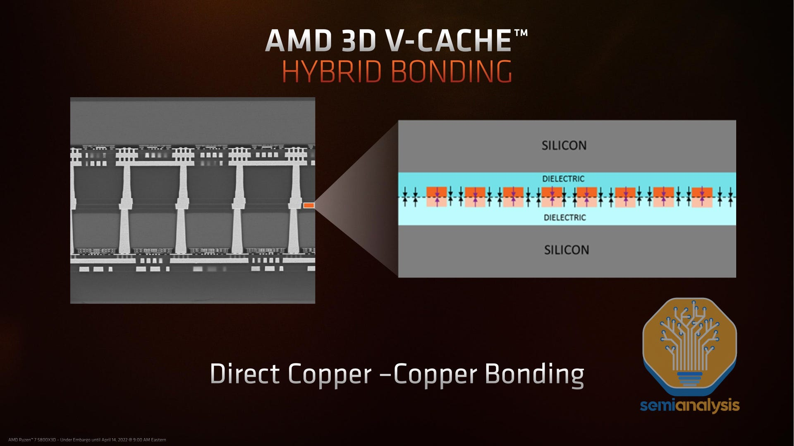

Slide 93
https://youtu.be/2ACiuKgYUkI?si=JdFd24_P_okyt6ix&t=864

