Slide 1

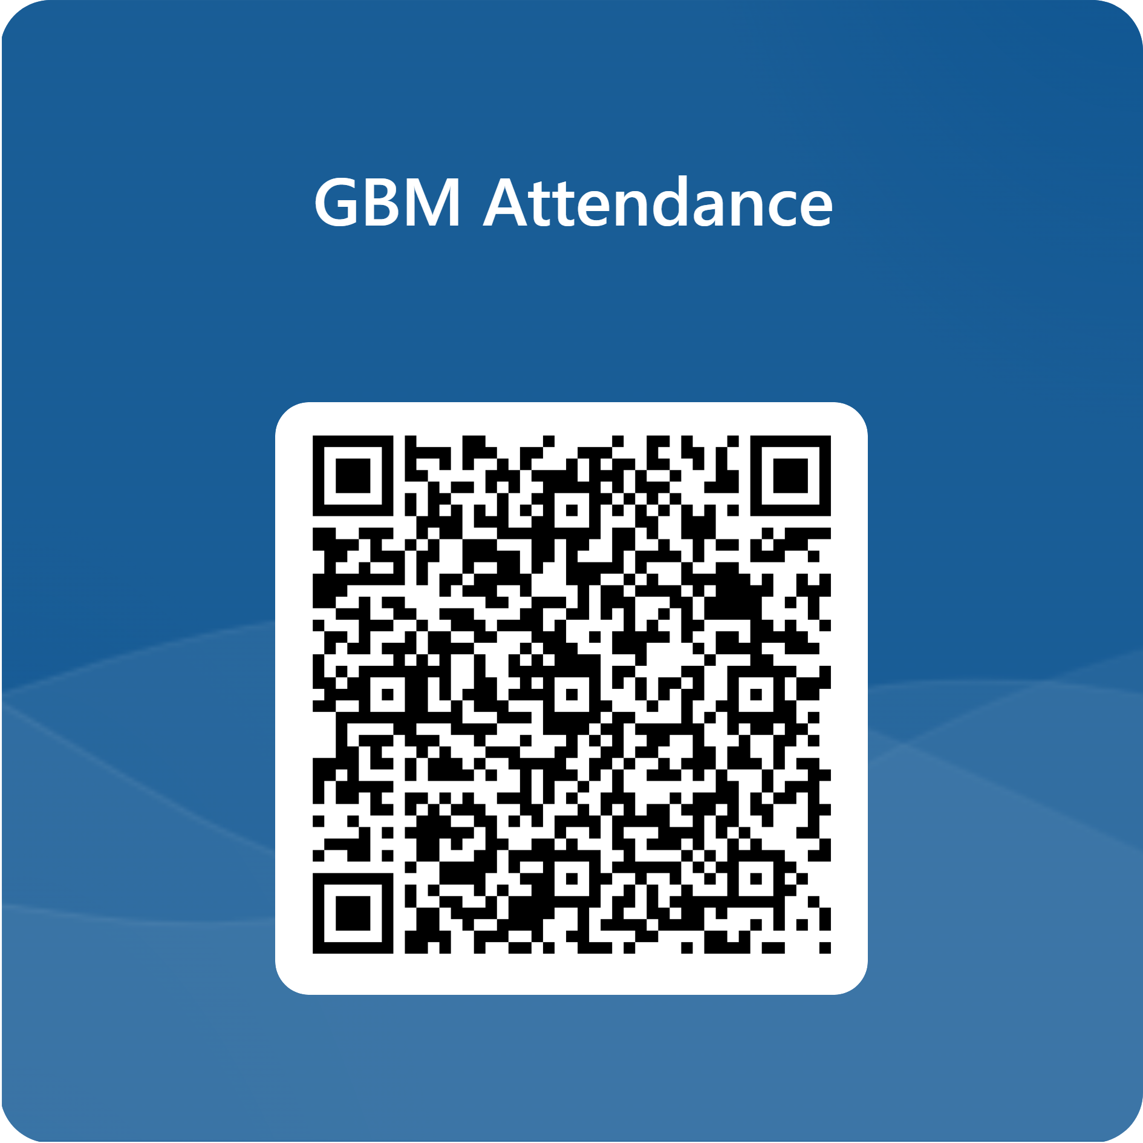
Lithography & Patterning
Evan Chen

Slide 2
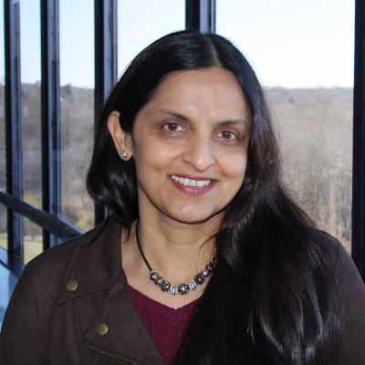

General Updates (1 of 2)
Distinguished Lecturer Seminar Next Week!
  Dr. Mukta Farooq (IBM)
  Heterogeneous Integration and Advanced Packaging for The Chiplet Era
  Next Monday, October 5th @ 6:00 PM
  Walker 6113
Another Distinguished Lecturer!
  Chris Berry (IBM)
  Reliability topics for the miniaturization and qualification of Advanced Silicon CMOS Technologies
  November 2nd
  More Details to Come!

Slide 3
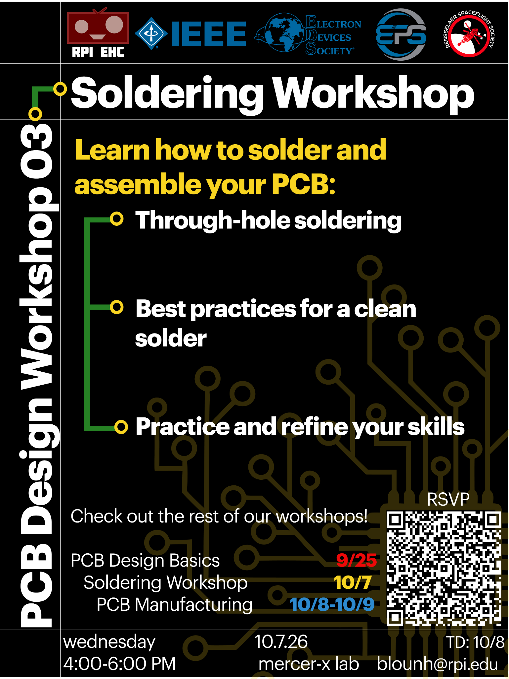
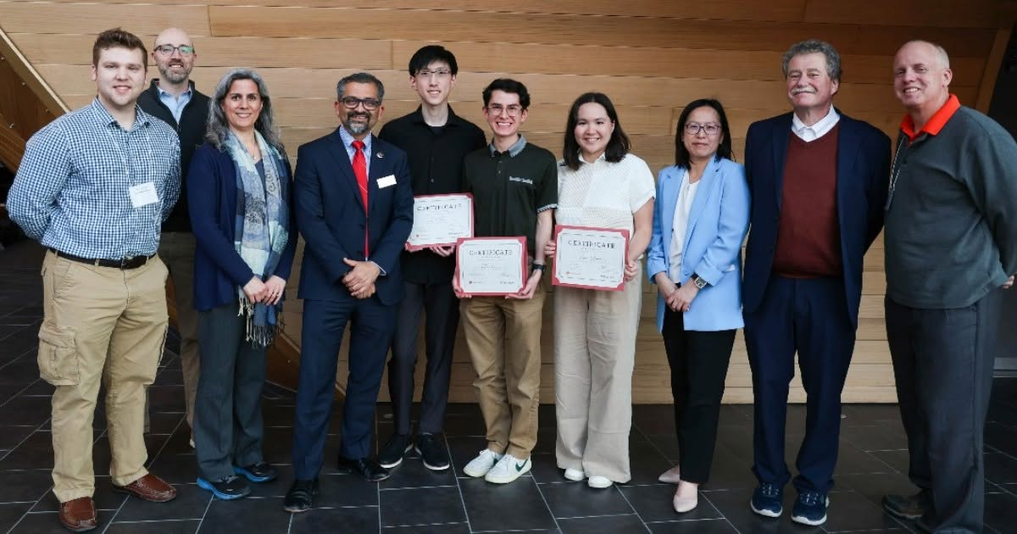
General Updates (2 of 2)
PCB Workshop(s)!
  Sponsored by IEEE EPS/EDS, RPI EHC, and Rensselaer Spaceflight Society
    PCB Design Basics: 9/25
    Soldering Workshop: 10/7
    PCB Manufacturing: 10/8-9
Semiconductor Summit!!!
  This Wednesday 9/30 from 11am - 5pm
goat

Slide 4
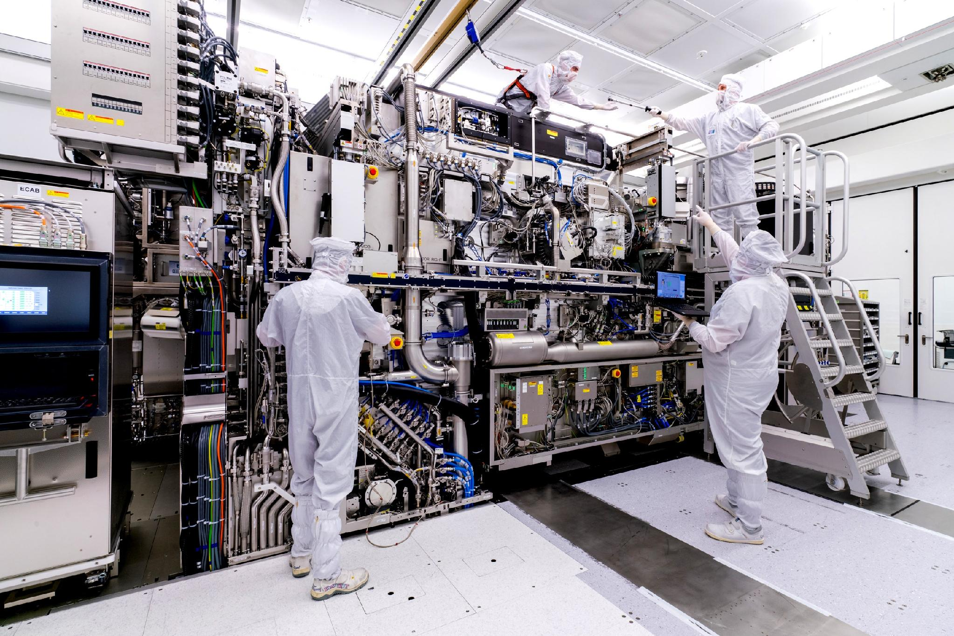
Overview
Motivation for Lithography
History of Development
Resolution Enhancement Techniques
Lithography Types & Settings

Slide 5
What is Lithography? Why is Lithography? (How is Lithography?)
Let’s say you wanted to build a full adder out of transistors

Slide 6
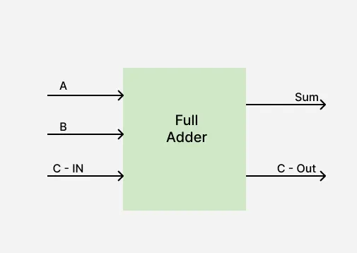
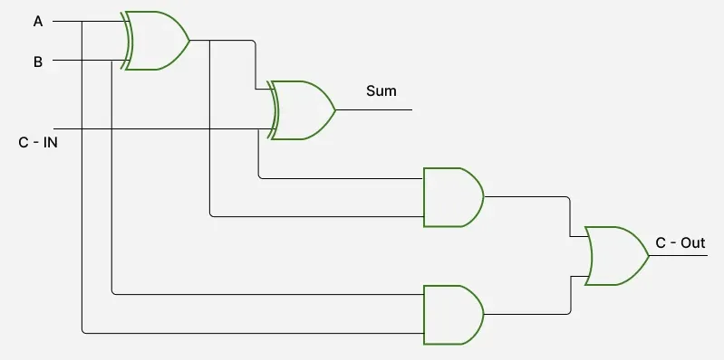
What is Lithography? Why is Lithography? (How is Lithography?)

Slide 7
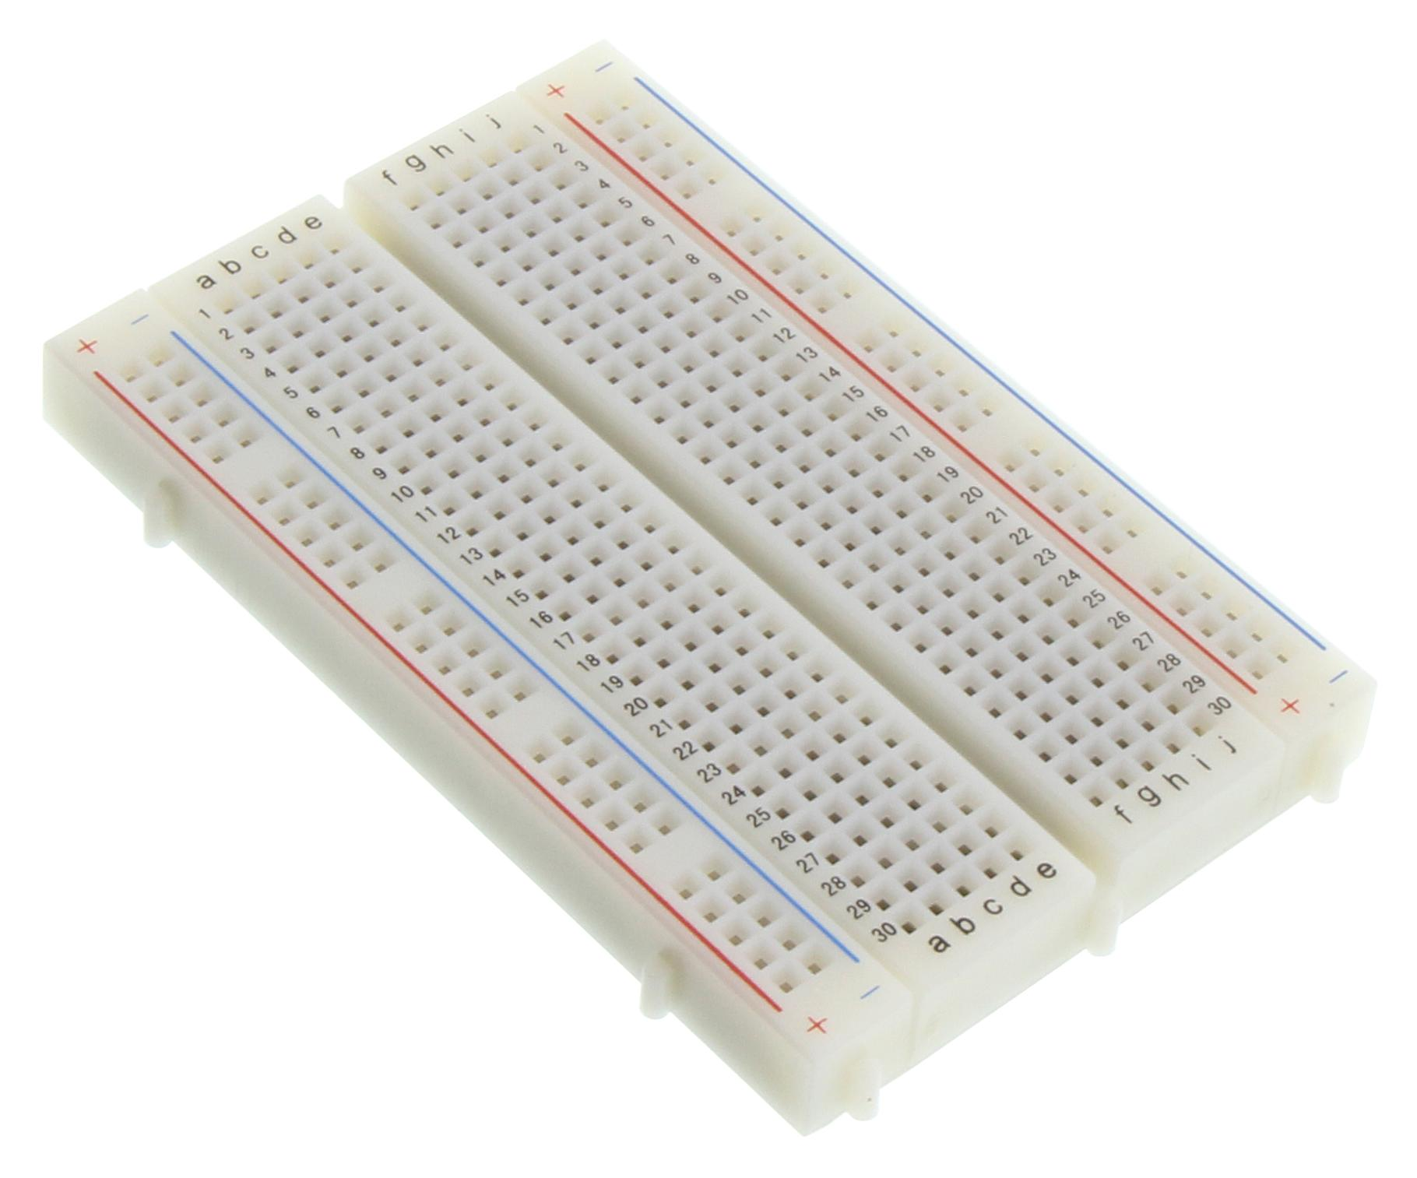
What is Lithography? Why is Lithography? (How is Lithography?)

Slide 8
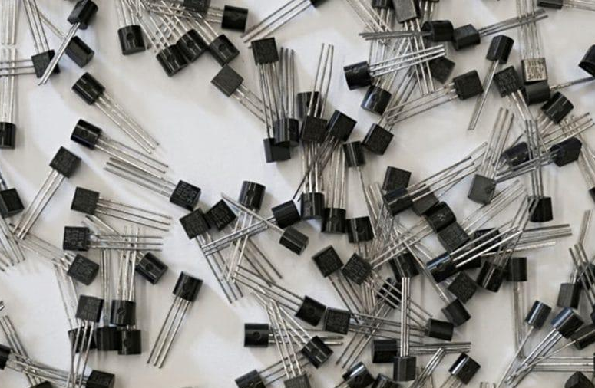
What is Lithography? Why is Lithography? (How is Lithography?)

Slide 9

What is Lithography? Why is Lithography? (How is Lithography?)

Slide 10
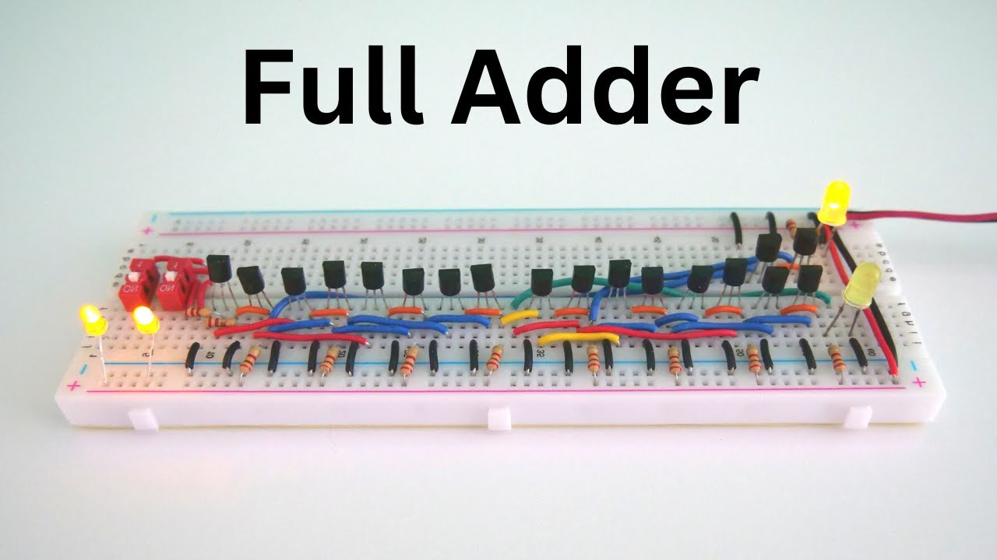
What is Lithography? Why is Lithography? (How is Lithography?)

Slide 11
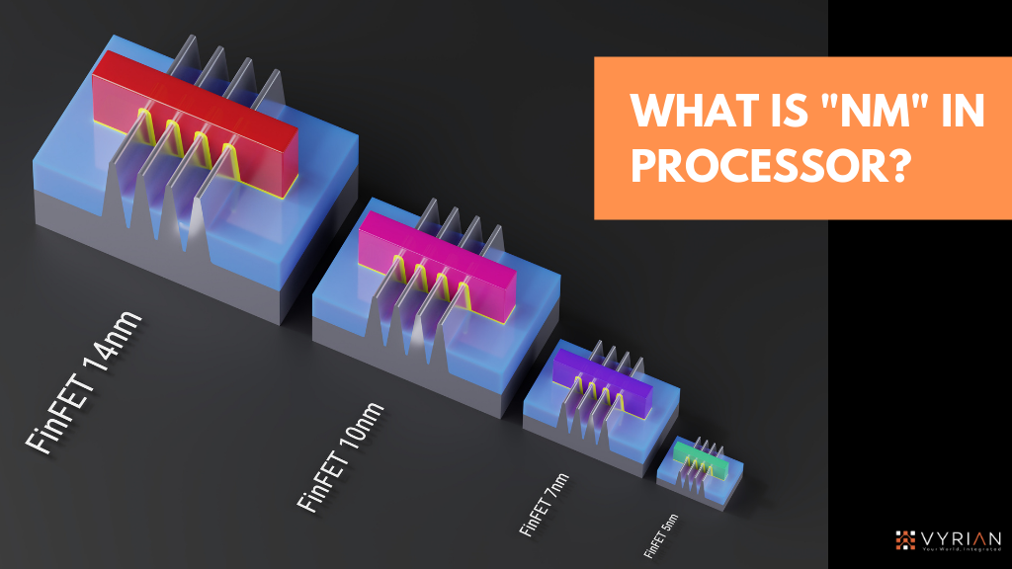
What is Lithography? Why is Lithography? (How is Lithography?)

Slide 12
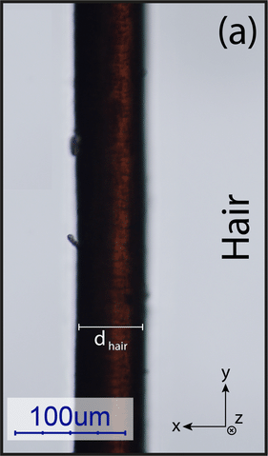
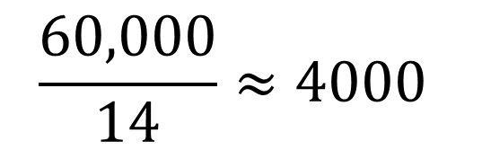
What is Lithography? Why is Lithography? (How is Lithography?)
60µm = 60,000nm
14nm

Slide 13
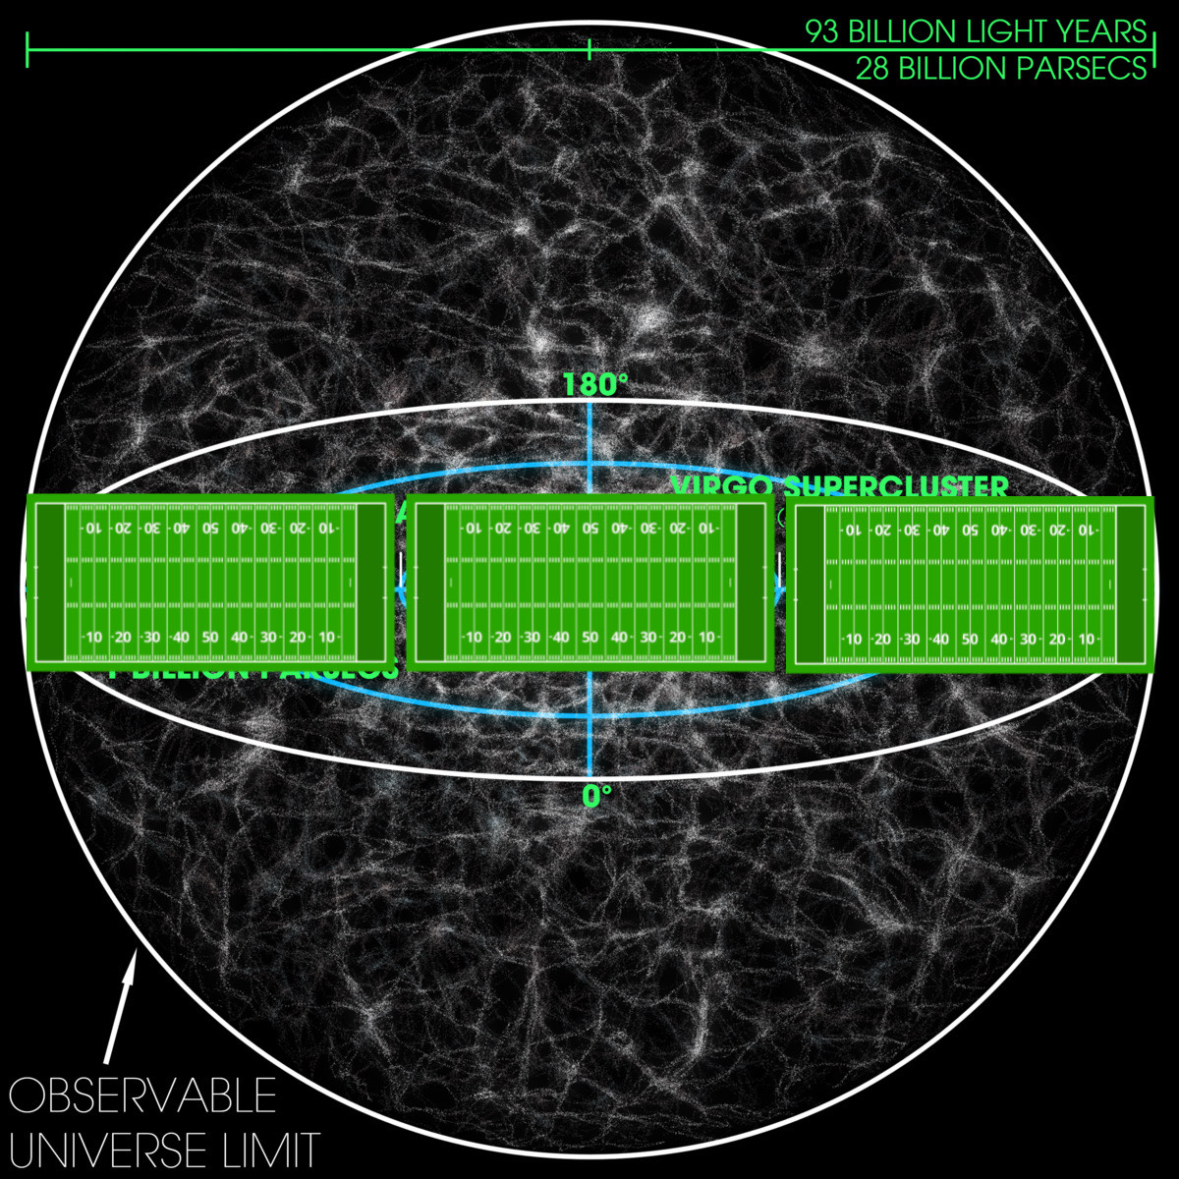
What is Lithography? Why is Lithography? (How is Lithography?)

Slide 14
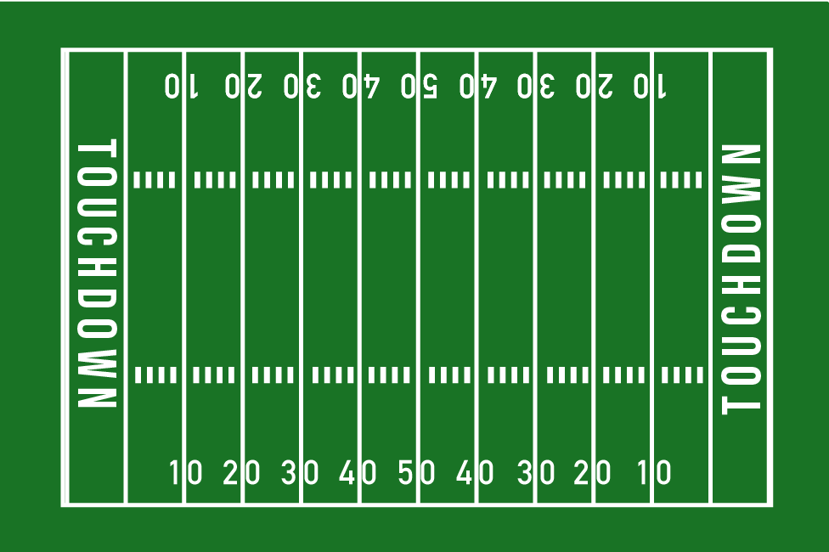
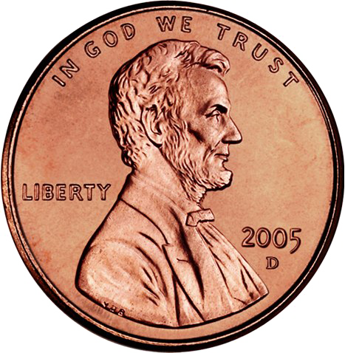
What is Lithography? Why is Lithography? (How is Lithography?)
14nm FinFET
Human hair diameter (60µm)

Slide 15
What is Lithography? Why is Lithography? (How is Lithography?)
Probably not going to be able to make 14nm transistors using hands, tools, machines, etc…

Slide 16
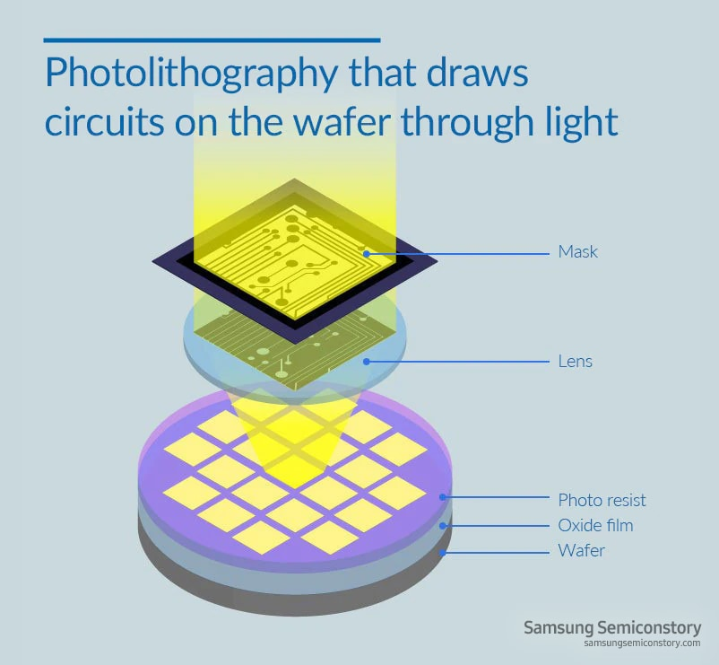
What is Lithography? Why is Lithography? (How is Lithography?)
The solution?
LITHOGRAPHY!
Basically, we’ll design our transistors and circuits using light
What is Lithography?
Method of transferring circuit design to silicon wafer
  Patterns are too small to be transferred physically
  Light has wavelength in scale ~nm
  Followed by less precise “blanket techniques”

Slide 17
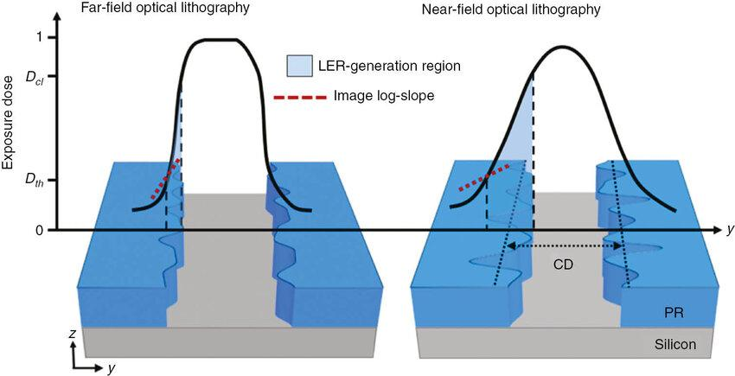
Lithography Over the Years
What is the goal when optimizing the lithography process?
  Better resolution!

Slide 18
Lithography Over the Years
What is the goal when optimizing the lithography process?
  Better resolution!

Slide 19
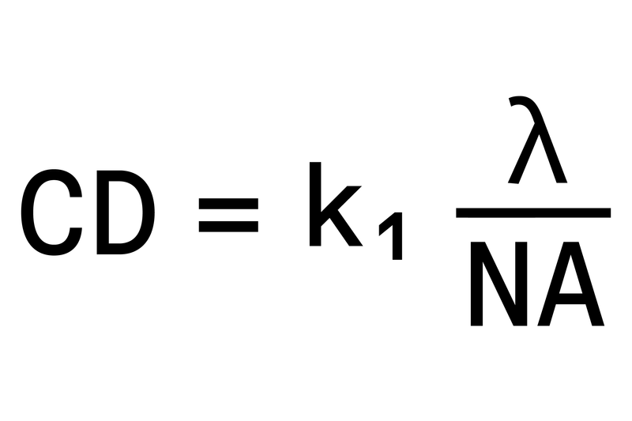
Lithography Over the Years- Characteristic Equation
CD: Critical Dimension (Minimum feature size)
K1: Process Coefficient
  Typ. 1, Can go to ~0.5 or lower
Lambda: Wavelength of incoming light
NA: Numerical Aperture
  Typ. 0.5-0.7, can go above 1, min 0.25
We’ll come back to this…

Slide 20
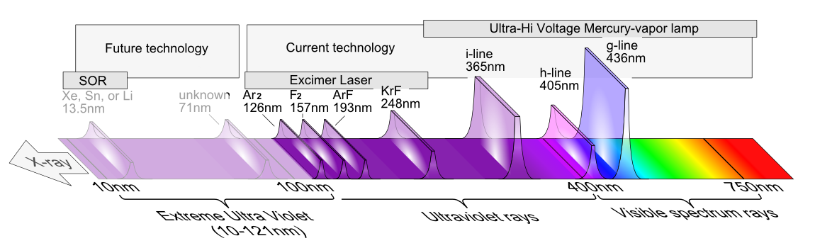
Lithography Over the Years- Wavelengths
Mercury Lamp (UV)
  G-line (436nm), H-line (405nm), I-line (365nm)
Excimer Laser (DUV)
  KrF (248 nm)
  ArF (193nm)
EUV (13.5nm)

Slide 21
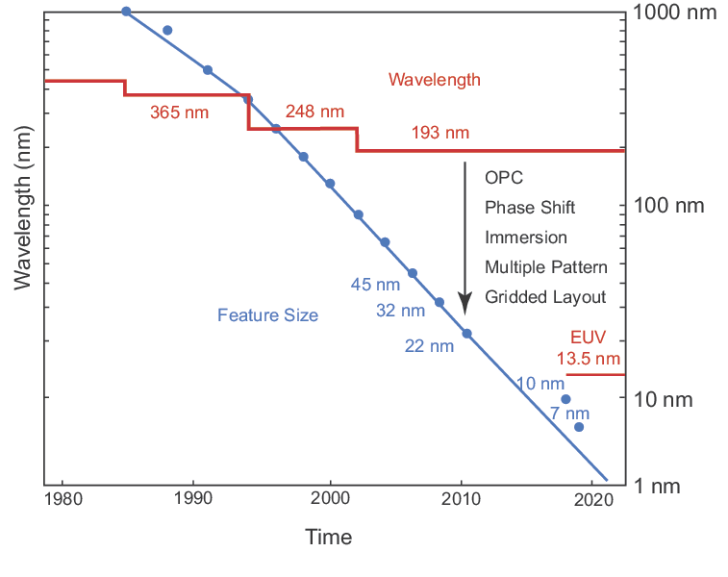
Lithography Over the Years
Before 1990:
  “Like drawing thick lines with a sharp pencil”
After 1990
  “Mask Designer’s Nightmare”

Slide 22
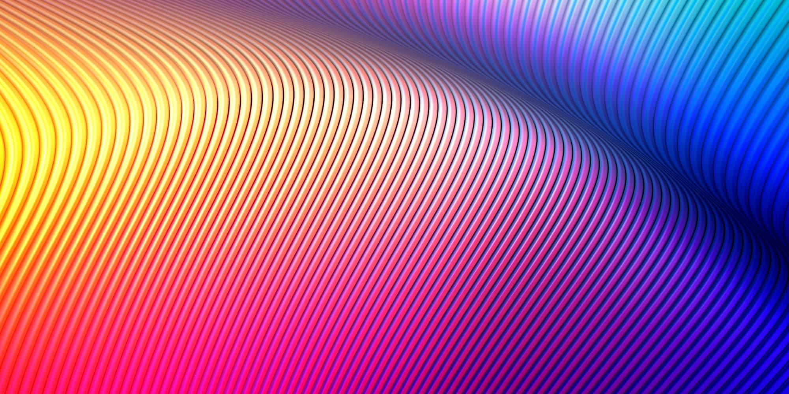
Resolution Enhancement Techniques - Brute Force for Moore’s Law (k1)
Resolution Enhancement Techniques
Optical Proximity Correction
Phase Shift Masks
Immersion Lithography
Double Patterning Techniques
(image unrelated)

Slide 23
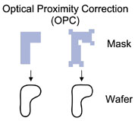
Resolution Enhancement Techniques - OPC
Optical Proximity Correction (OPC)
Constructive/Destructive Interference
  Introduce serifs/additional patterns so OUTPUT looks correct (mask doesn’t)
  VERY interesting field for optics engineering & computer science

Slide 24
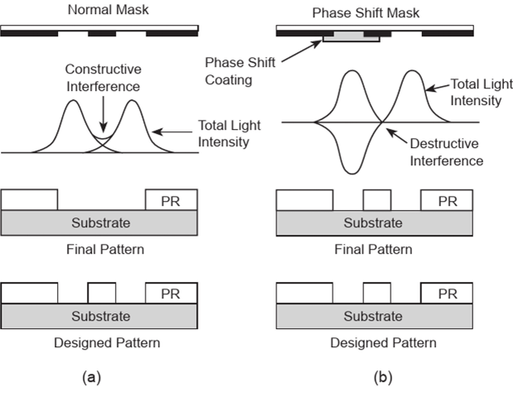
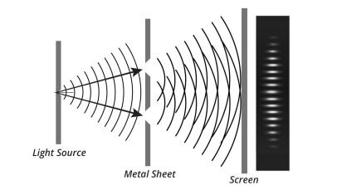
Resolution Enhancement Techniques - Phase Shift Masks
Phase Shift Masks
Control interference for better feature fidelity

Slide 25
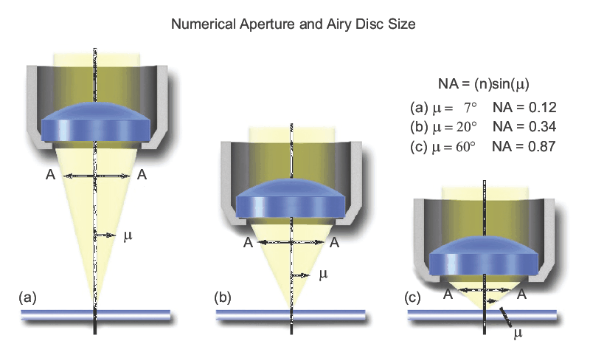
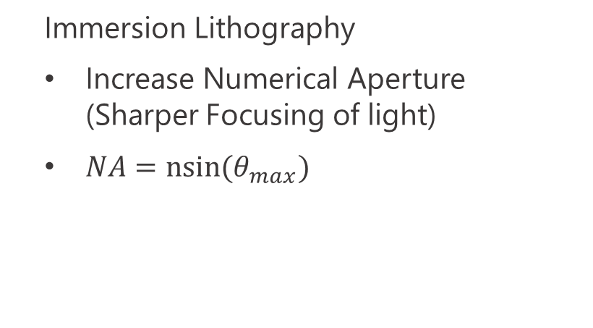
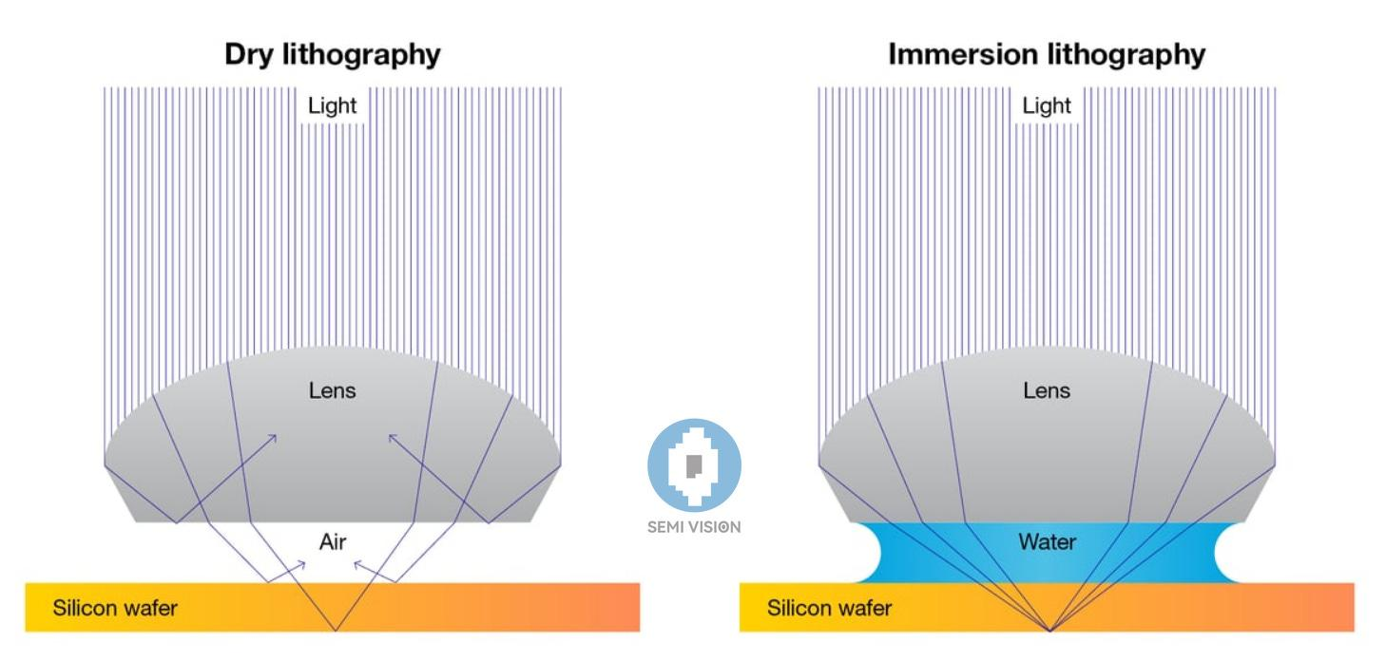
Resolution Enhancement Techniques - Immersion Lithography

Slide 26
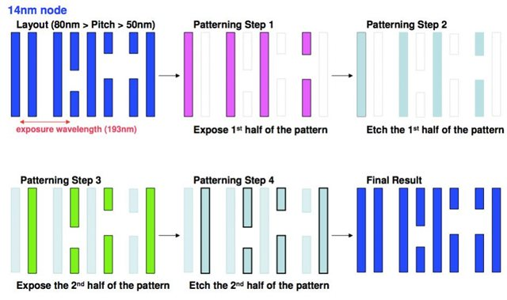

Resolution Enhancement Techniques - Double Patterning
  Solve interference problem by just making more masks
    2x, 4x patterning
  POV: Mask designers selling more masks to do the same work

Slide 27
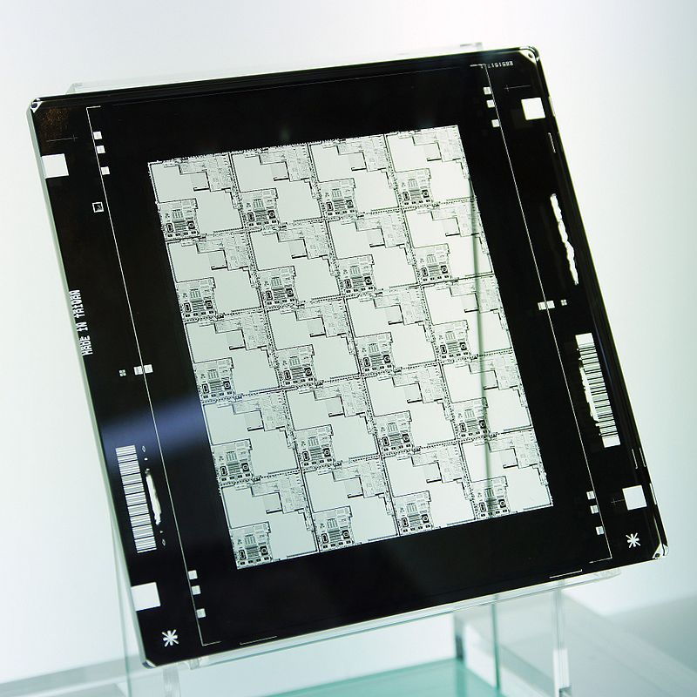
Mask Design
Exposure Area:
Limited by Reduction Lenses
~26x33 mm max
DUV/Older systems:
Quartz (Fused Silica)
Chromium
Can cost ~10-100k
https://youtu.be/9RZreu5z_Gc?si=rI32Z36lvvmAOuUl

Slide 28
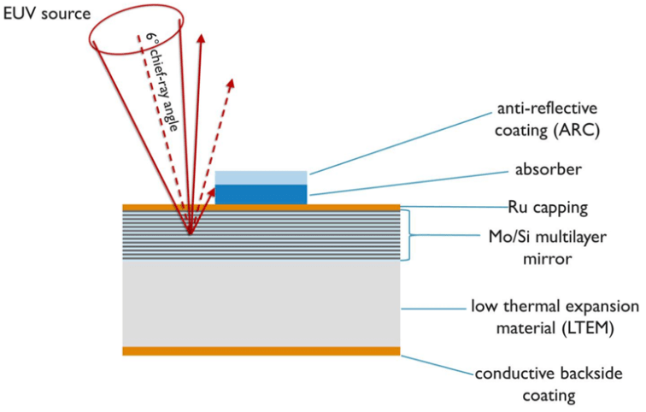
Mask Design (EUV)
Extremely Expensive
“Mirror mask”
~70% of energy is absorbed
  11 mirrors -> 0.7^11 = 2% energy transfer
50+ layers of Molybdenum + Silicon
Can cost ~500k each

Slide 29
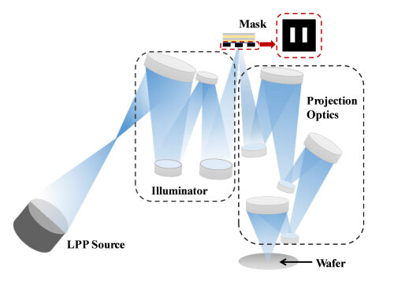
Mask Design (EUV)

Slide 30
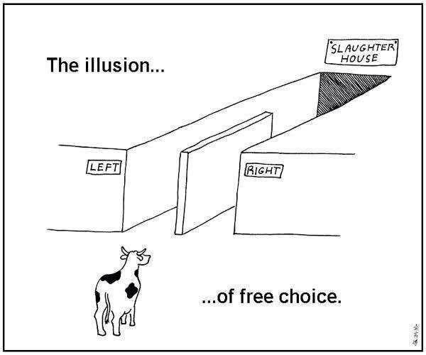
Lithography Types- “Choose your own adventure”
Contact
Non-Contact
Projection
E-Beam*

Slide 31
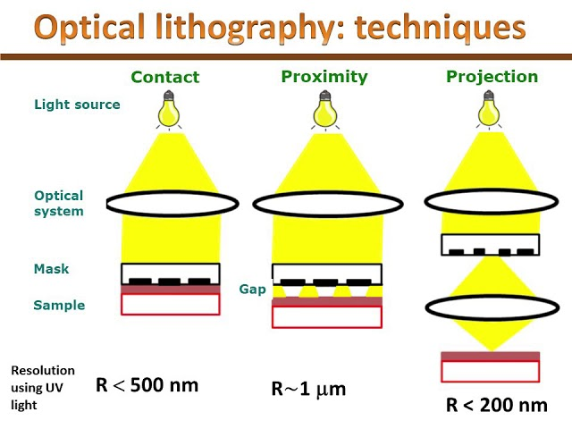
Lithography Types- “Choose your own adventure”

Slide 32
Lithography Types- Performance Comparison
Each are useful!
  Which would you use for…
    Academic (Very low volume)
    Industry (High Volume)
    Research
Parameter | Contact | Non-Contact | Projection | E-beam
Cost | Low | Low | High | High
Speed | Med | High | High | Low
Defectivity | Very High | Low | Low | Low
Resolution | Med | Low | High | Very High
Complexity | Low | Med | High | Med

Slide 33
Lithography Procedure
Spincoat
Soft-Bake
Expose
Post-exposure Bake (Optional)
Develop
Hard-Bake

Slide 34
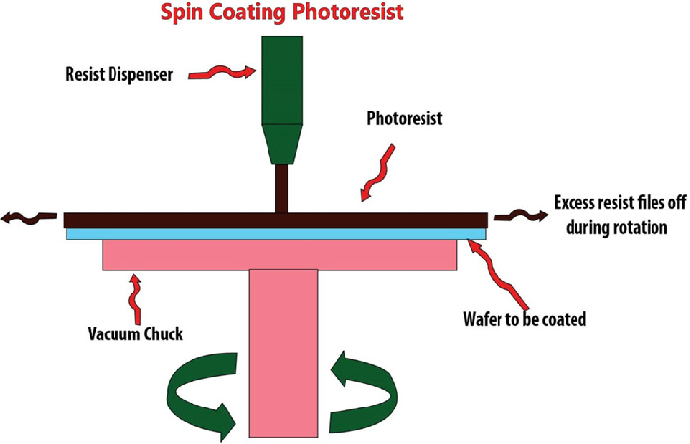
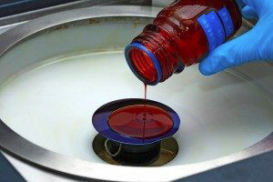
Lithography Procedure- Spincoat

Slide 35
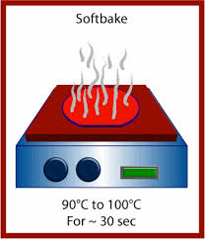
Lithography Procedure- Softbake
Solidify photoresist
Removes solvent
Can be done with hotplate in research applications
Integrated in lithography machine for industry applications

Slide 36
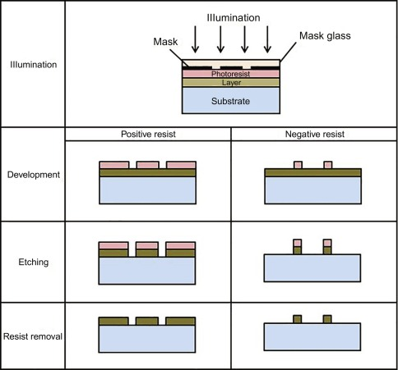
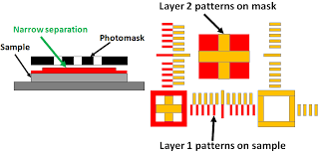
Lithography Procedure- Exposure
Align with previous layers of mask
Use lightsource (EUV, DUV, etc) to bond photoresist

Slide 37
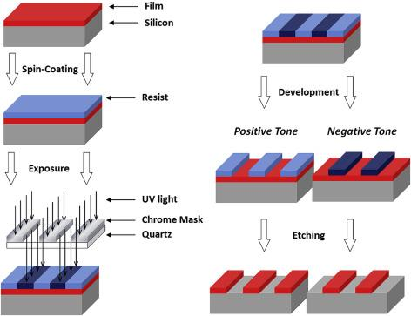
Lithography Procedure- Develop
Dissolves un-bonded photoresist

Slide 38
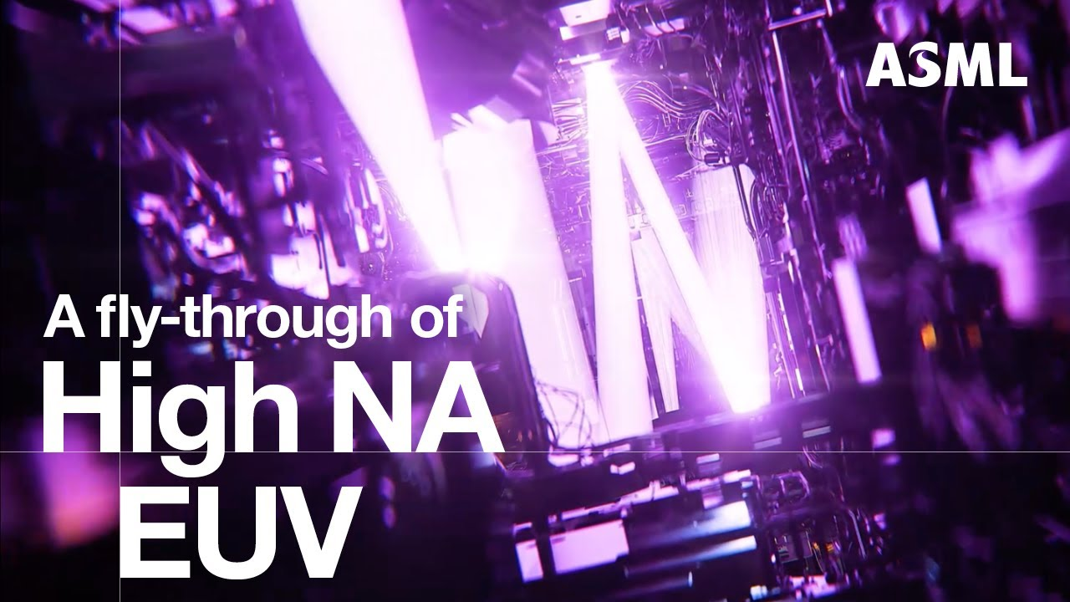
Lithography Procedure- Modern Systems
https://youtu.be/h_zgURwr6nA?si=Jx0LdQDefZiJwbs1

Slide 39
The End
Thanks for listening!

Slide 40

Kahoot Time!

