Slide 1
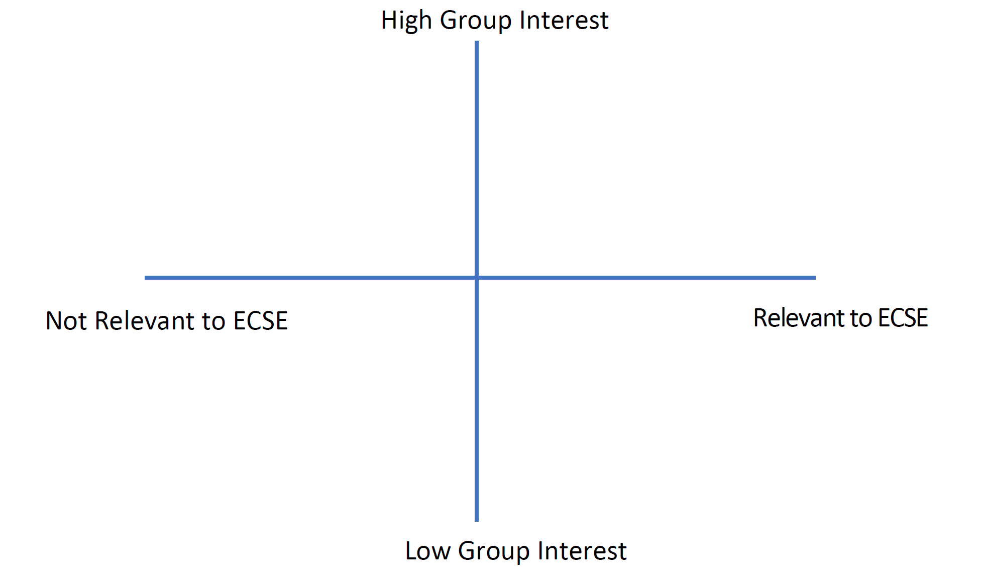
1. ECSE and Society
Individually: choose three topics that interest you and read the related articles.
ECSE and Society Articles
2. High Interest/ECSE Relevance Framework
As a group: place each of your chosen topics in the framework below. Were any particularly popular?
3. Applications and Challenges
Individually: locate the topic that your group placed furthest in the top right corner. How is this topic applicable to ECSE? How is it applicable to society? What do you see as the main challenges for this topic?
4. RPI Courses
Individually: use the ECSE website and RPI’s course catalog to find courses that are relevant to the topic from step 3. How are they relevant to the topic?
RPI ECSE Courses by Focus Area
RPI Course Catalog

